Slide 1
Labour Force Survey
Quarter 4, 2025
19th February 2026

Slide 2
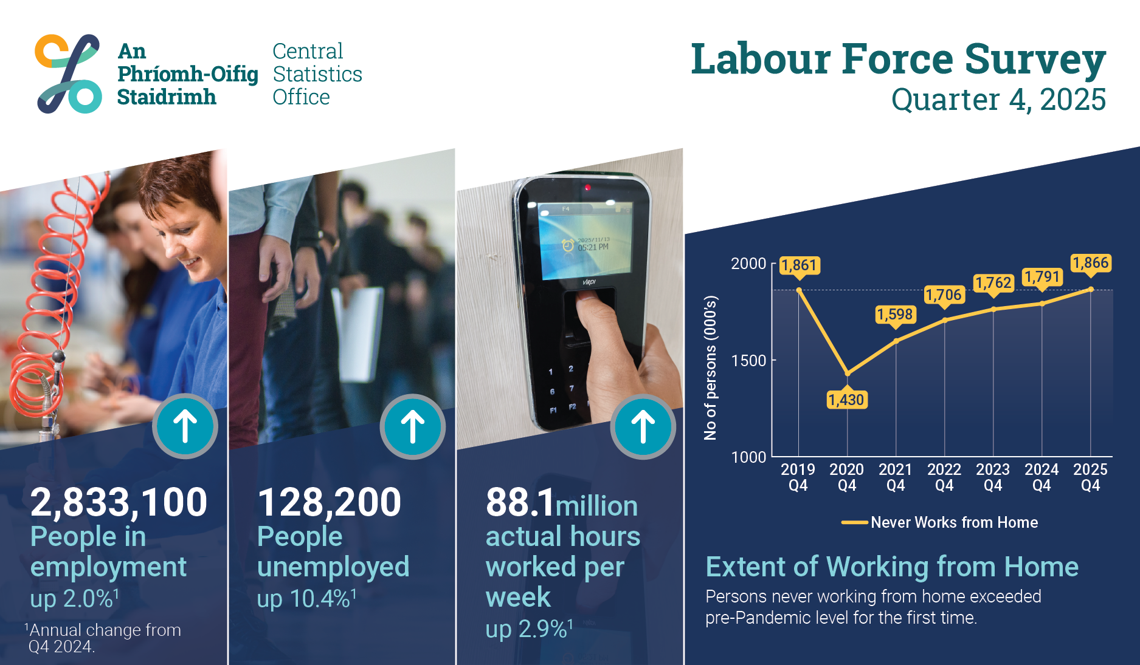
Infographic
Thousands

Slide 3
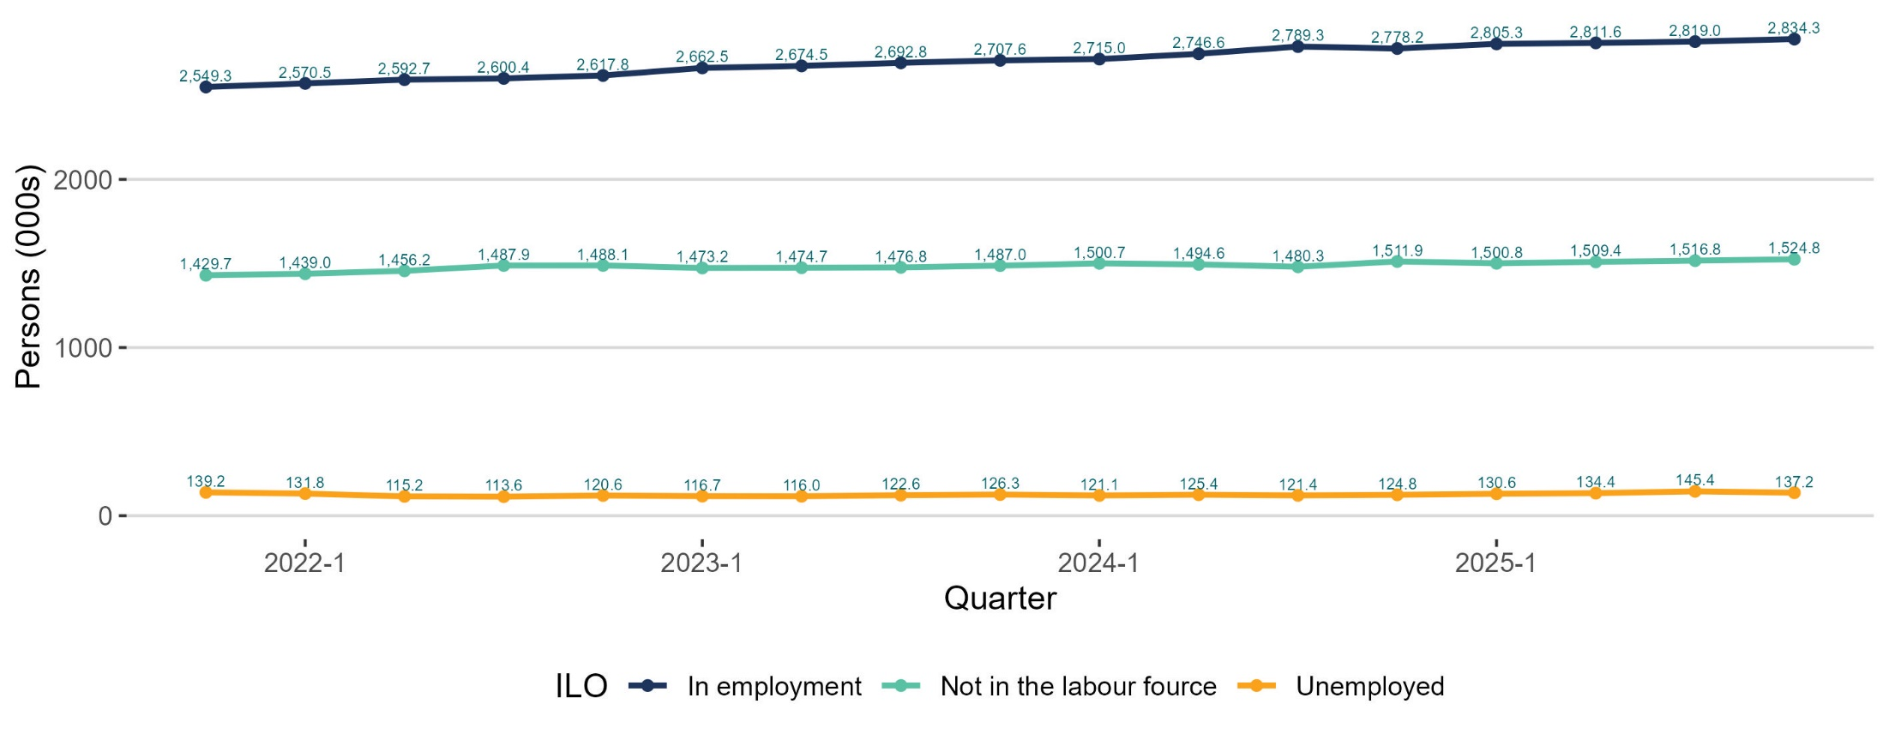
Seasonally adjusted employment up; unemployed down
thousands

Slide 4
In employment
Q4 2025:
Persons in employment: 2,833,100 +2.0%
Employment rate (15-64): 74.5% +0.2 p.p.
Seasonally adjusted: 2,834,300 +0.5% on Q3 2025

Slide 5
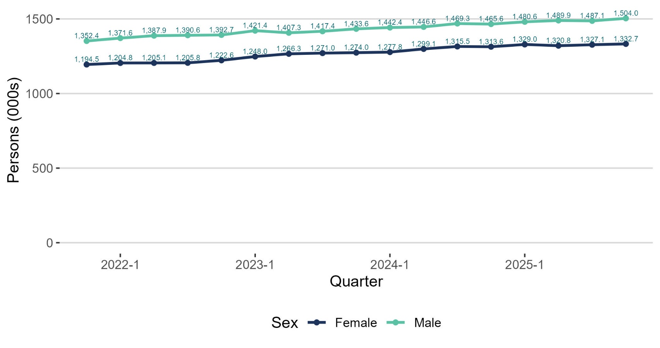
Seasonal adjustment employment up for males & females

Slide 6
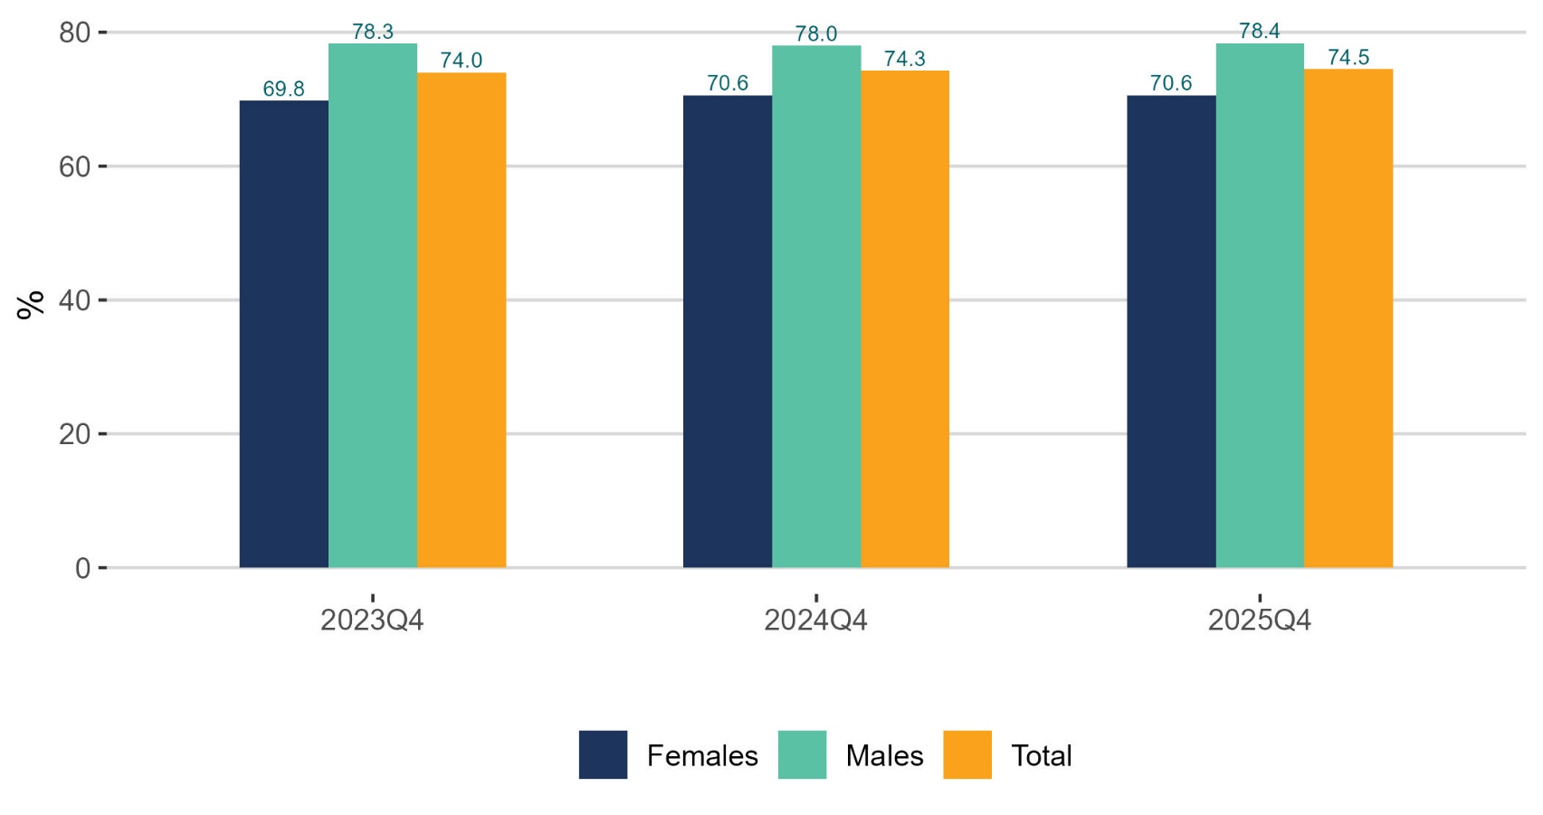
Male employment rate up; female unchanged

Slide 7
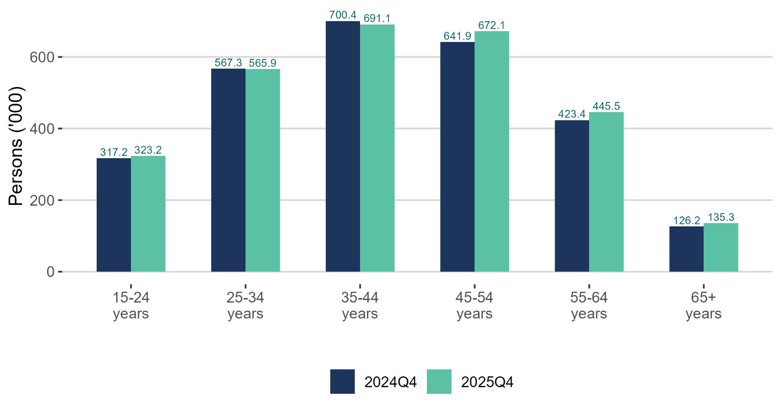
Employment increasing for older age groups

Slide 8
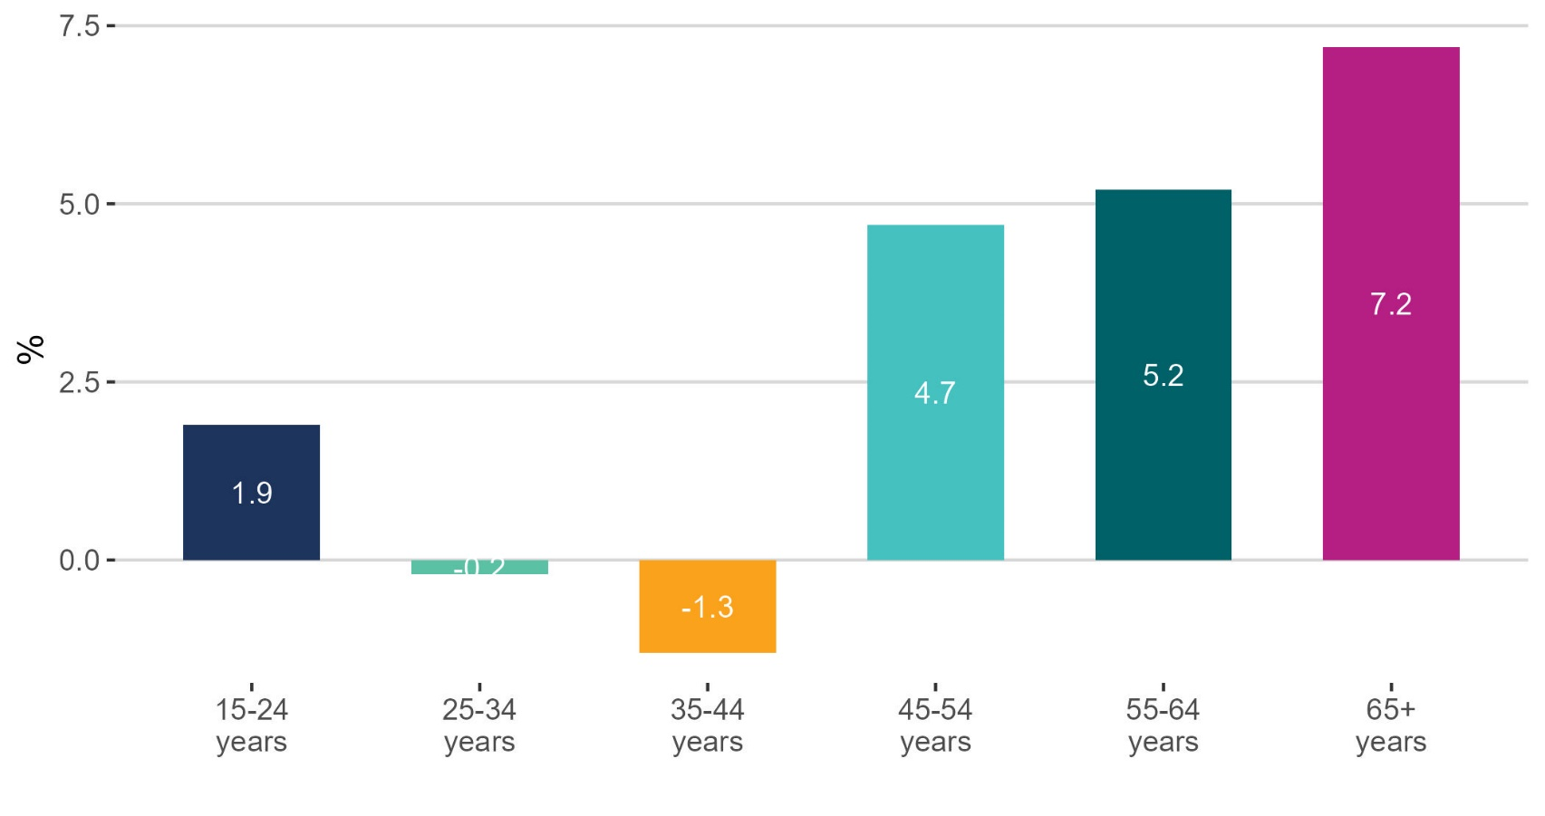
Employment increasing for older age groups

Slide 9
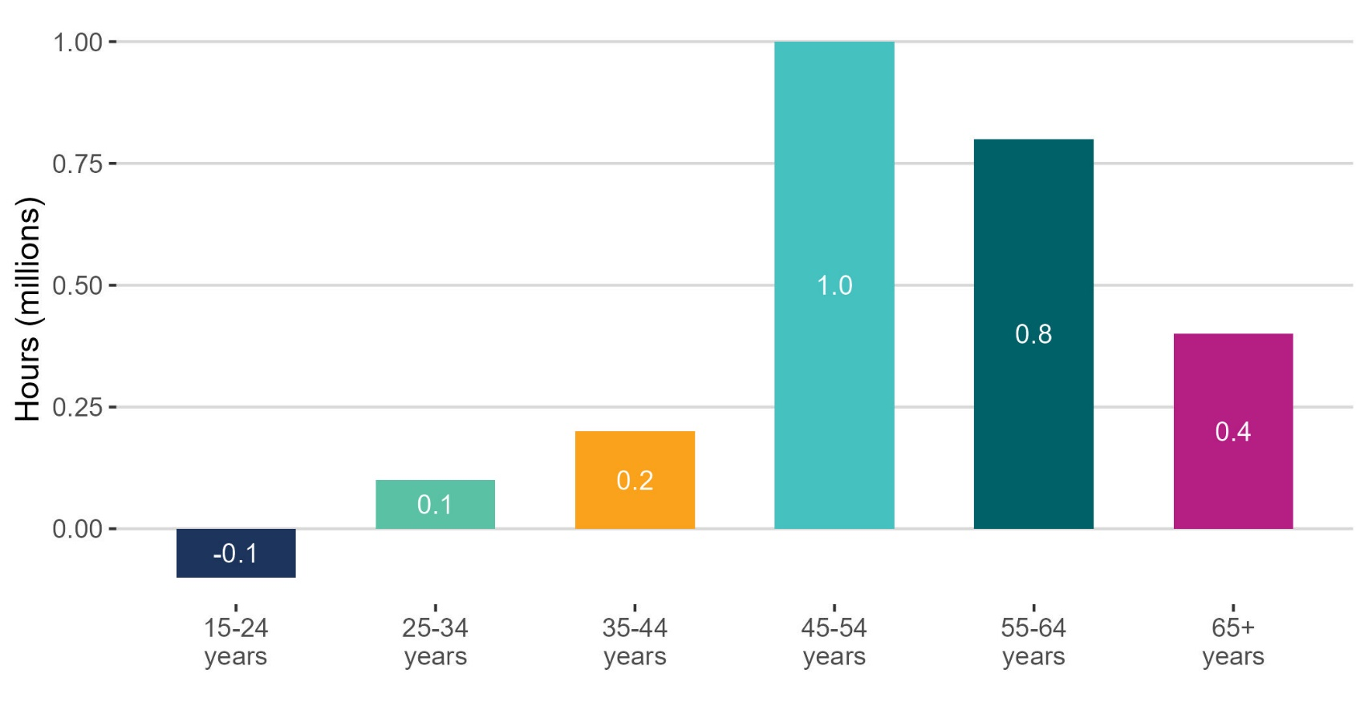
Older age cohorts increase in actual hours worked

Slide 10
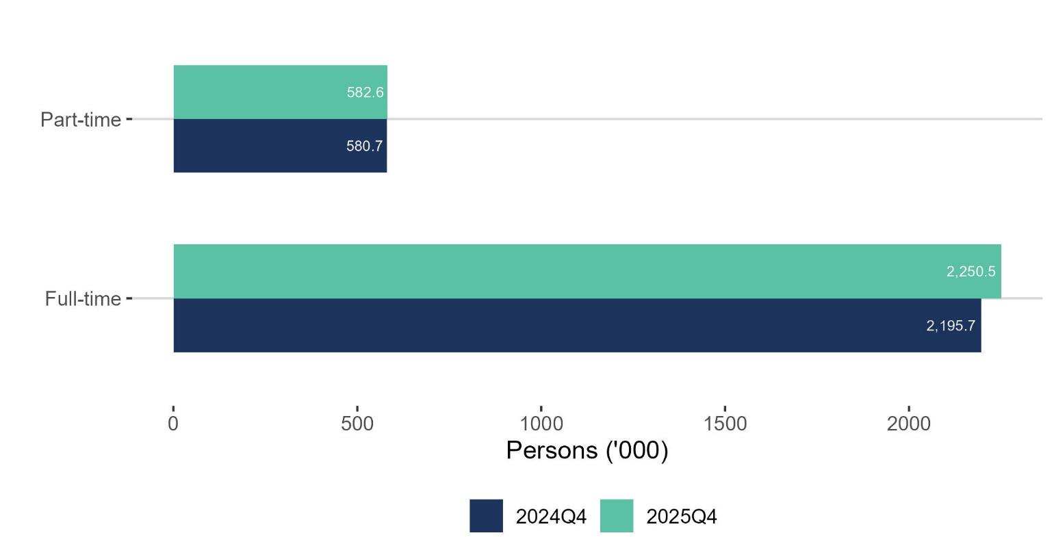
Full-time employment increased

Slide 11
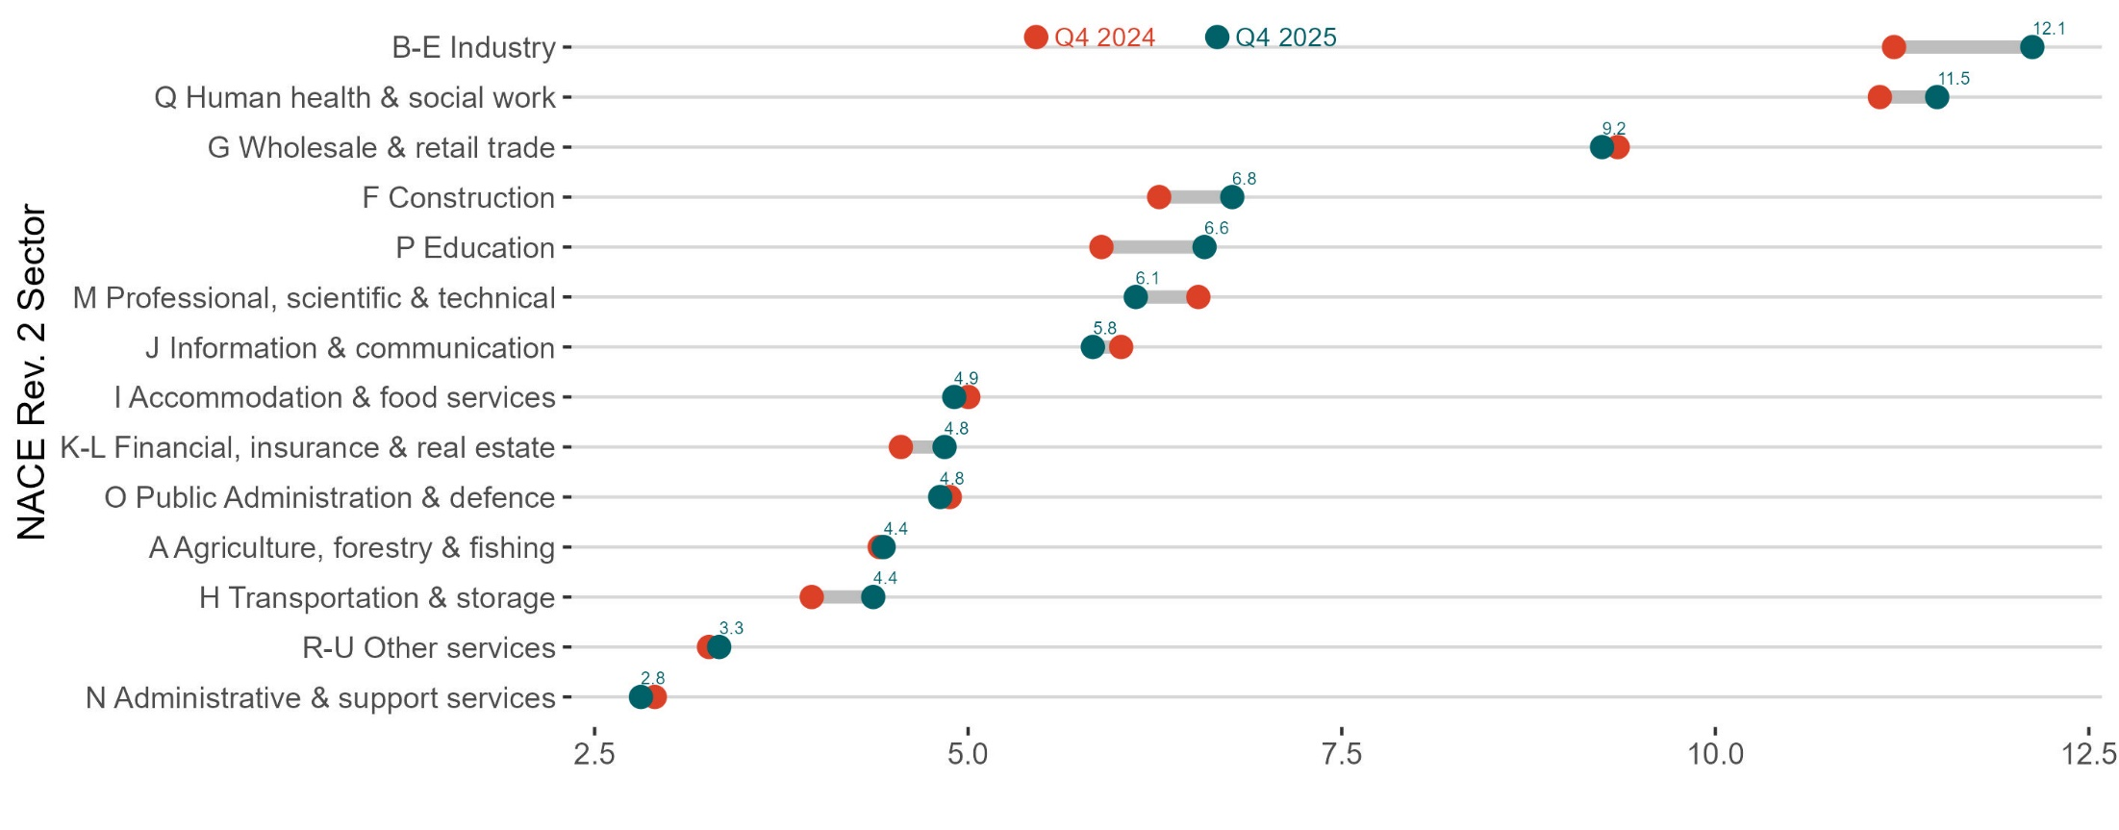
Actual hours worked per week increased

Slide 12
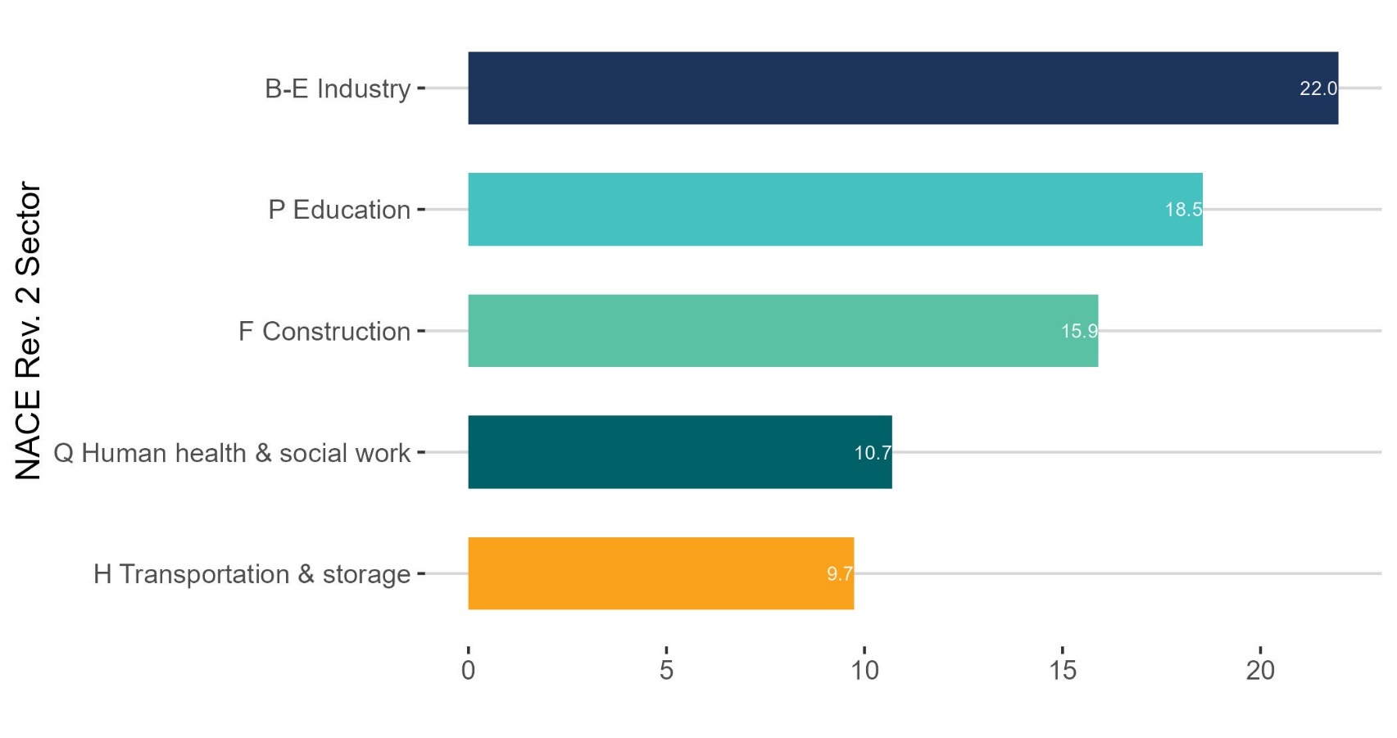
Largest increase in Industry

Slide 13
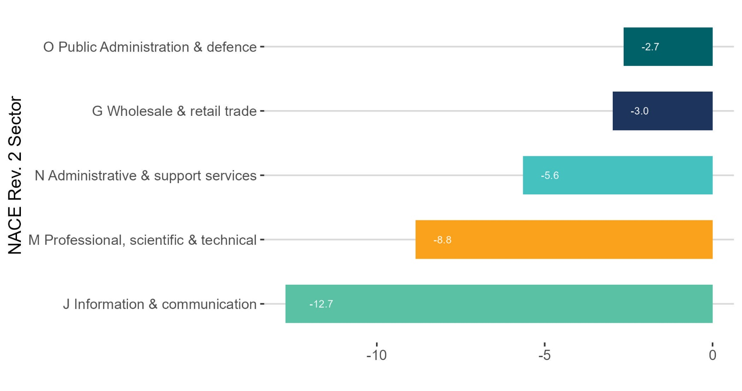
Largest decrease in Information & communication

Slide 14
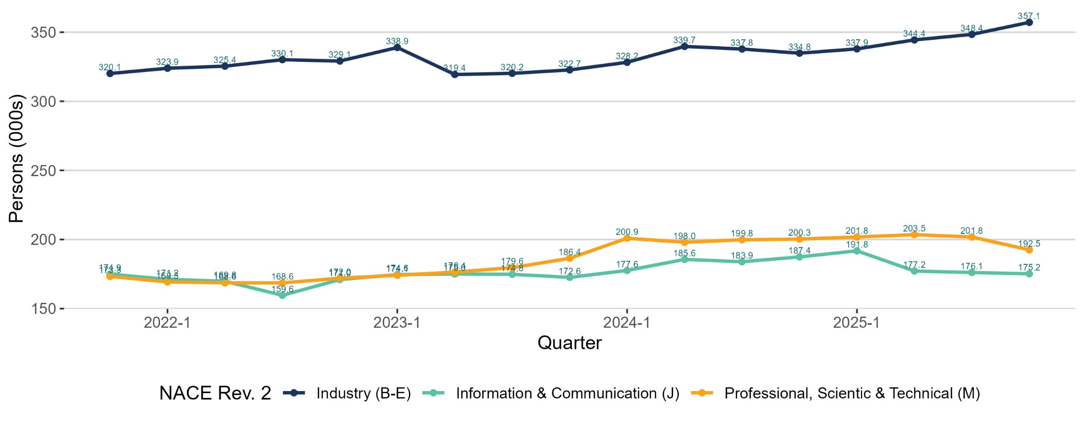
Three consecutive quarters of decline in Information & Communication seasonally adjusted estimates

Slide 15
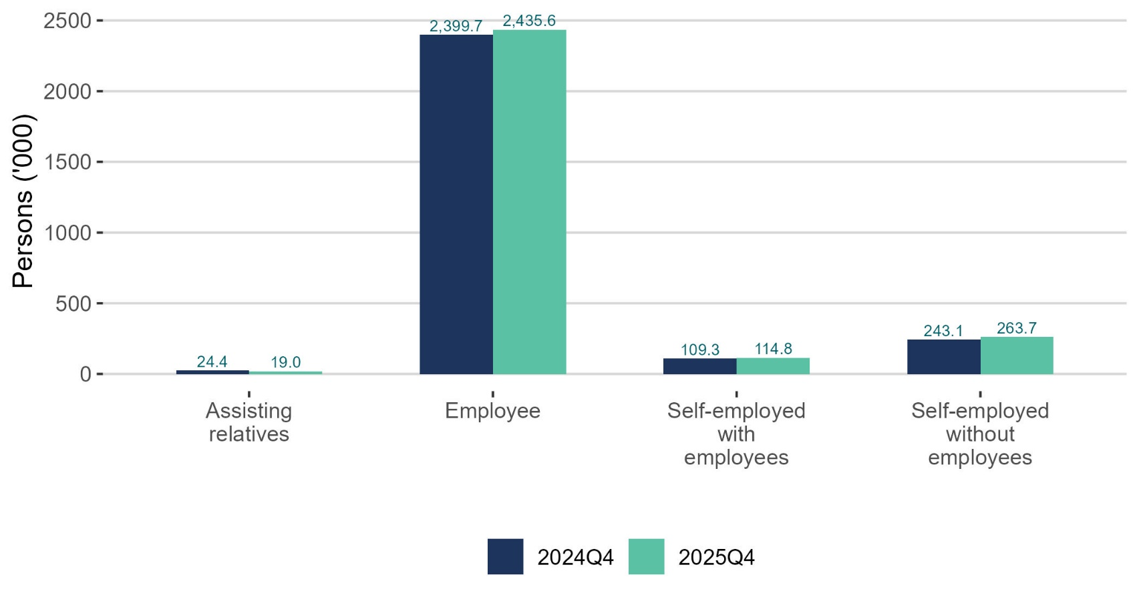
Increase in both employees and self-employed

Slide 16
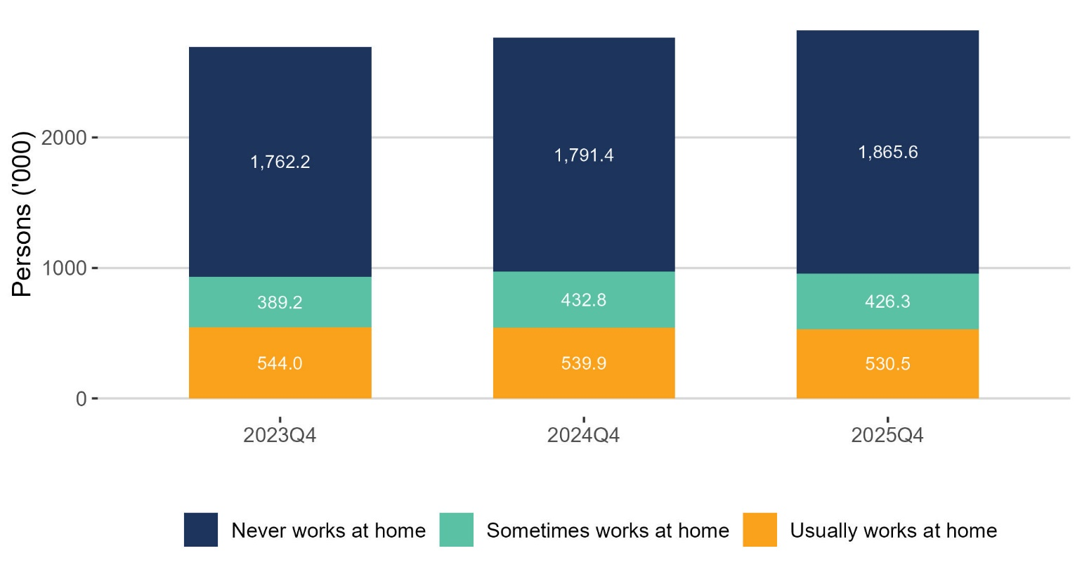
Non-remote workers increasing

Slide 17
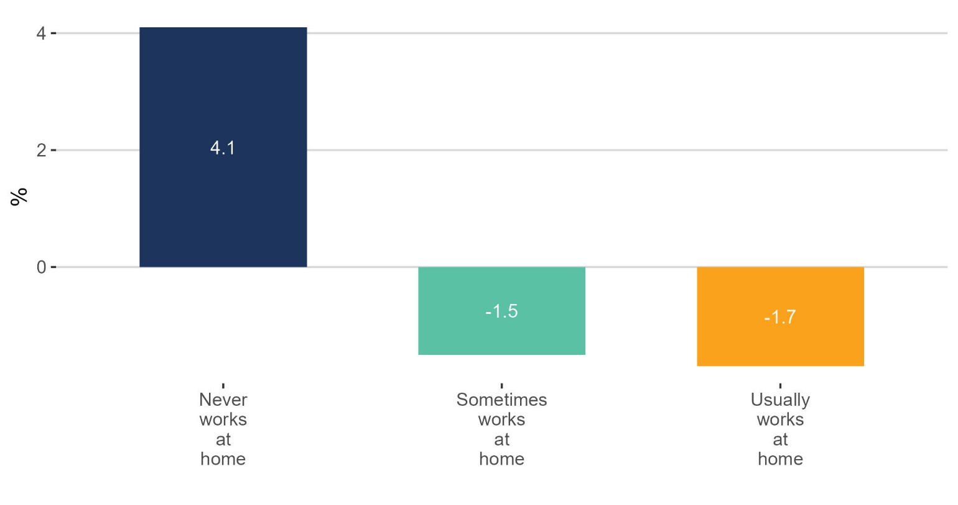
Non-remote workers increasing

Slide 18
Unemployment
Q4 2025:
Persons unemployed: 128,200 +10.4%
Unemployment rate (15-74): 4.4% +0.4 p.p
Persons unemployed (SA): 137,200 -5.6% on Q3 2025
Seasonally adjusted rate: 4.6% -0.3 p.p on Q3 2025

Slide 19
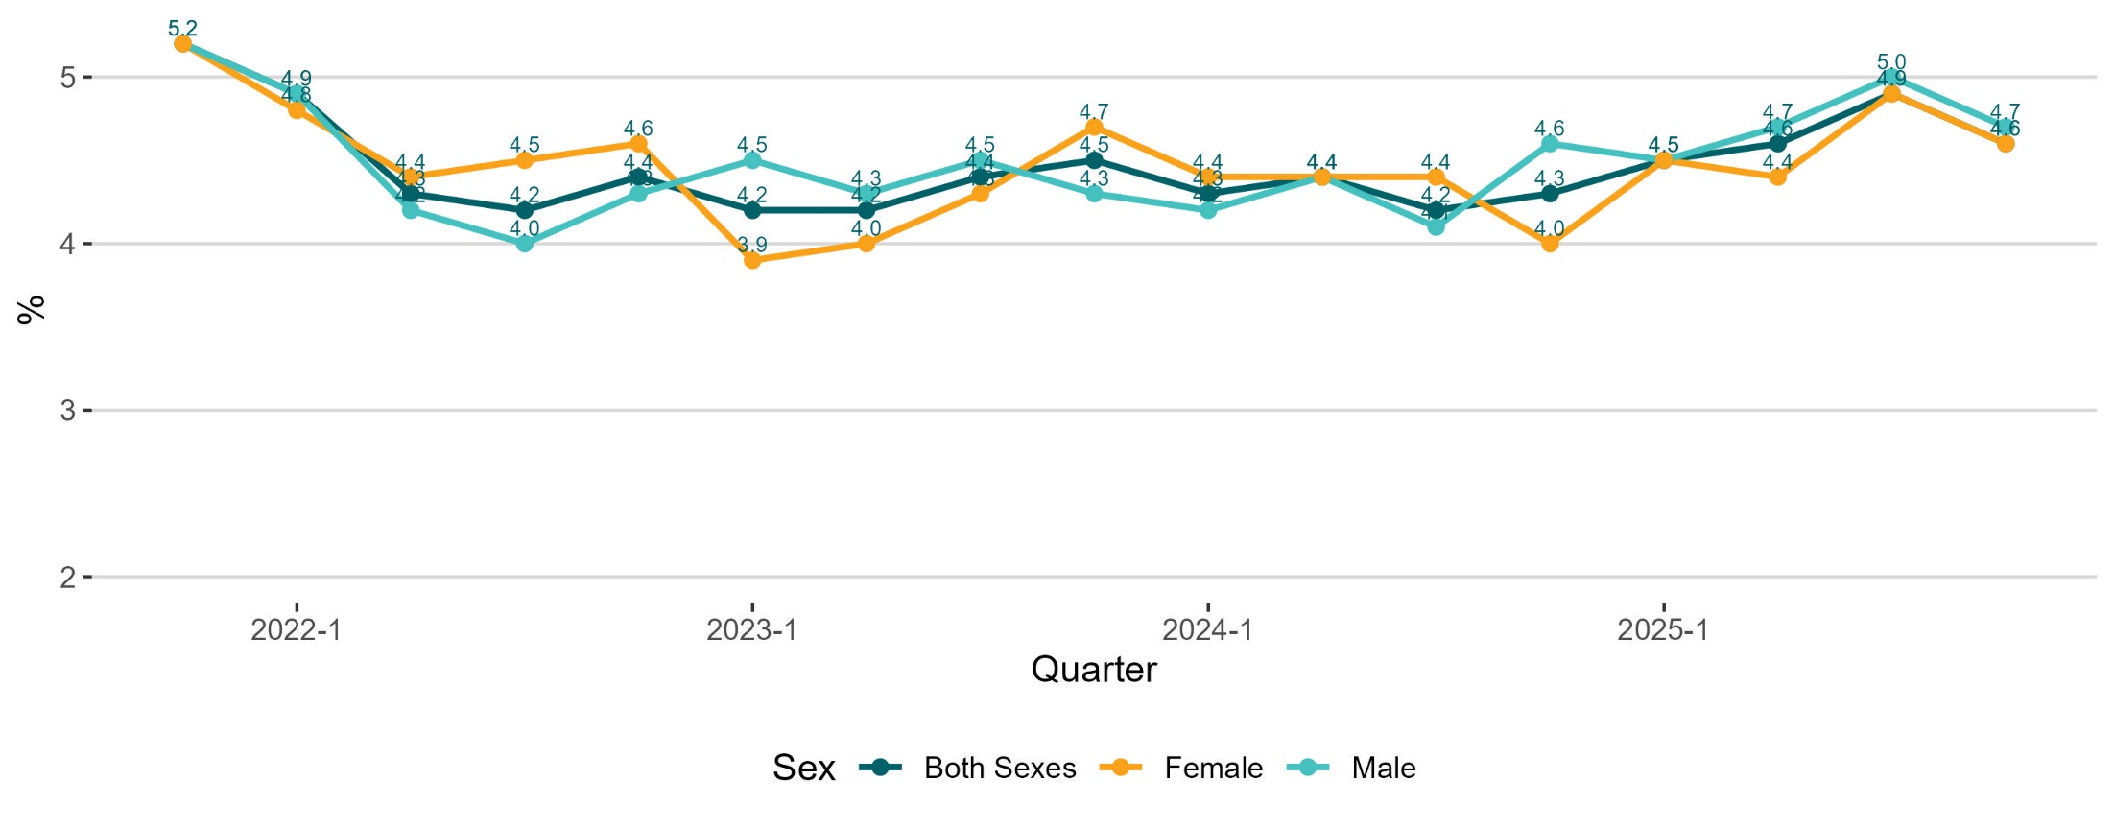
Seasonal adjustment unemployment rate

Slide 20
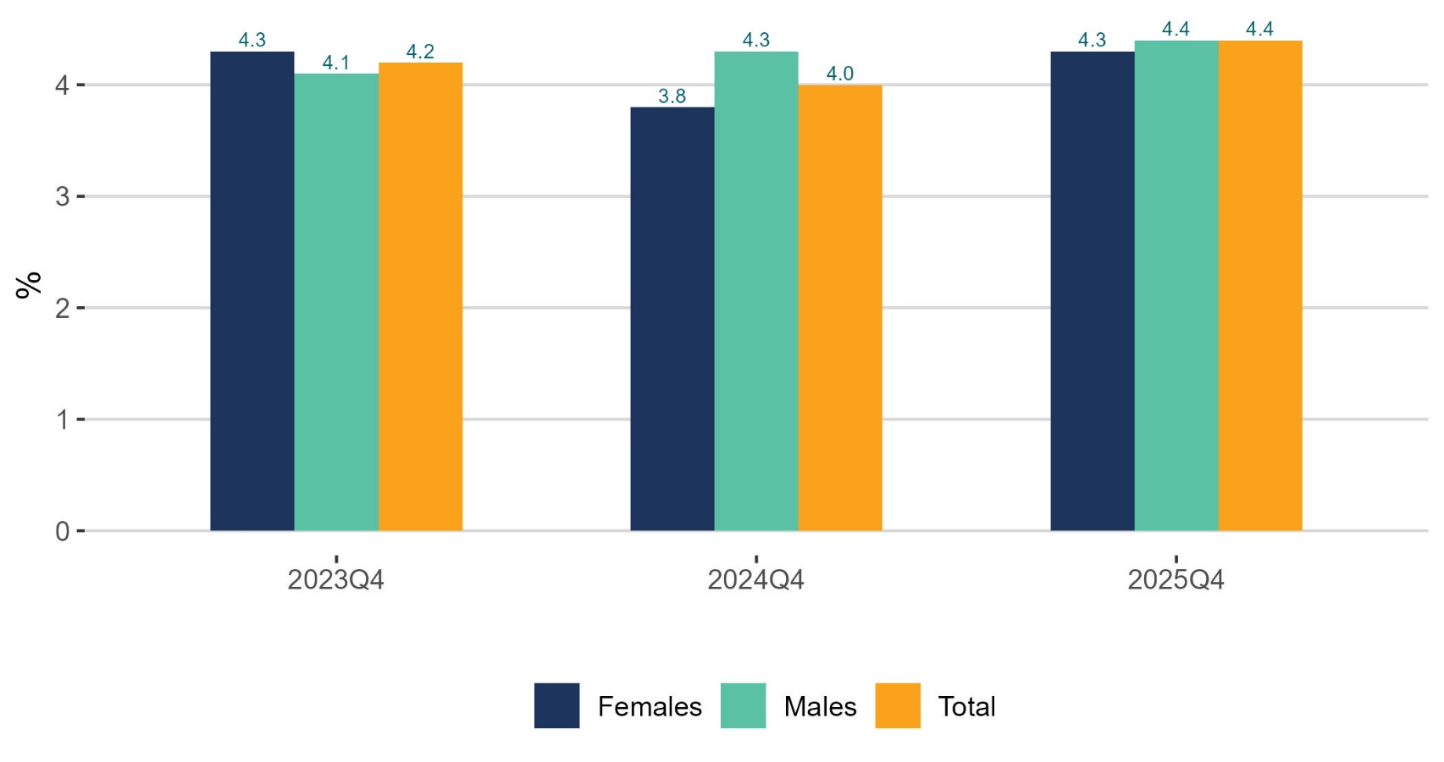
Unemployment rate increasing for both males and females

Slide 21
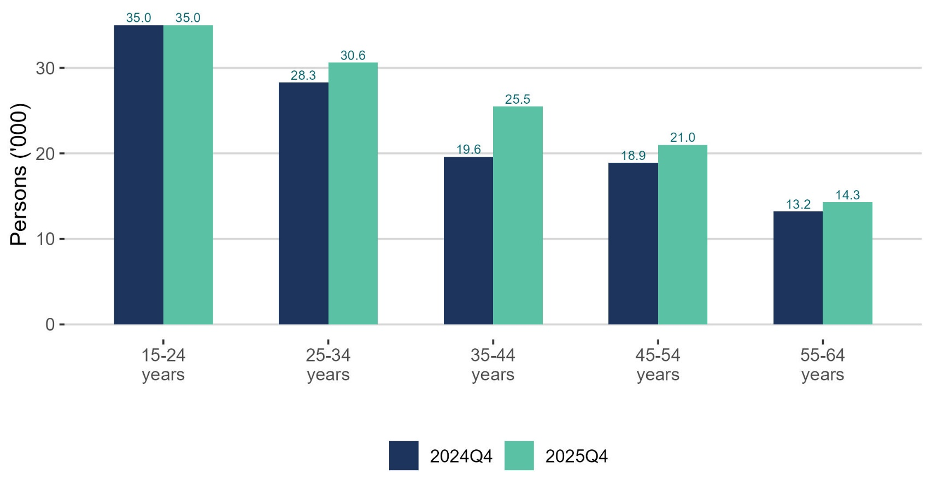
Unemployment up across all age groups except youths

Slide 22
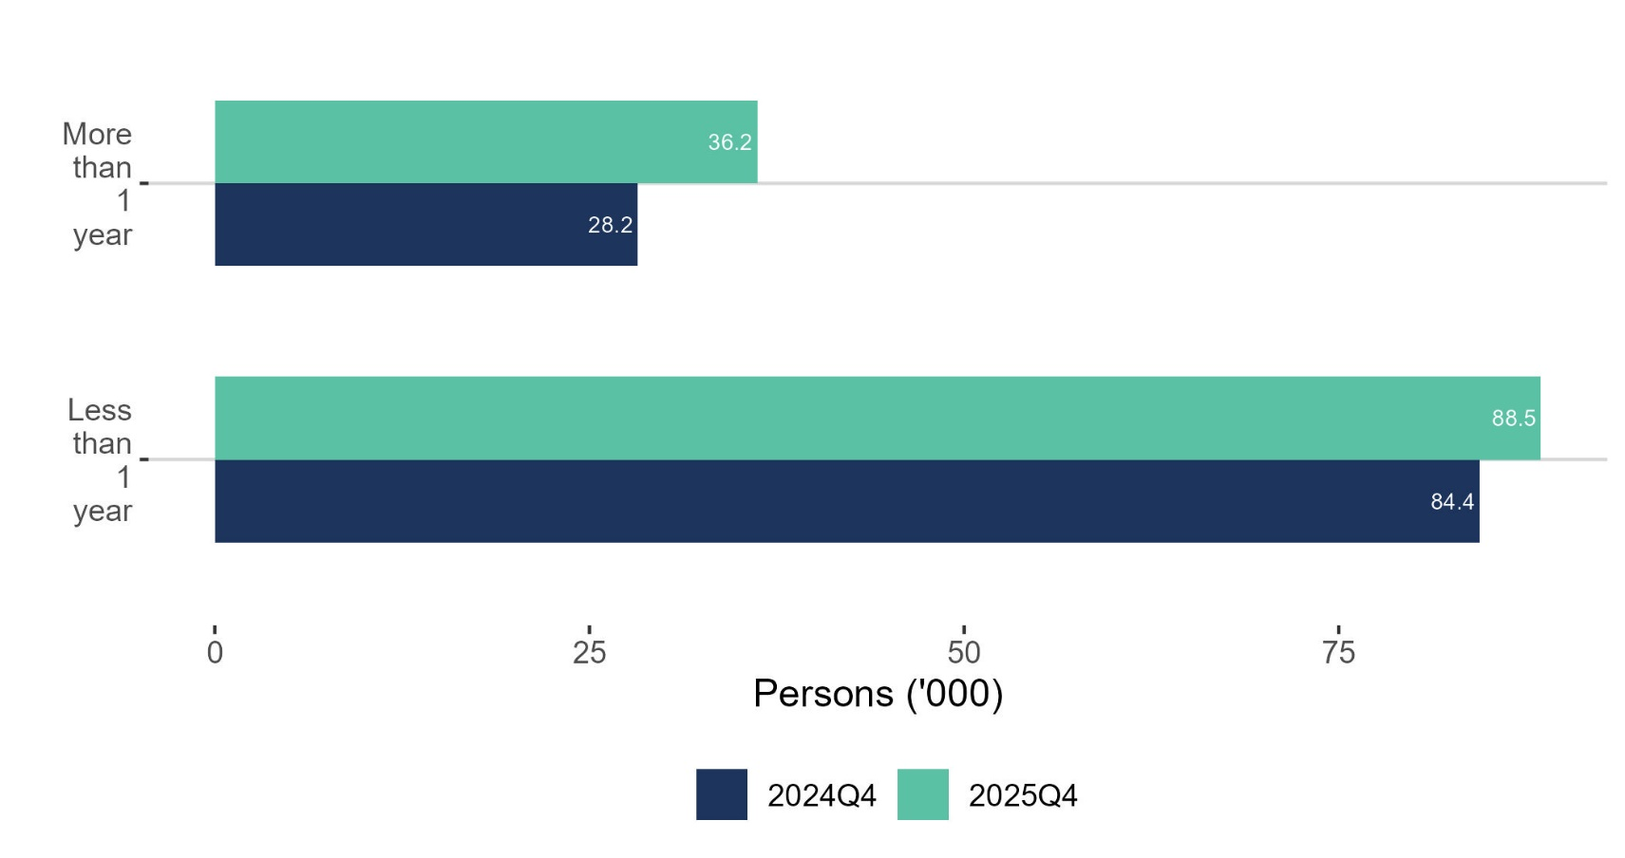
Long term unemployment increased

Slide 23
Labour Force
Q4 2025:
Persons in labour force: 2,961,300 +2.4%
Participation rate (15+): 65.8% +0.3 p.p.
Seasonally adjusted participation rate: 66.1% unchanged from Q3 2025

Slide 24
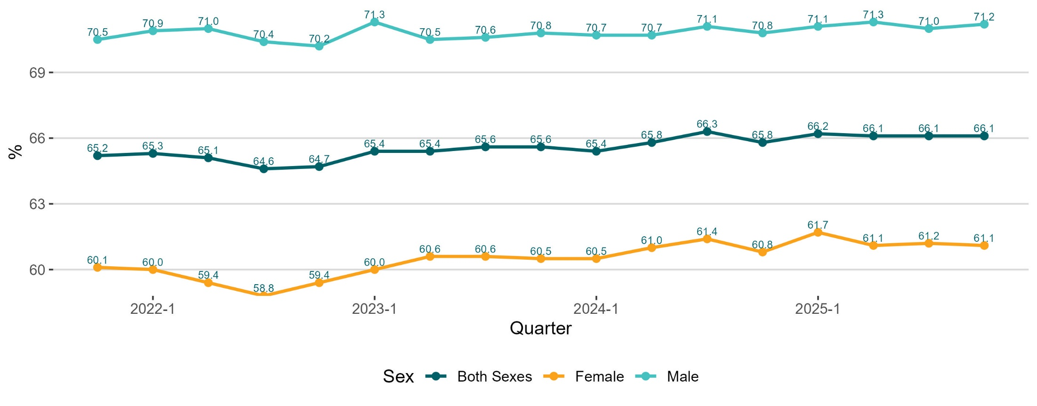
Seasonally adjusted participation rate

Slide 25
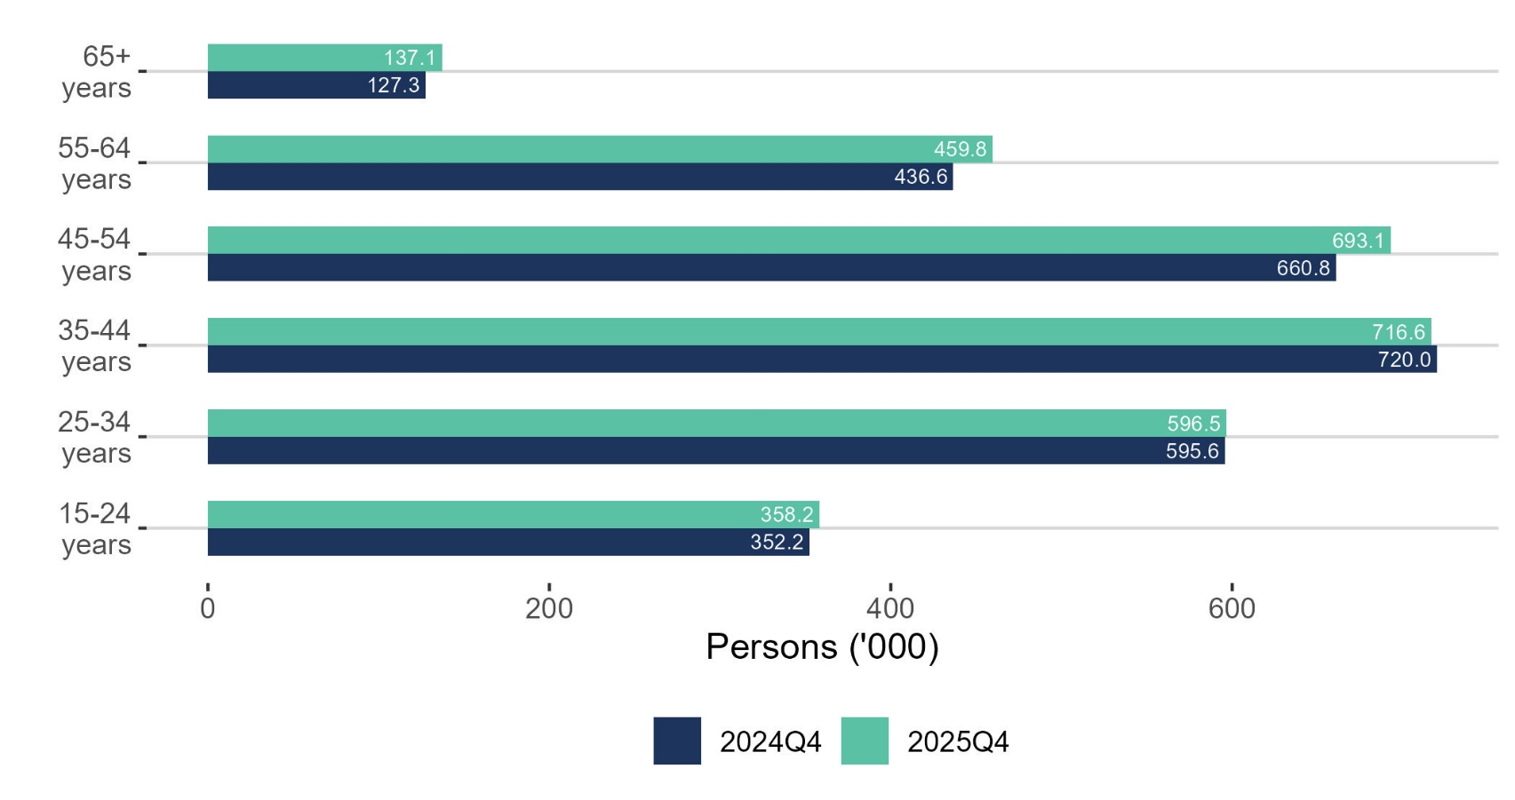
Labour Force increase for older age-cohorts

Slide 26
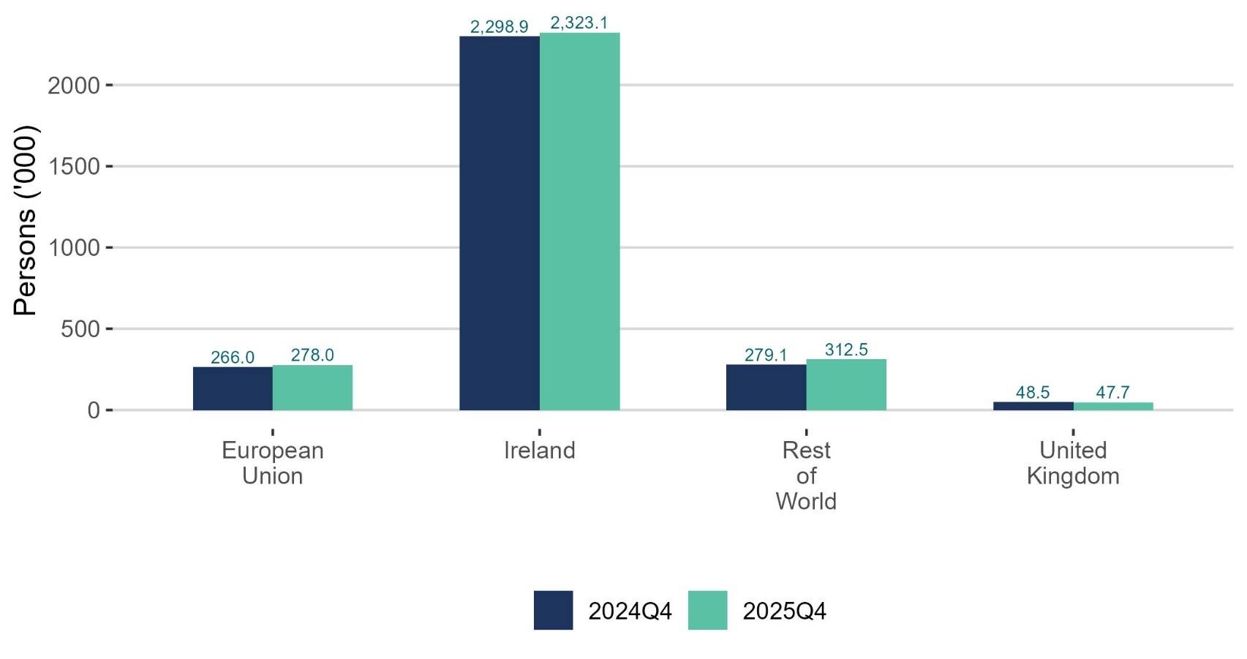
Largest increase in Labour Force from Rest of the World

Slide 27
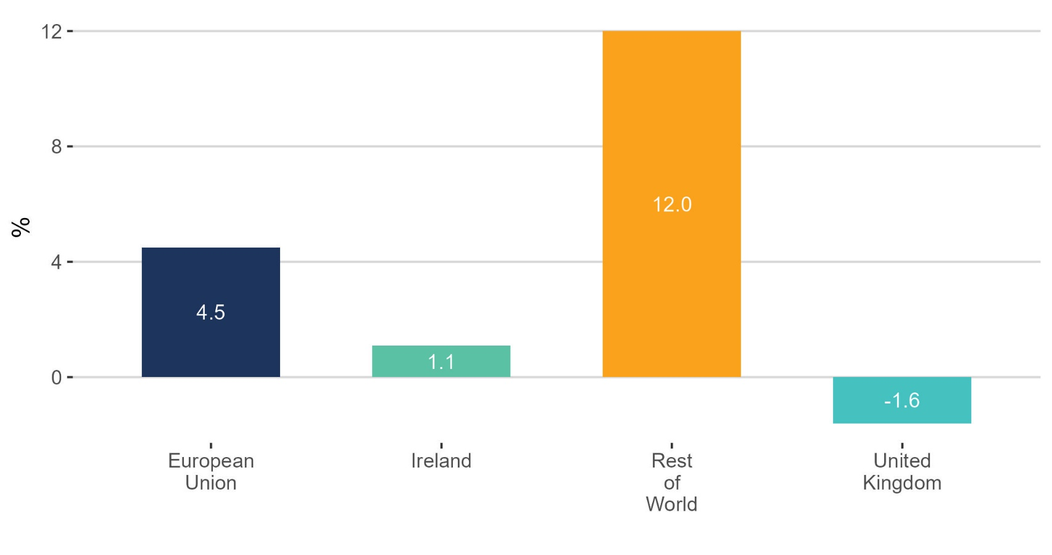
Largest increase in Labour Force from Rest of the World

Slide 28
Labour Force
Unadjusted
  Increased by 68,800 (2.4%) over the year to 2,961,300 in Q4 2025
  Demographic effect +44,000
  Participation effect +24,800
  Participation rate increased by 0.3p.p. to 65.8%
Adjusted
  Increase of 11,300 or 0.4% over the quarter to 2,973,800 in Q4 2025

Slide 29
Not in the Labour Force
Q4 2025:
Persons not in the Labour Force: 1,535,900 +0.9%
Potential additional Labour Force: 111,400 -2.0%

Slide 30
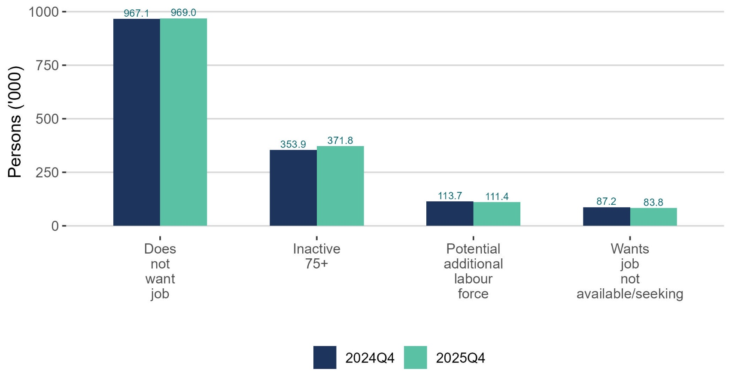
Does not want a job up slightly

Slide 31
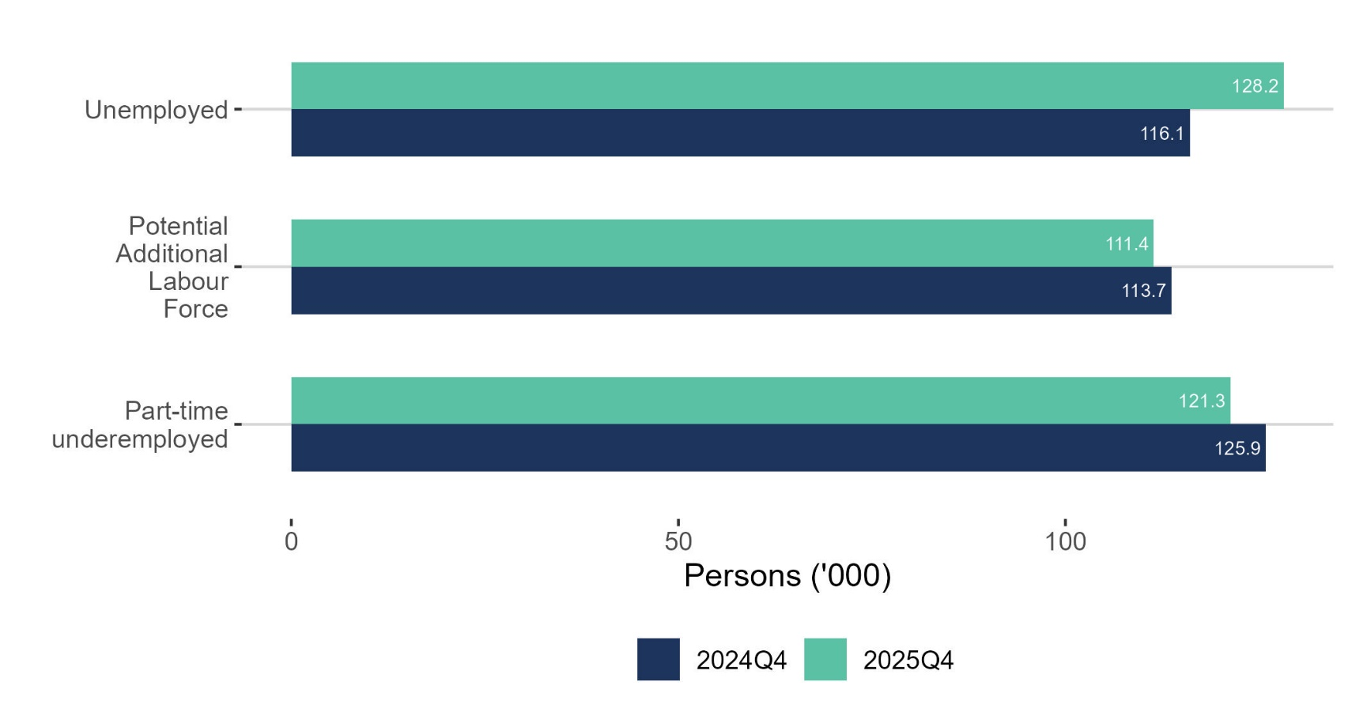
Part-time underemployed decreased

Slide 32
Young people (15-24) in the labour force
Q4 2025:
Employment rate: 46.0% -0.1 p.p.
Unemployment rate: 9.8% -0.2p.p.
Participation rate: 51.0% -0.2 p.p.
NEET rate 6.3% +0.8 p.p.

Slide 33
LFS Q4 2025 results summary
EMPLOYMENT
Increased 2.0% to a record 2,833,100
Actual hours worked as increased 2.9% driven by full-time employment
Employment rate up 0.2 p.p. to 74.5%
UNEMPLOYMENT
Increased 10.4% from 116,100 to 128,200
Unemployment rate 4.4%
Up among all age groups except youths
LABOUR FORCE
Increased 2.4% to 2,961,300
Participation down 0.3 p.p. to 65.8%

Slide 34
LFS Q2 2025 - Volunteering mini-module
KEY FINDINGS
16.1% of 15-74-year-olds volunteered
They volunteered more than 7.5 million hours per month
The largest number of volunteered are with sporting organisations
NEXT PUBLICATIONS
Sports Participation
Remote Working
Quality of Work

Slide 35
Labour Force Survey
Quarter 4 2025
Thank you.
LFS Q1 2026 results provisionally due for publication on 21st May 2026

Slide 36
Births 2001-2022
Notes:
Source: PxStat VSA16

Slide 37
Annex:
ILO Definitions and concepts
IESS Regulation
Impact of COVID-19 on LFS
Arrivals from Ukraine in Ireland

Slide 38
ILO classification in the LFS
Employment (15-89 years)
  Persons who worked in the week before the survey for one hour or more for payment or profit, including work on the family farm or business and all persons who were away from work during the reference week but had a job to which they could return to

Slide 39
ILO classification in the LFS
Unemployment (15-74 years)
  Persons who in the week before the survey, were
    without work – i.e. did not meet criteria to be classified as employed under ILO
    available to start work within the next two weeks
    had taken specific steps, in the previous four weeks to find work

Slide 40
ILO classification and LFS
Inactive (15+ years)
  All other persons

Slide 41
Integration of European Social Statistics (IESS) Regulation
New European regulation came into force on 01 January 2021
Implications for Irish Labour Market Statistics :
  https://www.cso.ie/en/releasesandpublications/in/lfs/implicationsoftheimplementationoftheintegrationofeuropeansocialstatisticsiessframeworkregulationonlabourmarketstatisticsinirelandin2021/
Impact of the regulation on the LFS series:
  https://www.cso.ie/en/releasesandpublications/ep/p-lfs/labourforcesurveyquarter12021/technicalnote/
The LFS questionnaires for Ireland up to Q1 2023 are available here: https://www.cso.ie/en/methods/surveyforms/labourforcesurvey/

Slide 42
Arrivals from Ukraine in Ireland
https://www.cso.ie/en/statistics/population/arrivalsfromukraineinireland/
As of the 3rd February 2026 there had been 121,048 Beneficiaries of Temporary Protection from Ukraine in Ireland.
Of these arrivals from Ukraine, 69% had activity in administrative data after 30 November 2025, based on data currently available to the Central Statistics Office (CSO).
Women and men aged 20 year and over made up 45% and 28% of arrivals respectively, while 27% were people aged under 20 years.
https://www.cso.ie/en/releasesandpublications/fp/p-aui/arrivalsfromukraineinirelandseries18/
Live Register figures for January 2026: 12,594 persons benefitting from Temporary Protection Directive:
https://www.cso.ie/en/releasesandpublications/ep/p-lr/liveregisterjanuary2026/

