Slide 1
Labour Force Survey Quarter 4 2021 Results 17 February 2022

Slide 2
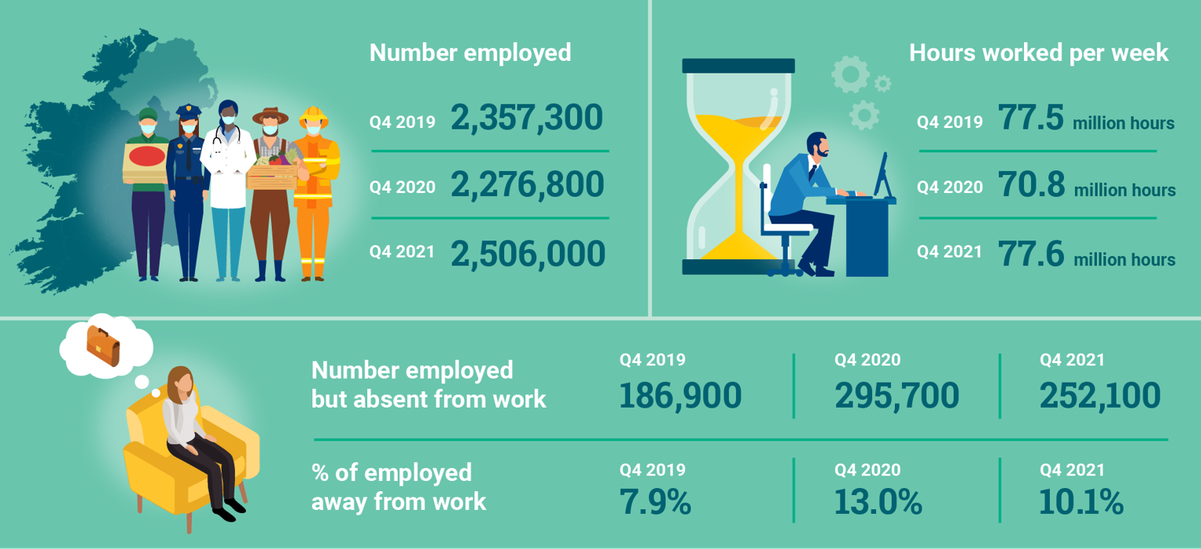
Infographic
Thousands

Slide 3
Persons (aged 15+) by ILO employment status, 2 year intervals
Thousands

Slide 4
Section 2: Labour Force In Q4 2021: In labour force: 2,633,300 Participation rate: 65.1% Outside the labour force: 1,411,800

Slide 5
Labour market participation volume
62.6%
Thousands

Slide 6
Participation rate (seasonally adjusted)
%

Slide 7
Participation rate by sex
%

Slide 8
Participation rate by age group
%

Slide 9
Participation rate by region (NUTS3)
%

Slide 10
Principal Economic Status
Thousands

Slide 11
Labour Force
Unadjusted
Increased by 214,800 (+8.9%) over the year to 2,633,300 in Q4 2021
Participation increased over the year from 60.6% to 65.1%
Demographic effect +22,900
Participation effect +191,900
Seasonally Adjusted
Increase of 20,700 or 0.8% over the quarter to 2,627,400 in Q4 2021

Slide 12
Section 3: In employment In Q4 2021: In employment: 2,506,000 Employment rate: 73.0% Covid-19 adjusted (Dec 2021): 2,439,099 Covid-19 adjusted rate (Dec 2021): 70.9%

Slide 13
Employment volume by sex
Thousands

Slide 14
Employment volume (seasonally adjusted) - % change on previous quarter
%

Slide 15
Employment and hours worked
Number of persons 15-89 years in employment (ILO), number of persons absent from work and Actual Hours worked per week (in millions)
 | Q4 2019 | Q4 2020 | Q4 2021 | Annual Change Q4 2019 to Q4 2020 | Annual Change Q4 2020 to Q4 2021 | Biennial change Q4 2019 to Q4 2021
Employment | 2,357,300 | 2,276,800 | 2,506,000 | -80,500 (-3.4%) | +229,100 (+10.1%) | +148,700 (+6.3%)
'Away from work' (not at work) | 186,900 | 295,700 | 252,100 | +108,800 (+58.2%) | -43,600(-14.7%) | +65,200 (+34.9%)
Actual Hours worked per week (millions) | 77.5 | 70.8 | 77.6 | -6.7 (-8.6%) | +6.8 (+9.6%) | +0.1 (+0.1%)

Slide 16
Employment by part-time/full-time and by sex
Thousands

Slide 17
Part-time Underemployed (as % of part-time employed)

Slide 18
PUP and EWSS recipients by ILO status
%

Slide 19
Persons in employment by economic sector
Thousands

Slide 20
Absences from work (as % of number employed), by Economic Sector

Slide 21
Total actual hours worked (millions) per week, by economic sector
(hours) millions

Slide 22
Section 4: Unemployment In Q4 2021: Persons unemployed: 127,400 Unemployment rate: 4.9% Covid19 adjusted (Dec 2021): 195,313 Covid19 adjusted rate (Dec 2021): 7.4%

Slide 23
Unemployed by sex
Thousands

Slide 24
Unemployment rate (seasonally adjusted)
%

Slide 25
Long-term unemployed
Thousands

Slide 26
Section 5: Annual averages

Slide 27
Persons by ILO status (aged 15+) – Annual average
%

Slide 28
Section 6: In summary

Slide 29
Infographic
Thousands

Slide 30
Thank You.

Slide 31
Annex: Impact of COVID-19 on LFS ILO Definitions and concepts IESS Regulation

Slide 32
COVID-19 and the Labour Force Survey (LFS)
The methodology in the Information Note published with the Q2 2020 LFS results in August 2020 still applies, please see link https://www.cso.ie/en/releasesandpublications/in/lfs/informationnote-implicationsofcovid-19onthelabourforcesurvey-quarter22020update/
COVID-19 continues to have a very significant impact on the data collection for the LFS
The Q4 2021 LFS results today adhere to the standard International Labour Organisation (ILO) criteria for calculating labour market estimates

Slide 33
ILO classification in the LFS
Employment (15-89 years)
Persons who worked in the week before the survey for one hour or more for payment or profit, including work on the family farm or business and all persons who were away from work during the reference week but had a job to which they could return to

Slide 34
Attachment to job
Testing for Job attachment pre and post IESS
 | Pre-IESS | Post-IESS
Holidays | No | No
Working time arrrangements | No | No
Illness/disability | No | No
Maternity/Paternity | No | No
Job related training | No | No
Parental | No | Yes
Off season | No | Yes
Temporary layoff | Yes | Yes¹
Other reason | No | Yes
Waiting to start a new job | n/a | No
¹ Post-IESS include all layoffs
Rules for attachment to job for absences from work
Pre-IESS | Post-IESS
Length of absence and share | Length of absence and salary payment
of salary paid applied to temporary | for parental leave
layoffs only
 | Off-season - whether do any occasional
 | work for employer or not
 | Layoffs/Other reason - length of absence
 | only

Slide 35
ILO classification in the LFS
Unemployment (15-74 years)
Persons who in the week before the survey, were
without work – i.e. did not meet criteria to be classified as employed under ILO
available to start work within the next two weeks
had taken specific steps, in the previous four weeks to find work

Slide 36
ILO classification and LFS
Inactive (15+ years)
All other persons

Slide 37
Integration of European Social Statistics (IESS) Regulation
New European regulation came into force on 01 January 2021
Implications for Irish Labour Market Statistics :
https://www.cso.ie/en/releasesandpublications/in/lfs/implicationsoftheimplementationoftheintegrationofeuropeansocialstatisticsiessframeworkregulationonlabourmarketstatisticsinirelandin2021/
Impact of the regulation on the LFS series:
https://www.cso.ie/en/releasesandpublications/ep/p-lfs/labourforcesurveyquarter12021/technicalnote/
The LFS questionnaires for Ireland up to Q4 2021 are available here: https://www.cso.ie/en/methods/surveyforms/labourforcesurvey/

