Slide 1
Labour Force Survey Quarter 3, 2025 20th November 2025

Slide 2
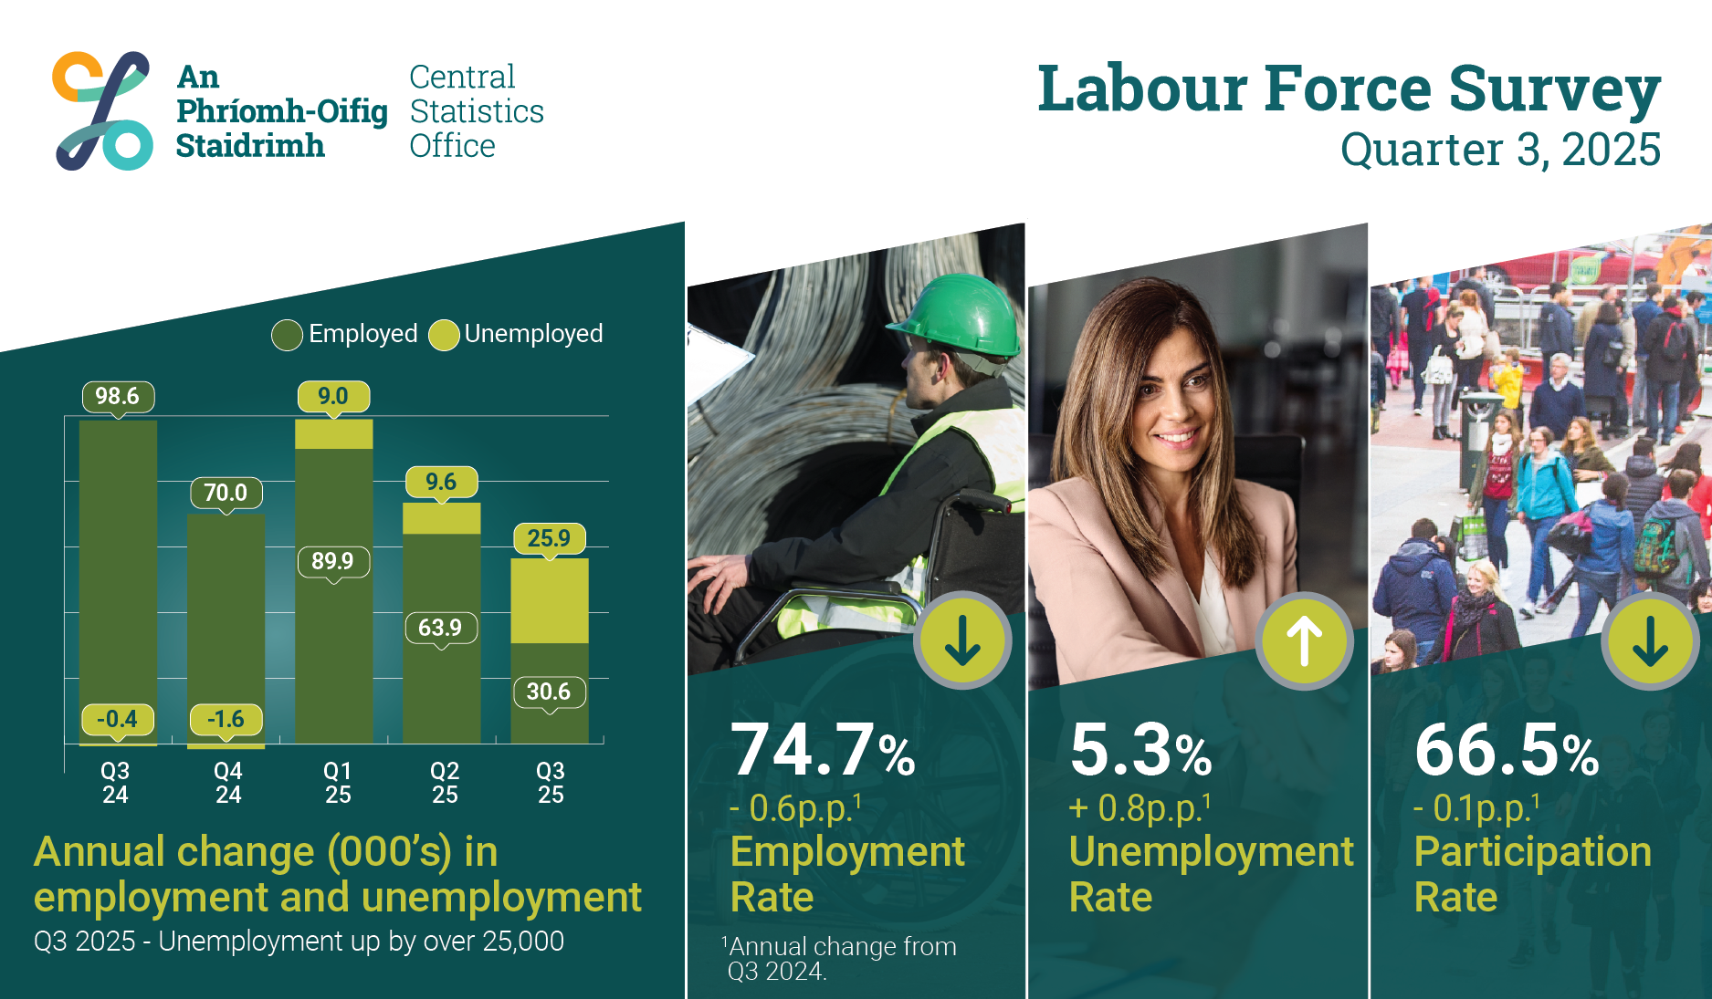
Infographic
Thousands

Slide 3
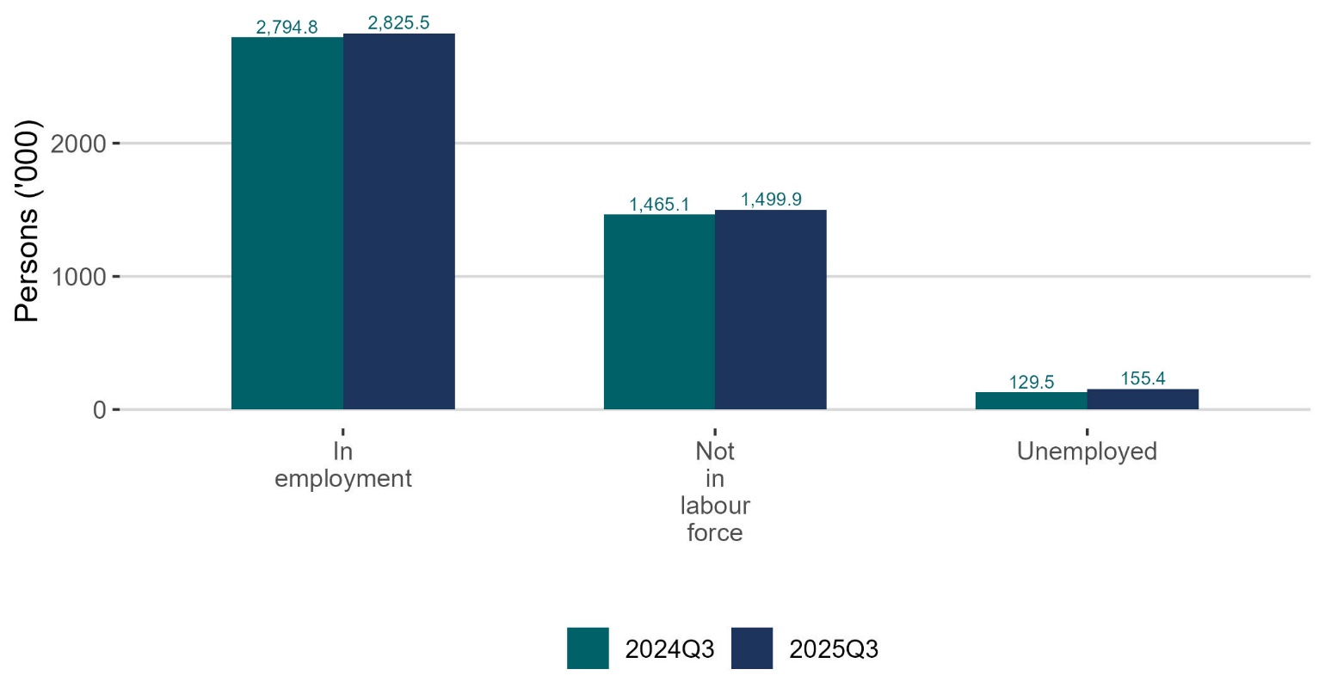
Employment, unemployment and not in the labour force increased
thousands

Slide 4
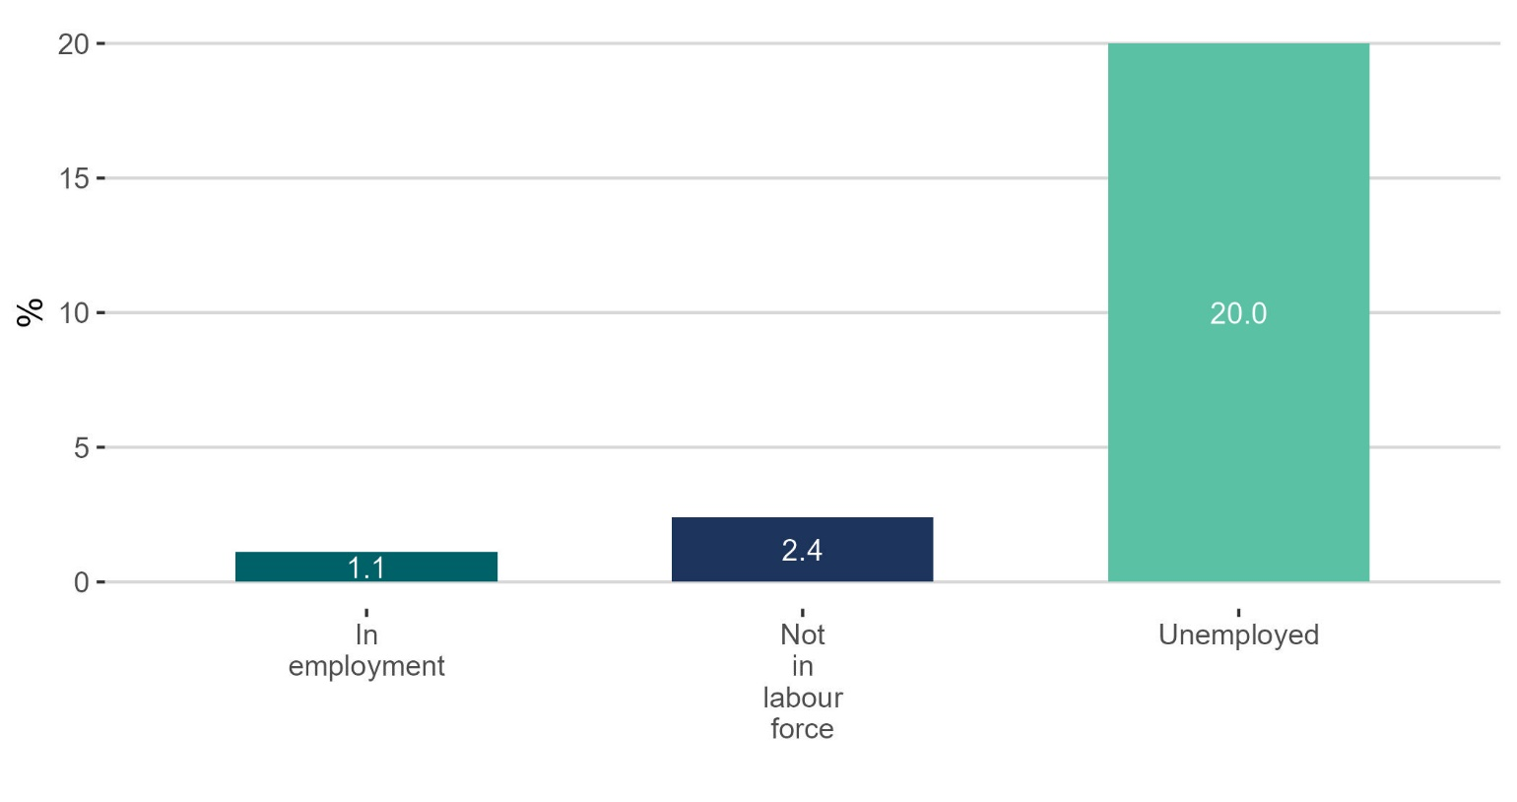
Unemployment had the largest percentage increase
%

Slide 5
In employment Q3 2025: Persons in employment: 2,825,500 +1.1% Employment rate (15-64): 74.7% -0.6 p.p. Seasonally adjusted: 2,812,800 +0.1% on Q2 2025

Slide 6
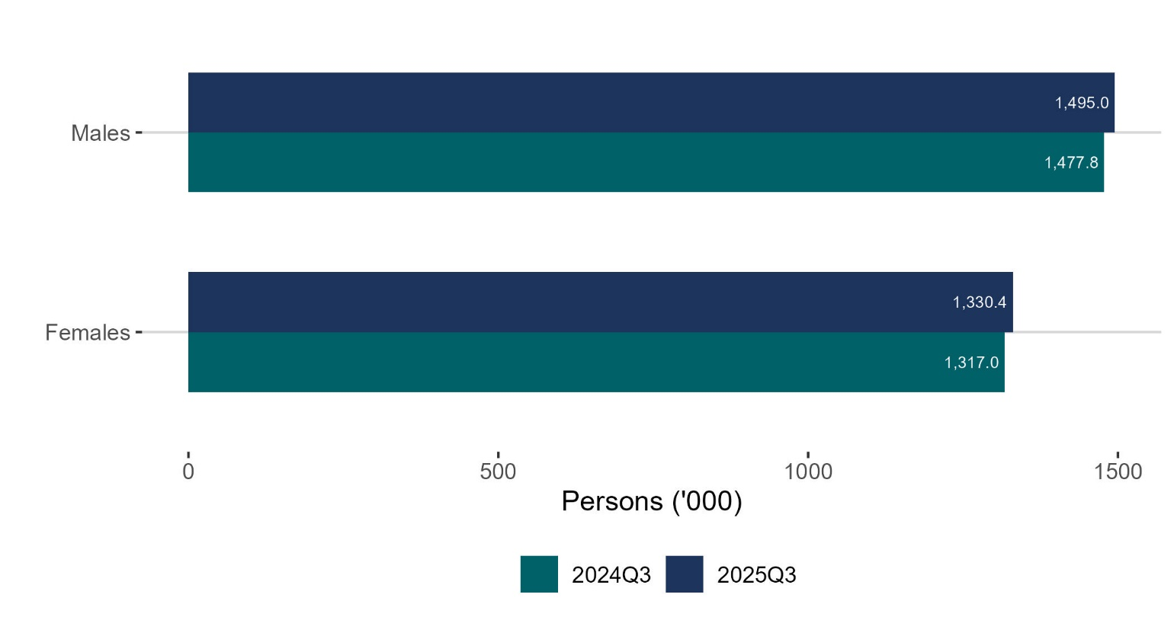
Employment (‘000) increased for both males and females
thousands

Slide 7
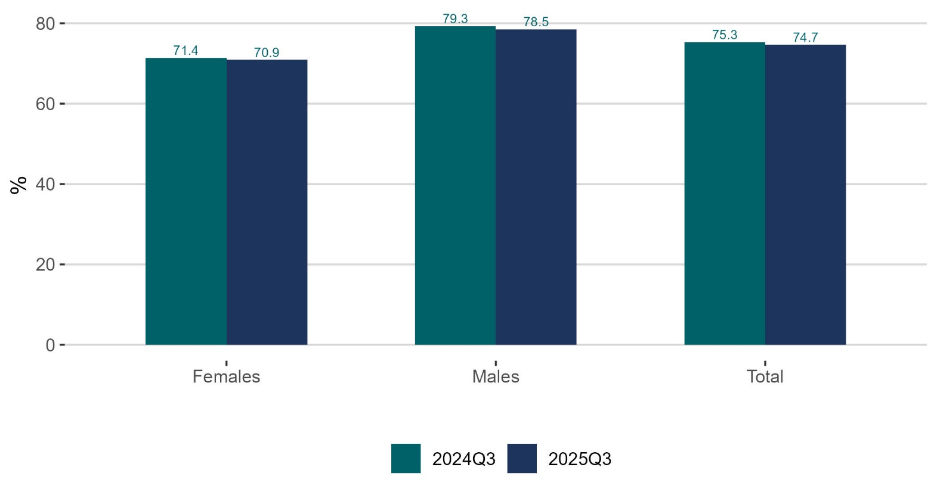
Employment rate (%) decreases for both males and females
%

Slide 8
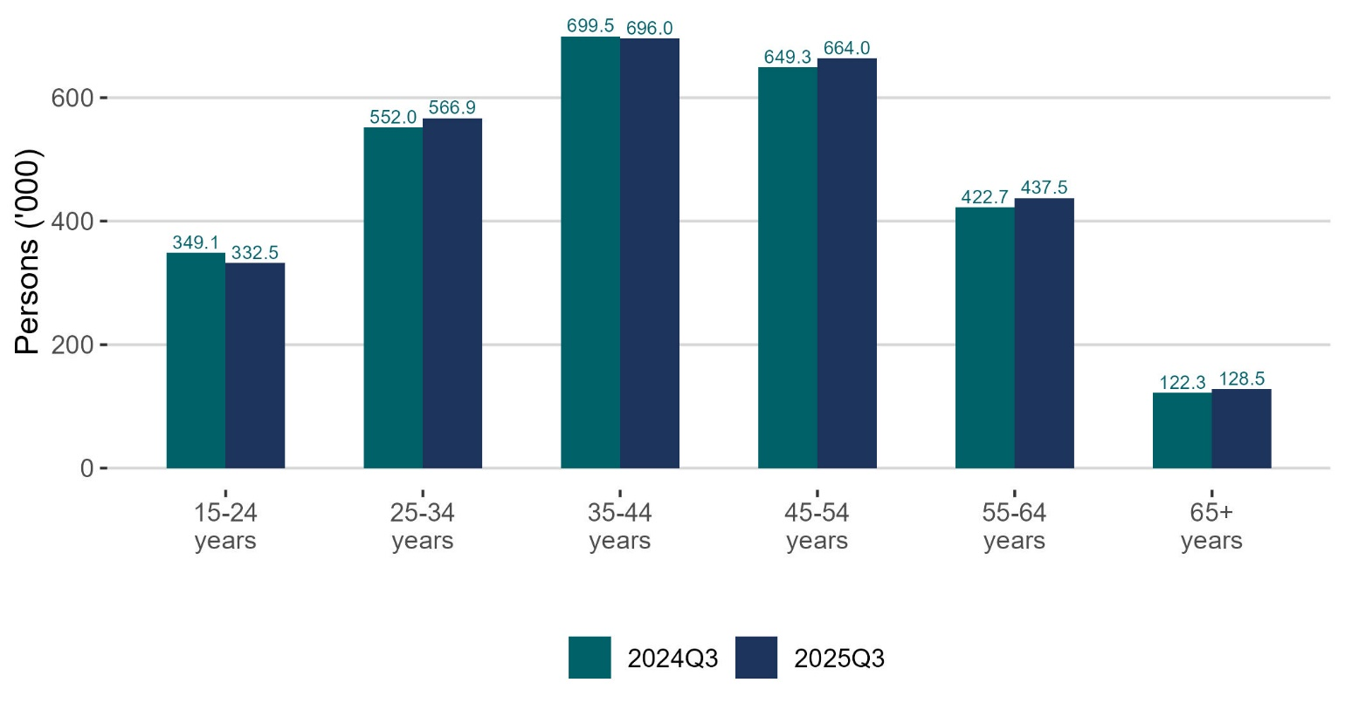
Employment (‘000) decreased in youth age group
thousands

Slide 9
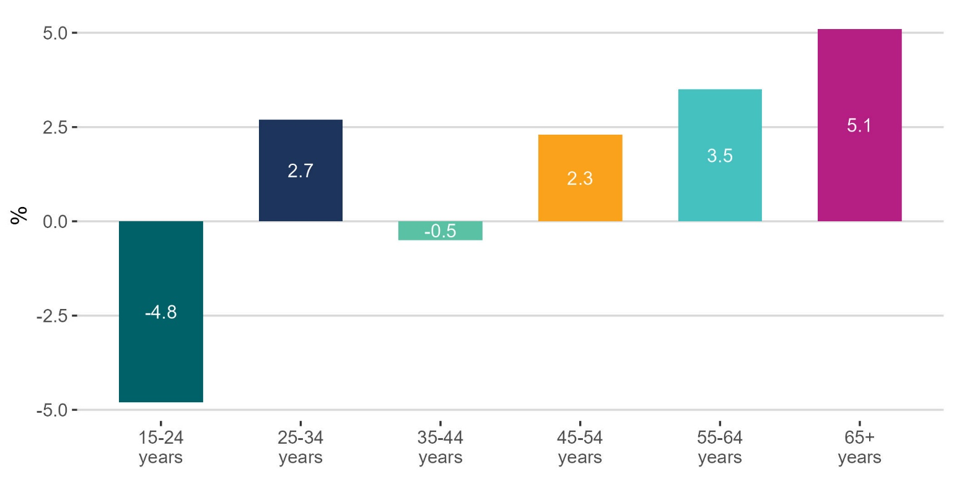
Employment (%) increased for oldest age group
%

Slide 10
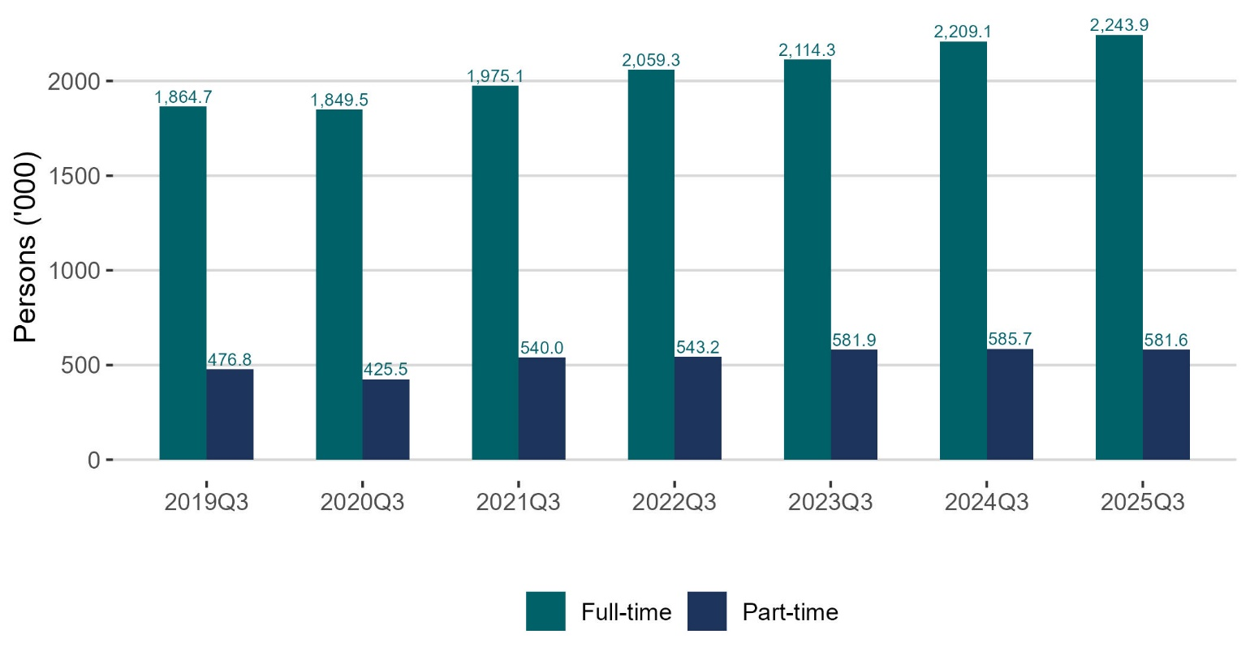
Full-time employment (‘000) increases while part-time decreases
thousands

Slide 11
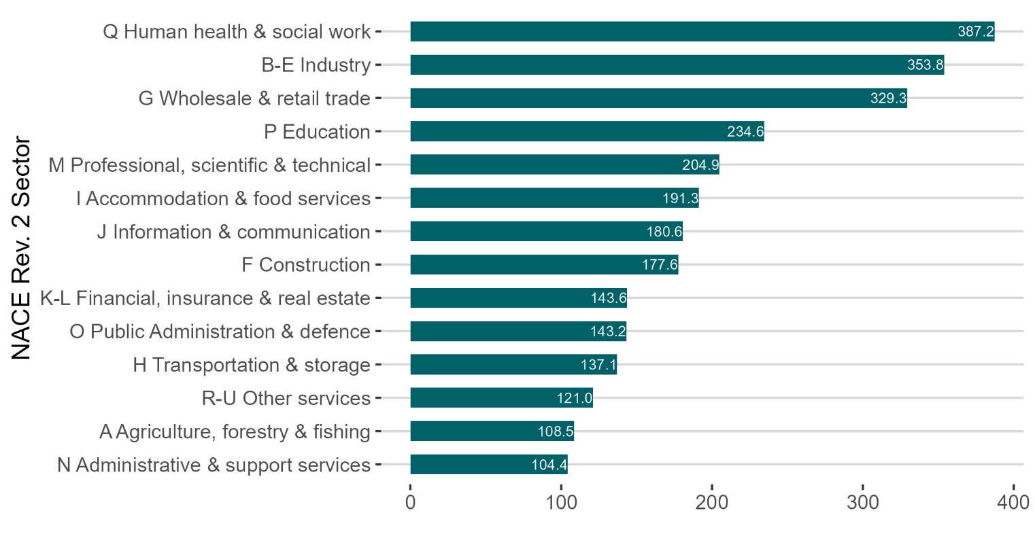
Human health & social work the sector with most employment (‘000)
thousands

Slide 12
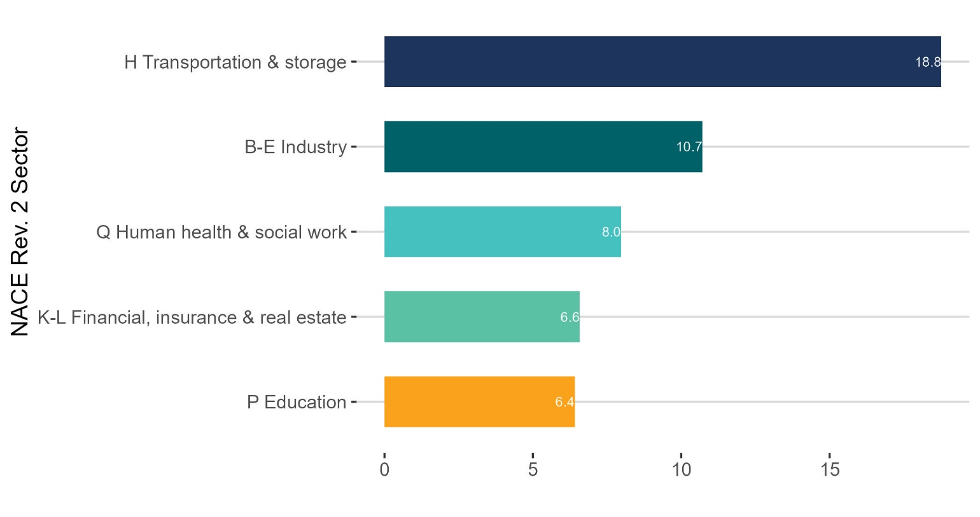
Transport & storage had the largest increase in employment (‘000)
thousands

Slide 13
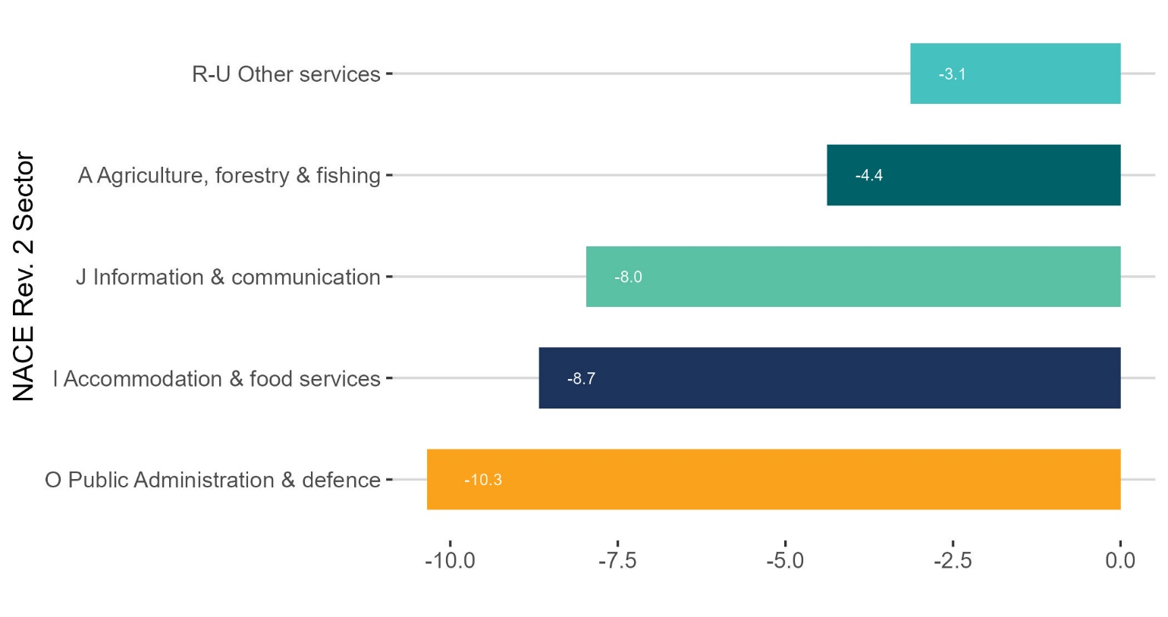
Public administration had the biggest drop in employment (‘000)
thousands

Slide 14
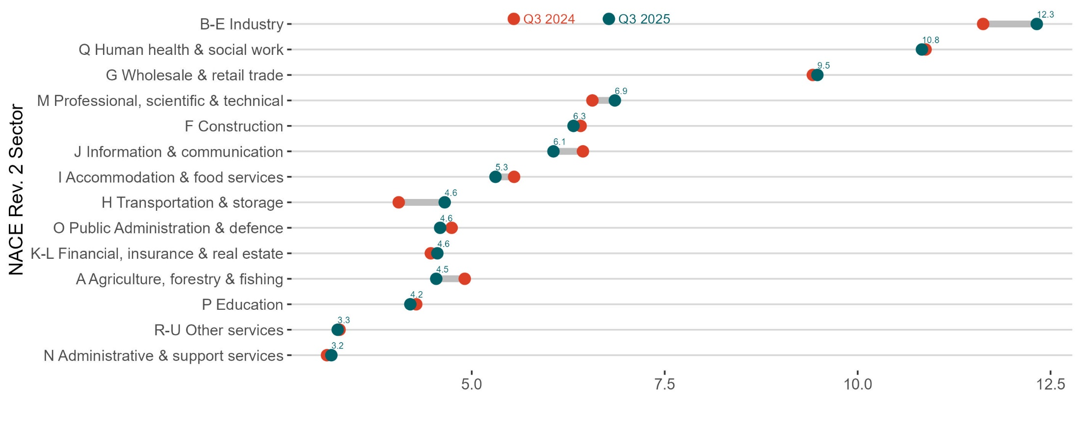
Most actual hours worked (millions) per week in Industry
(hours) millions

Slide 15
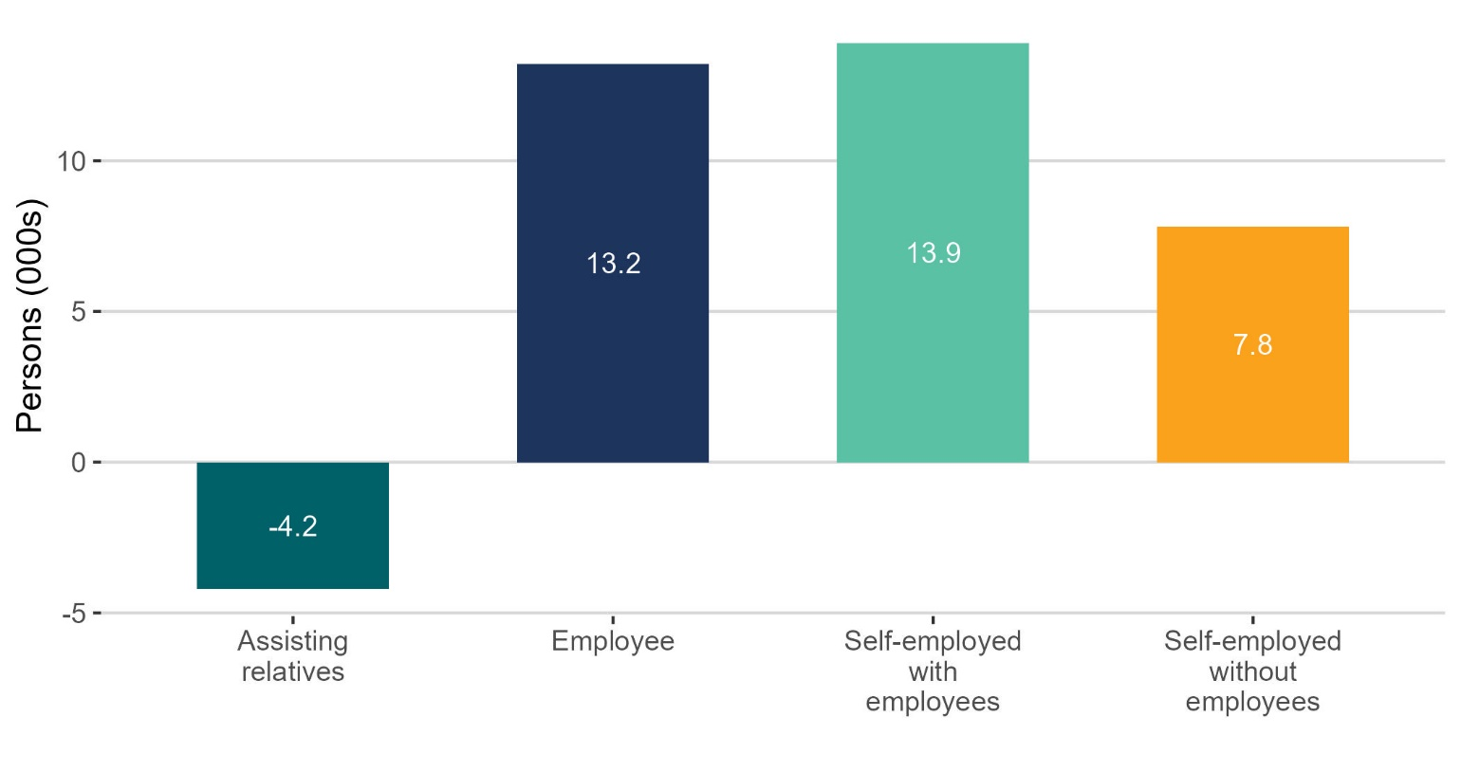
There were 21,700 more self-employed in the labour force
thousands

Slide 16
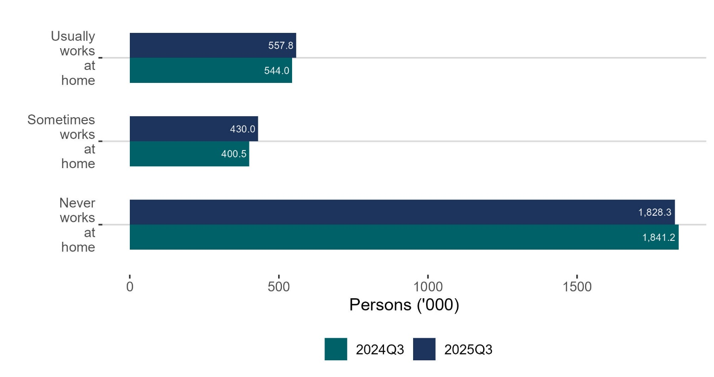
Remote working employment (‘000) increased while never works from home decreased
thousands

Slide 17
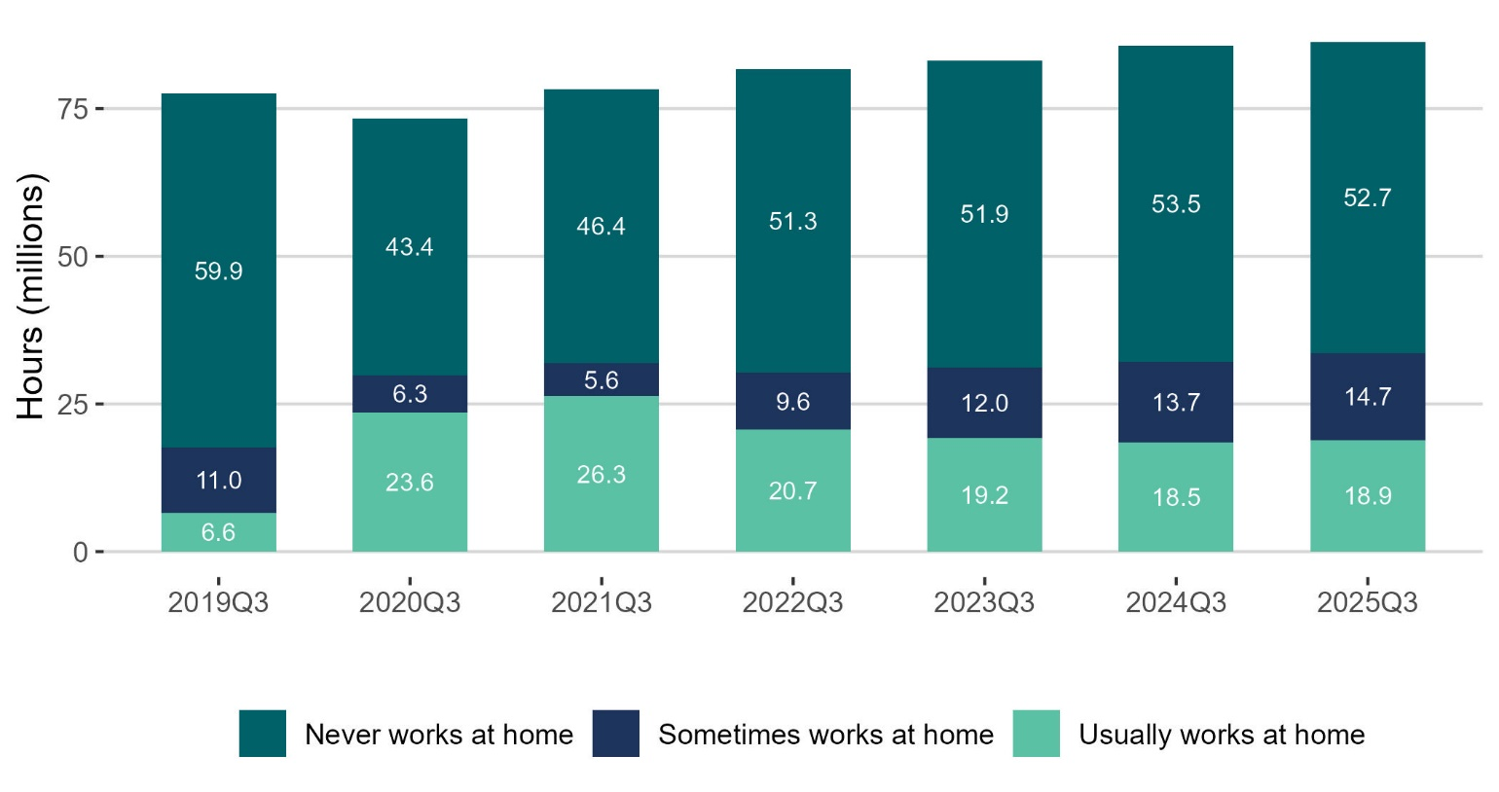
Actual hours worked (millions) per week increased for remote workers
Hours (millions)

Slide 18
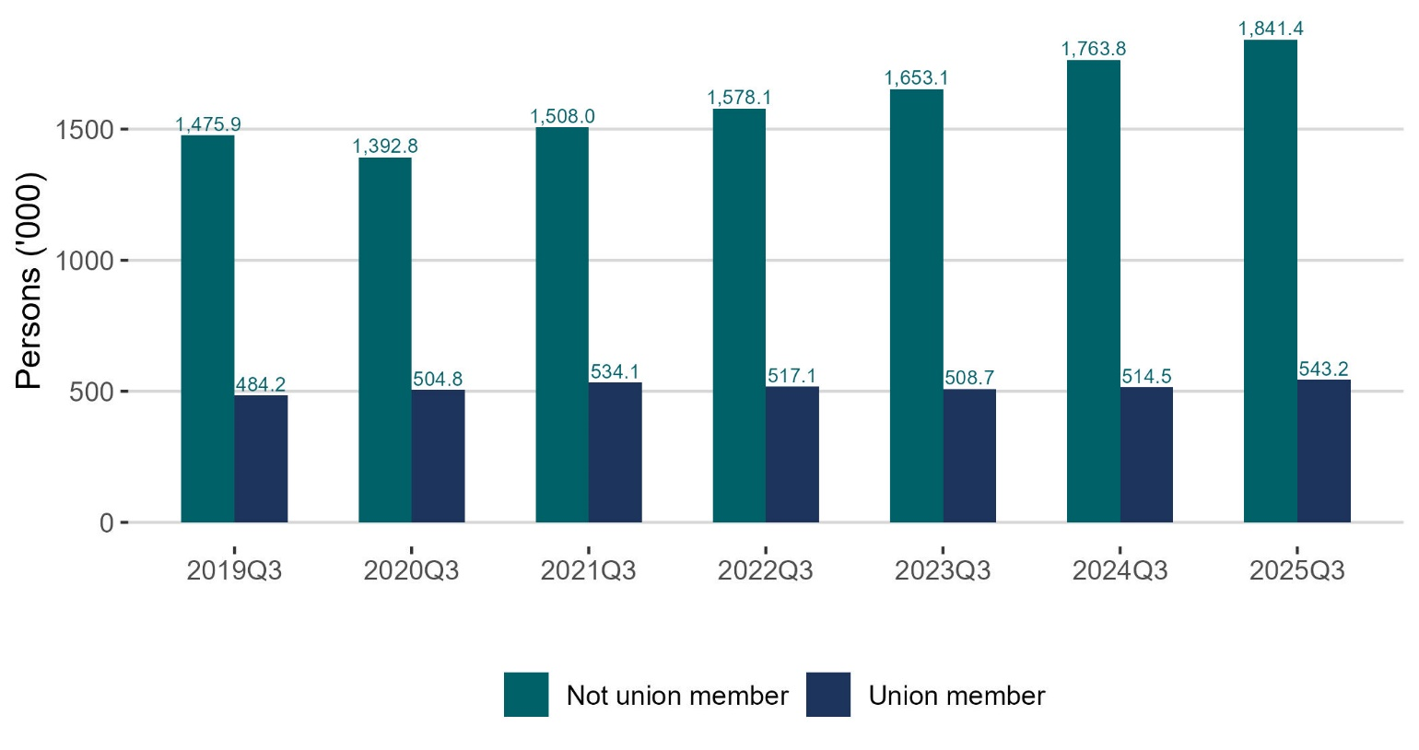
Non union members increasing more than union members
thousands

Slide 19
Unemployment Q3 2025: Persons unemployed: 155,400 +20.0% Unemployment rate (15-74): 5.3% +0.8 p.p Persons unemployed (SA): 147,100 +9.3% on Q2 2025 Seasonally adjusted rate: 5.0% +0.4 p.p on Q2 2025

Slide 20
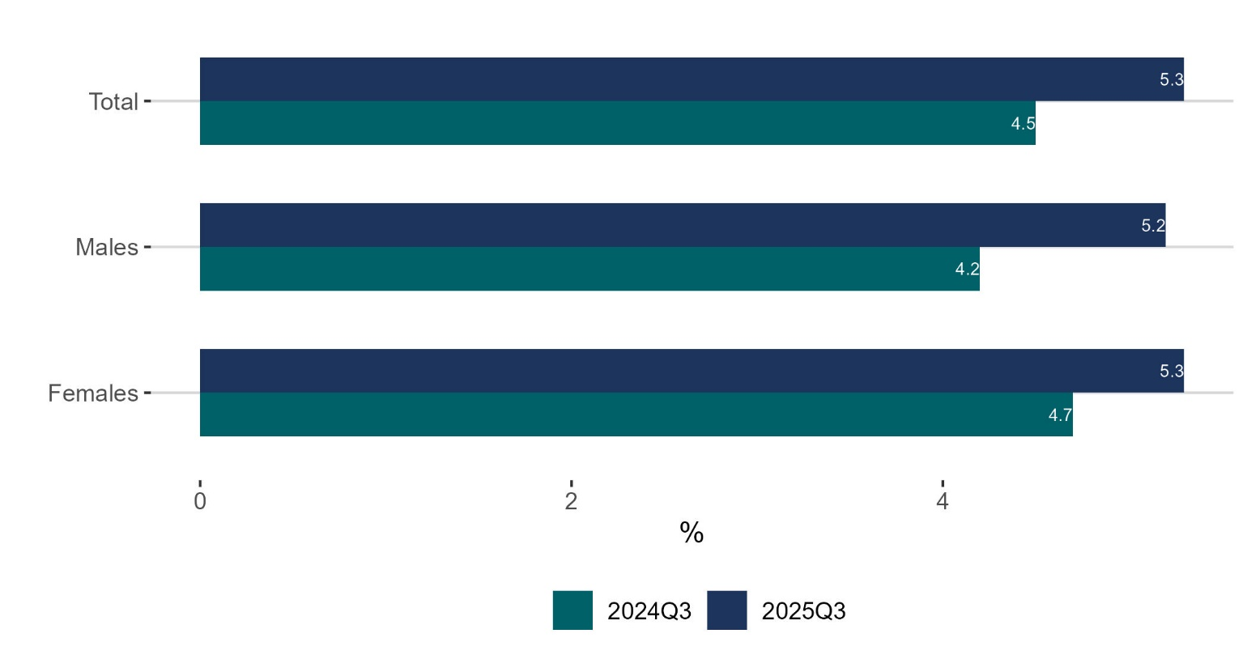
Unemployment rate (%) increased for males and females
%

Slide 21
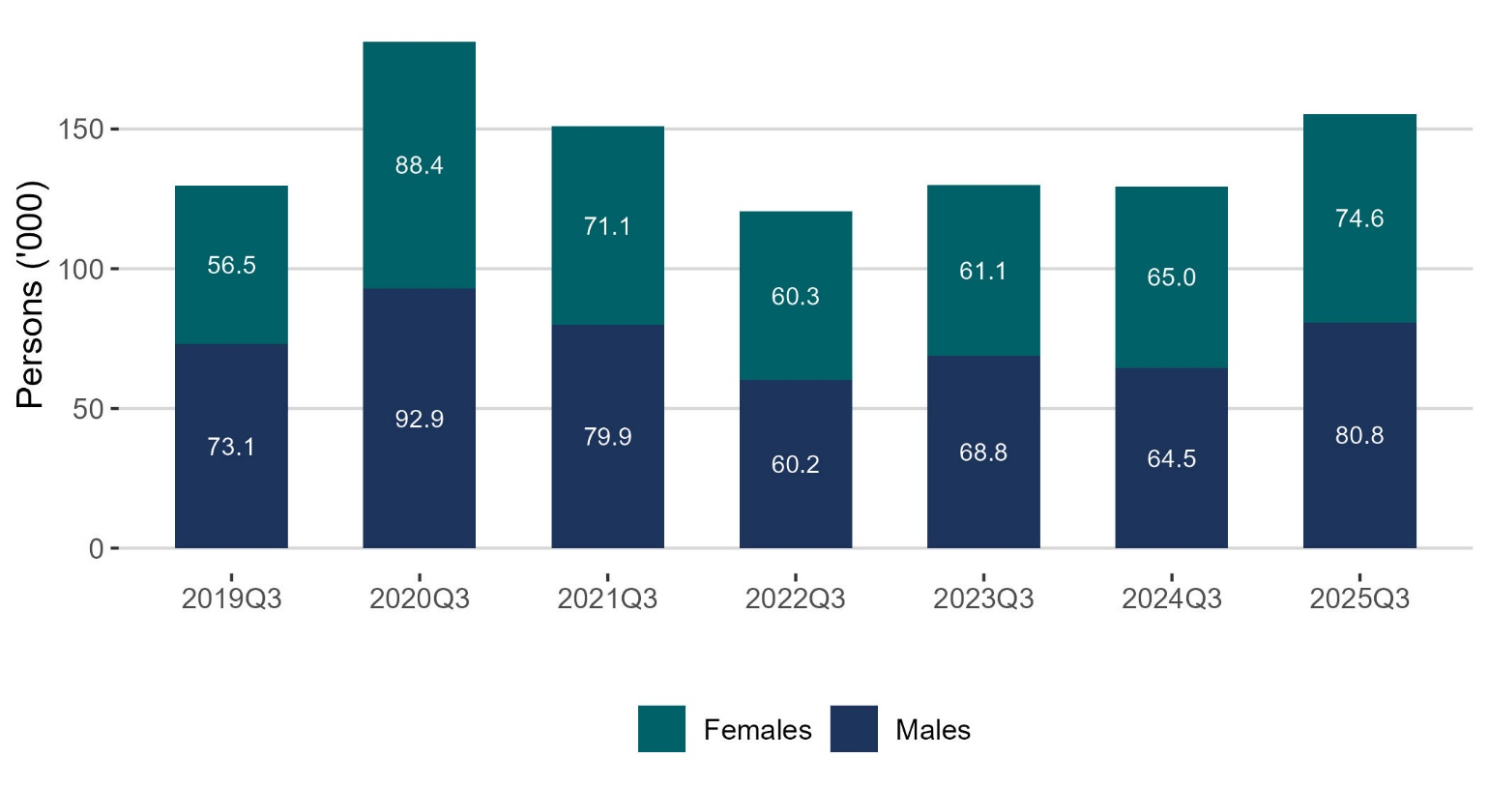
Unemployment (‘000) the highest since the pandemic
thousands

Slide 22
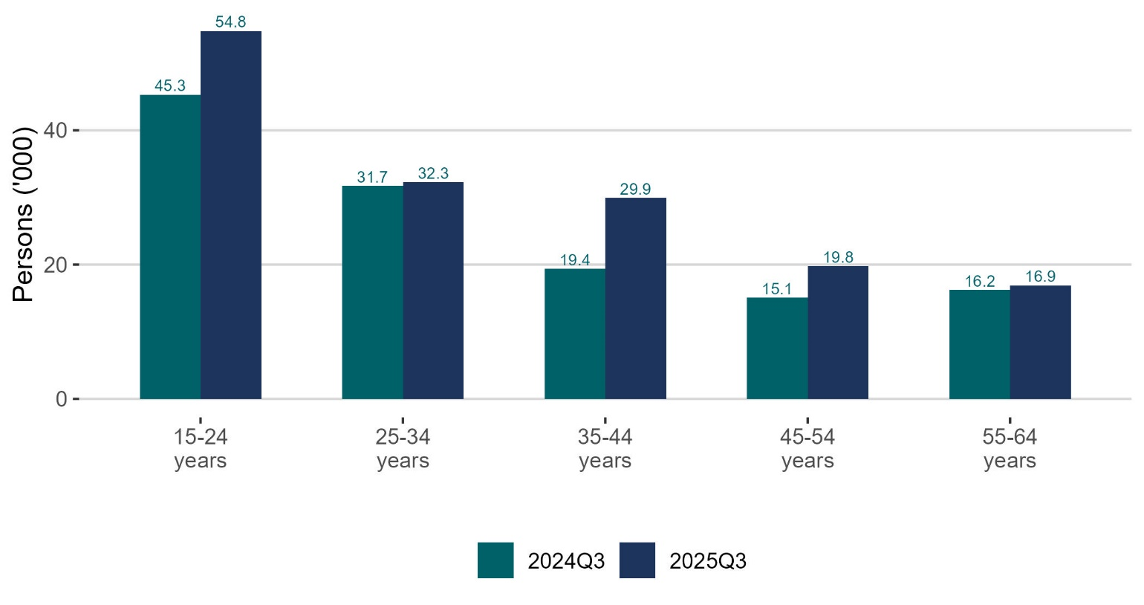
Unemployment (‘000) increased across all working age cohorts
thousands

Slide 23
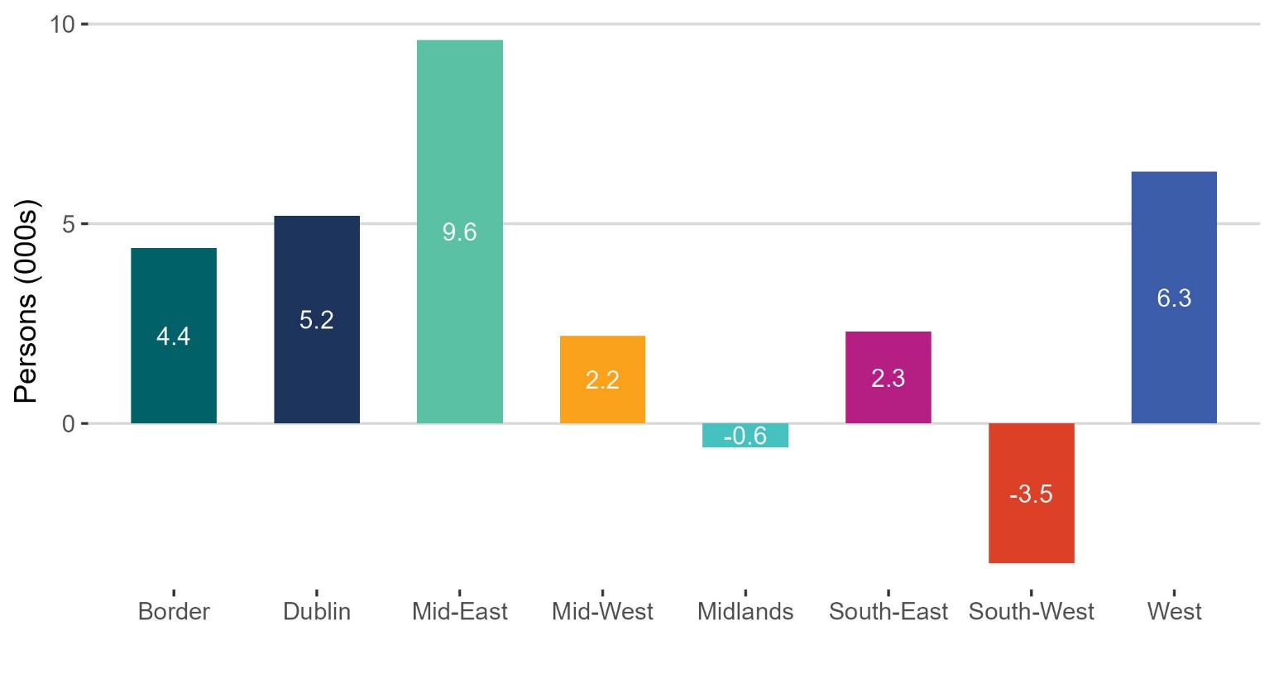
Unemployment (‘000) increased across most regions
Thousands

Slide 24
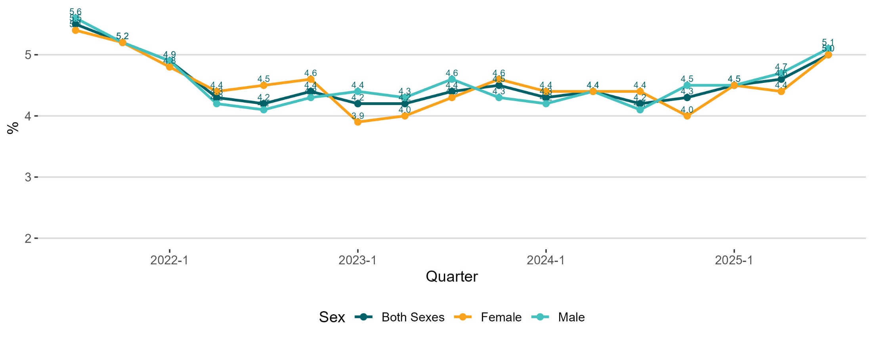
Unemployment rate(%) (seasonally adjusted), increased for males and females
%

Slide 25
Labour Force Q3 2025: Persons in labour force: 2,980,900 +1.9% Participation rate (15+): 66.5% -0.1 p.p. Seasonally adjusted participation rate: 66.1% unchanged from Q2 2025

Slide 26
Labour Force
Unadjusted
Increased by 56,500 (1.9%) over the year to 2,980,900 in Q3 2025
Demographic effect +52,300
Participation effect +4,300
Participation rate decreased by 0.1p.p. to 66.5%
Adjusted
Increase of 14,000 or 0.5% over the quarter to 2,963,200 in Q3 2025

Slide 27
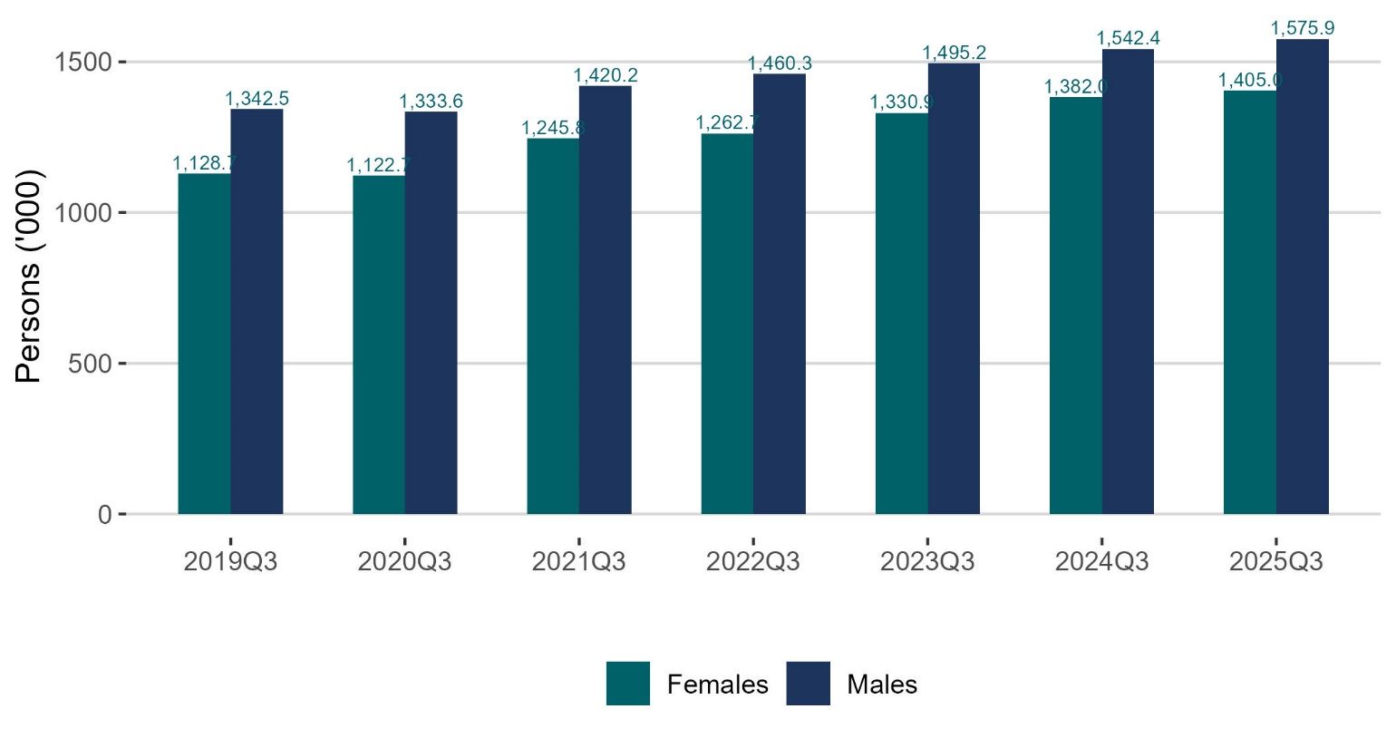
Labour force (‘000) at highest level for males and females
thousand

Slide 28

Labour force (‘000) increased across all age groups except youths
thousands

Slide 29
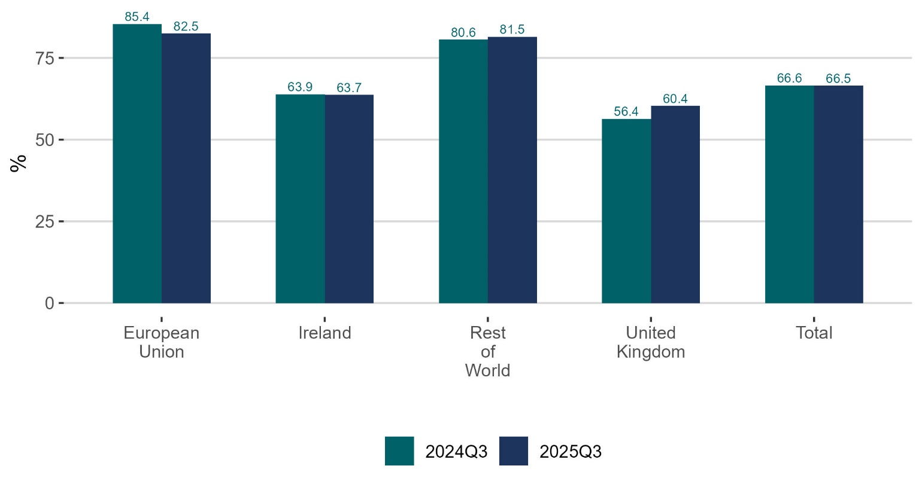
Participation rate (%) increased for Rest of the World cohort
%

Slide 30
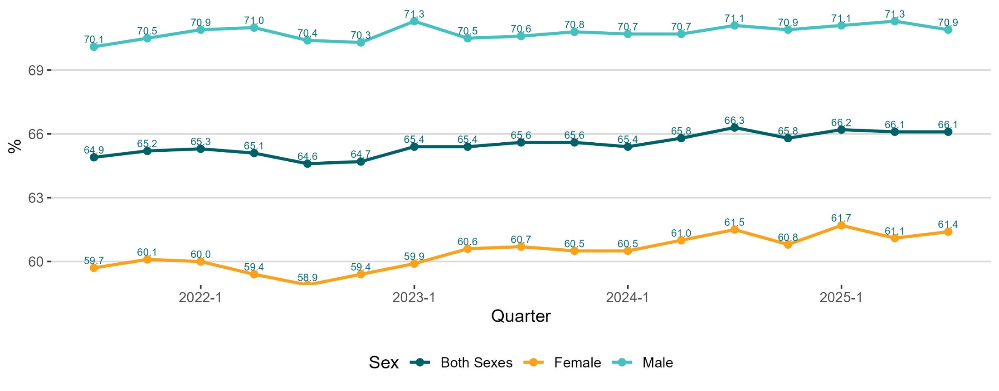
Participation rate (%) (seasonally adjusted), females increased; males decreased
%

Slide 31
Not in the labour force Q3 2025: Persons not in the labour force: 1,499,900 +2.4% Potential additional labour force: 119,200 -7.9%

Slide 32
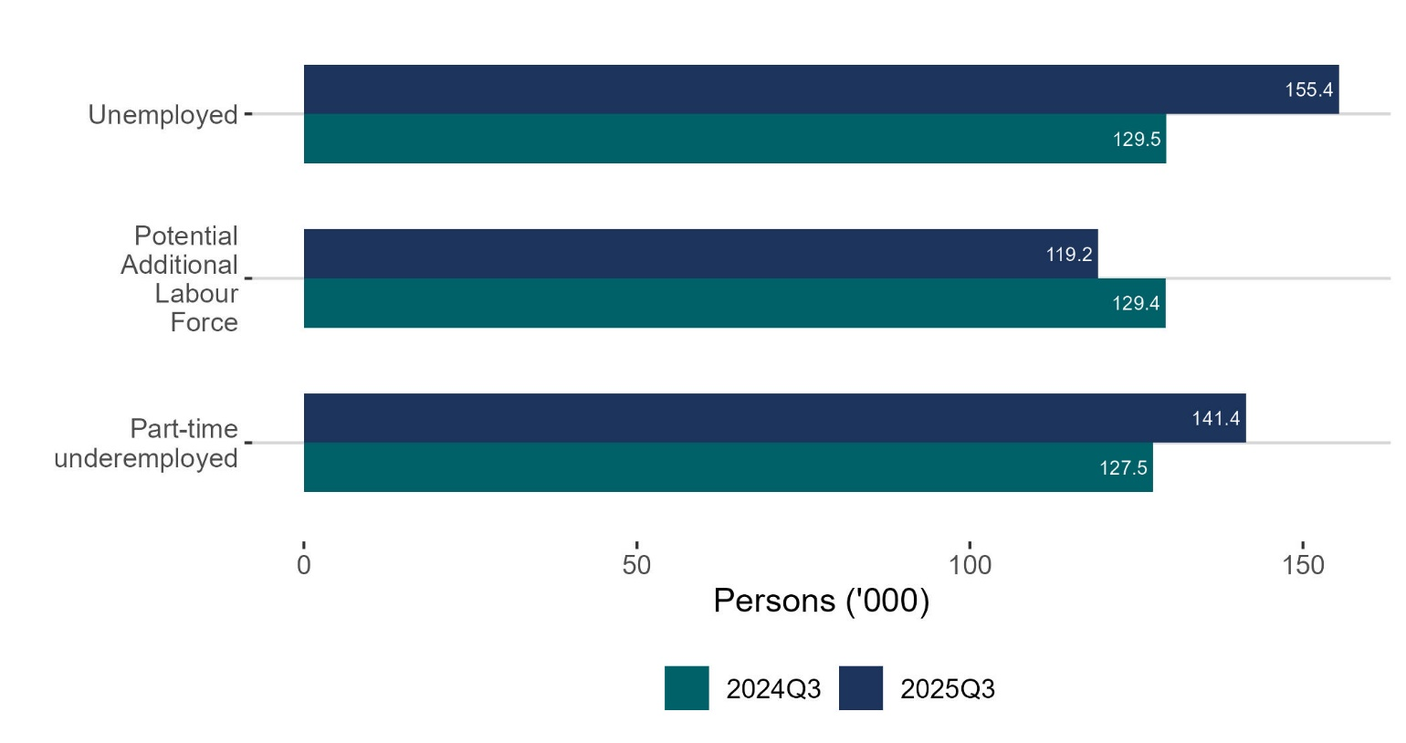
Part-time underemployed increased by 13,900
thousands

Slide 33
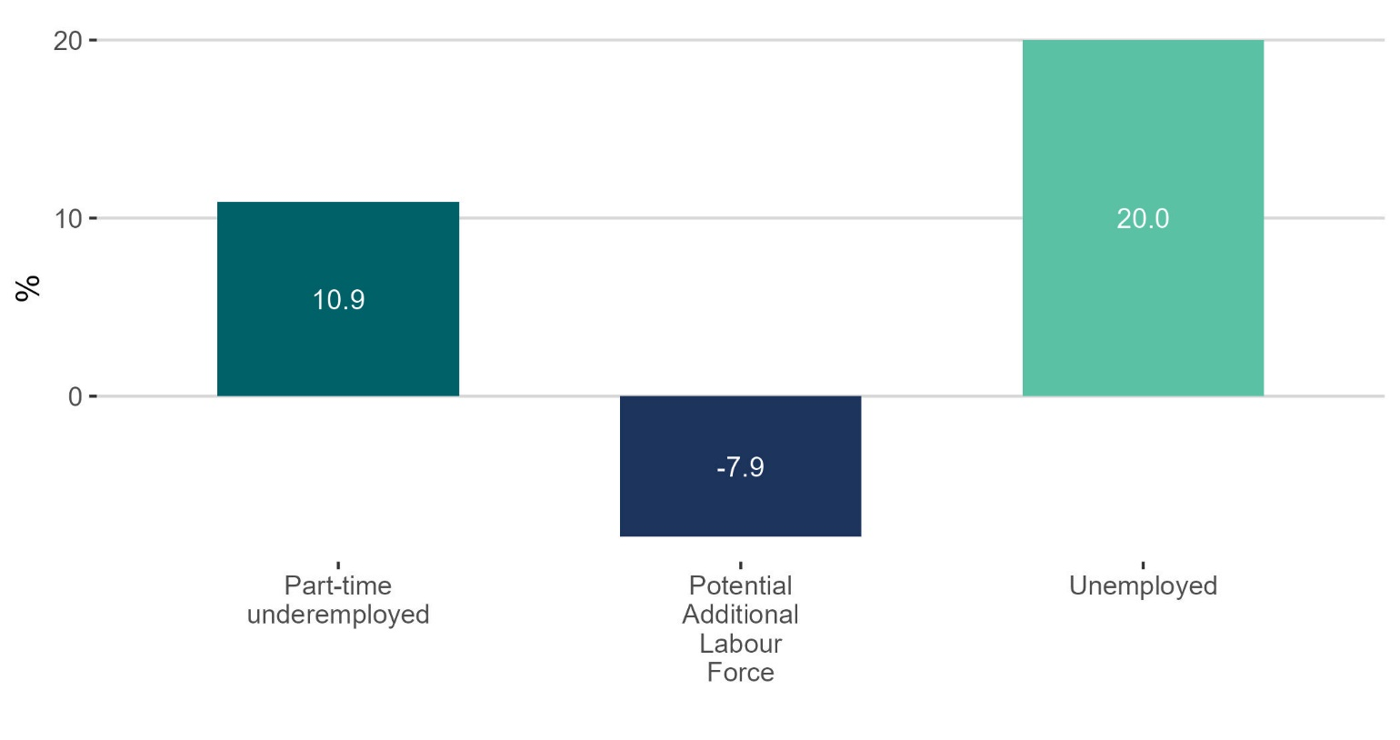
Part-time underemployed increased 10.9%
%

Slide 34
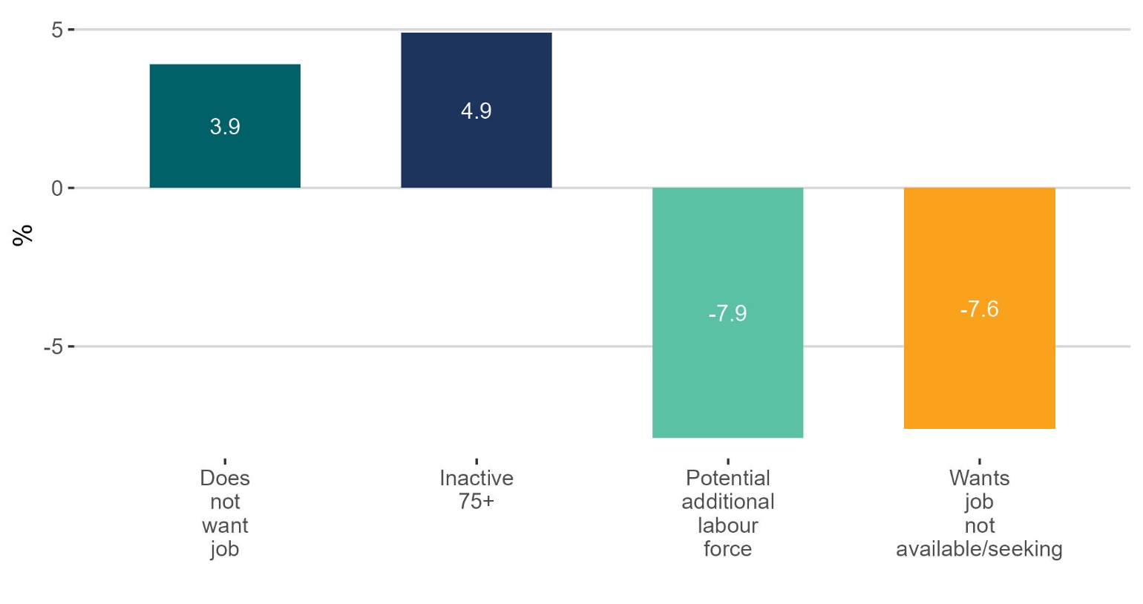
Does not want a job increased 3.9%
%

Slide 35
Young people (15-24) in the labour force Q3 2025:
Employment rate: 47.5% -3.4 p.p. Unemployment rate: 14.1% +2.7 p.p.
Participation rate: 55.3% -2.2 p.p. NEET rate 8.3% +1.5 p.p.

Slide 36
In summary…
EMPLOYMENT
Increased to a record 2,825,500
The 1.1% increase is the lowest since the pandemic
Employment rate has decreased to 74.7%
UNEMPLOYMENT
Increased 20% from 129,500 to 155,400
Unemployment rate 5.3%
Driven by young people and 35-44 year olds
LABOUR FORCE
Increased to 2,980,900
Participation down 0.1 p.p. to 66.5%

Slide 37
Labour Force Survey Quarter 3 2025 Thank you. LFS Q4 2025 results provisionally due for publication on 19th February 2026

Slide 38
Births 2001-2022
Notes:
Source: PxStat VSA16

Slide 39
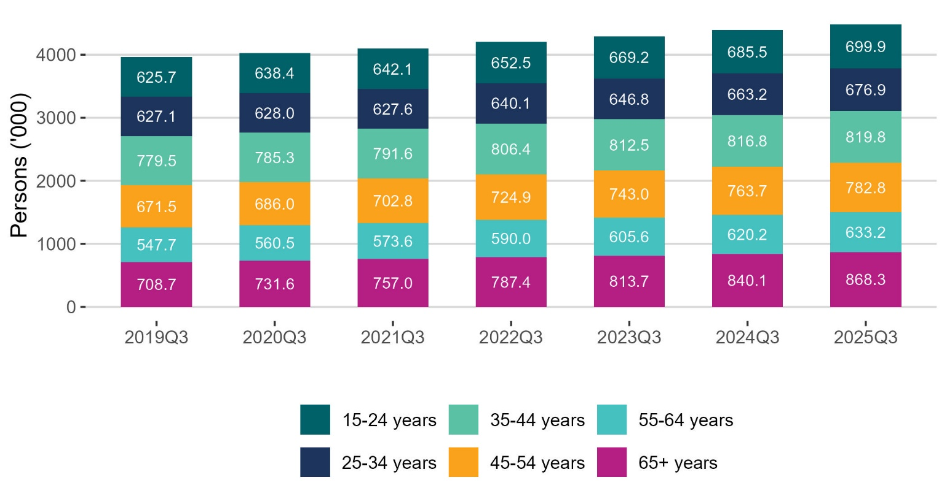
Population age groups

Slide 40
Annex: ILO Definitions and concepts IESS Regulation Impact of COVID-19 on LFS Arrivals from Ukraine in Ireland

Slide 41
ILO classification in the LFS
Employment (15-89 years)
Persons who worked in the week before the survey for one hour or more for payment or profit, including work on the family farm or business and all persons who were away from work during the reference week but had a job to which they could return to

Slide 42
ILO classification in the LFS
Unemployment (15-74 years)
Persons who in the week before the survey, were
without work – i.e. did not meet criteria to be classified as employed under ILO
available to start work within the next two weeks
had taken specific steps, in the previous four weeks to find work

Slide 43
ILO classification and LFS
Inactive (15+ years)
All other persons

Slide 44
Integration of European Social Statistics (IESS) Regulation
New European regulation came into force on 01 January 2021
Implications for Irish Labour Market Statistics :
https://www.cso.ie/en/releasesandpublications/in/lfs/implicationsoftheimplementationoftheintegrationofeuropeansocialstatisticsiessframeworkregulationonlabourmarketstatisticsinirelandin2021/
Impact of the regulation on the LFS series:
https://www.cso.ie/en/releasesandpublications/ep/p-lfs/labourforcesurveyquarter12021/technicalnote/
The LFS questionnaires for Ireland up to Q1 2023 are available here: https://www.cso.ie/en/methods/surveyforms/labourforcesurvey/

Slide 45
Arrivals from Ukraine in Ireland
https://www.cso.ie/en/statistics/population/arrivalsfromukraineinireland/
As of the week ending 3rd June 2025 there had been 113,917 Beneficiaries of Temporary Protection from Ukraine in Ireland.
Of these arrivals from Ukraine, 70% had activity in administrative data after 31 March 2025, based on data currently available to the Central Statistics Office (CSO).
Women and men aged 20 year and over made up 46% and 26% of arrivals respectively, while 29% were people aged under 20 years.
https://www.cso.ie/en/releasesandpublications/fp/p-aui/arrivalsfromukraineinirelandseries16/
Live Register figures for July 2025: 12,278 persons from Ukraine benefitting from Temporary Protection Directive:
https://www.cso.ie/en/releasesandpublications/ep/p-lr/liveregisterjuly2025/

