Slide 1
Labour Force Survey
Quarter 2, 2026
20th August 2026

Slide 2
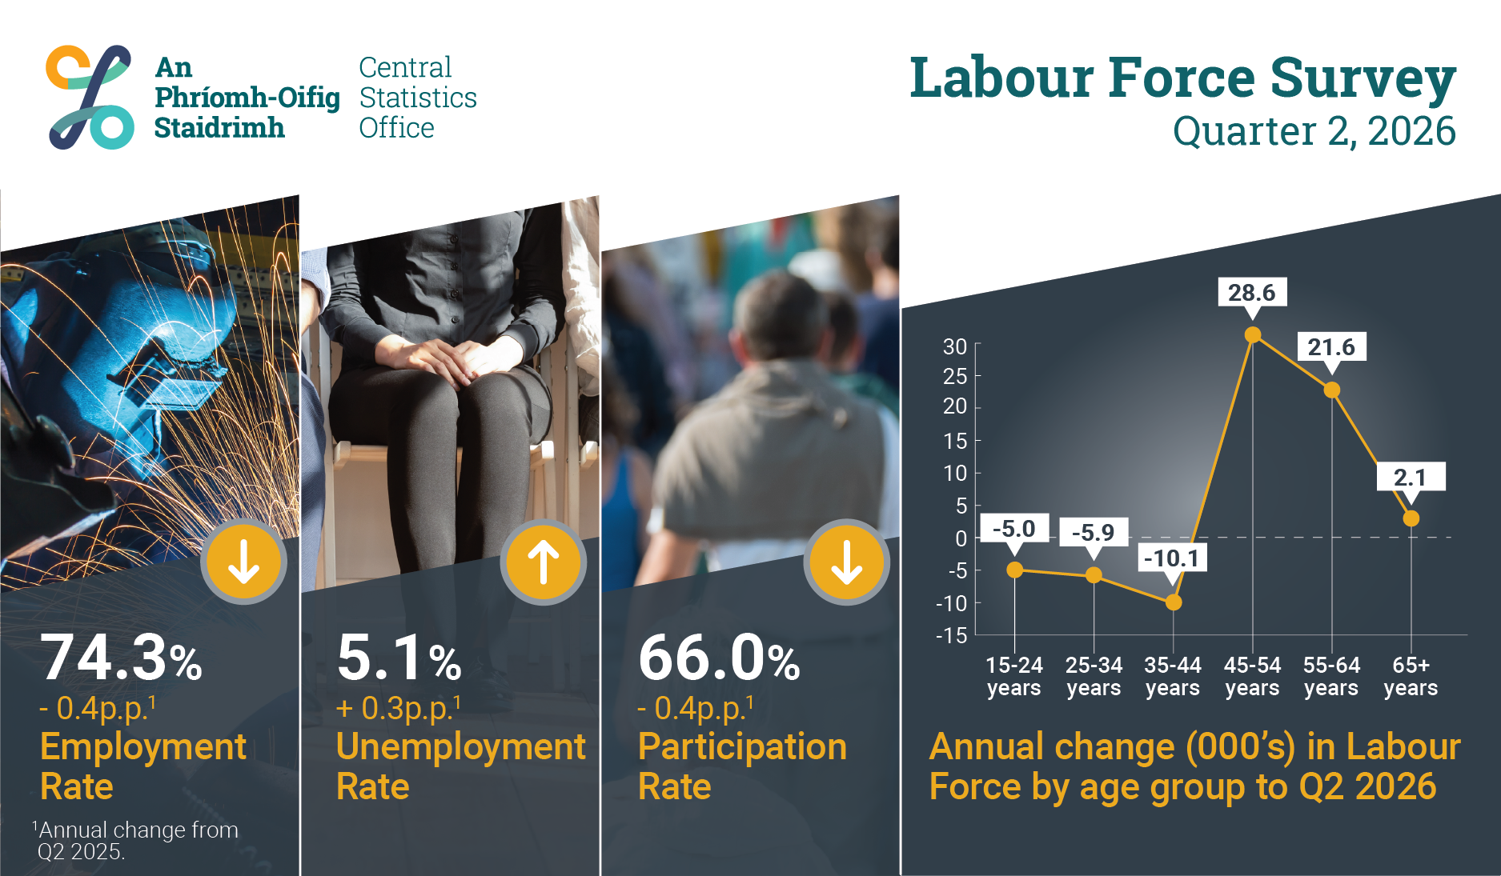

Slide 3
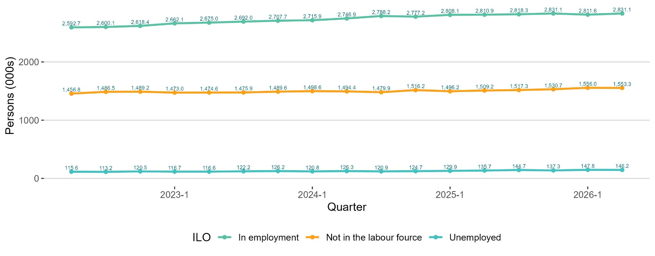
Seasonally adjusted ILO status (thousands) trend
Employment
▲ 19,500 (0.7%) from last quarter Q1 2026.
▲ 238,400 (9.2%) in last four years.
Not in the Labour force
▼ 2,700 (-0.2%) from last quarter Q1 2026.
▲ 96,500 (6.6%) in last four years.
Unemployment
▼ 1,600 (-1.1%) from last quarter Q1 2026.
Seasonally adjusted unemployment rate: 4.9%.
thousands

Slide 4
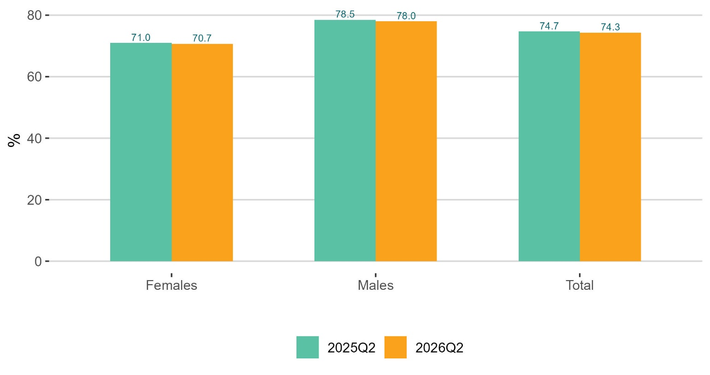
Employment
EMPLOYMENT
2,839,300
▲ 0.8% on year
Aged 15–89
HOURS WORKED
89.0 million
No change on year
Actual hours worked per week
Employment rate %
Aged 15-64

Slide 5
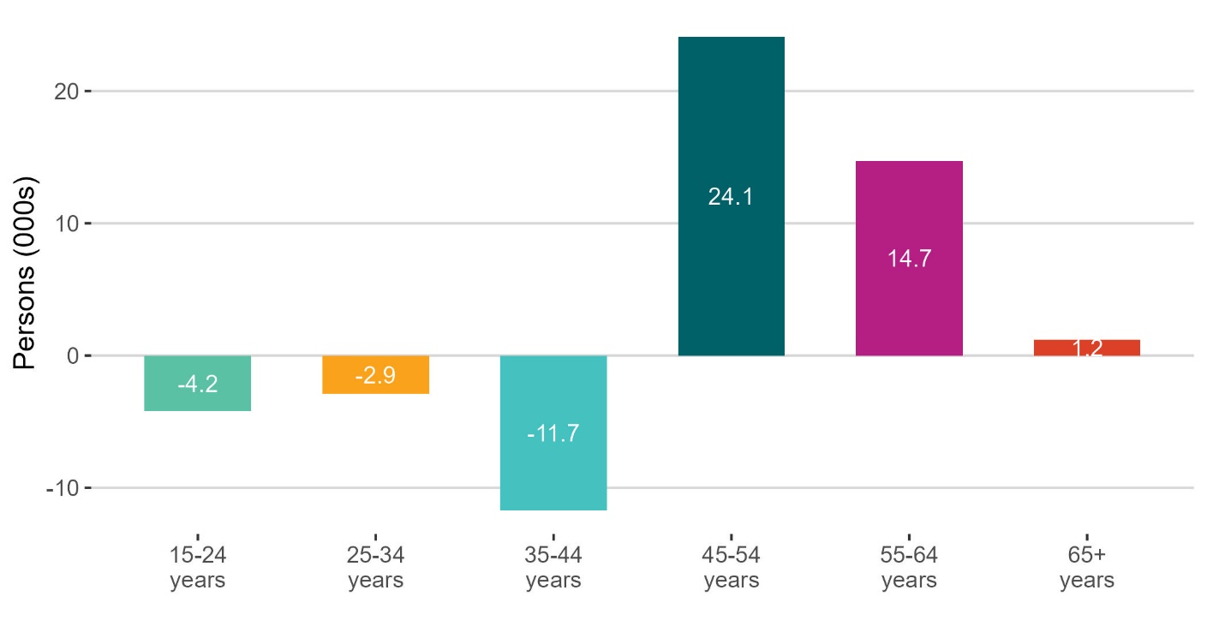
Fall in younger age cohorts in employment
Largest positive contribution
The 45-54 years age cohort increased by 3.5% to 686,100.
The 55–64-year-olds increased 3.4% to 449,600.
Largest decline
Among 35-44-year-olds, down 1.7% to 690,000.
Youth employment down 1.3% to 321,100.
What's driving the change?
Females 35-44 years down 13,700.
Those aged 20-24 years driving youth employment down.
thousands

Slide 6
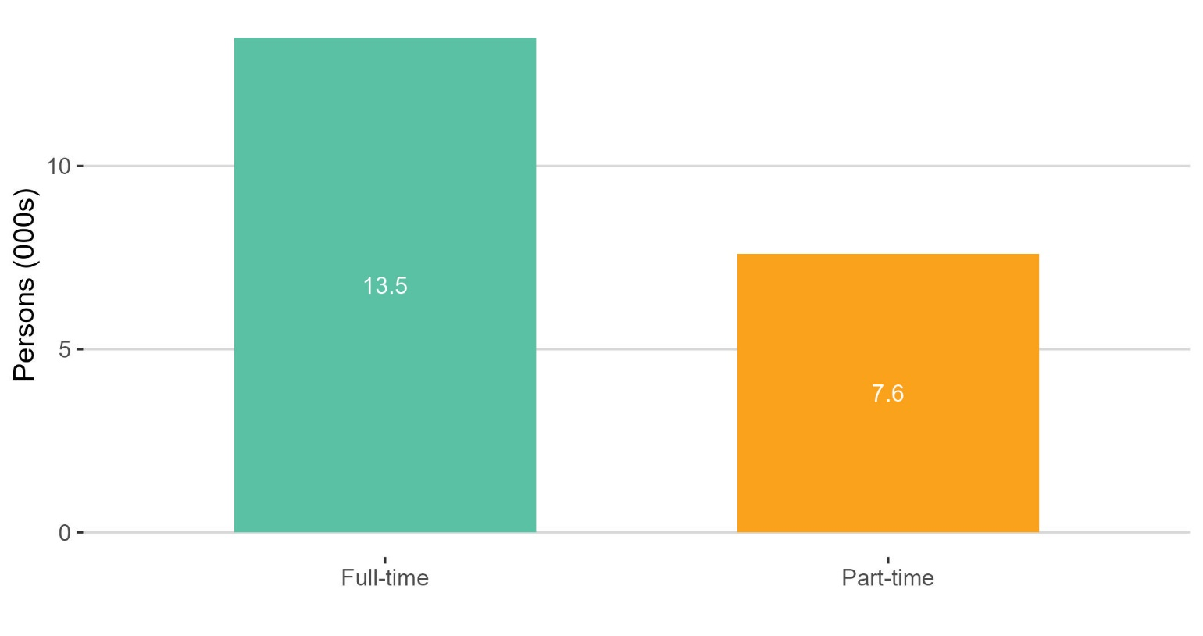
Increase in full-time & part-time employment
FULL-TIME EMPLOYMENT
2,249,600
▲ 0.6% on year
Aged 15–89
PART-TIME EMPLOYMENT
589,600
▲ 1.3% on quarter
Aged 15–89
thousands

Slide 7
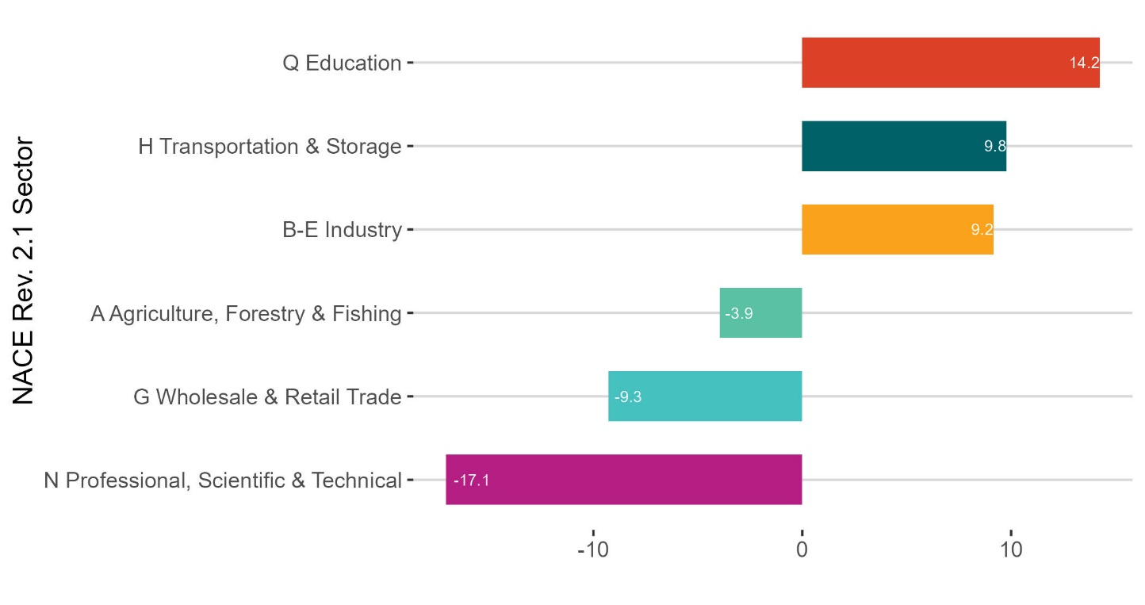
What was the change in employment (thousand) for NACE Rev. 2.1. sectors?
Largest positive contribution
Education, up 5.9% to 256,900.
Transports & Storage up 7.9% to 134,000.
Industry up 2.6% to 356,000
Largest decline
Professional, Scientific & Technical down 8.2% to 189,800.
Wholesale & Retail Trade down 3.1% to 289,800
Other notable sectors
Construction increased by 1,400 or 0.8%.
ICT declined by 2,700 or 1.5%.
thousands

Slide 8
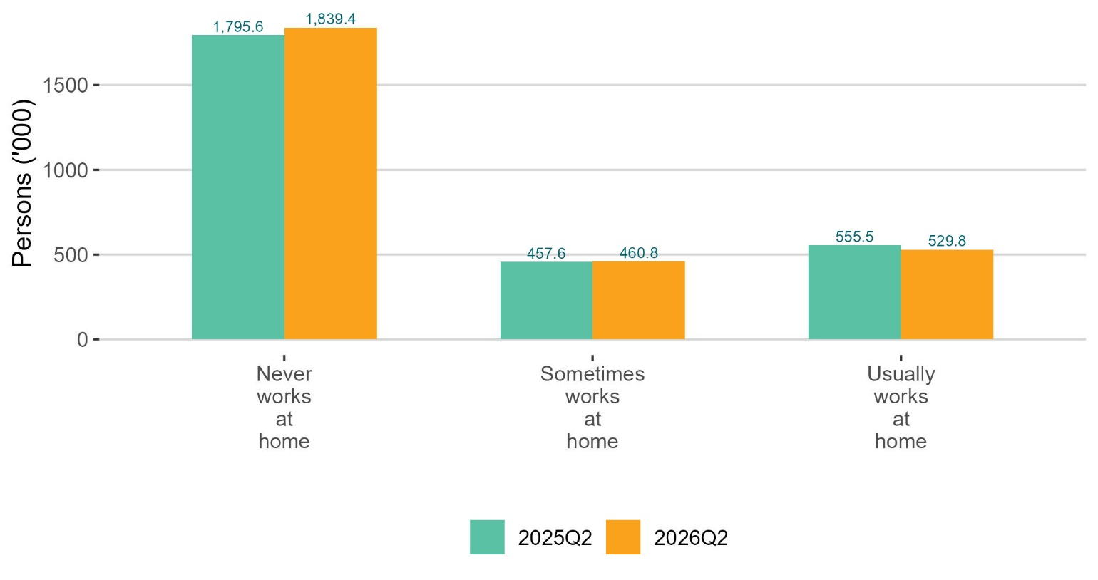
Decline in those that usually work from home
thousands

Slide 9
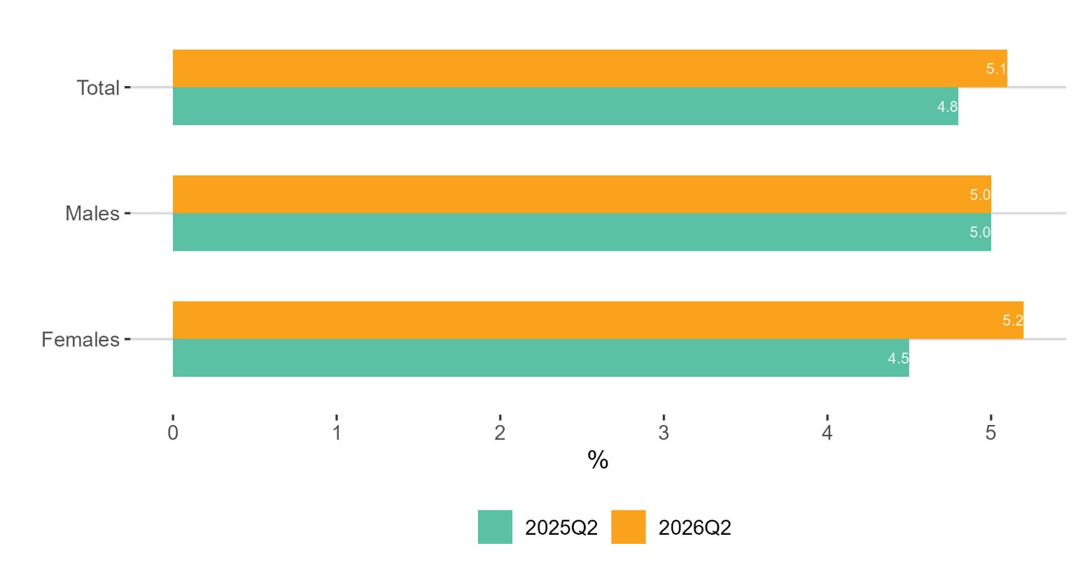
Unemployment
UNEMPLOYMENT
151,000
▲ 7.2% on year
Aged 15–74
UNEMPLOYMENT RATE
4.9%
▼ 0.1 pp on quarter
Seasonally adjusted
Unemployment rate %
Aged 15-74

Slide 10
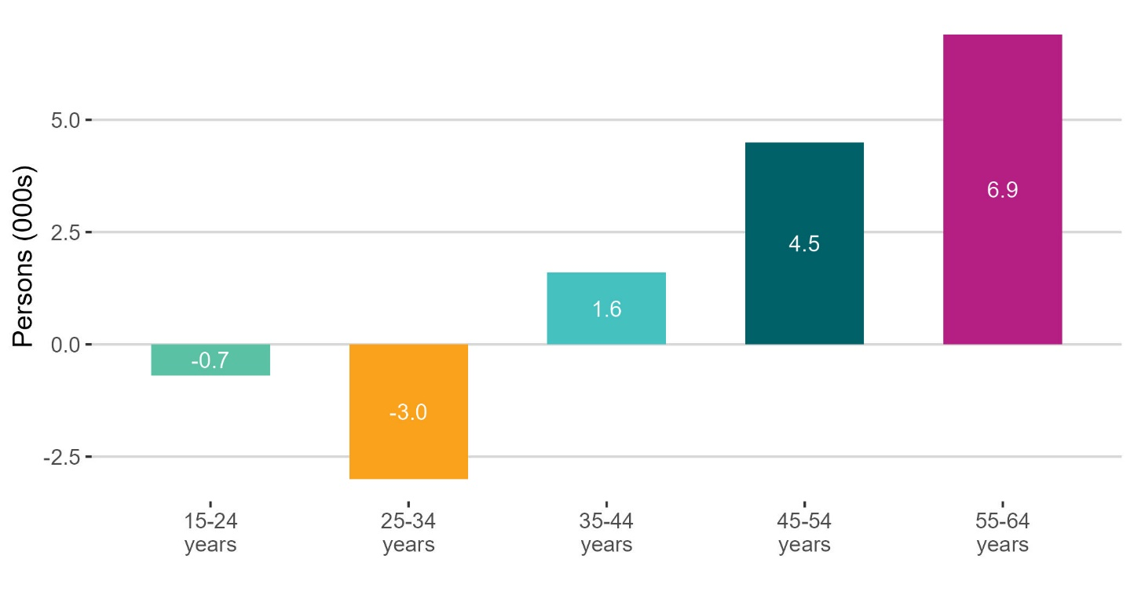
Fall in unemployment for younger age cohorts
Largest increase
The 55-64-year-olds increased 54.8% to 19,500.
45–54-year-olds increased 25.3% to 22,300.
Largest decline
Among 25-34-year-olds down 8.5% to 31,800.
Decline in youths due to 15–19-year-olds, down 1,700.
Impact on unemployment rate
Increase in unemployment rate of 0.3 pp to 5.1%.
Youth unemployment rate remained unchanged at 13.2%.
thousands

Slide 11
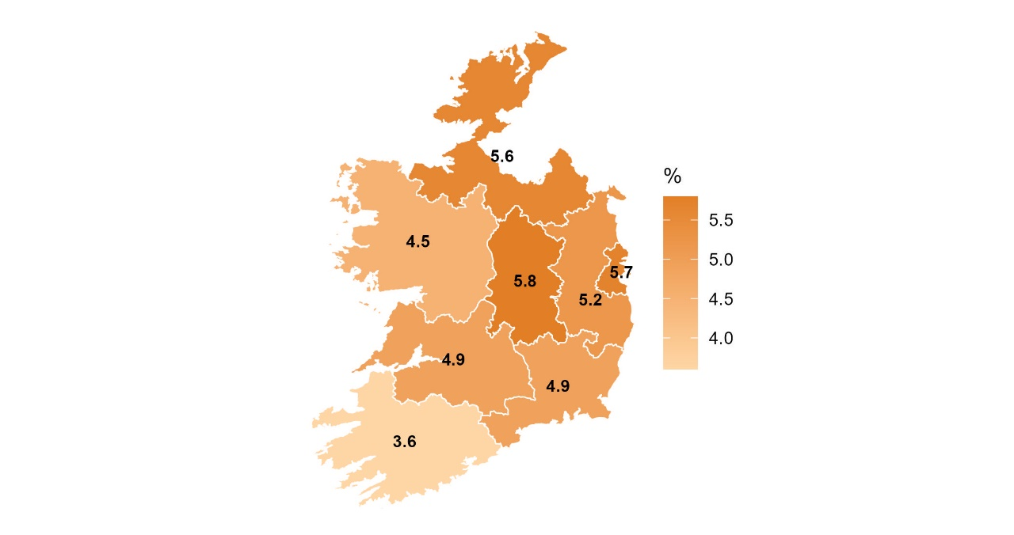
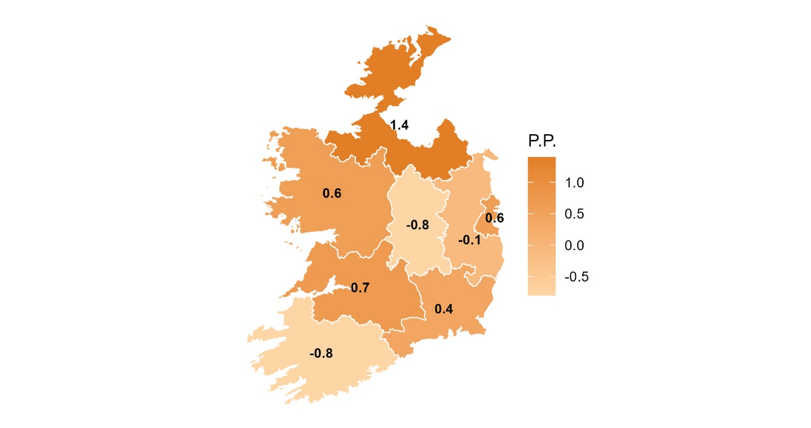
Unemployment rate increased in East and Border
Unemployment rate (%)
Change (pp) in unemployment rate
%
pp

Slide 12
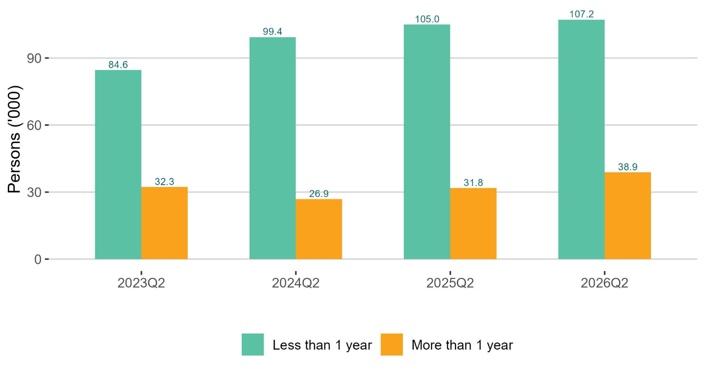
Long-term unemployment increased
LONG-TERM UNEMPLOYED
26.6%
▲ 3.4 pp on year
Unemployed 1 year or more
LONG-TERM UNEMPLOYMENT RATE
1.3%
▲ 0.2 pp on year
Aged 15–74
thousands

Slide 13
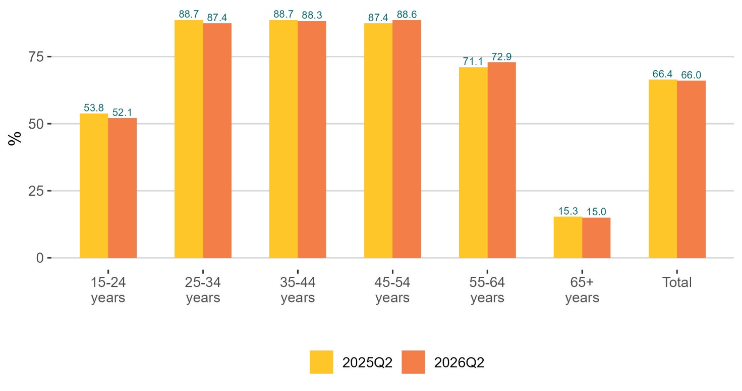
Labour force
LABOUR FORCE
2,990,200
▲ 1.1% on year
Aged 15 and over
PARTICIPATION RATE
65.7%
▲ 0.2 pp on quarter
Seasonally adjusted
Participation rate %
Aged 15 and over

Slide 14
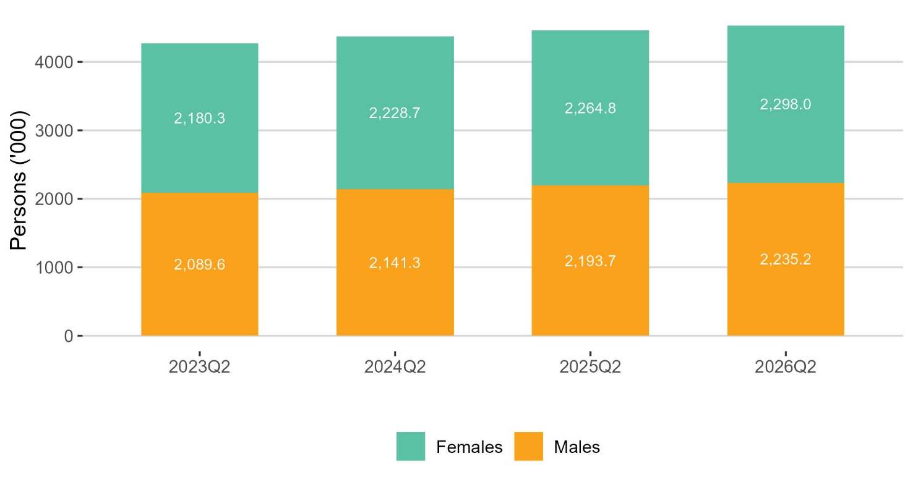
Change in the labour force
DEMOGRAPHIC EFFECT
+37,000
What the change in population would have contributed to the labour force if the participation rate had not changed
PARTICIPATION EFFECT
-5,700
What the change in participation rate would have contributed to the labour force if the population had not changed
thousands

Slide 15
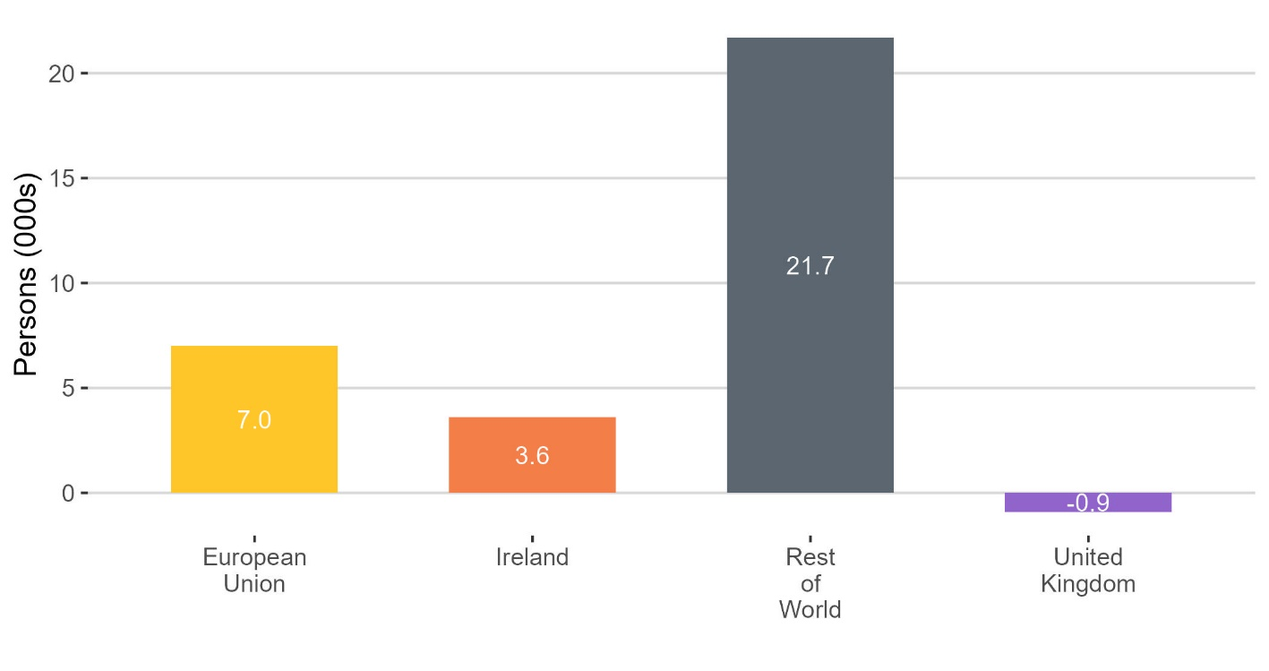
Change in labour force (thousands) by country of citizenship
Largest positive contribution
Rest of the World increased by 7.3% to 320,000 in the labour force.
EU citizens increased 2.5% to 282,500.
ROW labour force participation
Among those from the Rest of the World:
Employment increased 19,000.
Unemployment increased 2,700.
Irish citizens
Irish citizens increased 0.2% to 2,334,600 in the labour force.
Employment down 100.
Unemployment up 3,700.
.
thousands

Slide 16
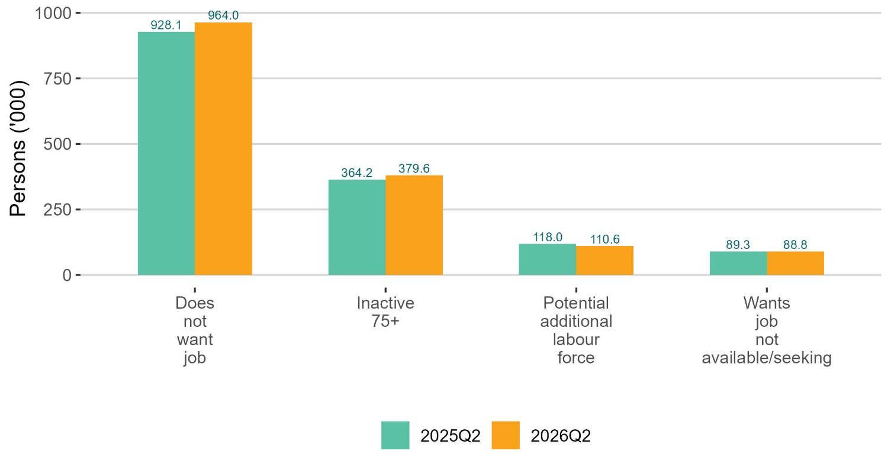
Outside the labour force
NOT IN THE LABOUR FORCE
1,543,000
▲ 2.9% on year
Aged 15 and over
NEET RATE
6.5%
▲ 0.6 pp on year
Aged 15–24
thousands

Slide 17
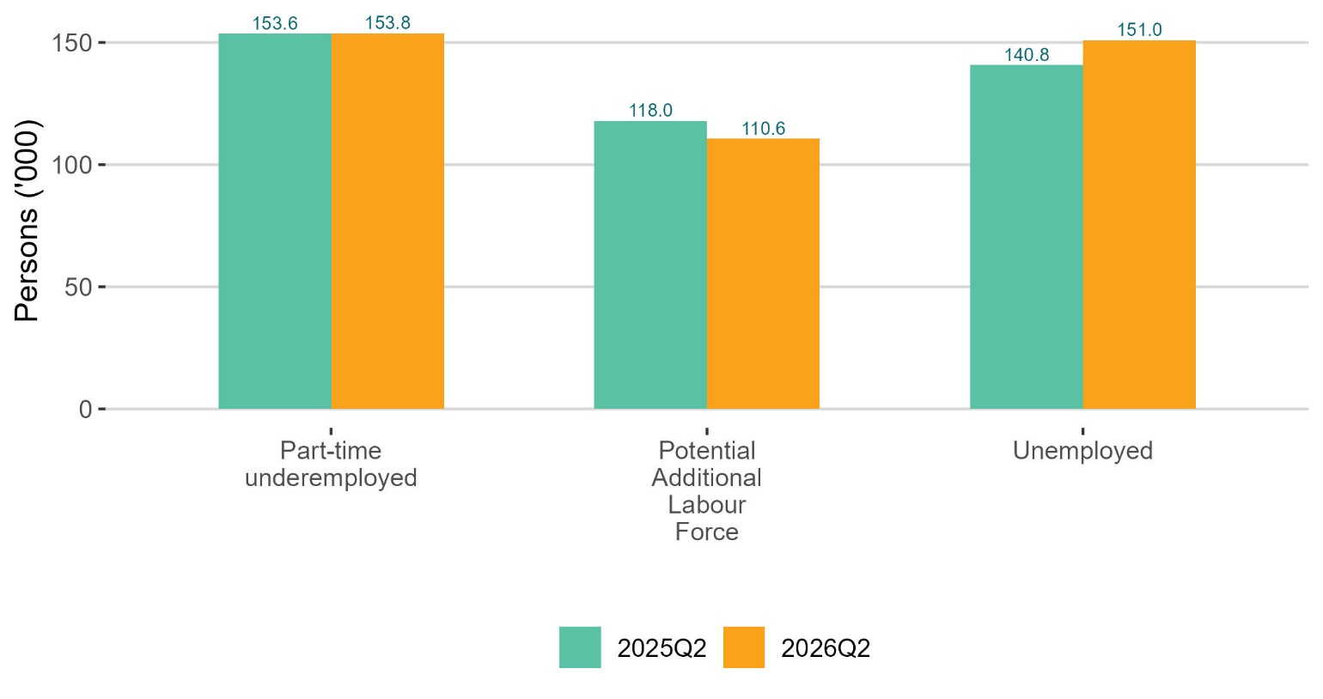
Labour market slack
LABOUR MARKET SLACK
415,400
▲ 0.7% on year
Aged 15 and over
POTENTIAL ADDITIONAL LABOUR FORCE
110,600
▼ 6.3% on year
Aged 15 and over
thousands

Slide 18
In summary
EMPLOYMENT RATE
UNEMPLOYMENT RATE
PARTICIPATION RATE
74.3%
5.1%
66.0%
▼ 0.4 pp on year
▲ 0.3 pp on year
▼ 0.4 pp on year
Aged 15–64
Aged 15-74
Aged 15 and over
KEY FINDINGS
Employment increased 0.8% to more than 2.8 million, driven by an increase in older age cohorts and citizens from the Rest of the World.
The employment rate has declined by 0.4 pp to 74.3%.
Those unemployed increased 7.2% to 151,000, driven by rise in female unemployment.
Despite increase of 1.1% in the labour force participation rate declined as those not in the labour force increase 2.9%.

Slide 19
Labour Force Survey
Quarter 2 2026
Thank you.
LFS Q3 2026 results provisionally due for publication in 19 November 2026

Slide 20
Annex:
Quality Indicators
ILO Definitions and concepts
IESS Regulation
Arrivals from Ukraine in Ireland
Additional charts

Slide 21
Quality Indicators
Reference period | Q2 2025 | Q3 2025 | Q4 2025 | Q1 2026 | Q2 2026
Houses in final data | 13,242 | 13,149 | 12,911 | 12,518 | 13,389
Response rate | 44.0 | 43.6 | 42.9 | 41.7 | 44.5
Refusals | 16.8 | 17.2 | 17.3 | 17.1 | 19.4
Non-contacts | 33.1 | 36.6 | 32.7 | 28.9 | 26.7
Average grossing factor assigned | 173.7 | 178.6 | 180.4 | 186.9 | 175.8
Standard Error - Employment | 15,600 | 15,600 | 16,400 | 17,900 | 16,400
Standard Error - Unemployment | 6,300 | 7,500 | 6,800 | 7,500 | 6,400

Slide 22
ILO classification in the LFS
Employment (15-89 years)
  Persons who worked in the week before the survey for one hour or more for payment or profit, including work on the family farm or business and all persons who were away from work during the reference week but had a job to which they could return to

Slide 23
ILO classification in the LFS
Unemployment (15-74 years)
  Persons who in the week before the survey, were
    without work – i.e. did not meet criteria to be classified as employed under ILO
    available to start work within the next two weeks
    had taken specific steps, in the previous four weeks to find work

Slide 24
ILO classification and LFS
Inactive (15+ years)
  All other persons

Slide 25
Integration of European Social Statistics (IESS) Regulation
New European regulation came into force on 01 January 2021
Implications for Irish Labour Market Statistics :
  https://www.cso.ie/en/releasesandpublications/in/lfs/implicationsoftheimplementationoftheintegrationofeuropeansocialstatisticsiessframeworkregulationonlabourmarketstatisticsinirelandin2021/
Impact of the regulation on the LFS series:
  https://www.cso.ie/en/releasesandpublications/ep/p-lfs/labourforcesurveyquarter12021/technicalnote/
The LFS questionnaires for Ireland up to Q4 2024 are available here: https://www.cso.ie/en/methods/surveyforms/labourforcesurvey/

Slide 26
Arrivals from Ukraine in Ireland
https://www.cso.ie/en/statistics/population/arrivalsfromukraineinireland/
As of the 23rd June 2026 there had been 122,636 Beneficiaries of Temporary Protection from Ukraine in Ireland.
Of these arrivals from Ukraine, 69% had activity in administrative data after 31 March 2026, based on data currently available to the Central Statistics Office (CSO).
Women and men aged 20 year and over made up 45% and 29% of arrivals respectively, while 26% were people aged under 20 years.
https://www.cso.ie/en/releasesandpublications/fp/p-aui/arrivalsfromukraineinirelandseries19/
Live Register figures for July 2026: 11,488 persons benefitting from Temporary Protection Directive:
https://www.cso.ie/en/releasesandpublications/ep/p-lr/liveregisterjuly2026/

Slide 27
In employment
Q2 2026:
Persons in employment: 2,839,300 +0.8%
Employment rate (15-64): 74.3% -0.4 p.p.
Seasonally adjusted: 2,831,100 +0.7% on Q1 2026

Slide 28
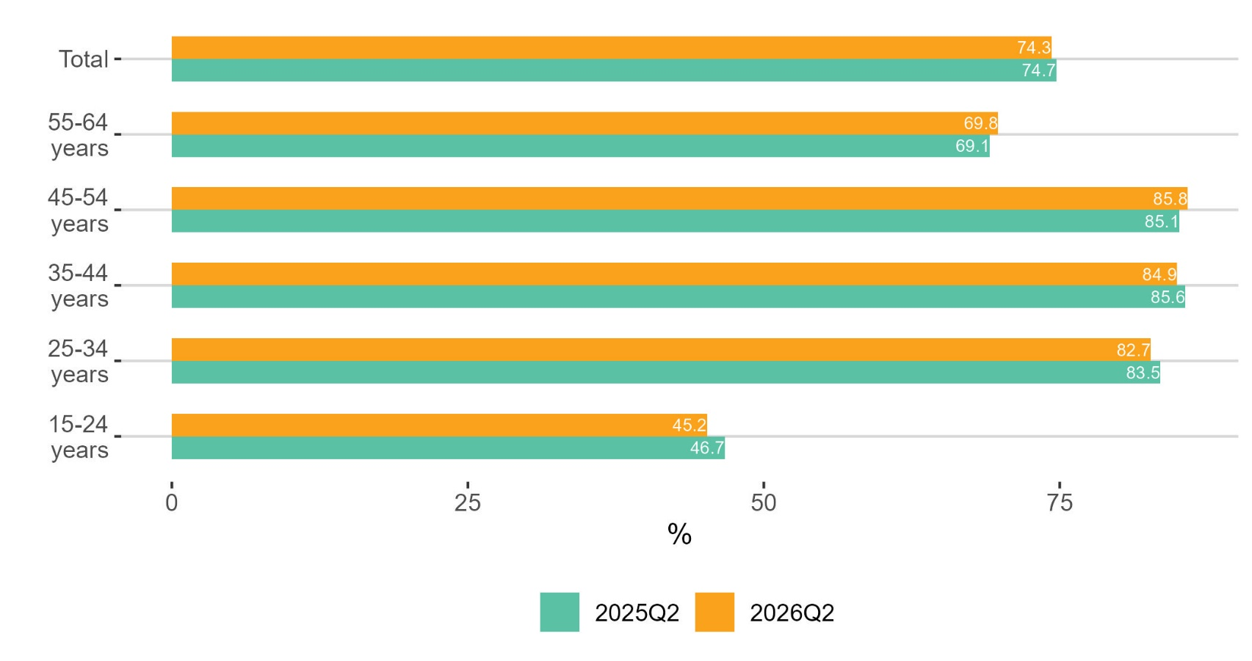
Employment rate declined for younger age groups
%

Slide 29
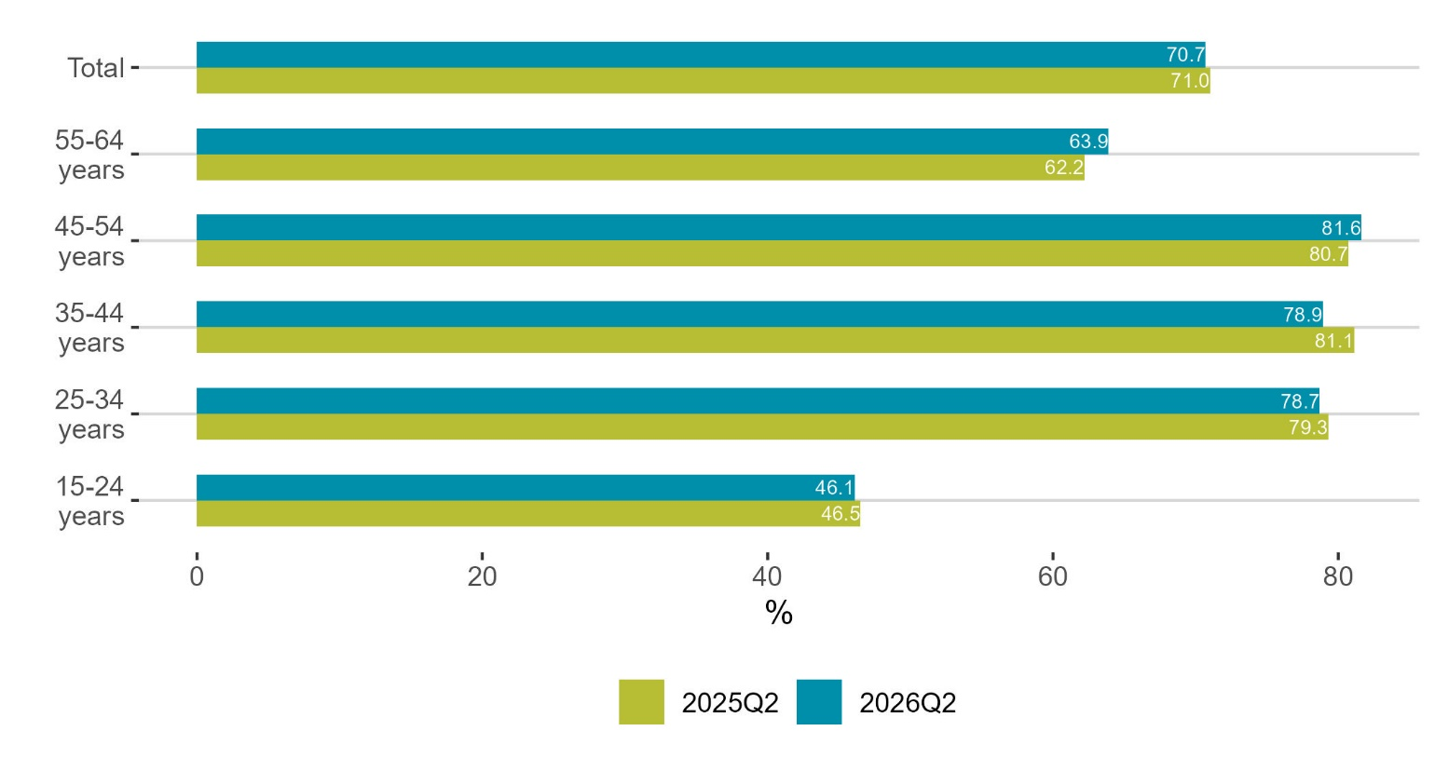
Employment rate declined for female younger age groups
%

Slide 30
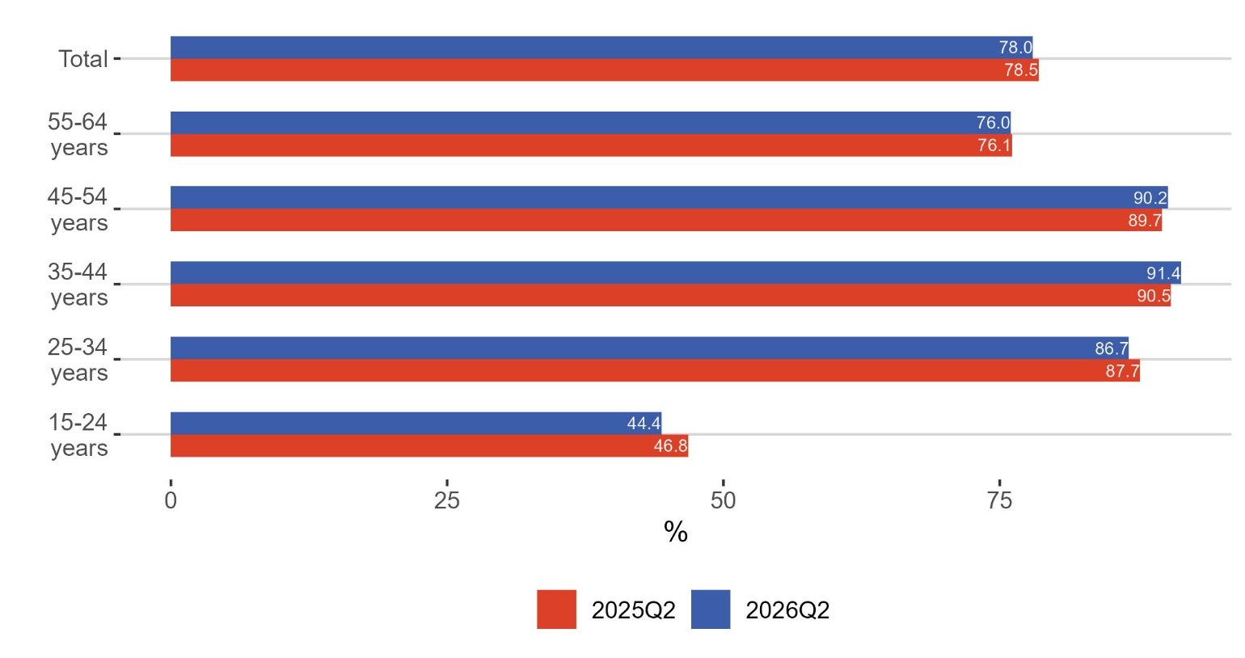
Male employment rate increased to 91.4% for 35-44 year olds
%

Slide 31
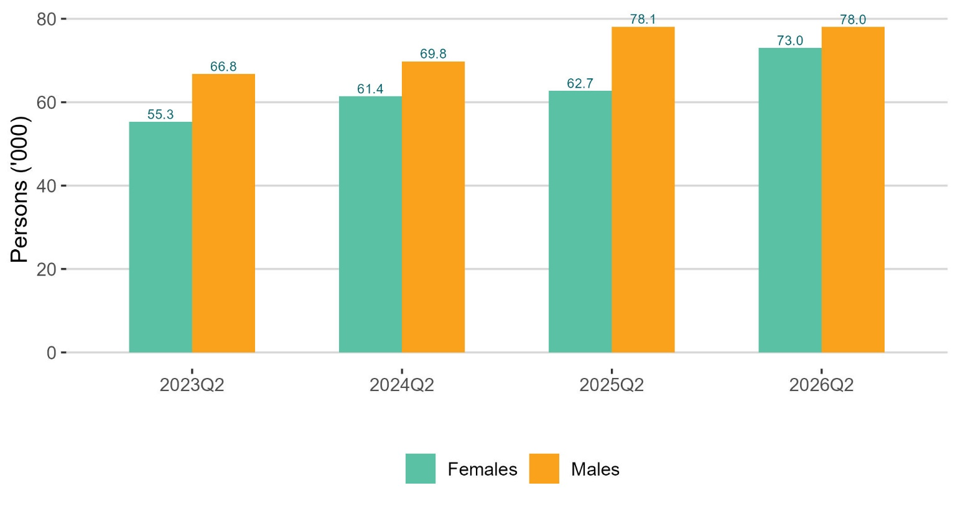
Unemployment by sex
thousands

Slide 32
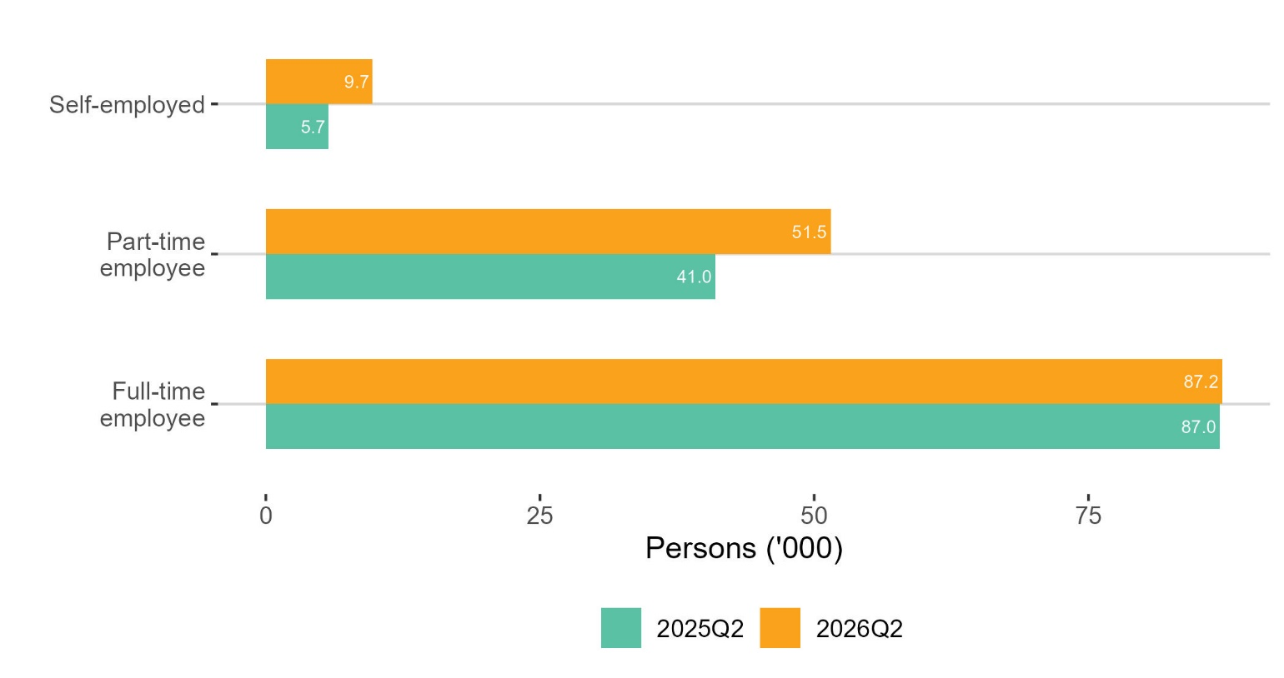
Type of work seeking
thousands

