Slide 1
Labour Force Survey
Quarter 2, 2025
21st August 2025

Slide 2
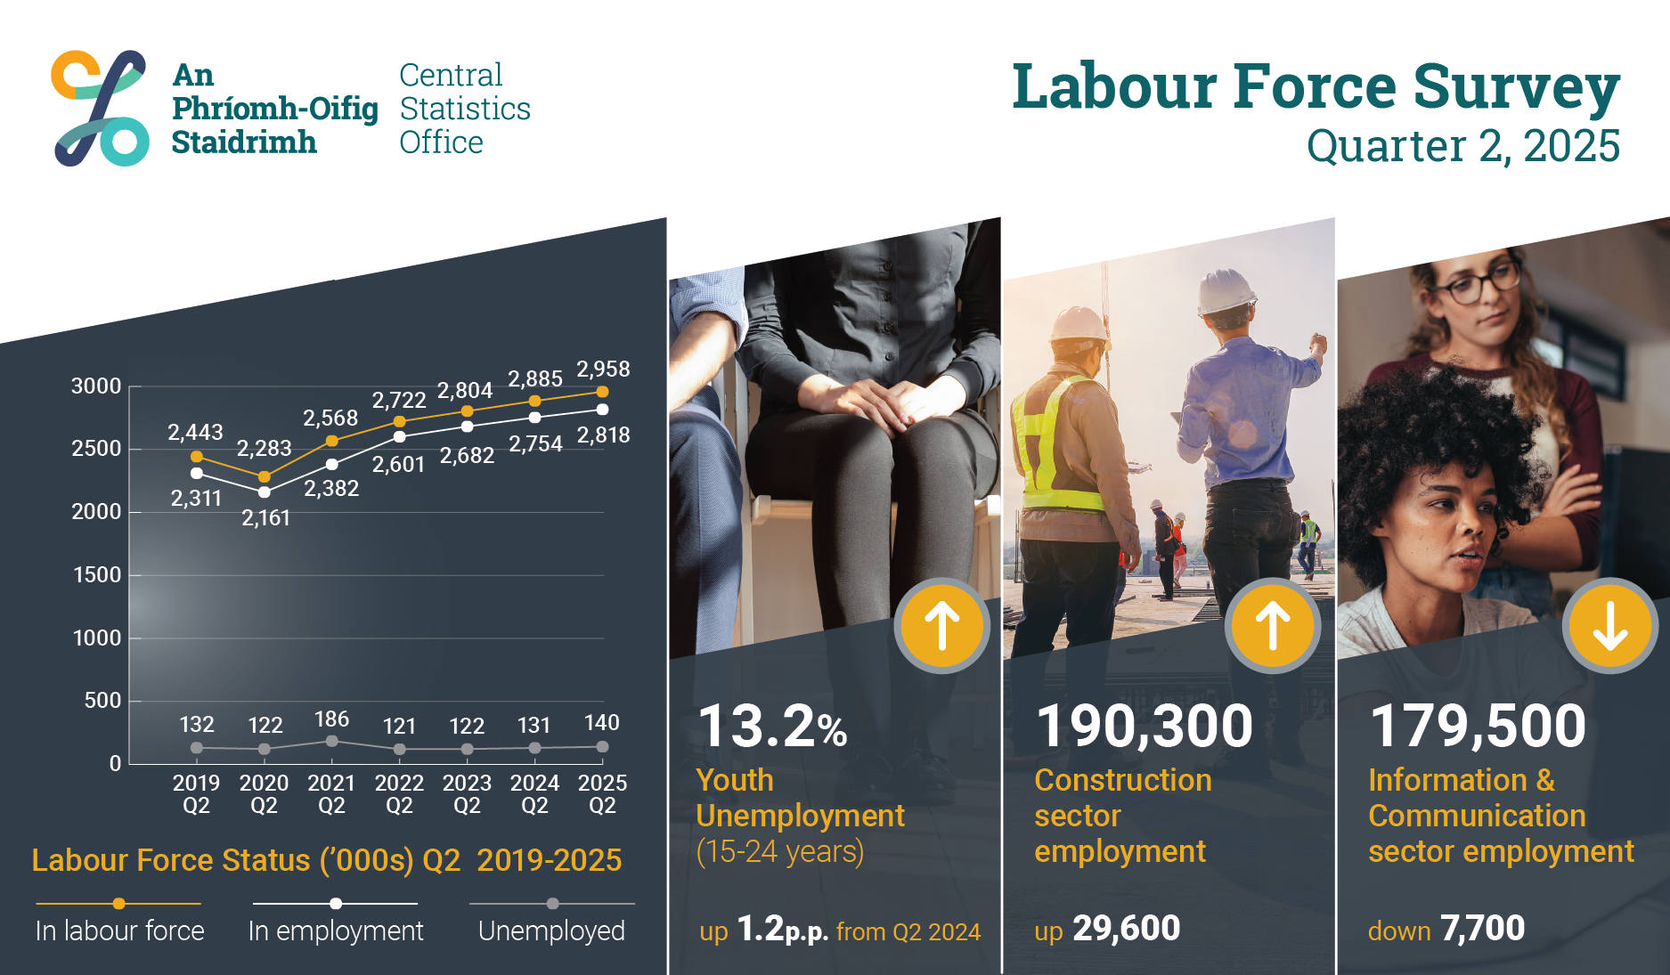
Infographic
Thousands

Slide 3
Employment has increased by more than 770,000 in ten years
thousands

Slide 4
In employment
Q2 2025:
Persons in employment: 2,818,100 +2.3%
Employment rate (15-64): 74.7% +0.3 p.p.
Seasonally adjusted: 2,813,200 +0.1% on Q1 2025

Slide 5
Employment rate (%) increases for both males and females
%

Slide 6
Employment (‘000) increased across all age groups
thousands

Slide 7
Employment rate decreased (p.p.) for younger age groups
p.p

Slide 8
Greater increase in full-time than part-time employment (‘000)
thousands

Slide 9
Construction had the largest increase in employment (‘000)
thousands

Slide 10
Information & Communication had the biggest drop in employment (‘000)
thousands

Slide 11
Total actual hours worked (millions) per week increased the most in Construction
(hours) millions

Slide 12
There were 16,700 more self-employed in the labour force
thousands

Slide 13
In employment (seasonally adjusted), males increased while females decreased
thousands

Slide 14
Slight increase on hybrid working (%)
%

Slide 15
Unemployment
Q2 2025:
Persons unemployed: 140,800 +7.3%
Unemployment rate (15-74): 4.8% +0.2 p.p
Persons unemployed (SA): 134,400 +2.6 on Q1 2025
Seasonally adjusted rate: 4.6% +0.1 p.p on Q1 2025

Slide 16
Younger ages driving unemployment (‘000)
thousands

Slide 17
Slight increase in long-term unemployment (‘000)
Thousands

Slide 18
Unemployment (‘000) (seasonally adjusted), increased for males; down for females
thousands

Slide 19
Labour Force
Q2 2025:
Persons in labour force: 2,958,900 +2.5%
Participation rate (15+): 66.4% +0.3 p.p.
Seasonally adjusted participation rate: 66.2% unchanged from Q1 2025

Slide 20
Labour Force
Unadjusted
  Increased by 73,500 (2.5%) over the year to 2,958,900 in Q2 2025
  Demographic effect +49,200
  Participation effect +24,300
  Participation rate increased by 0.3p.p. to 66.4%
Adjusted
  Increase of 17,200 or 0.6% over the quarter to 2,951,100 in Q2 2025

Slide 21
Participation rate (%) for males increased; decreased for females
%

Slide 22
Labour force (‘000) increased across all age groups
thousands

Slide 23
Largest increase in labour force (‘000) from Irish citizens
thousand

Slide 24
Participation rate (%) (seasonally adjusted), males increased; females decreased
%

Slide 25
Not in the labour force
Q2 2025:
Persons not in the labour force: 1,499,600 +1.0%
Potential additional labour force: 118,000 -3.8%

Slide 26
Part-time underemployed increased by 11,800
thousands

Slide 27
Young people (15-24) in the labour force
Q2 2025:
Employment rate: 46.7% -1.0 p.p.
Unemployment rate: 13.2% +1.2 p.p.
Participation rate: 53.8% -0.4 p.p.
NEET rate 5.9% +0.7 p.p.

Slide 28
Infographic
Thousands

Slide 29
Labour Force Survey
Quarter 2 2025
Thank you.
LFS Q3 2025 results provisionally due for publication on 20th November 2025

Slide 30
Births 2001-2022
Notes:
Source: PxStat VSA16

Slide 31
Annex:
ILO Definitions and concepts
IESS Regulation
Impact of COVID-19 on LFS
Arrivals from Ukraine in Ireland

Slide 32
ILO classification in the LFS
Employment (15-89 years)
  Persons who worked in the week before the survey for one hour or more for payment or profit, including work on the family farm or business and all persons who were away from work during the reference week but had a job to which they could return to

Slide 33
ILO classification in the LFS
Unemployment (15-74 years)
  Persons who in the week before the survey, were
    without work – i.e. did not meet criteria to be classified as employed under ILO
    available to start work within the next two weeks
    had taken specific steps, in the previous four weeks to find work

Slide 34
ILO classification and LFS
Inactive (15+ years)
  All other persons

Slide 35
Integration of European Social Statistics (IESS) Regulation
New European regulation came into force on 01 January 2021
Implications for Irish Labour Market Statistics :
  https://www.cso.ie/en/releasesandpublications/in/lfs/implicationsoftheimplementationoftheintegrationofeuropeansocialstatisticsiessframeworkregulationonlabourmarketstatisticsinirelandin2021/
Impact of the regulation on the LFS series:
  https://www.cso.ie/en/releasesandpublications/ep/p-lfs/labourforcesurveyquarter12021/technicalnote/
The LFS questionnaires for Ireland up to Q1 2023 are available here: https://www.cso.ie/en/methods/surveyforms/labourforcesurvey/

Slide 36
Arrivals from Ukraine in Ireland
https://www.cso.ie/en/statistics/population/arrivalsfromukraineinireland/
As of the week ending 3rd June 2025 there had been 113,917 Beneficiaries of Temporary Protection from Ukraine in Ireland.
Of these arrivals from Ukraine, 70% had activity in administrative data after 31 March 2025, based on data currently available to the Central Statistics Office (CSO).
Women and men aged 20 year and over made up 46% and 26% of arrivals respectively, while 29% were people aged under 20 years.
  https://www.cso.ie/en/releasesandpublications/fp/p-aui/arrivalsfromukraineinirelandseries16/
Live Register figures for July 2025: 12,278 persons from Ukraine benefitting from Temporary Protection Directive:
  https://www.cso.ie/en/releasesandpublications/ep/p-lr/liveregisterjuly2025/

