Slide 1
Labour Force Survey Quarter 1 2022 Results 26 May 2022

Slide 2
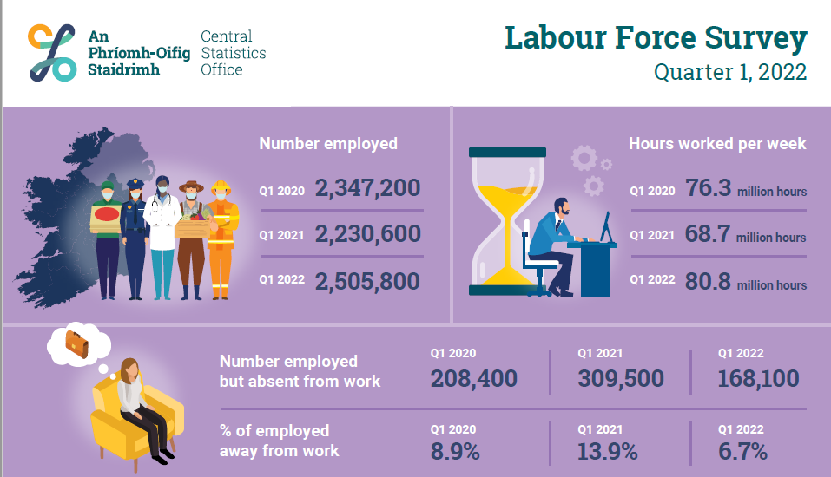
Infographic
Thousands

Slide 3
Persons (aged 15+) by ILO employment status, 2 year intervals
Thousands

Slide 4
Section 2: In employment Q1 2022: Persons in employment: 2,505,800 Employment rate: 72.8% Seasonally adjusted: 2,532,200

Slide 5
In employment (seasonally adjusted), number of persons
%

Slide 6
In employment, year on year change
Thousands

Slide 7
Employment rate, by sex and age, change (percentage points) Q1 2020 to Q1 2022,
p.p.

Slide 8
Principal Economic Status, Females by age, change (number) Q1 2020 to Q1 2022,
Thousands

Slide 9
Share of those in employment who were working full-time, by sex and age, change (percentage points) Q1 2020 to Q1 2022,
p.p.

Slide 10
Persons in employment by NACE sector, Q1 2020 and Q1 2022
Thousands

Slide 11
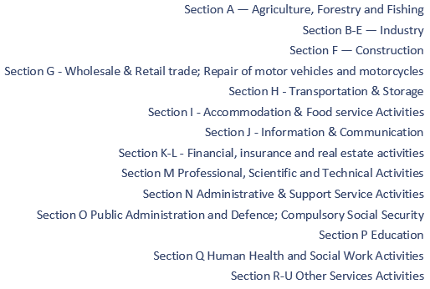
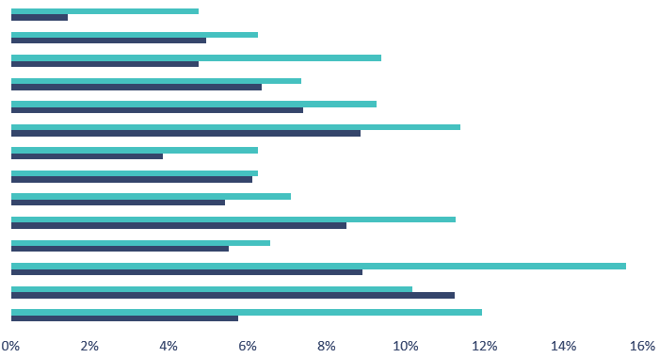
Absences (as % of number employed), by NACE sector, Q1 2020 and Q1 2022

Slide 12
Total actual hours worked (millions) per week, by NACE sector, Q1 2020 and Q1 2022
(hours) millions

Slide 13
Section 3: Unemployment In Q1 2022: Persons unemployed: 126,700 Unemployment rate: 4.8% Seasonally adjusted: 131,700 (-4,500) Seasonally adjusted unemployment rate: 5.0%

Slide 14
Unemployment rate (seasonally adjusted)
%

Slide 15
Unemployed by duration of unemployment, Q1 2022
Thousands

Slide 16
Section 4: Labour Force In Q1 2022: In labour force: 2,632,500 Participation rate: 64.8% Seasonally adjusted participation rate: 65.2% Outside the labour force: 1,431,000

Slide 17
Participation rate (seasonally adjusted)
%

Slide 18
Participation rate by sex
%

Slide 19
Participation rate by age
%

Slide 20
Participation rate by NUTS3 region
%

Slide 21
Labour Force
Unadjusted
Increased by 231,400 (+9.6%) over the year to 2,632,500 in Q1 2022
Participation increased over the year from 60.0% to 64.8%
Demographic effect +26,600
Participation effect +204,800
Seasonally Adjusted
Increase of 23,900 or 0.9% over the quarter to 2,653,200 in Q1 2022

Slide 22
Section 5: Summary

Slide 23
Infographic
Thousands

Slide 24
Thank You.

Slide 25
Annex: ILO Definitions and concepts IESS Regulation Impact of COVID-19 on LFS

Slide 26
ILO classification in the LFS
Employment (15-89 years)
Persons who worked in the week before the survey for one hour or more for payment or profit, including work on the family farm or business and all persons who were away from work during the reference week but had a job to which they could return to

Slide 27
Attachment to job
Testing for Job attachment pre and post IESS
 | Pre-IESS | Post-IESS
Holidays | No | No
Working time arrrangements | No | No
Illness/disability | No | No
Maternity/Paternity | No | No
Job related training | No | No
Parental | No | Yes
Off season | No | Yes
Temporary layoff | Yes | Yes¹
Other reason | No | Yes
Waiting to start a new job | n/a | No
¹ Post-IESS include all layoffs
Rules for attachment to job for absences from work
Pre-IESS | Post-IESS
Length of absence and share | Length of absence and salary payment
of salary paid applied to temporary | for parental leave
layoffs only
 | Off-season - whether do any occasional
 | work for employer or not
 | Layoffs/Other reason - length of absence
 | only

Slide 28
ILO classification in the LFS
Unemployment (15-74 years)
Persons who in the week before the survey, were
without work – i.e. did not meet criteria to be classified as employed under ILO
available to start work within the next two weeks
had taken specific steps, in the previous four weeks to find work

Slide 29
ILO classification and LFS
Inactive (15+ years)
All other persons

Slide 30
Integration of European Social Statistics (IESS) Regulation
New European regulation came into force on 01 January 2021
Implications for Irish Labour Market Statistics :
https://www.cso.ie/en/releasesandpublications/in/lfs/implicationsoftheimplementationoftheintegrationofeuropeansocialstatisticsiessframeworkregulationonlabourmarketstatisticsinirelandin2021/
Impact of the regulation on the LFS series:
https://www.cso.ie/en/releasesandpublications/ep/p-lfs/labourforcesurveyquarter12021/technicalnote/
The LFS questionnaires for Ireland up to Q1 2022 are available here: https://www.cso.ie/en/methods/surveyforms/labourforcesurvey/

Slide 31
COVID-19 and the Labour Force Survey (LFS)
With the PUP scheme having finished on the 25 March 2022, COVID-19 Adjusted Measures of Employment and Unemployment in the LFS have been discontinued since the number of persons in receipt of the PUP at the end of the reference period is zero.
Users should note the following Information Note published with the Q2 2020 LFS results in August 2020 for information regarding these measures. Please see link https://www.cso.ie/en/releasesandpublications/in/lfs/informationnote-implicationsofcovid-19onthelabourforcesurvey-quarter22020update/
Labour Force Survey data for Quarter 1 2022 was collected by a combination of telephone and face-to-face interviews carried out by CSO Household Survey Interviewers.

