Slide 1
Ireland and Northern Ireland -
A Joint Census Publication 2021/2022
Presenters: Daniel McConville (NISRA) & Maria Yasin (CSO)

Slide 2
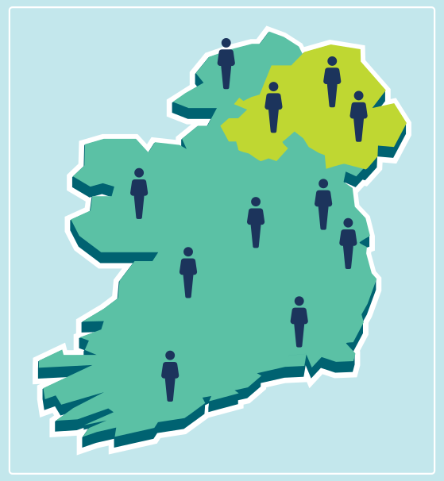
Introduction
Joint report between Central Statistics Office (CSO) and Northern Ireland Statistics and Research Agency (NISRA)
Combines Census 2021 in Northern Ireland and Census 2022 in Ireland
Chapters:
Population and Age
Marital and Civil Partnership Status and Households
Ethnicity, Place of Birth, Language and Religion
Health and Carers
Labour Force, Employment, Education and Cross-Border Workers
Housing

Slide 3
Chapter 1: Population and Age
Census 2021 in Northern Ireland
Census 2022 in Ireland

Slide 4
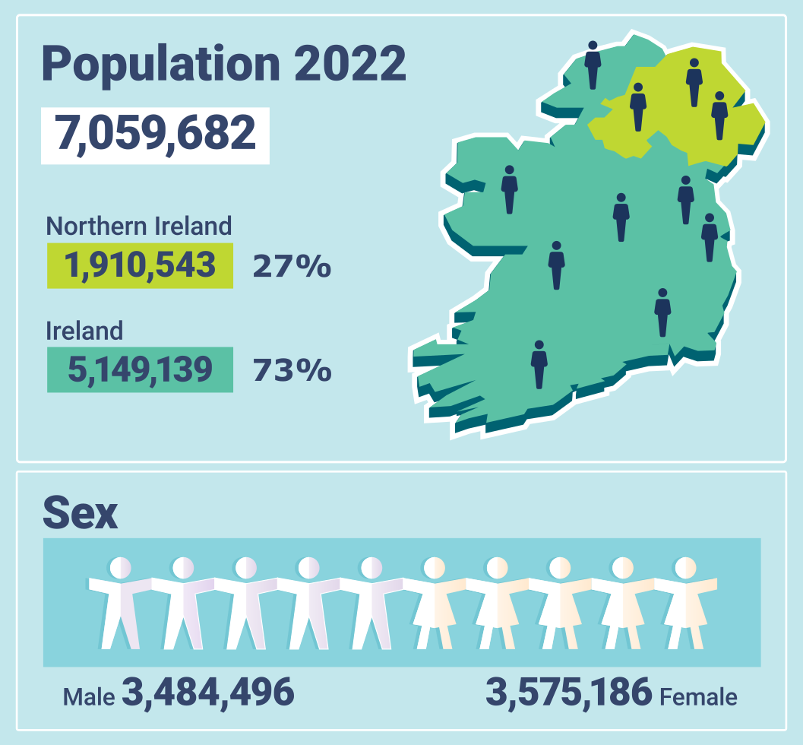
Population in 2022
In 2022, the population on the island of Ireland was 7.1 million people
The first time the population exceeded 7 million people since 1851
5.15 million people (73%) in Ireland and 1.91 million in Northern Ireland (27%)
Sex, 2022
There were 3,484,496 males and 3,575,186 females
Overall sex ratio of 97.5 males to every 100 females:
97.7 in Ireland
96.8 in Northern Ireland

Slide 5
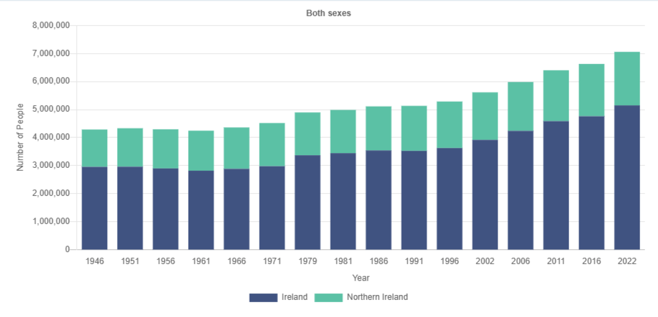
Population change
Population, 1946 to 2022
Between 2002 and 2022, the population on the island of Ireland increased by 26% (almost 1.5 million people)
the population in Ireland grew by 31%
the population in Northern Ireland grew by 13%

Slide 6
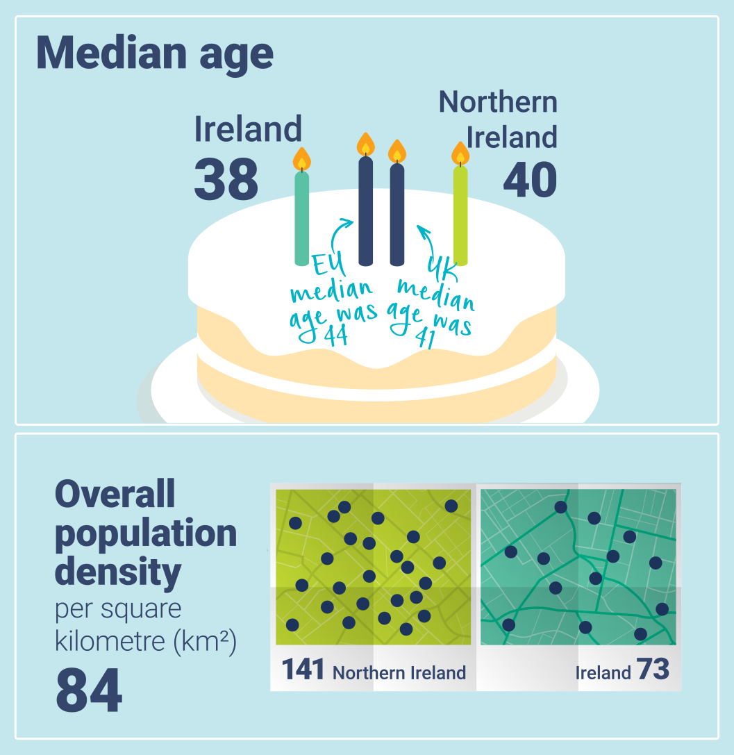
Median age, 2022
Median age was 38 years in Ireland and 40 in Northern Ireland (compares with 44 in the EU and 41 in the UK)
Increased over the 50 years from 1971 to 2022:
from 27 to 38 in Ireland
from 28 to 40 in Northern Ireland
Population density, 2022
The overall population density for the island was 84 people per km²
The population density in Northern Ireland was almost double that of Ireland (141km² vs 73km²)

Slide 7
Chapter 2: Marital and Civil Partnership status and Households
Census 2021 in Northern Ireland
Census 2022 in Ireland

Slide 8
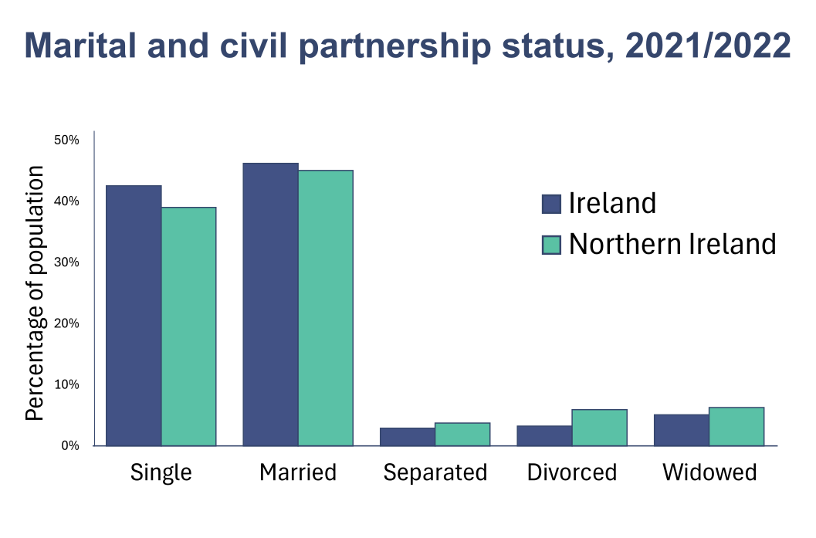
Marital and civil partnership status- aged 15+, 2021/2022
Just under half of the population in each jurisdiction (49%) were either married or separated
Close to two-fifths were single (43% in Ireland and 39% in Northern Ireland)
Proportion of divorced people in Northern Ireland was double that of Ireland (6% vs 3%)

Slide 9
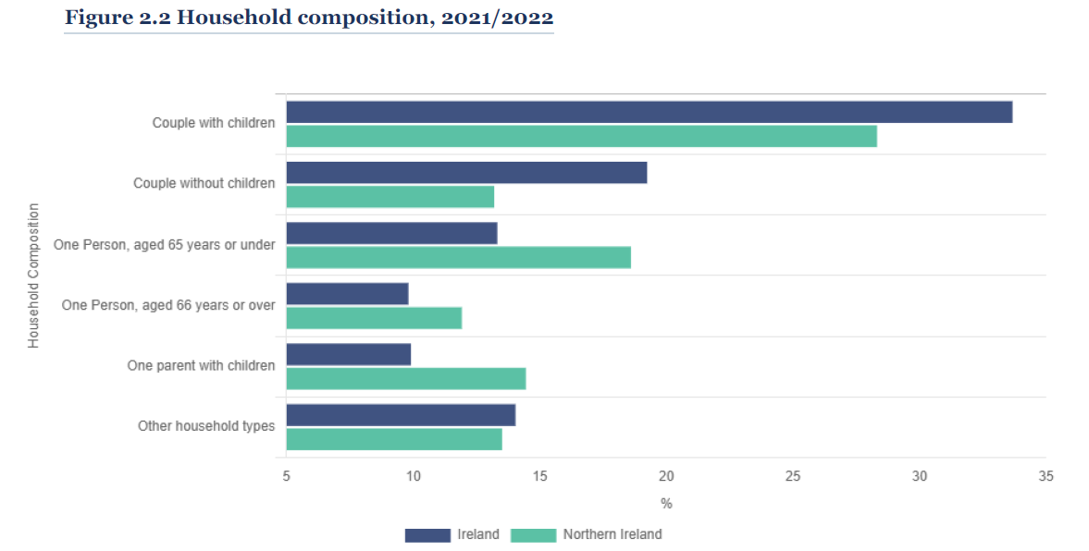
Household composition, 2021/2022
Couple with children:
Over one-third (34%) of households in Ireland and 28% in Northern Ireland
One person living alone:
23% of households in Ireland compared with 31% in Northern Ireland
10% of households in Ireland and 12% in Northern Ireland contained a person aged 66 years and over living alone
One-parent households:
10% of total households in Ireland and 14% in Northern Ireland

Slide 10
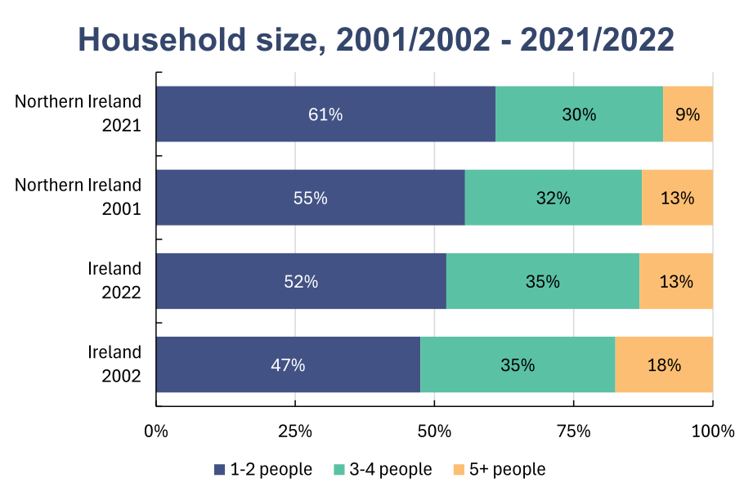
Household size
In general, the proportion of smaller households is increasing while the proportion of larger households is decreasing.
One and two person households:
In Ireland, increased from 47% in 2002 to 52% in 2022
In Northern Ireland, increased from 55% in 2001 to 61% in 2021
5 or more person households:
In Ireland, decreased from 18% in 2002 to 13% in 2022 in Ireland.
In Northern Ireland, decreased from 13% in 2001 to 9% in 2021

Slide 11
Chapter 3: Ethnicity, Place of Birth, Language, and Religion
Census 2021 in Northern Ireland
Census 2022 in Ireland

Slide 12
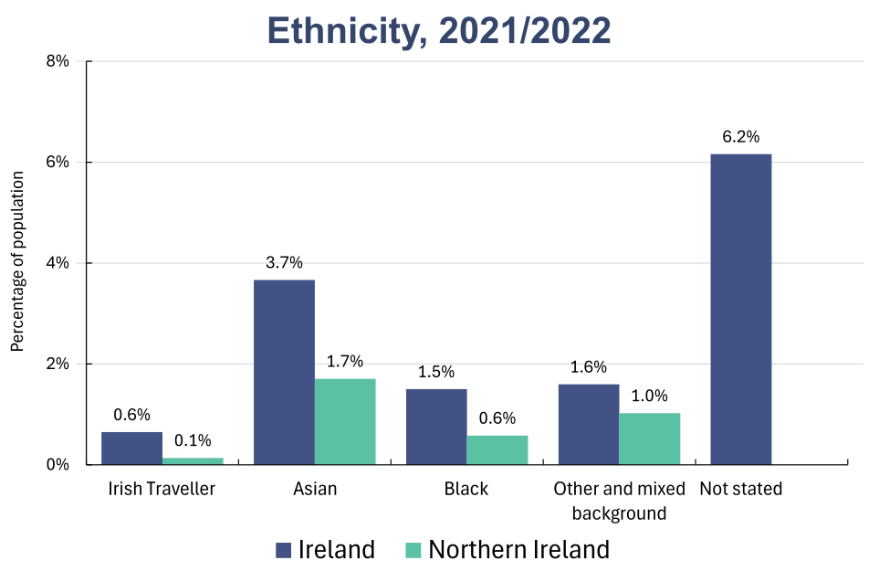
Ethnicity, 2021/2022
White: 86% in Ireland compared with 97% in Northern Ireland
Irish Traveller: 32,900 people (0.6%) in Ireland and 2,600 people (0.1%) in Northern Ireland
Asian: 3.7% (186,300 people) in Ireland and 1.7% (32,500 people) in Northern Ireland
Black: 1.5% (76,200 people) in Ireland and 0.6% in Northern Ireland (11,000 people)

Slide 13
Place of Birth, 2021/2022
Place of Birth | Ireland |  | Northern Ireland
 | Count | % | Count | %
Ireland | 4,067,400 | 80% | 40,400 | 2%
Northern Ireland | 61,800 | 1% | 1,646,300 | 87%
Great Britain | 227,300 | 4% | 92,300 | 5%
Rest of Europe | 386,500 | 8% | 71,100 | 4%
Asia & Middle East | 157,400 | 3% | 29,200 | 2%
Africa | 73,200 | 1% | 10,800 | 1%
Rest of the World | 111,200 | 2% | 13,100 | 1%
In Ireland, 20% (1,017,000) were born outside Ireland – 1% were born in Northern Ireland and 4% were born in Great Britan
In Northern Ireland, 257,000 (13%) were born outside Northern Ireland – 2% were born in Ireland and 5% were born in Great Britan
Outside of the island of Ireland and Great Britain, the most frequently reported countries of birth were:
Poland, India and Romania in Ireland
Poland, Lithuania and India in Northern Ireland

Slide 14
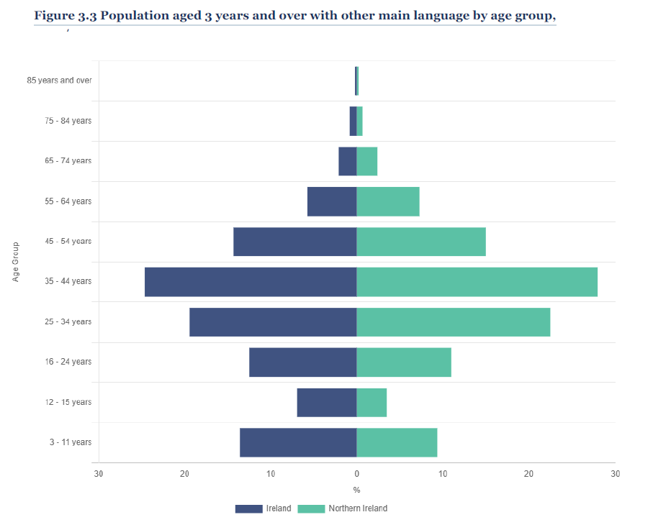
Language other than English or Irish- aged 3+, 2021/2022
Main language other than English or Irish
In Ireland, 15% (735,500 people)
In Northern Ireland, 4% (79,100 people)
Most common age group was 35 to 44 years - 28% in Northern Ireland and 25% in Ireland
Top languages spoken
Ireland | Northern Ireland
Polish (121,300) | Polish (20,100)
Romanian (55,800) | Lithuanian (9,000)
French (50,900) | Romanian (5,600)

Slide 15
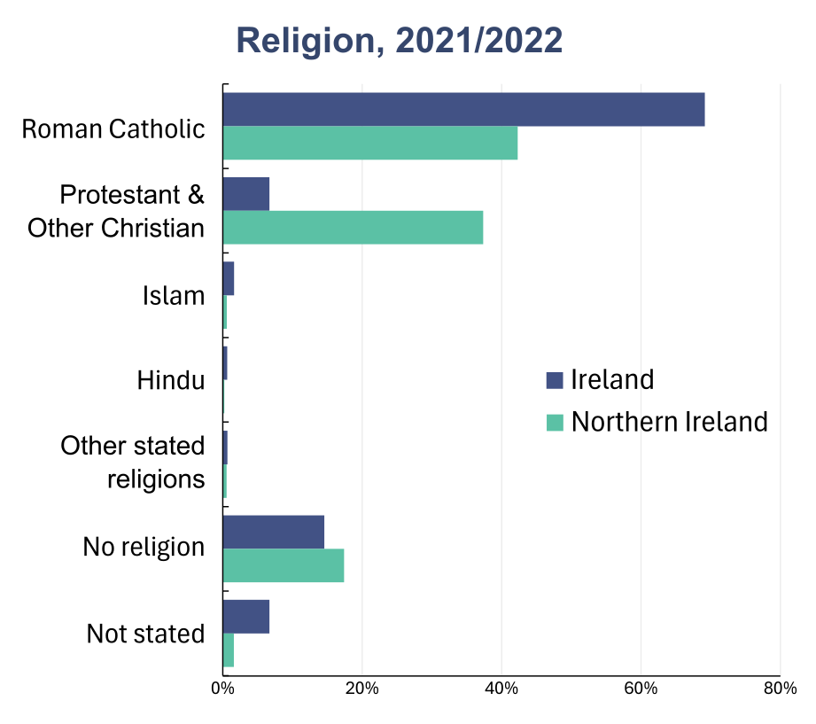
Religion, 2021/2022
Roman Catholic
69% in Ireland; 42% in Northern Ireland
Protestant and Other Christian
7% in Ireland; 37% in Northern Ireland
No religion
Ireland - 15%
ranged from 7% of people in Monaghan to 24% of people in Dún Laoghaire-Rathdown
Northern Ireland - 17%
ranged from 8% in Mid Ulster to 31% in Ards and North Down

Slide 16
Chapter 4 – Health and Carers
Census 2021 in Northern Ireland
Census 2022 in Ireland

Slide 17
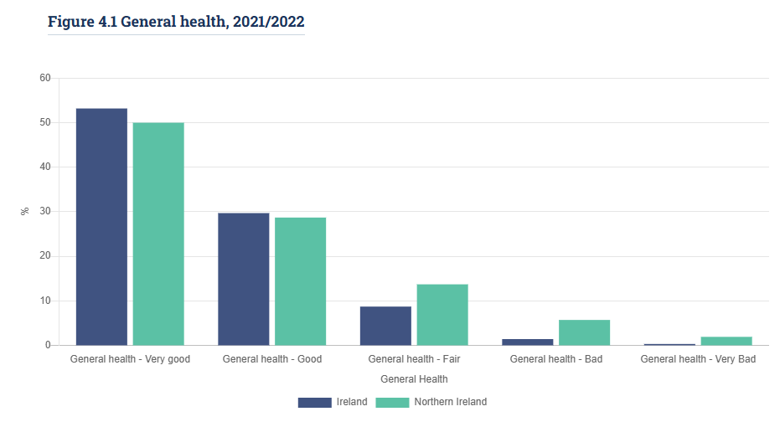
General Health
In Ireland, 83% of people reported their health as good or very good, compared with 79% in Northern Ireland
One in seven (14%) people in Northern Ireland reported fair general health compared with 9% of people in Ireland
There was a higher proportion of people reporting their general health as either bad or very bad in Northern Ireland at 8%, compared with 2% in Ireland

Slide 18
General Health by Age
General health declined with age in both Ireland and Northern Ireland, with more people reporting fair, bad, or very bad health as they got older
Children (0–14 years) had mostly very good or good health (91% in Ireland, 97% in Northern Ireland)
Adults (20–64 years) saw an increase in bad or very bad health (1% to 4% in Ireland, 2% to 16% in Northern Ireland)
Older adults (85+ years) had worse health, with 9% reporting bad or very bad health in Ireland, compared with 25% in Northern Ireland
While the proportion of people reporting bad or very bad health increased with age in both Ireland and Northern Ireland, the proportions increased at a greater rate in Northern Ireland

Slide 19
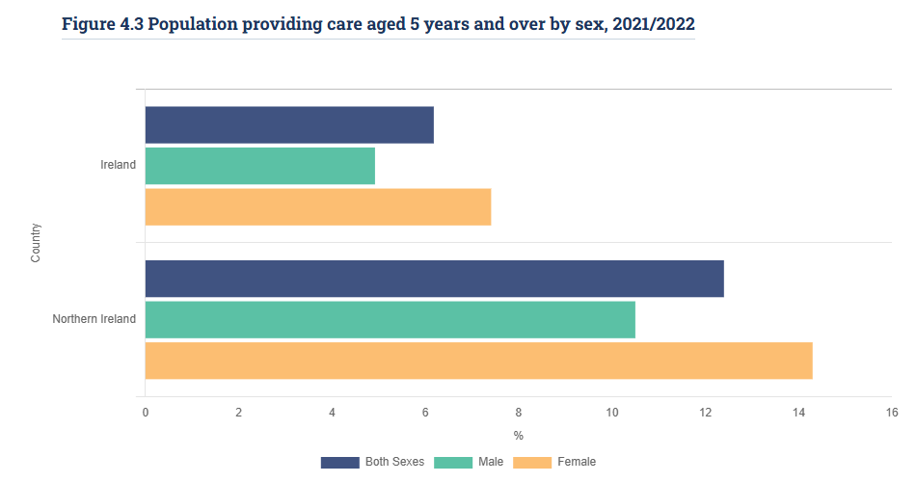
Unpaid Carers
In Northern Ireland, 12% of people aged five years and over provided regular unpaid care, compared with 6% in Ireland
In both Ireland and Northern Ireland, a greater proportion of females provided unpaid care than males. In Ireland, 7% of females and 5% of males regularly provided unpaid help. In Northern Ireland, 14% of females were unpaid carers, compared with 11% of males

Slide 20
Chapter 5 - Labour Force, Employment, Cross-border Workers and Education
Census 2021 in Northern Ireland
Census 2022 in Ireland

Slide 21
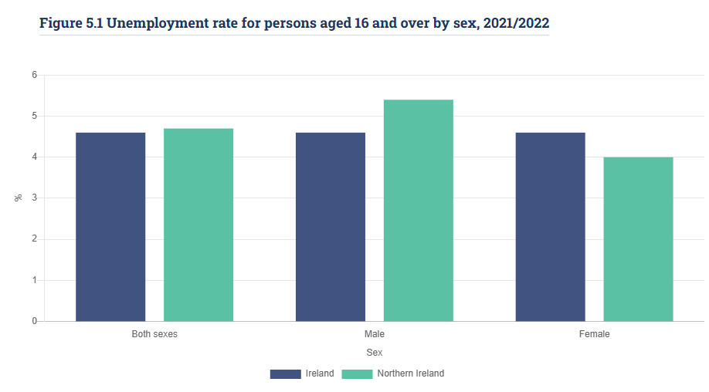
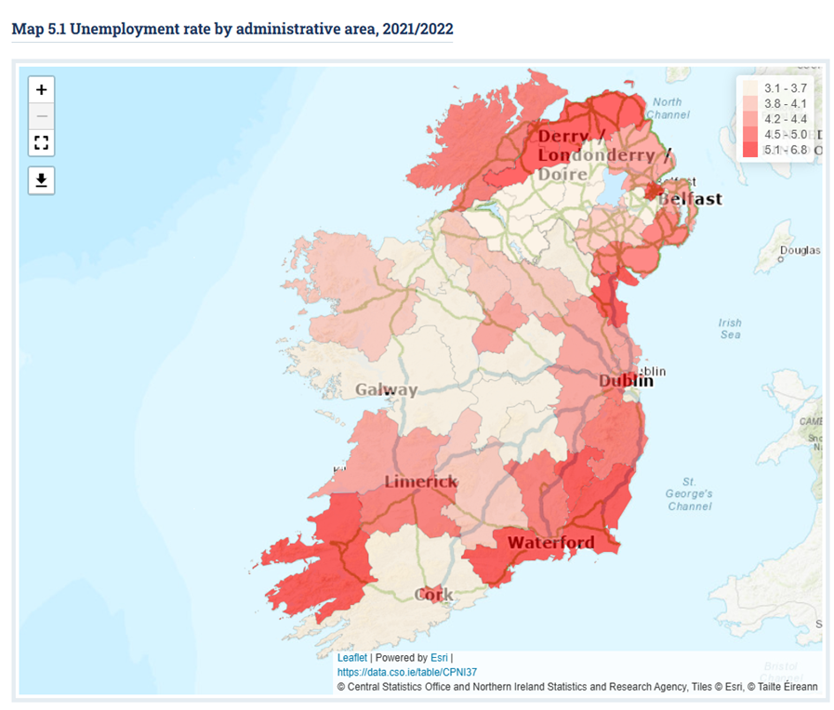
Unemployment Rate

Slide 22
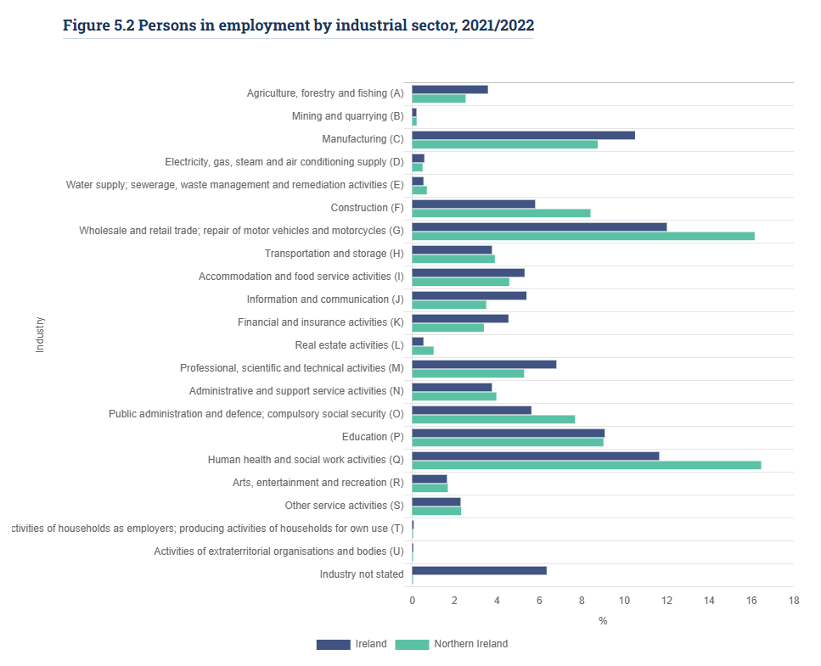
People in Employment by Industrial Sector
Sectors with Higher Employment in Northern Ireland
Human Health & Social Work: 16% (Northern Ireland), 12% (Ireland)
Wholesale & Retail Trade: 16% (Northern Ireland), 12% (Ireland)
Construction: 8% (Northern Ireland), 6% (Ireland)
Public Administration & Defence: 8% (Northern Ireland), 6% (Ireland)
Sectors with Higher Employment in Ireland
Professional, Scientific & Technical: 7% (Ireland), 5% (Northern Ireland)
Information & Communication: 5% (Ireland), 3% (Northern Ireland)

Slide 23
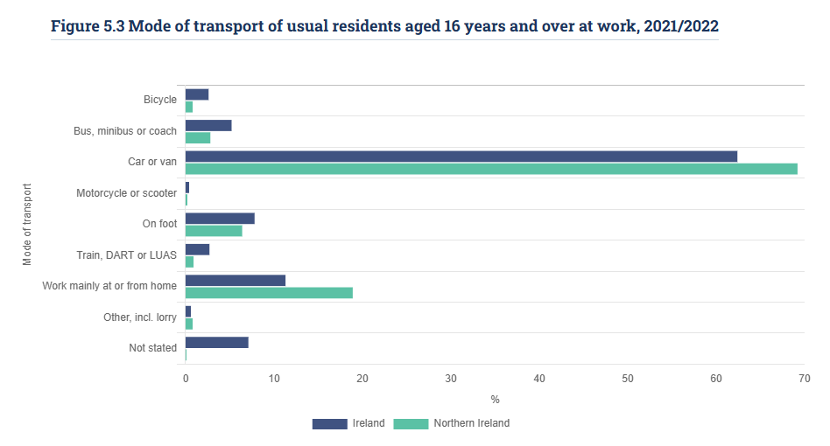
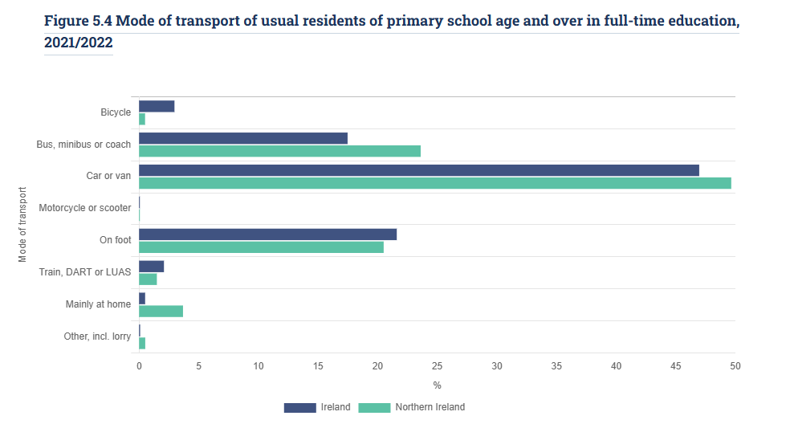
Mode of Transport

Slide 24
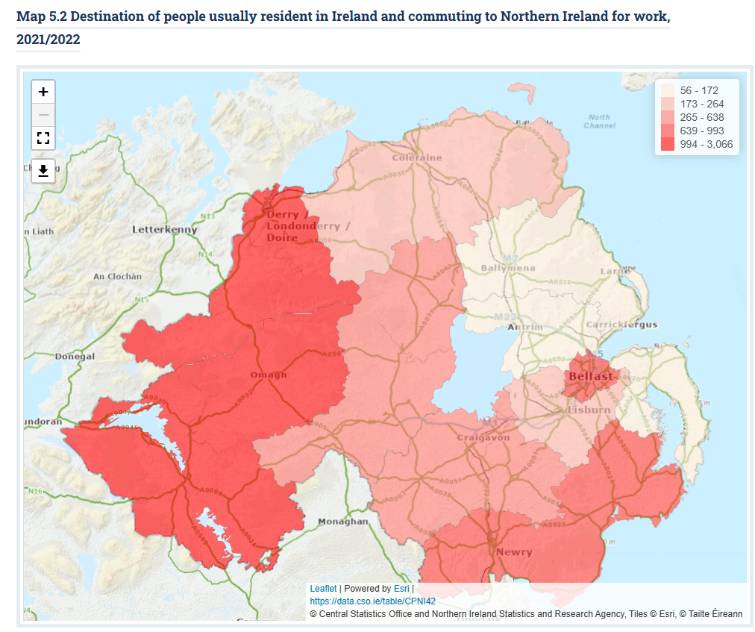
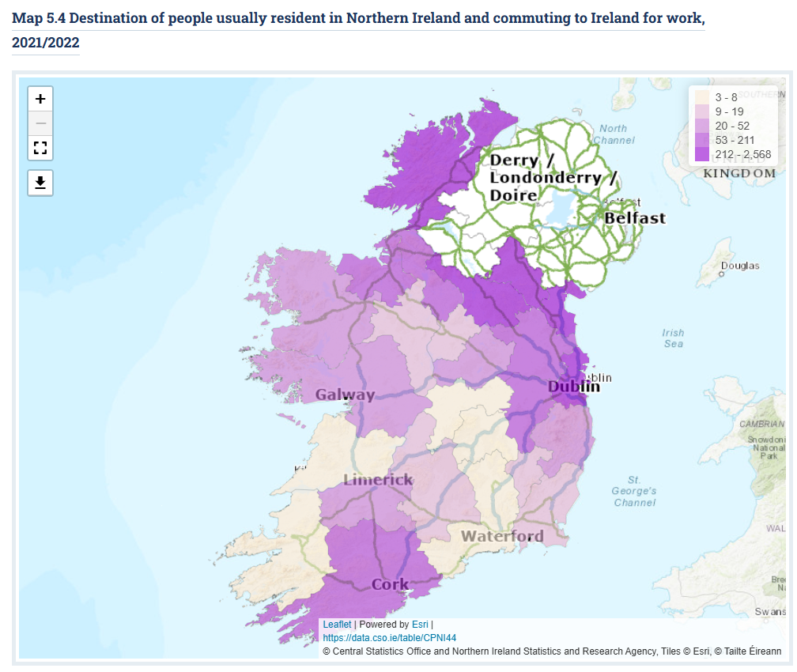
Destination of cross-border workers

Slide 25
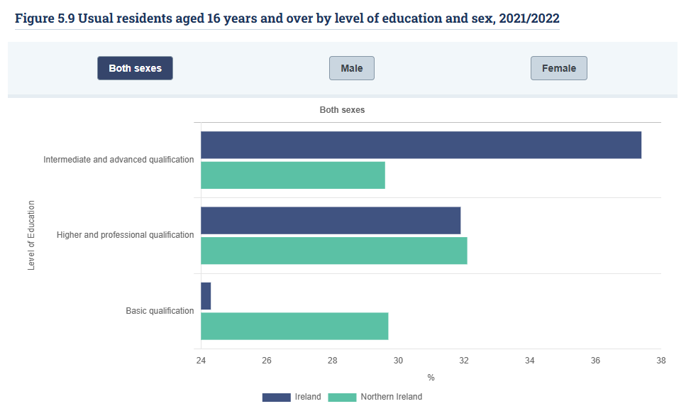
Education
Basic qualifications: 24% in Ireland, 30% in Northern Ireland
Intermediate & advanced qualifications: 37% in Ireland, 30% in Northern Ireland
Higher & professional qualifications: Equal in both countries at 32%.

Slide 26
Chapter 6 – Housing
Census 2021 in Northern Ireland
Census 2022 in Ireland

Slide 27
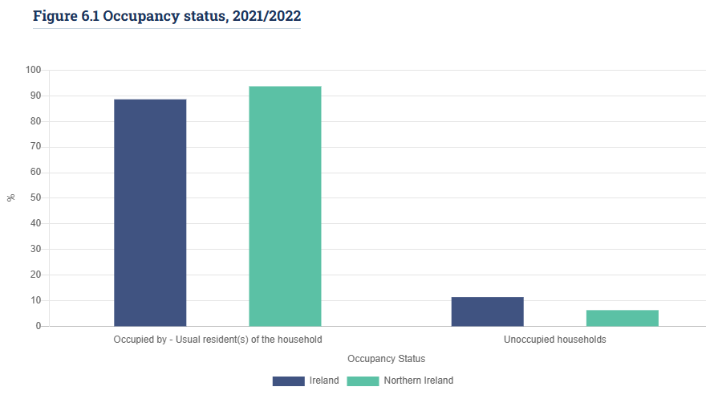
Occupancy Status
There were 2,112,121 permanent housing units in Ireland in 2022, of which 89% were occupied and 11% were unoccupied
In Northern Ireland, there were 819,612 permanent housing units, of which 94% were occupied and 6% were unoccupied

Slide 28
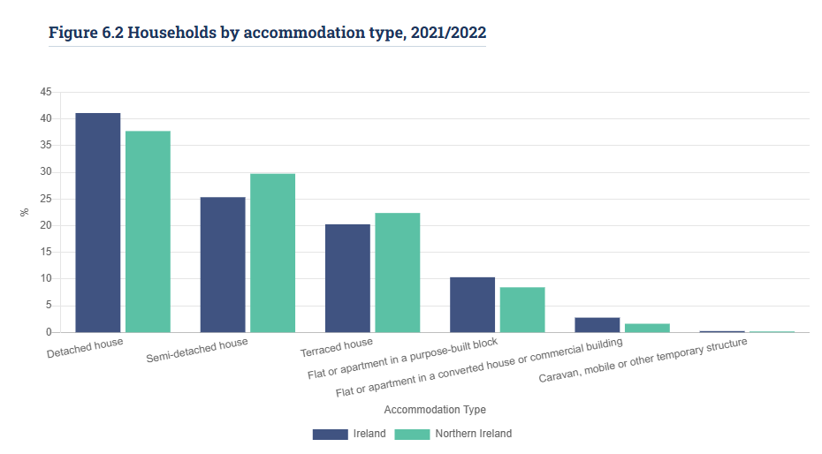
Accommodation Type
Detached houses: 41% of households in Ireland, 38% in Northern Ireland
Semi-detached houses: 25% in Ireland, 30% in Northern Ireland
Temporary dwellings (caravans, mobile homes, etc.): 0.2% of households in Ireland (4,424 homes), 0.1% in Northern Ireland (1,087 homes)

Slide 29
