Slide 1
Census 2022 Summary Results 30 May 2023

Slide 2
Census 2022 Background
Census Night – Sunday, 03 April 2022
Six years since previous Census
Over 5,600 field staff
10-week period field operation
Preliminary figures released in June 2022
Census Processing May 2022 to February 2023
Thematic publications will be released throughout 2023
All data and summary publication available now on www.cso.ie

Slide 3
Section 1: Summary results Census 2022 Population change Household size and Marital status Health, disability, caring and volunteering Migration and diversity
Notes:
In this section we will look changes in the population, both the recent census and over time.
I will present on household size and marital status before looking at some of the data available in the area of Health, disability, caring and volunteering.
I will then look at some areas from the migration and diversity chapter.

Slide 4
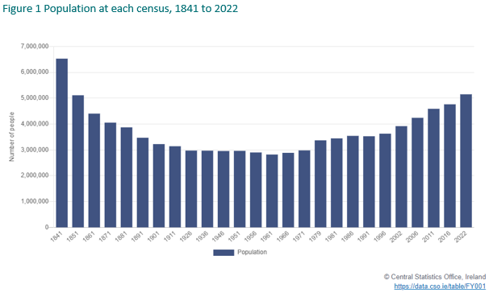
Census 2022 Population
Population at each census, 1841 to 2022
Population of 5,149,139
Up 387,274 (8%) since 2016
Annual average increase of 1.3%
2011-2016 increase of 4%, annual average increase of 0.7%
Notes:
On Census Night, Sunday, 03 April 2022, there were 5.15 million people in the State.
This is an increase of almost 390k people since the last Census in 2016, or 8% in the population over this six year period
When averaged out over the 6 year period, this represents an average yearly increase of 1.3%
In the previous census period, 2011 to 2016, the total growth was 4%, with an average increase each year of just 0.7%.
From the graph, which shows data from 1841 to 2022 we can see that Census 2022 marked the first time since before the famine (in 171 years) that the population of Ireland has gone over 5 million people.
After a continued decline since 1841, Ireland recorded its lowest population in 1961 when it stood at 2.8 m people.
Since then it began to increase and, in 2022, was 83% higher than 61 years previously.

Slide 5
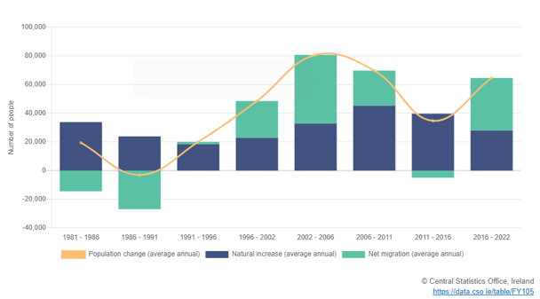
What drove this population change?
Components of population change (average annual figures) for each intercensal period,
1981 to 2022
Population change: 387,274 increase
Natural increase made up 167,487 of the change (births minus deaths)
The estimate for Net Migration is 219,787
Growth between 2016 and 2022 driven by net migration
2006 to 2011 and 2011 to 2016 growth driven by natural increase
Notes:
The pop increase of almost 370K people is driven from two elements
natural increase, which is birth minus deaths, and
estimated net migration, which is derived from the difference between the pop change and the natural increase over the period.
In the figure, natural increase is represented in blue and net migration in green.
For the pop growth in the years 2016 to 2022 we can see that net migration was > natural increase, indicating that the population growth during this time was driven net migration.
This is different to the 2 previous censuses where natural increases were the main driver of population increases.

Slide 6
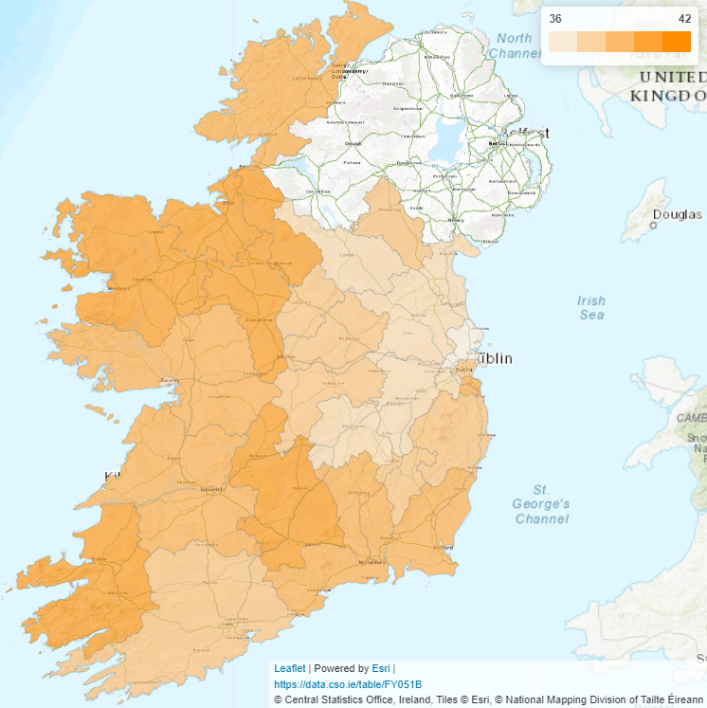
Average age of population by county and city, 2022
County population changes
Average age
Percentage change of population since the previous census by county and city, 2022
Population in every county increased between 2016 and 2022
Average age:
37.4 in 2016
38.8 years in 2022
Increased in all counties
Youngest: Fingal, Kildare and Meath
Oldest: Mayo, Kerry, Roscommon and Leitrim
Ageing population in 2022
Notes:
Every county recorded population growth between 2016 and 2022.
Increases in population since 2016 ranged from 5% in Donegal, Kilkenny and Tipperary to 14% in Longford.
Population growth tended to be stronger in the east of the country with Meath growing by 13%, followed by Fingal (12%) and Kildare (11%).
Average age:
The average age of the population increased from 37.4 years in 2016 to 38.8 years in 2022. In the 11 years between 2011 and 2022, the average age increased by 2.7 years and by 3.7 years since 2002.
Fingal, Kildare and Meath continued to be the counties with the youngest age on average.
Mayo, Kerry, Roscommon and Leitrim had the oldest populations.
All counties recorded an increase in average age between 2016 and 2022.
The county recording the largest growth in average age was Kildare; its average age rose by 2 years.
In 2022 we can see evidence of an ageing population:
-older age groups grew in size while younger ones declined
The highest increases in population numbers was seen among the over 70s increasing by 25%.
There was a 7% fall in the number of people aged 0 to 9.
There was a 4% fall in the number of people aged 25 to 39.

Slide 7
Household size and Marital status
Time Capsule ~ 350,000 forms completed
100 years - 2122
Household size:
2022: Average 2.74 people in private occupied dwellings
(2016: 2.75)
Household size ranged from 2.48 (Dublin City) to 3.02 (Fingal and Meath)
Marital Status:
Single people: 41% to 43%
more males than females
Married people: 48% to 46%
equal males and females
Separated/divorced: 6%
more females than males
Population aged 15 years and over by detailed marital status and sex, 2022
Notes:
HOUSEHOLD SIZE:
The average household size is the number of people in private dwellings as a proportion of the number of occupied dwellings.
Census 2022 recorded 1,841,152 private occupied dwellings and 5,046,681 people in private households.
In 2022, there were on average 2.74 people per private household.
small decrease compared with the 2016 average, which stood at 2.75.
2011 average was 2.73
Average household size differed across counties – 2.48 (Dublin city) to 3.02 (fingal and meath)
Higher in East, lower in the West – generally
TIME CAPSULE:
Recall also the voluntary completion of the Time Capsule – respondents had opportunity to incl. a message on the HH form. The CSO can report that almost 350k HH forms incl. some form of message.
The CSO will not publish any info from the time cap, but will retain them in secure storage with the census forms for 100 years until they are ready for release in 2122.
MARITAL STATUS:
The percentage of people aged 15 years and over who were single increased from 41% in 2016 to 43% in 2022.
Married people, including those who were re-married, and people in a same-sex civil partnership, accounted for 46% of the population aged 15 years and over, down from 48% six years previously.
The percentage of people who were separated or divorced remained stable at 6%.

Slide 8
General health
Population by general health, 2011 to 2022
83% of people reporting very good or good general health (down from 87% in 2016)
Between 2016 and 2022, all age groups under 75 years reported a change from good to less good health
Notes:
A question on general health was first collected in Census 2011
The percentage of people reporting their general health status as either very good or good was 83 % in 2022 – this represents a decrease from 87% in 2016
All age groups below 75 years reported a change from good to less good health.
There were small increases reported in the age groups over 75 from good to very good health between 2016 and 2022

Slide 9
Smoking tobacco products
Population by age group and smoking frequency, 2022
Never smoked
Given up smoking
Smoked daily
Smoked occasionally
Higher percentage of smokers in 20s and 30s
Smoking, all ages:
15% Males, 11% Females
80%
9%
4%
Notes:
A question on smoking tobacco products was included for the first time in an Irish census in 2022.
Almost 80% of the population reported they had either never smoked (3,113,712) (60%) or given up smoking (974,145) (19%).
13% of the population smoked either daily or occasionally in 2022.
The was a higher prevalence of both daily and occasional smoking among people in their 20s and 30s
The age group with the highest proportion of people smoking were the 25-29 year olds
Smoking was more prevalent among males (15%) than females (11%) in all age groups – an this was seen in both daily and occasional smokers

Slide 10
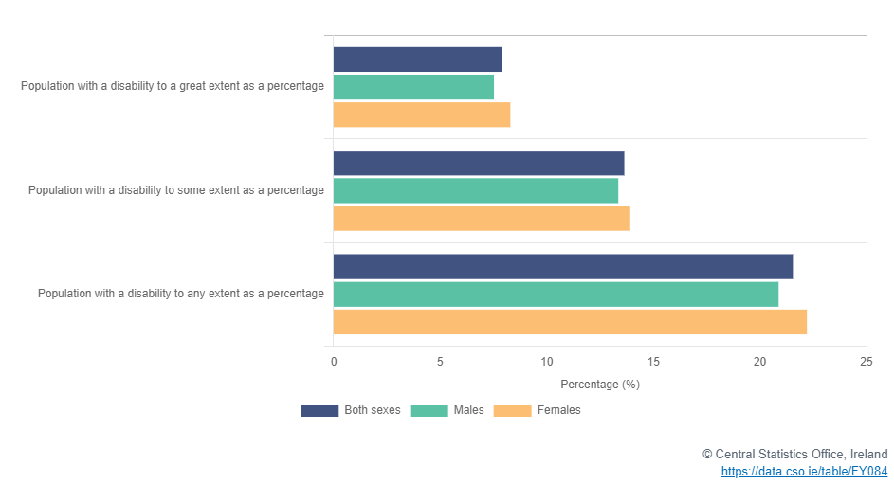
Disability
Population with a disability to any extent as a percentage of all population by sex, 2022
People who experienced a long-lasting condition or difficulty:
Any extent – 22%
Great extent – 8%
Some extent – 14%
Notes:
In 2022, the two ques on long lasting conditions and difficulties were revised.
- 22% of people who experienced a long lasting condition or difficulty to any extent
Of these 8% to a great extent
14% to some extent

Slide 11
Childcare
Children aged under 15 in childcare by age group and type of childcare, 2022
Just under 1 in 3 children < 15 years in childcare
Most common types: Creches and unpaid relative or family
Type of childcare differs by age group
Childcare hours greater for younger children
Notes:
A question on whether children attended childcare, the type of facility they attended and the weekly hours they attended for was asked for the first time in 2022.
Just under 1 in 3 children under the age of 15 were in childcare in 2022.
The most common type of childcare used was a creche or a similar facility.
The second most common type of childcare was provided by an unpaid relative or family member.
AGE GROUP
Creches were the facilities most likely to be used by children aged 3 to 4.
Older children aged 9 to 14 were more likely to be minded by an unpaid relative or family member.
HOURS
Younger children in childcare tended to spend more hours per week than older preschool and school age children
Older children in primary school were most likely to attend childcare for up to 10 hours per week.

Slide 12
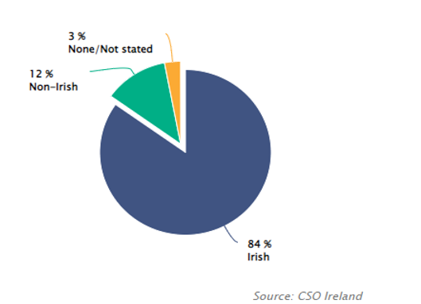
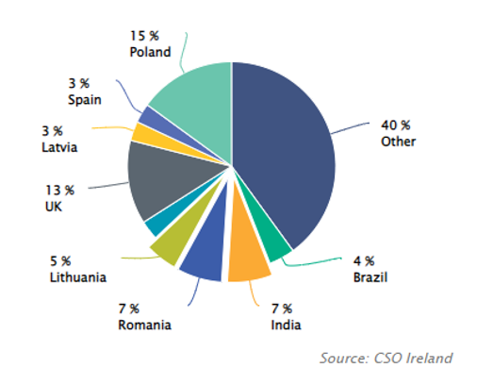
Citizenship
Population usually resident and present in the State by citizenship (%), 2022
Non-Irish population usually resident and present in the State by citizenship (%), 2022
Notes:
Looking at the broad categories of Citizenship:
84% of the people who usually lived in Ireland recorded their citizenship as either Irish or Dual Irish.
Non Irish citizens account for 12% of the usually resident population in 2022 – of these the largest groups were Polish and UK citizens, followed by India, Romania and Lithuania.
The question on nationality changed in Census 2022 to capture information on country of citizenship. This change may have impacted comparisons with previous census data.
In 2016 – 87% of the usually resident population were Irish and 11% were Non Irish.

Slide 13
Dual Irish
Dual Irish citizens usually resident and present in the State by place of birth, 2022
84% Irish citizens: 81% Irish only, 3% Dual Irish
Dual Irish (170,597): 63% increase from 2016
Dual Irish: place of birth
37% - born in Ireland
63% - born outside Ireland
Irish-UK, Irish-American, Irish-Polish and Irish-Australian were the largest groups of dual Irish citizens
Notes:
Of the 84% (4.3m) of people recording Irish citizenship, over 170k were grouped into the category of ‘dual Irish’, this represents an increase of 63%
Dual Irish citizenship records where people were both citizens of Ireland and another country.
63% of those recording a citizenship of dual Irish were born outside Ireland.
The largest groups of dual Irish citizens were Irish UK, American, Polish and Australian.
The proportions of dual citizens born inside or outside of Ireland varies across different dual citizenship categories for example - A much larger proportion of Irish UK citizens were born outside Ireland compared to the Irish Americans, Polish and Australians – where they were more balanced around a 50/50 split for born inside or outside Ireland.

Slide 14
Religion
Roman Catholic percentage by administrative county, 2022
Usually resident population:
Roman Catholic fell from 79% in 2016 to 69% in 2022
No religion increased from 10% in 2016 to 14% in 2022
Church of Ireland remained the second largest religious category in 2022
Notes:
The question on religion has been on the Census for many years and allows us examine the various religions that the people living in Ireland identify with.
It also provides a picture of changes over time of people who identify with No Religion.
There was a fall in the proportion of the usually resident population who identified as Roman Catholic by over 180k to 3.5million (69%) in 2022.
The No Religion category increased from 451,941 people to 736,210.
The Church of Ireland category showed little change but remained the second largest religious category with 124,749 people (2%).
Fastest growing Religions were Hindu and Christian Orthodox.
Hindus – which more than doubled from 13k to 33k and
Orthodox which increased from over 60k people to over 100k people in 2022.
Looking at Religion by County – Mayo recorded the highest percentage of Roman Catholics (80%), while Dublin City recorded the lowest at 53%

Slide 15
Section 2: Summary results Census 2022 Employment, occupation, industry and commuting Education and the Irish language Dwelling characteristics
Notes:
This section will look at some of the findings about employment, commuting, the Irish language and home ownership.
There is more detail and additional topics covered in the publication

Slide 16
Population aged 15 years and over by principal economic status, 1986 - 2022
Principal economic status
More people at work
Fewer people looking after home/family
Retired population up from 8% in 1986 to 16% in 2022
Notes:
Principal Economic Status in the census measures whether people are at work, unemployed or not in the labour force.
The share of the population at work has been increasing since 2011 with a corresponding decrease in unemployment.
Combining the people at work and the unemployed we can see the share of the population in the labour force increased steadily over 30 years between 1986 and 2006.
Since 2006 the proportion of the population in the labour force has fallen slightly.
What has been driving these changes?
Just over 1 in 10 people aged 15 and over are students and this has stayed relatively constant over recent censuses.
We can see there has a been a big change in the share of the population looking after the home or family over time down from 26% in 1986 to under 7% in 22.
Also we are seeing a rise in the proportion of retired persons from 8% in 1986 to 16% in 22
So more recently the increase in women entering the labour force has been offset by increases in the share of the retired population.

Slide 17
Employment by sector
Selected industrial groups, 2011 to 2022
Employment in the Manufacturing sector was up 21% and in the Construction industry it was up 32% since 2016
In both the Information & Communications and the Professional, Scientific & Technical Activities sectors employment was up close to 40% from 2016 to 2022
There were over 20% more workers in public sector dominated categories
Notes:
We have seen an increase in the number of people at work and we can further look at what sectors of the economy have seen the largest changes.
Click
Employment in manufacturing was up 21% between 16 and 22
The number of people working in the Construction industry stood at nearly 135,000, up 32%.
Click
In the Information and communications activities sector, which includes many tech companies, and in the Professional, scientific and technical activities sector, which would include firms in accountancy, law, engineering for example, employment was up 39%
Click
Public administration and defence was one of the few sectors that saw a drop in employment between the 2011 and 2016 censuses but grew by 23% to almost 130,000 between 16 to 22.
Human health and social work activities was the second largest sector with almost 270,000 in employment and saw the largest absolute increase of nearly 46,000 since 2016.

Slide 18
Working from home
Working from home by occupation, 2022
New question on working from home
Nearly 750,000 people, a third of workers, indicated that they worked from home for at least some part of their week
Business, Media, & Public Service professionals were most likely to work from home (80%)
Workers in Elementary Administration & Service occupations were least likely to ever work from home (3%)
Notes:
In 2022, a new question was asked on the census form about whether people ever worked from home.
Nearly 750,000 people, a third of workers, indicated that they worked from home for at least some part of their week.
Four out of five Business, media and public service professionals were availing of home working, that would include legal professionals, accountants for example
The proportion of workers in the Science, research, engineering and technology professionals group who ever worked from home was also high at 78%, this would include IT specialists.
Workers in Elementary administration and service occupations were the least likely to ever work from home, at just 3%, this group includes couriers and cleaners for example

Slide 19
Full-time and part-time workers
Question on employment was expanded to include full-time and part-time status
75% of workers reported they worked full-time
Notes:
For the first time, the census asked workers whether they were at work on a full-time or part-time basis.
Overall 75% of workers reported they worked full-time
The three occupational groups where workers were most likely to be part-time were:
Secretarial occupations such as receptionists and typists: 39% of workers.
Workers in personal services such as hairdressers, beauticians and cleaners: 37% of workers.
Sales occupations: 36% of workers.
The occupational groups where workers were least likely to be part-time included:
Professionals and associate professionals in Science, engineering and technology where over 90% of workers were full-time
Similarly protective service occupations such as Gardai and prison officers

Slide 20
Commuting
1.2 million people driving to work, up 4% since 2016
The number of people working mainly from home was up 173% to nearly 260,000
4% fewer people commuting to work by train, LUAS or DART
Fewer third level students were commuting on foot or by bike, but more were using public transport and cars
88% more children aged 5 to 12 cycling to school and 79% more children and students aged 13 to 18
Notes:
The census questions on commuting give insight into how and when people travel to their place of work, school, college and childcare.
The number of people who drove to work increased by 4% to 1.2 million between 2016 and 2022.
A big increase was recorded in the number of people who work mainly at or from home, up 173% to nearly 260,000.
There were 4% fewer people commuting to work by train, LUAS or DART.
Fewer third level students commuted to their place of education on foot or by bike, but more used public transport and cars.
The main form of transport for school children remained the car and while the actual number of children cycling to school was relatively small nonetheless in 2022, there were 88% more primary school age children cycling to school than in 2016, and the number of secondary school aged children cycling to school was up 79%.

Slide 21
Irish speakers
Level of Irish spoken, 2022
1.87 million people could speak Irish, up 6% since 2016
Daily Irish speakers was 71,968, down 2%
New part to the question on ‘how well do you speak Irish?’
Notes:
The question on Irish language ability continues to provide important data on how many people can speak Irish, how often they use it and in which areas of the country it is more prevalent.
The number of people who indicated that they could speak Irish increased by 6% between 2016 and 2022 to 1,873,997.
There were 72,000 people speaking Irish daily outside of the education system, a fall of 1,835 on the 2016 figure.
New part to the question on how well Irish is spoken

Slide 22
Home ownership and renting
Average weekly rent, 2011 to 2022
Home ownership down to 66% in 2022 from 68% in 2016 and 70% in 2011
Average weekly rent in private rental accommodation up 37% to €273 between 2016 and 2022
Notes:
In Census 2022, people were asked about several aspects of their home and whether they owned it or were renting.
Just to say we are currently analysing data on the total housing stock including unoccupied dwellings and the results of that will be published in July.
The proportion of owner-occupied dwellings continued to fall, down from almost 70% to 66% in the 11 years between 16 and 22.
The average rent paid in properties rented from a private landlord increased by 37% to €273 per week in the six years to 2022.

Slide 23
Nature of occupancy and year built
Dwellings built before 2016
Dwellings built between 2016 and 2022
Notes:
Data on the year a property was built is only available for dwellings that were occupied on Census Night and is completed by the householder. Of the occupied housing stock, over 93,000 were reported to be built between 2016 and 2022, almost twice as many as in the 2011 to 2015 period.
Over half (52%) of homes built since 2016 were owner occupied with a mortgage or loan and just 11% were owned outright whereas 38% of older dwellings were owned outright.
15% of the dwellings built since 2016 were rented from private landlords.
Another approximately 12,500 or 13% were rented from local authorities.
Just over 6% were rented from voluntary or cooperative bodies compared to 1% of older dwellings

Slide 24
Renewable energy
Solar panel usage (%) by county, 2022
New question on renewable energy
23% of households reported they used renewable energy sources
Over 70% of dwellings built since 2016 used renewable energy sources
6% of households used solar panels, 30% of dwellings built since 2016 had solar panels
Notes:
A question about renewable energy sources was asked for the first time.
Nearly a quarter of households reported that they used renewable energy sources.
In older houses wood was the most common renewable energy source
Over 70% of the dwellings built since 2016 used at least one renewable energy source.
Over 40% of this same cohort had heat pumps.
Approximately 30% had solar panels.
Overall the use of solar panels was reported by 6% of households, ranging from 3% of households in Dublin City to 11% of households in Meath.

Slide 25
Publication Schedule

Slide 26
