Slide 1
Creating PX Files
Paul Rockley
FSLG - 29th September 2016

Slide 2
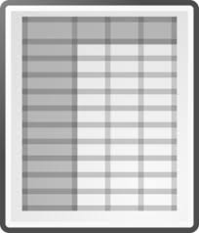
PX-file
First steps
Moving to Automation
PX file composition
Program workflow

Slide 3
First Steps
Options for Manual Creation
PX-Make (Statistics Denmark)
PX-Edit (Statistics Finland)
R Software
pxR Package
Advice
Statistics Finland site
http://tilastokeskus.fi/tup/pcaxis/lataus_tyokalut_en.html

Slide 4
Why Automate?
Input Errors reduced
Speed
Reproducibility

Slide 5
PX File - Composition
Two Parts…
Header
Data

Slide 6
PX file example used in presentation…
Month
Location
Sex
Age Group
Statistic

Slide 7
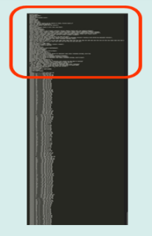
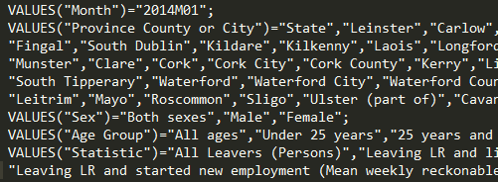
PX File - Header
Coding of Variables…

Slide 8
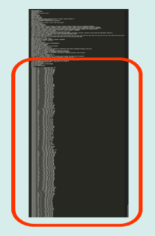
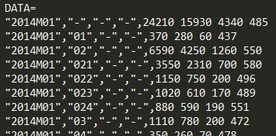
PX File - Data
HEADER
DATA

Slide 9
Program Workflow
Summarise
Merge
Create PX file
PX

Slide 10
Process 1 Summarise

Slide 11
Process 1 – Summarise

Slide 12
Process 2 Merge
Merge on composite key

Slide 13
Process 3 Create PX file
PX
Create blank PX file
Header - read in PX header template and replace marker text
Data - write to file after formatting and confidentiality checks

Slide 14
Detail – 2) Read in PX header template and replace marker text
Process 3 –
Create PX file

Slide 15
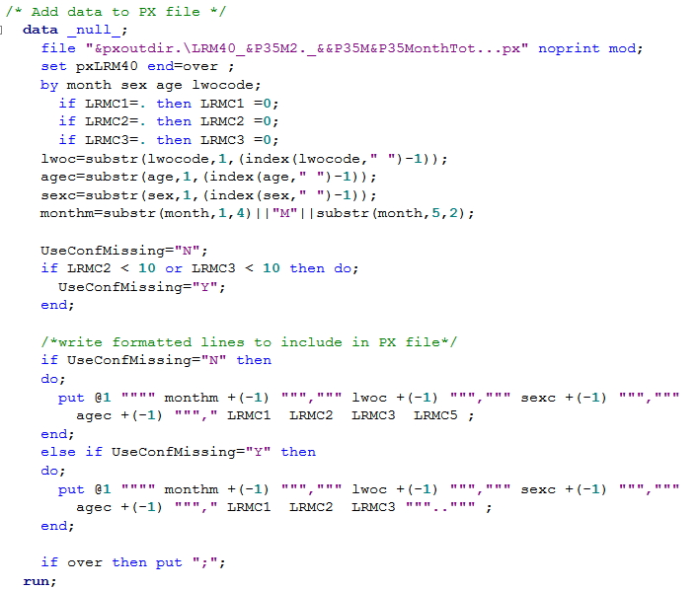
Detail – 3) Write data to PX file
Process 3 –
Create PX file

Slide 16
Detail – 3.1) Formatted Output
Process 3 –
Create PX file

Slide 17
Detail – 3.2) Confidentiality
Process 3 –
Create PX file

Slide 18
PX-file

Slide 19
Thank you

