Slide 1
GFS Seminar Non-Financial Accounts 2008 – 2021 : Interesting Times
Tom Fitzgerald

Slide 2
Outline of Presentation
Overview of Revenue, Expenditure and Balance 2008 - 2021
Revenue
Breakdown of income sources
2008 – 2021 : Trends, Comparisons and Contrasts
Tax
Expenditure
Breakdown of expenditure
2008 – 2021 : Trends, Comparisons and Contrasts
Social Benefits

Slide 3
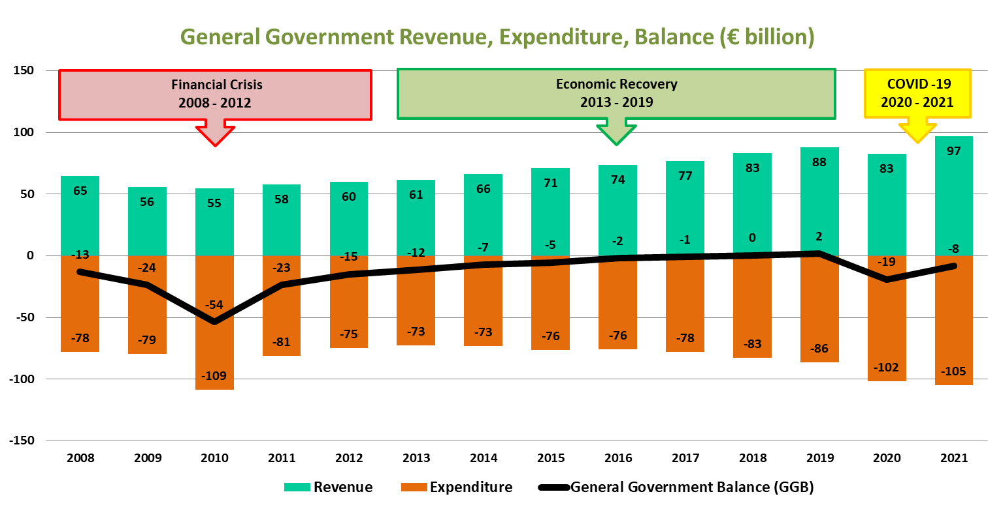

Slide 4
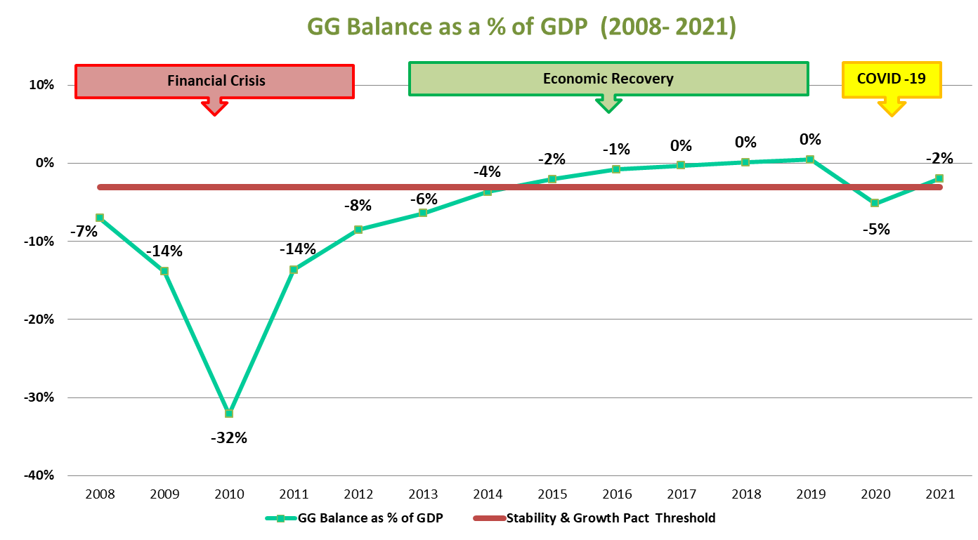

Slide 5
General Government - Revenue Sources
Taxes
Indirect Taxes – VAT, Direct Taxes - Taxes on income, profits and capital gains, Capital Taxes
Social contributions
Actual social contributions – PRSI, Employers' imputed social contributions
Sales of goods and services
Incidental sales and fees of non-market establishments
Investment income
Interest, Dividends, Rent of Natural Resources
Current transfers
Domestic and International
Capital transfers
Investment Grants & Other Transfers - Domestic and International

Slide 6
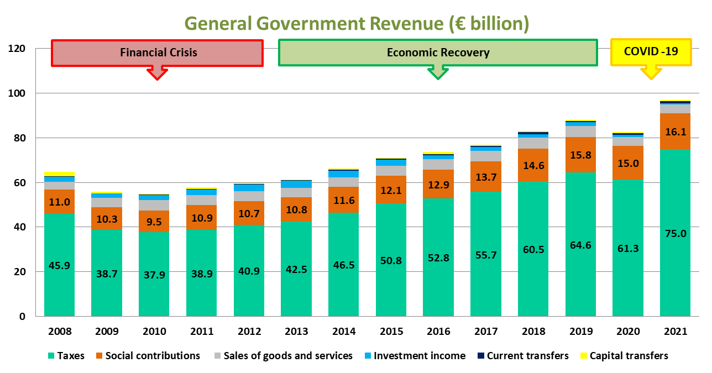

Slide 7
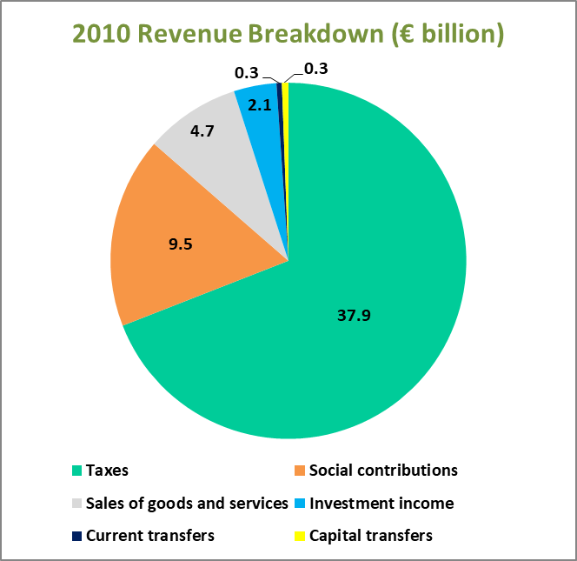
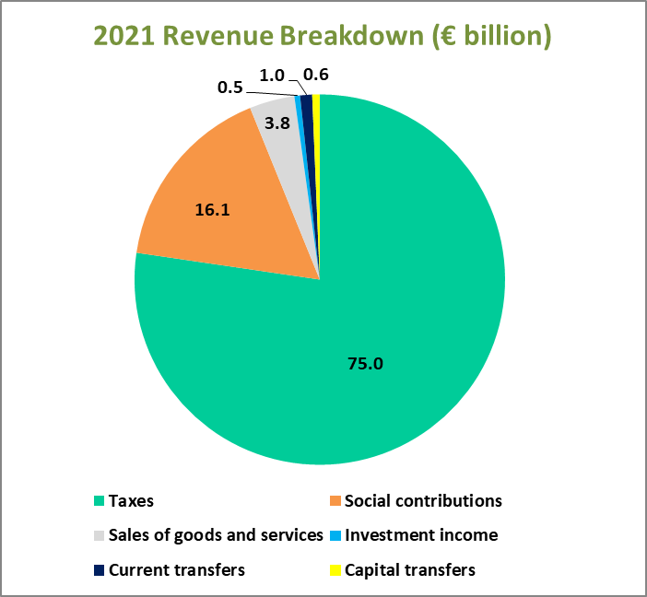

Slide 8
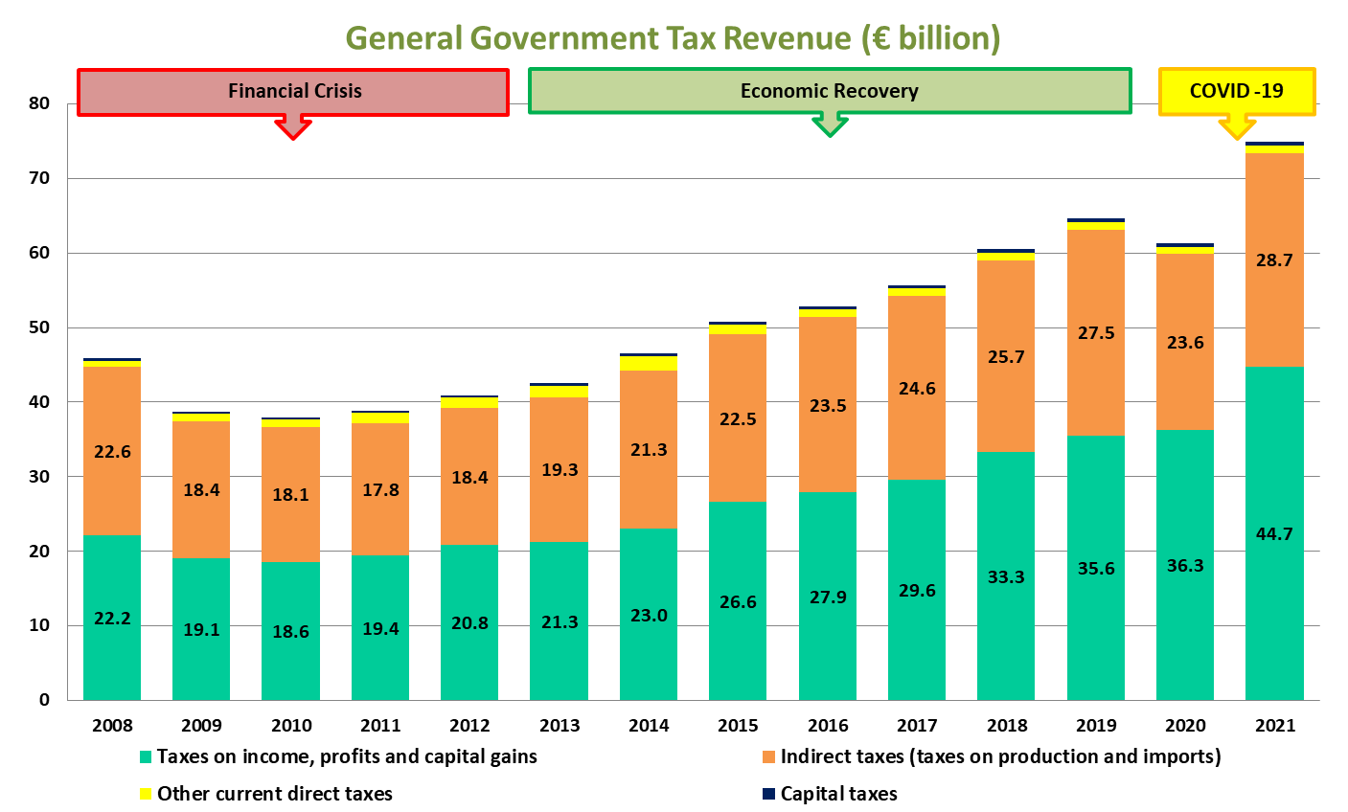

Slide 9
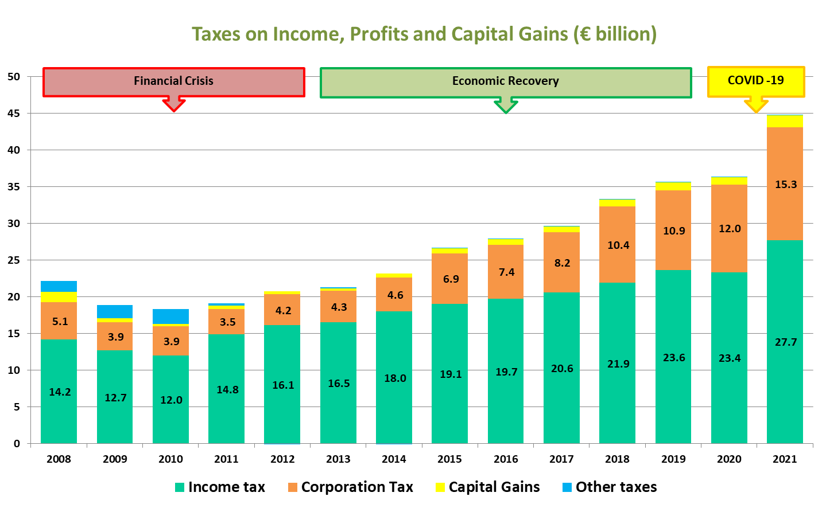

Slide 10
General Government - Expenditure
Compensation of Employees
Use of Goods and Services
Social Benefits
Subsidies
Gross Fixed Capital Formation
Interest
Current Transfers
Capital Transfers

Slide 11
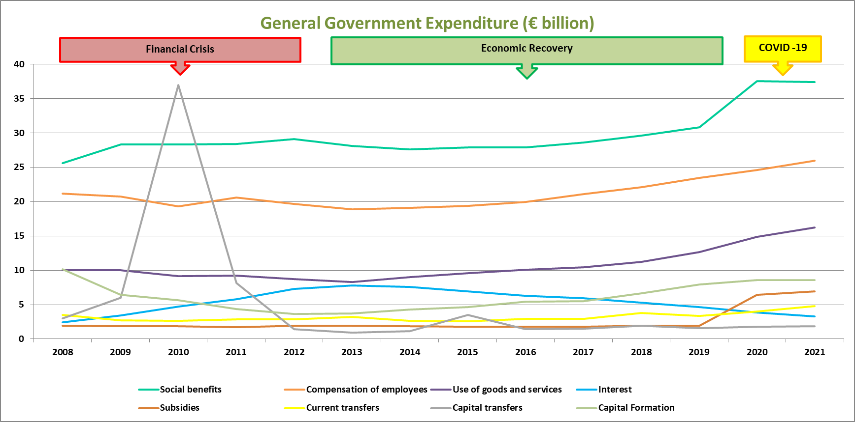

Slide 12
Social Benefits
Social benefits in cash
Social Protection Payments
Pandemic Unemployment Payment
Pensions
Social benefits in kind (via market producers)
Examples include:
General Medical Service Scheme
Drug Payment Scheme
Housing Assistance Payment Scheme

Slide 13
