Slide 1
Overview of Government Finance Statistics Stephen McDonagh

Slide 2
Overview
Role of Central Statistics Office
What is Government Finance Statistics
How is data compiled
Relationship with public accounts (Exchequer)

Slide 3
Role of CSO
National Statistical Institute (NSI)
Part of the European Statistical System
Primacy of role of the NSI and of the DG in relation to statistical matters established in national and EU law.
Statistics Act, 1993
Regulation (EC) No 223/2009 (as amended 2015)

Slide 4
Structure of division - functions
Government Accounts Compilation & Outputs Division
Government Finance Statistics & Excessive Deficit Procedure
Health and Social Protection Accounts
(Total economy)
EDP notification for Ireland
Government Deficit & Debt
National Accounts (ESA 2010) government series
Revenue, expenditure, GDP contribution, assets and liabilities
System of Health Accounts
Social Protection Statistics (ESSPROS)
Estimates of Pension Liabilities

Slide 5
What is Government Finance?
Exchequer
National Debt
On/off balance sheet
Hospitals
Departments and agencies
Public sector pay
Local Authorities
Universities
Commercial semi states
Public service
Schools and VECs

Slide 6
What is Government Finance Statistics
Compiled as part of National Accounts
Legally binding EU standards – European System of Accounts 2010 (ESA2010)
Describe the economic functions and activity of government
Based on the concept of “general government” (from ESA2010)

Slide 7
Outputs
Non-financial accounts of government
Revenue/Income
Expenditure
Financial accounts of government
Assets
Liabilities

Slide 8
Outputs
Government Finance Statistics are part of the National Accounts Framework
But GFS presentation of revenue/expenditure is more like standard business accounting than national accounts presentation
However all of the measures/concepts map into national accounts framework and sequence of accounts

Slide 9
Excessive Deficit Procedure
Excessive Deficit Procedure notification
Biannual, end March/September
Reporting of government deficit and debt levels for Ireland to Eurostat as required under Stability and Growth Pact and subsequent EU legislation.
Reporting forms part of “preventive arm” of EDP – monitoring of EU MSs deficit and debt levels
SGP limited these to 3% of GDP (deficit) and 60% of GDP (debt)
Fiscal Compact requires ‘balanced budget’ or surplus i.e. structural deficit of not more than 0.5% of GDP

Slide 10
EDP – Key measures
${GG Surplus/Deficit}_{nf}=Revenue −Expenditure$
${GGSurplus/Deficit}_{f}=∆ Assets − ∆ Liabilities$
In theory ${GG Deficit}_{nf}$ = ${GG Deficit}_{f}$
In practice there is usually a statistical discrepancy
$GG Debt=\sum{({Currency \& Deposits}_{Liab}+}{Loan}_{Liab}+{Debt Securities}_{Liab}$)

Slide 11
Where does the data come from
Exchequer statement – overall balance and specific transactions
Finance Accounts – final audited accounts of Exchequer
Estimates system – expenditure by programme, subhead
Appropriation accounts
Tax data from Revenue Commissioners
NTMA/ISIF returns
Joint surveys with Dept of Finance
Annual reports of other bodies
Local authority accounts

Slide 12
ESA 2010 accounting
Double / quadruple entry
Time of recording - accrual
Gross recording
Financial transactions - exchange of one asset type for another (e.g. cash to shares) has no impact on surplus/deficit
Consolidation – flows between subsectors of government do not appear in consolidated general government presentation

Slide 13
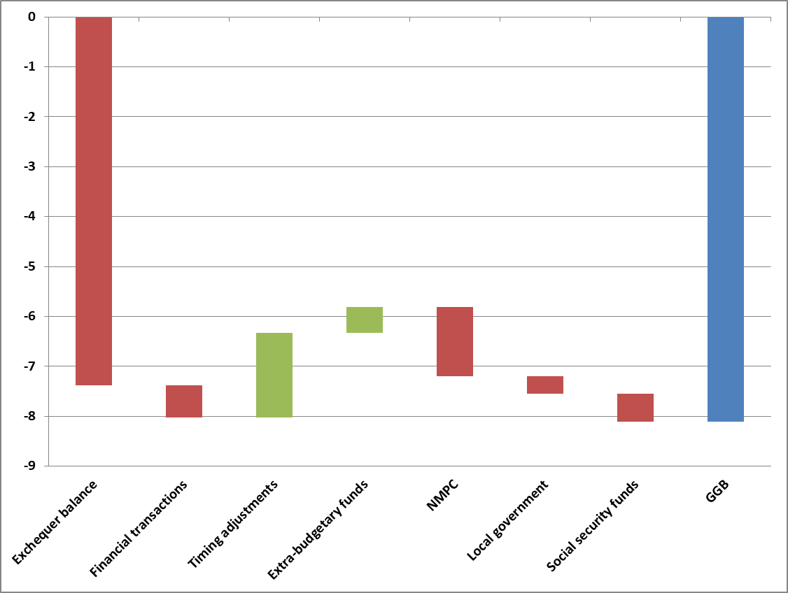
From Exchequer to general government 2021, €bn
-7.4
-0.7
1.7
0.5
-1.4
-0.4
-0.6
-8.1

Slide 14
CSO GFS publications https://www.cso.ie/en/statistics/governmentaccounts/ Information note https://www.cso.ie/en/releasesandpublications/in/webggb/informationnote-walkfromexchequerbalancetogeneralgovernmentbalance/ CSO Government Accounts Compilation and Outputs Division gfs@cso.ie

