Slide 1
The Availability of Housing Statistics in Ireland – Gaps and Future Needs
Ronan Lyons, Trinity College Dublin
CSO Housing Statistics Seminar
Dublin Castle, 18 October 2016

Slide 2
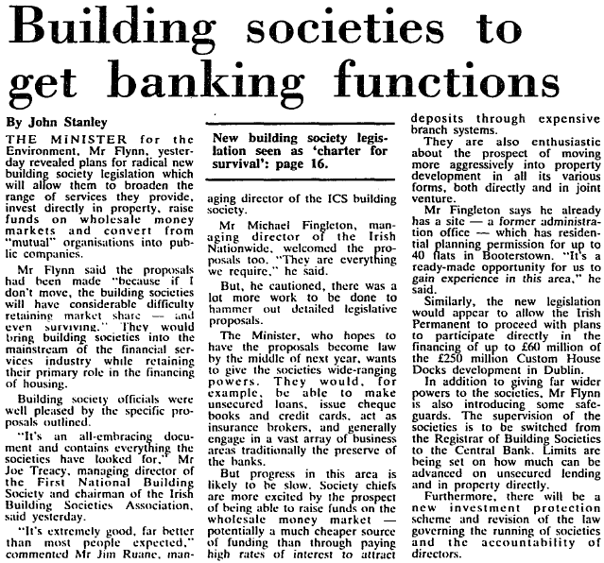
Lessons from history: the forgotten bubble of 1988
Source: Own work-in-progress

Slide 3
Structure
A History of Housing Statistics
The New RPPI
Further Improvements
Beyond Prices

Slide 4
A brief history of housing prices…
Valuations (based primarily on rental) started in the mid-19C
Continued for over a century… (And still going for commercial property)
Dept of Environment simple averages, from 1969 on
And quarterly from early 1970s
The only measure of housing prices until the mid-1990s
Also other housing statistics, e.g. loan by institution and borrower type

Slide 5
What’s wrong with simple averages?
The type of properties that trade in busts are structurally different from those that trade in booms
Clear insight from DOE series in 2010: implies strong price gains at a time when prices were falling
Above-average income households were less affected
Need to control for…
Property attributes, e.g. type, size, age
Location attributes – typically a collection of markets (e.g. counties)

Slide 6
A brief history of housing prices…
Valuations (based primarily on rental) started in the mid-19C
Continued for over a century… (And still going for commercial property)
Dept of Environment simple averages, from 1969 on
And quarterly from early 1970s
The only measure of housing prices until the mid-1990s
Also other housing statistics, e.g. loan by institution and borrower type
PTSB-ESRI: first mix-adjusted index (hedonic price regression)
Based on one major lender, mortgage-backed transaction prices
Quarterly from 1996; ended in 2010 – reliance on one lender, problematic when transaction/mortgage volumes fell 90%+
Other measures pre-2006 included estate agent valuations/estimates

Slide 7
Convergence in housing price statistics
2006 – daft.ie: based on population of online listings
Including those not on daft.ie; analogous rental price index
Hedonic price regression, system of ~400 micro-markets; tweaked upon introduction of CSO v1
Currently being extended back to 1922 (also rents)
2011 – CSO v1: based on population of mortgages (at key banks)
Hedonic price regression, county-level ‘fixed effects’
In line with best practice in other countries
2012 – myhome.ie: based on online listings
Hedonic price regression
Since 2015, method similar to daft.ie/CSO

Slide 8
Structure
A History of Housing Statistics
The New RPPI
Further Improvements
Beyond Prices

Slide 9
The new CSO index
A step-change on CSO v1:
Includes cash purchases; population of all transactions
Includes property size, age, energy rating (from SEAI BER register)
Includes location at Census Small Area
Allows the publication of average transaction prices

Slide 10
Old and new indices tell similar stories to each other – and to the Daft.ie index, with differences likely due to weighting
Year-on-year change in RPPI: Dublin
Year-on-year change in RPPI: Ex-Dublin

Slide 11
Structure
A History of Housing Statistics
The New RPPI
Further Improvements
Beyond Prices

Slide 12
Suggestions for CSO v3!
Residential property prices depend on…
Size: is m² as recorded in BER accurate? (What about m³?!)
Age: vintage vs. quality (vs. depreciation)
Location: schools, transport facilities, green space
Much of this already bundled into location ‘fixed effect’
However, single biggest missing factor currently is site size
One of the first characteristics included in academic research on property values – garden space, but also option value (mews, corner house)
OSI PRIME2 database, PRAI Land Registry, EU INSPIRE directive…

Slide 13
Structure
A History of Housing Statistics
The New RPPI
Further Improvements
Beyond Prices

Slide 14
What do policymakers need to manage the housing system well?
Register of residency: who lives where?
Could be linked to land/property tax credits
Register of beneficial ownership: who owns what?
Cadastre is standard elsewhere (and was in 1850s Ireland!)
Register of transactions
RPPR – but with significantly improved stamp duty form; also bids
RTB – renters are people too!
Register of construction projects
Application – Approval – Commencement – Completion – then occupancy
Improvements / Change of use / Etc

Slide 15
Thank you!
Looking forward to comments and questions…

