Slide 1
18 October 2016
Central Statistics Office
Housing Statistics Seminar
New Residential Property Price Index (RPPI)
Gregg Patrick

Slide 2
Overview
RPPI Methodology
Why compile the RPPI?
Quality adjustment
Original versus New RPPI
Statistical Outputs
New Price indices
Additional indicators
Accessing the statistics
Future developments

Slide 3
Why compile the RPPI?
National Needs
Macroeconomic monitoring
Informing policy
Asset valuation
Informing purchasing decisions
EU requirements
Harmonised Index of Consumer Prices (HICP)
Commission Regulation (EU) No 93/2013
Macroeconomic Imbalance Procedure (MIP)

Slide 4
Quality Adjustment (1)
Why quality adjust?

Slide 5
Quality Adjustment (2)
How to quality adjust?

Slide 6
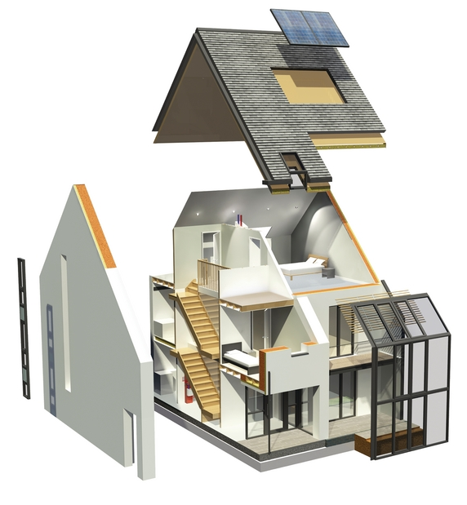
Quality Adjustment (3)
The Hedonic Method – Deconstruct Price
3 Principal Characteristics:
Location
Building (Size)
Land (Area)

Slide 7
Quality Adjustment (4)
Price modelling
$$\ln\left(p_{it}\right)= x_{it}β+δ_{t}D_{t} + µ_{it}$$
$p_{it}$ is price
$x_{it}$ is a vector of dwelling characteristics
$β$ is a vector of explanatory price coefficients
$δ_{t}$ is a vector of time period coefficients
$D_{t}$ is a vector of ‘time dummies’
$µ_{it}$ is an error term

Slide 8
Original RPPI
Based on mortgage transaction data:
Price
Buyer Type (first-time buyer, former owner-occupier, etc.)
New/Existing
Building floor area (m2)
No. of bedrooms
Dwelling type (detached, semi-detached, etc.)
County/Dublin postcode
Weaknesses
Excludes cash buyers
Limited location information

Slide 9
New RPPI (1)
Data Sources
Data Matching
Stamp Duty data
Building Energy Ratings data
CSO Census
Geo-
directory

Slide 10
New RPPI (2)
Address String Matching
21 THE PARK (plus Estate, Town and County)
Matched Address | JWD
21 THE PARK (same Estate, Town and County) | 0.8776
21 THE AVENUE (same Estate, Town and County) | 0.8328
21 THE CRESCENT (same Estate, Town and County) | 0.8303
21 THE HAMPTONS *** Same County | 0.8284
21 THE DRIVE *** Same County | 0.8236
21 THE CLOSE *** Same County | 0.8236
21 THE HEATHERS *** Same County | 0.8102
21 THE CRESCENT *** Same County | 0.8073
21 THE MEADOWS *** Same County | 0.8017
21 THE LAURELS *** Same County | 0.7918

Slide 11
New RPPI (3)
Variable Selection:
Source | Included
Stamp Duty Data | Price (dependent),
BER Data | Total floor area (m2), Dwelling Type
GeoDirectory | Eircode Routing Key
Census related | Pobal HP Deprivation Index

Slide 12
New RPPI (4)
New versus Original RPPI

Slide 13
Statistical Outputs (1)
New Price Indices:
Dublin City Houses
Dún Laoghaire-Rathdown Houses
Fingal Houses
South Dublin Houses
Border Houses
Midland Houses
West Houses
Mid-East Houses
Mid-West Houses
South-East Houses
South-West Houses
National (excluding Dublin) Apartments

Slide 14
Statistical Outputs (2)

Slide 15
Statistical Outputs (3)
New Additional Indicators:
Volume of Transactions
Value of Transactions
Average Price of Transactions
Available by:
Buyer Type
New/Existing
Houses/Apartments
Region/County/Eircode Routing Key

Slide 16
Statistical Outputs (4)

Slide 17
Statistical Outputs (5)
Accessing RPPI Results:
www.cso.ie

Slide 18
Future Developments
Expanded Range of Additional Indicators
New & Existing House Price Indices?
Further Analysis of Mortgage/Cash-Buyer Differences
Land variable for price model?
Specialised Technical Group?

