Slide 1
18 October 2016
Central Statistics Office
Housing Statistics Seminar
Joe Treacy
Central Statistics Office
Ireland

Slide 2
Housing Statistics Seminar 18 October 2016
Policy Context
Action Plan for Housing and Homelessness
Budget 2017
Statistical insight to inform policy
What’s available?
What are the gaps?
Who are the producers of housing statistics?
How can we work together to build the full picture?

Slide 3
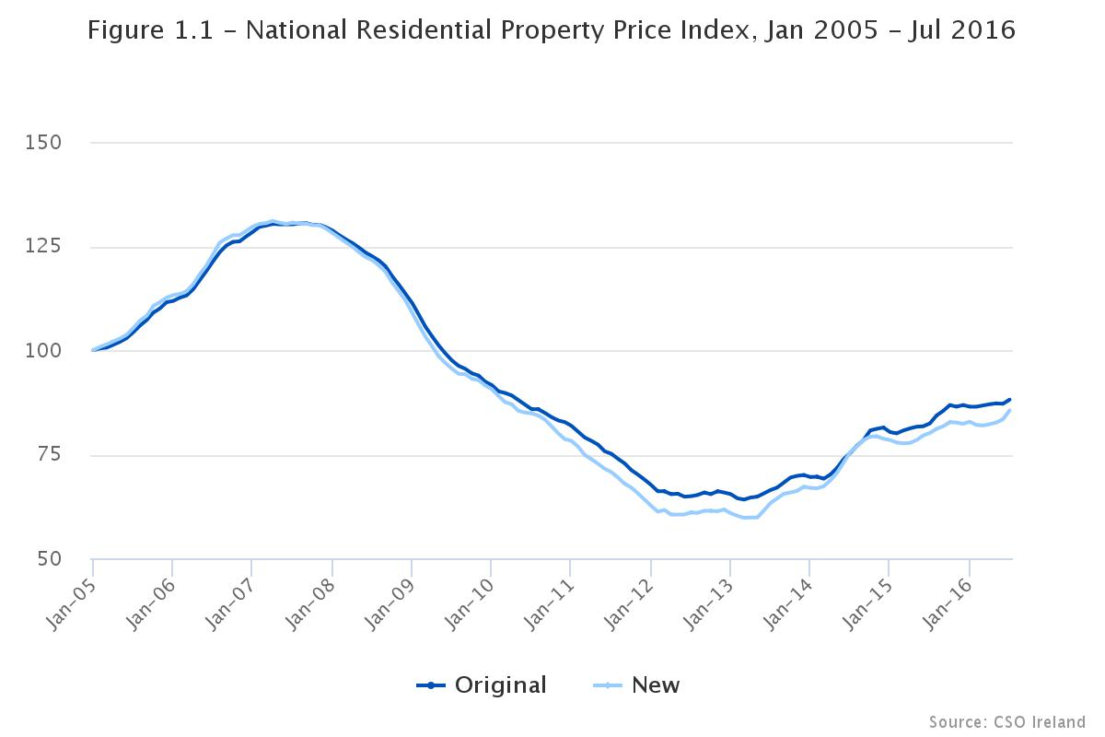
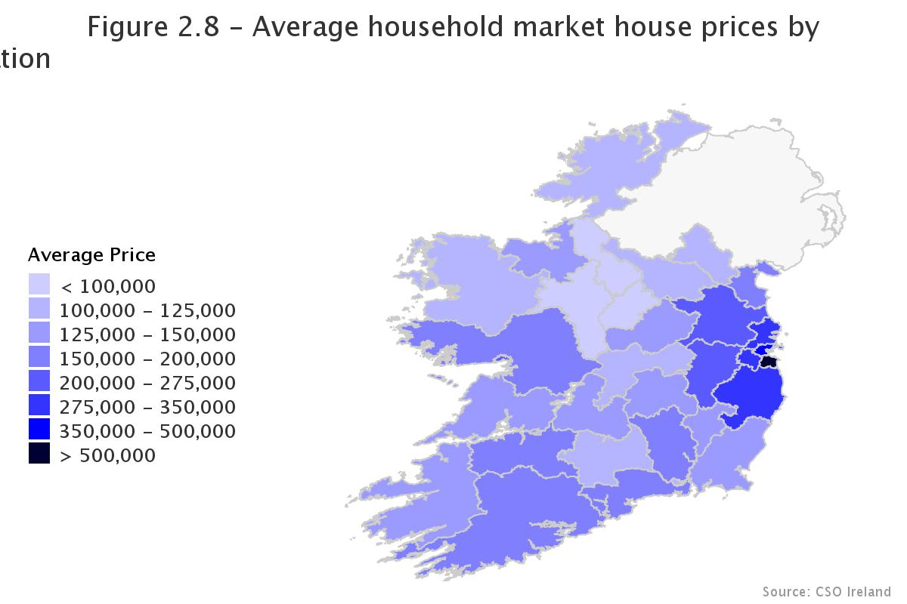
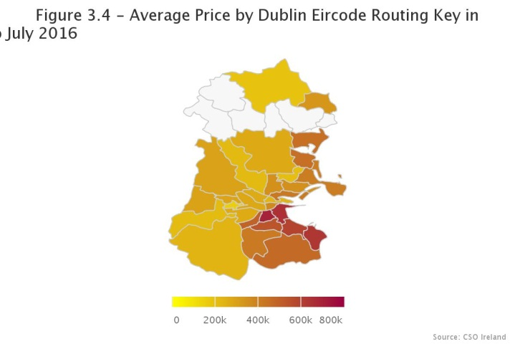
Housing Statistics Seminar 18 October 2016

Slide 4
Housing Statistics Seminar 18 October 2016
New App
Eircode Interactive House Prices
Now on www.cso.ie

Slide 5
Housing Statistics Seminar 18 October 2016
CSO Statistics on the Housing Market
Residential Property Price Index (RPPI)
Turnover – Value, Volume and Average Price
House Prices by Eircode Areas
Stock of Housing – Census 2016
Planning Permissions

Slide 6
Housing Statistics Seminar 18 October 2016
Department of Housing
Commencement Notices
House Completions
New House Guarantee Registrations
House Building Costs Index
Available at:
http://www.cso.ie/en/databases/

Slide 7
Housing Statistics Seminar 18 October 2016
Time | Topic | Speaker
9.15 | Introduction | Joe Treacy, CSO
9.30 – 10.10 | New Residential Property Price Index | Gregg Patrick, CSO
10.10 – 10.50 | The Availability of Housing Statistics in Ireland – Gaps and Future Needs | Ronan Lyons, TCD
10.50 – 11.20 | Tea / Coffee
11.20 – 11.50 | Census 2016 Housing Statistics | Brendan Murphy, CSO
11.50 – 12.20 | Housing Policy in Ireland | David Duffy, Property Industry Ireland
12.20 – 12.50 | Discussion and concluding remarks

Slide 8
Housing Statistics Seminar 18 October 2016
Discussion and concluding remarks
What’s available?
What are the gaps?
How can we work together to build the full picture?
All presentations will be on www.cso.ie

