Slide 1

Census 2016
Counting Ireland’s Housing Stock
Brendan Murphy, CSO

Slide 2
Census Timeline
Census night – 24 April 2016
End of field campaign – May 2016
Preliminary Results – 14 July 2016
Processing complete – December 2016
First final results – April 2017
All results published – End 2017

Slide 3
Overview of Field Operation
GeoDirectory
  First used for Census 2011
  The National address database (owned by An Post and OSi)
  The postal address of most address points (approx 2.2 million) in the State
  The co-ordinates and geographical position of each building (accurate to 1m, building centre)
  Whether a building is commercial, residential or mixed residential/commercial
  Whether a building has single or multiple addresses
Almost 2,050,000 dwellings identified from most recent GeoDirectory (Oct 2015) for enumeration in Census 2016

Slide 4
Overview of Field Operation
GeoDirectory is hugely beneficial, however
  Over 40,000 additional dwellings found in 2011;
    One-off houses
    New housing estates
    Apartments in converted buildings
  Buildings with incorrect coordinates
  Addresses marked as residential but found by enumerators to be commercial
  Addresses which do not exist
Enumerators informed of these issues and instructed to perform full visual enumeration of their area

Slide 5
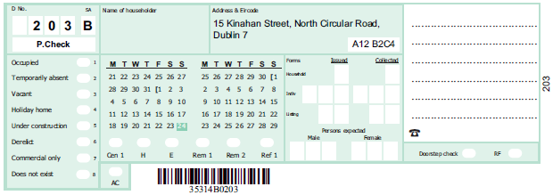
Overview of Field Operation
Each GeoDirectory address point selected for enumeration is given a unique number (Called D No) within each Enumeration Area
  This number is labelled on the enumerator map and in the Enumerator Record Book (ERB)
The Enumerator Record Book
  Key document used in Field
  Contains D Nos, Addresses and Eircodes for dwellings on GeoDirectory
  Enumerator marks the status of the dwelling
  Blank spaces for new dwellings

Slide 6
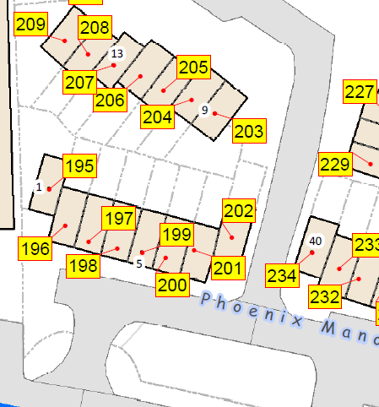
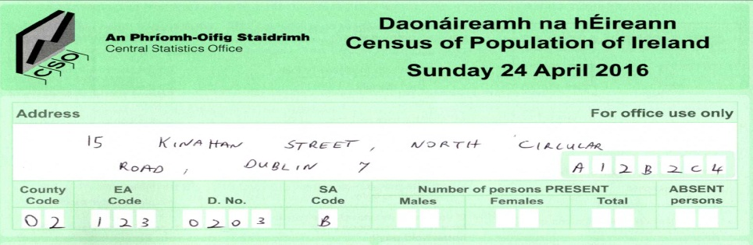
Occupied Housing
Use the map to arrive at a dwelling
Find the details associated with the dwelling in the ERB
If Occupied
  Transfer address, Eircode and geography codes (County, EA, SA and D. No) from the ERB to the front panel of the Census Form before handing over to the householder

Slide 7
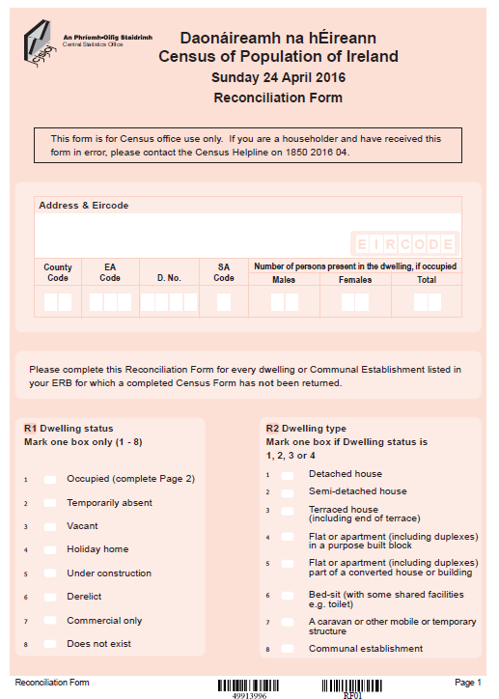
Unoccupied Housing
If Not Occupied
  Complete a reconciliation form
  Decide on the dwelling status
  Used for statistical purposes:
    Temporarily absent
    Vacant
    Holiday home

Slide 8
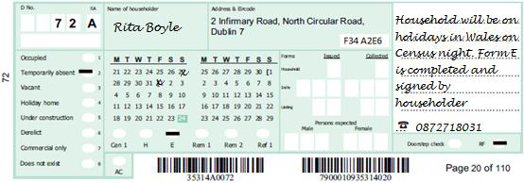
Determining the dwelling status
Temporarily absent
  For dwellings where the entire household is away on Census Night.
  In cases where the householder indicates that the household will be abroad, they must sign a declaration to that effect.
  A check should be made after Census Night to ensure that there was no change of plans.

Slide 9
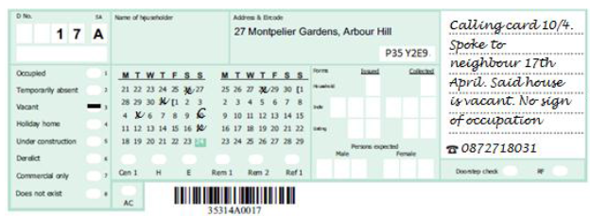
Determining the dwelling status
Vacant dwellings
  House is fit for habitation (has roof, walls, windows installed)
  Shows no sign of habitation e.g. no cars outside, junk mail accumulating, overgrown garden etc.
  Consult with neighbours
  At least 3 visits required

Slide 10
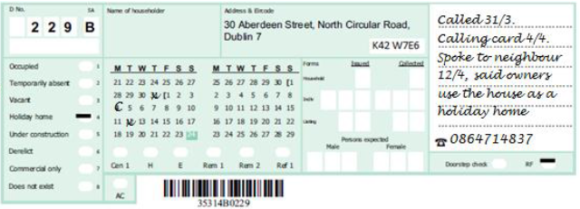
Determining the dwelling status
Holiday home
  Dwelling is used on part-time basis, weekends, etc.
  May be located in area likely to be popular among holiday makers
  Neighbours must be consulted in order to confirm that dwelling is a holiday home
  Must be revisited after Census night to verify that nobody spent Census Night in the dwelling.
  Can be in a city - city weekend flat.

Slide 11
Accounting for Every Dwelling
If Not Occupied
  Complete a reconciliation form
  Decide on the dwelling status
  Used for statistical purposes:
    Temporarily absent
    Vacant
    Holiday home
  Used for administrative purposes:
    Under construction
    Derelict
    Commercial only
    Does not exist

Slide 12
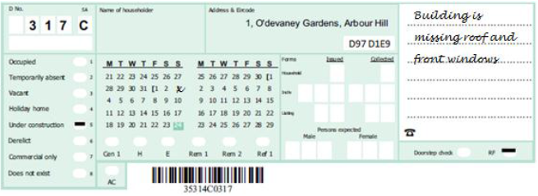
Determining the dwelling status
Under construction
  In the process of being built
  Missing either walls, roof, doors or windows.
  Any dwellings or estates under construction not listed in the ERB (.i.e. not on the GeoDirectory) are not to be enumerated

Slide 13
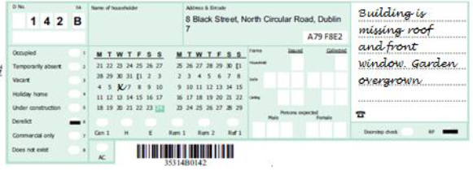
Determining the dwelling status
Derelict
  Likely to be an older building
  Looks dilapidated, garden may be overgrown, may be boarded up, windows may be missing.
  Any derelict dwellings or estates not listed in the ERB are not to be enumerated

Slide 14
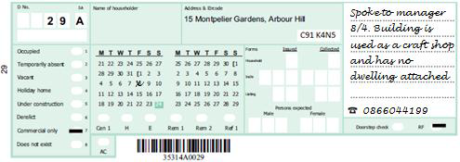
Determining the dwelling status
Commercial only
  Entries in the ERB may include buildings classified by the GeoDirectory as both commercial and residential.
  Some may not have a dwelling attached.
  Enumerator confirms with the person in charge that no one lives at the building before marking it as ‘Commercial only’.

Slide 15
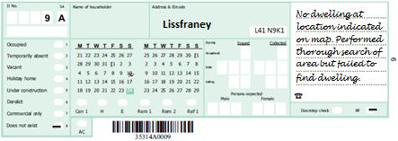
Determining the dwelling status
Does not exist
  Building that has recently been demolished
  Former multi unit building converted in to single dwelling

Slide 16
Census 2016 Preliminary Results
Table A - Change in population 2011-2016
Census Year | Population | Actual change | % change
2011 | 4,588,252 | 348,404 | 8.2
2016 | 4,757,976 | 169,724 | 3.7

Slide 17
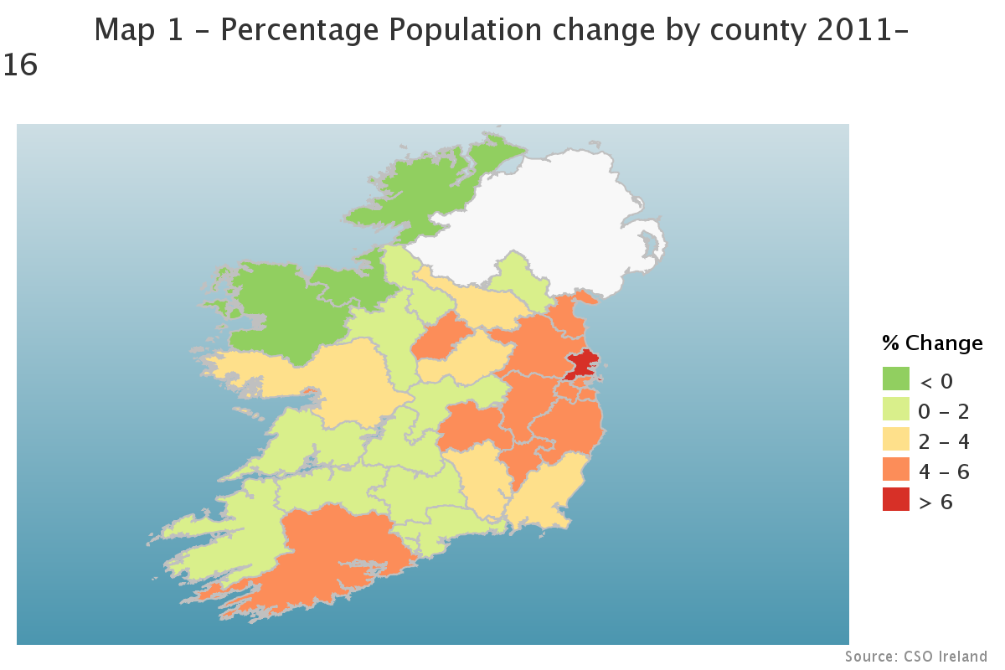
County change
Population - % change by county,
2011 - 2016

Slide 18
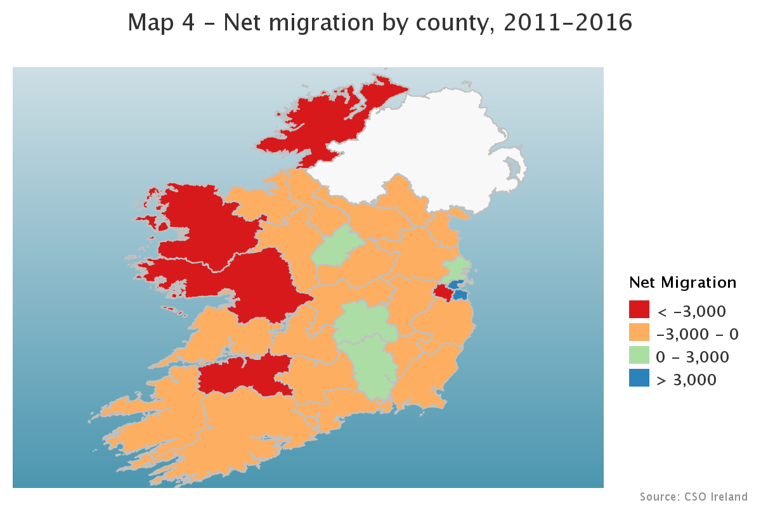
Net migration by county
Net migration by county
-6,731
+7,257
+4,380

Slide 19
Housing
Housing
Table F - Housing Stock 2011-2016
State totals | 2011 | 2016 | Actual change | % change
Housing stock | 2,003,914 | 2,022,895 | 18,981 | 0.9
Occupied households | 1,669,180 | 1,718,465 | 49,285 | 3
Temporarily absent | 45,283 | 44,868 | -415 | -0.9
Vacant holiday homes | 59,395 | 61,204 | 1,809 | 3
Other vacant dwellings | 230,056 | 198,358 | -31,698 | -13.8

Slide 20
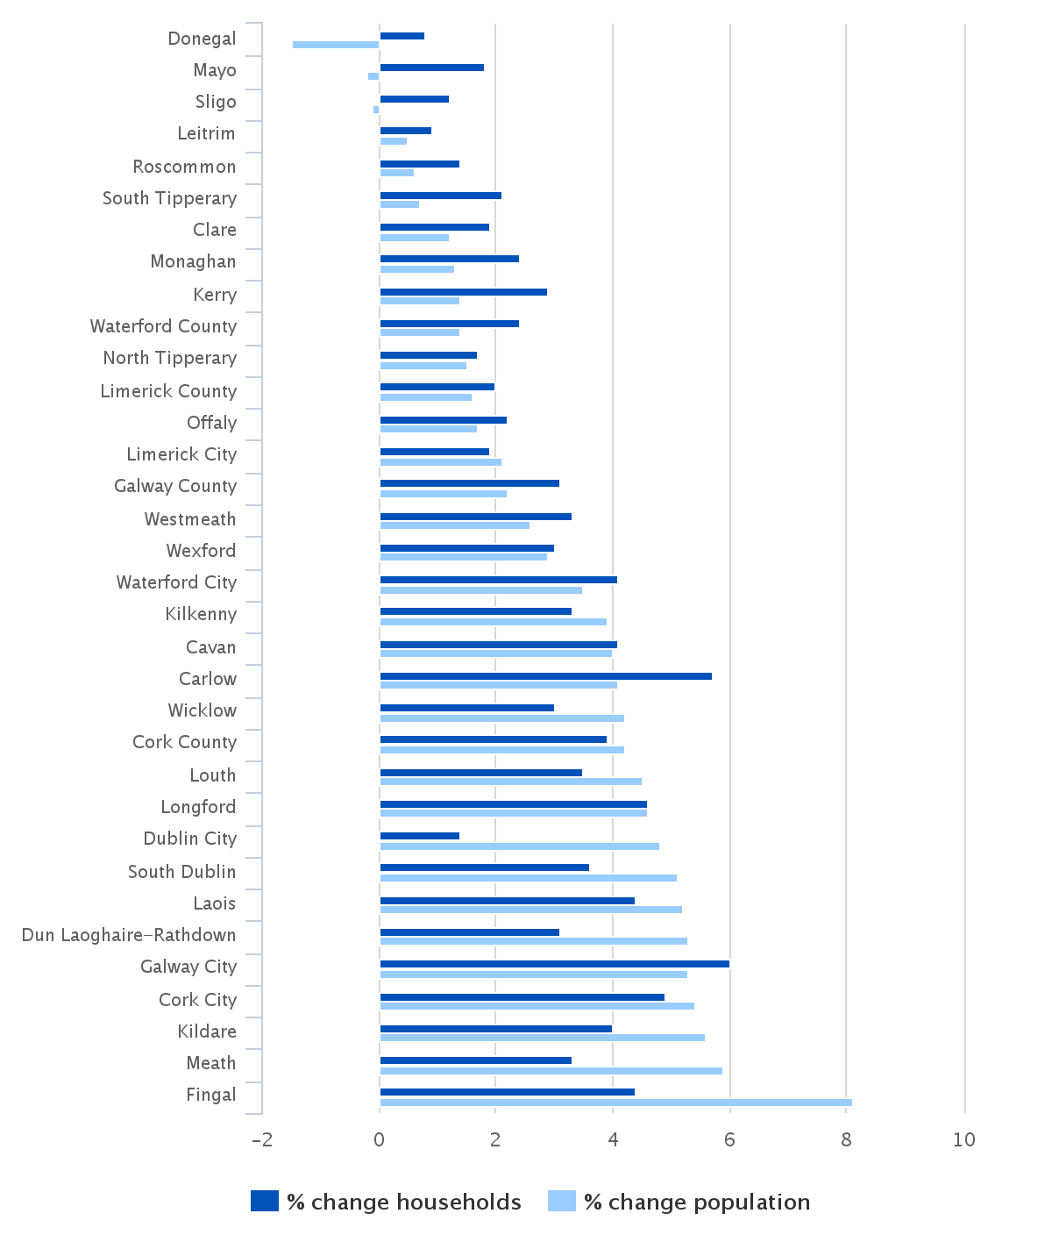
Households and Population
Households and Population

Slide 21
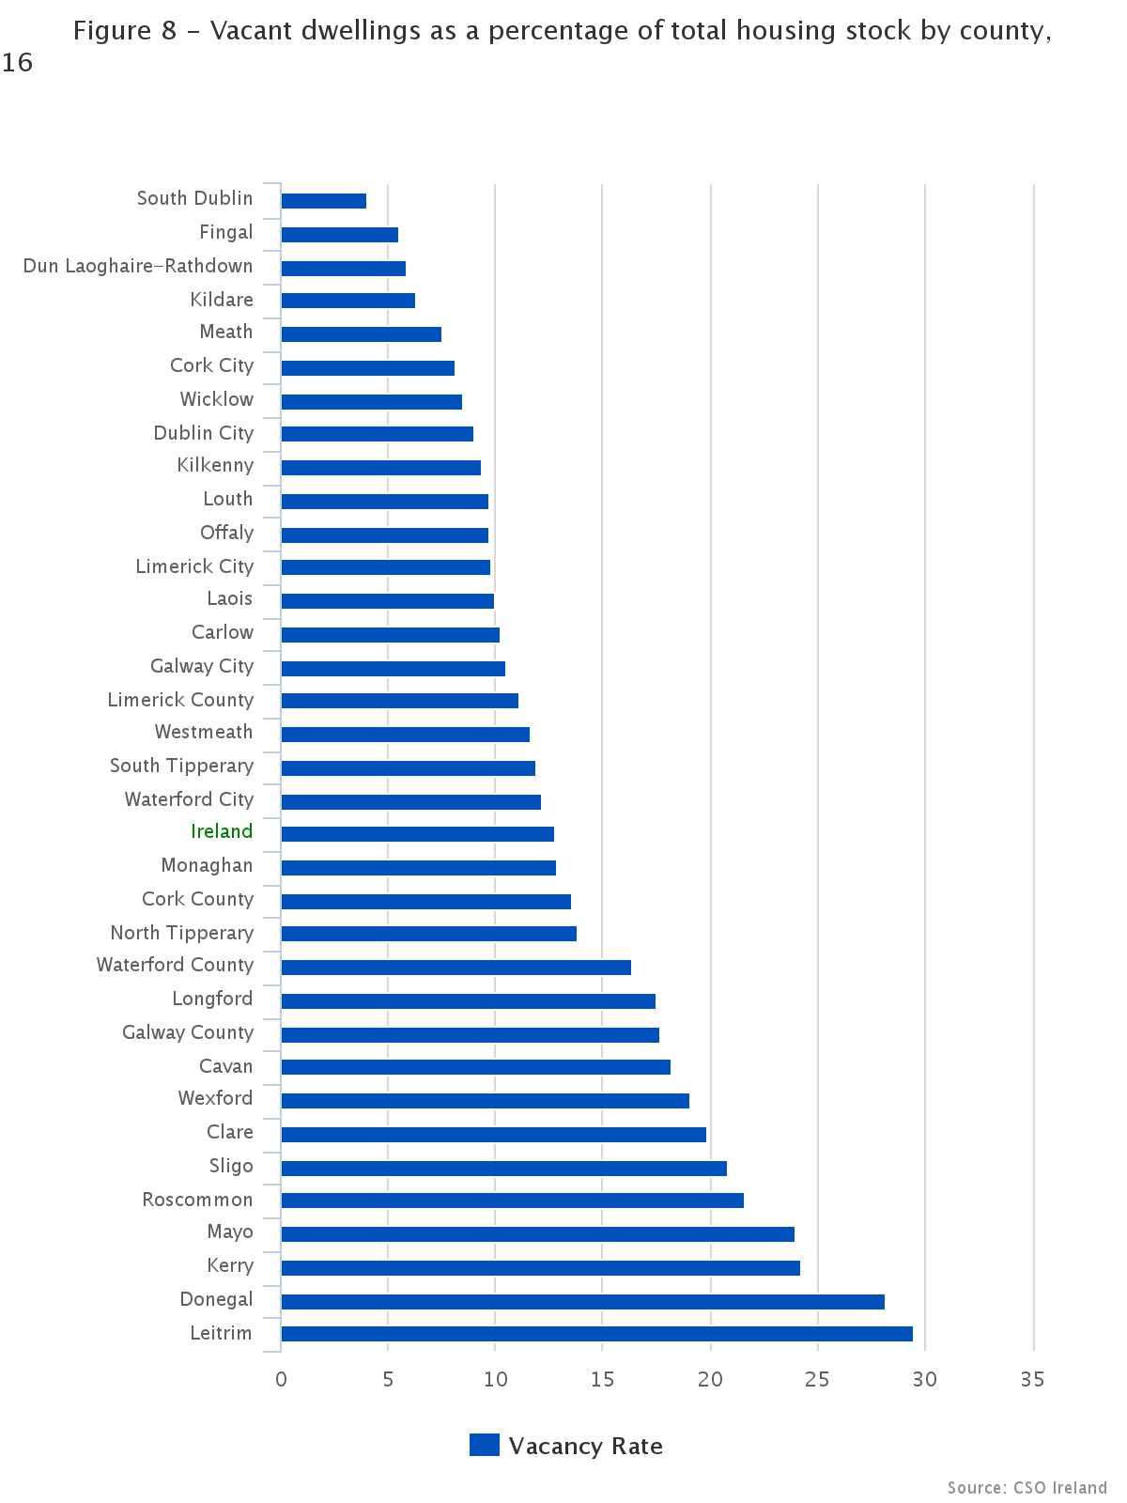
Vacancy rates 2016
Vacancy rates 2016

Slide 22
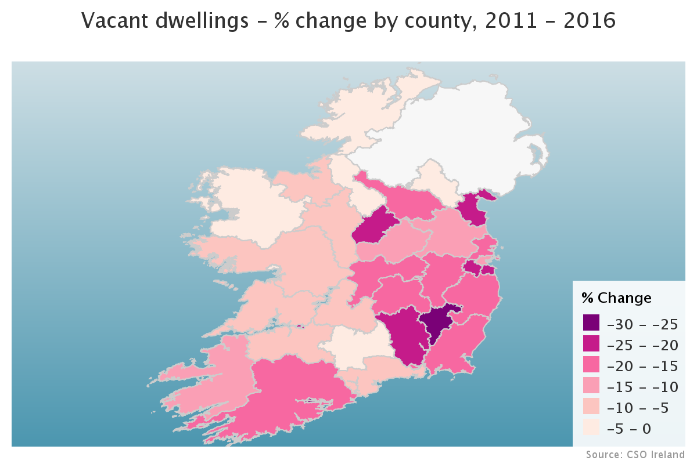
Vacant dwellings - % change by county,
2011 - 2016

Slide 23
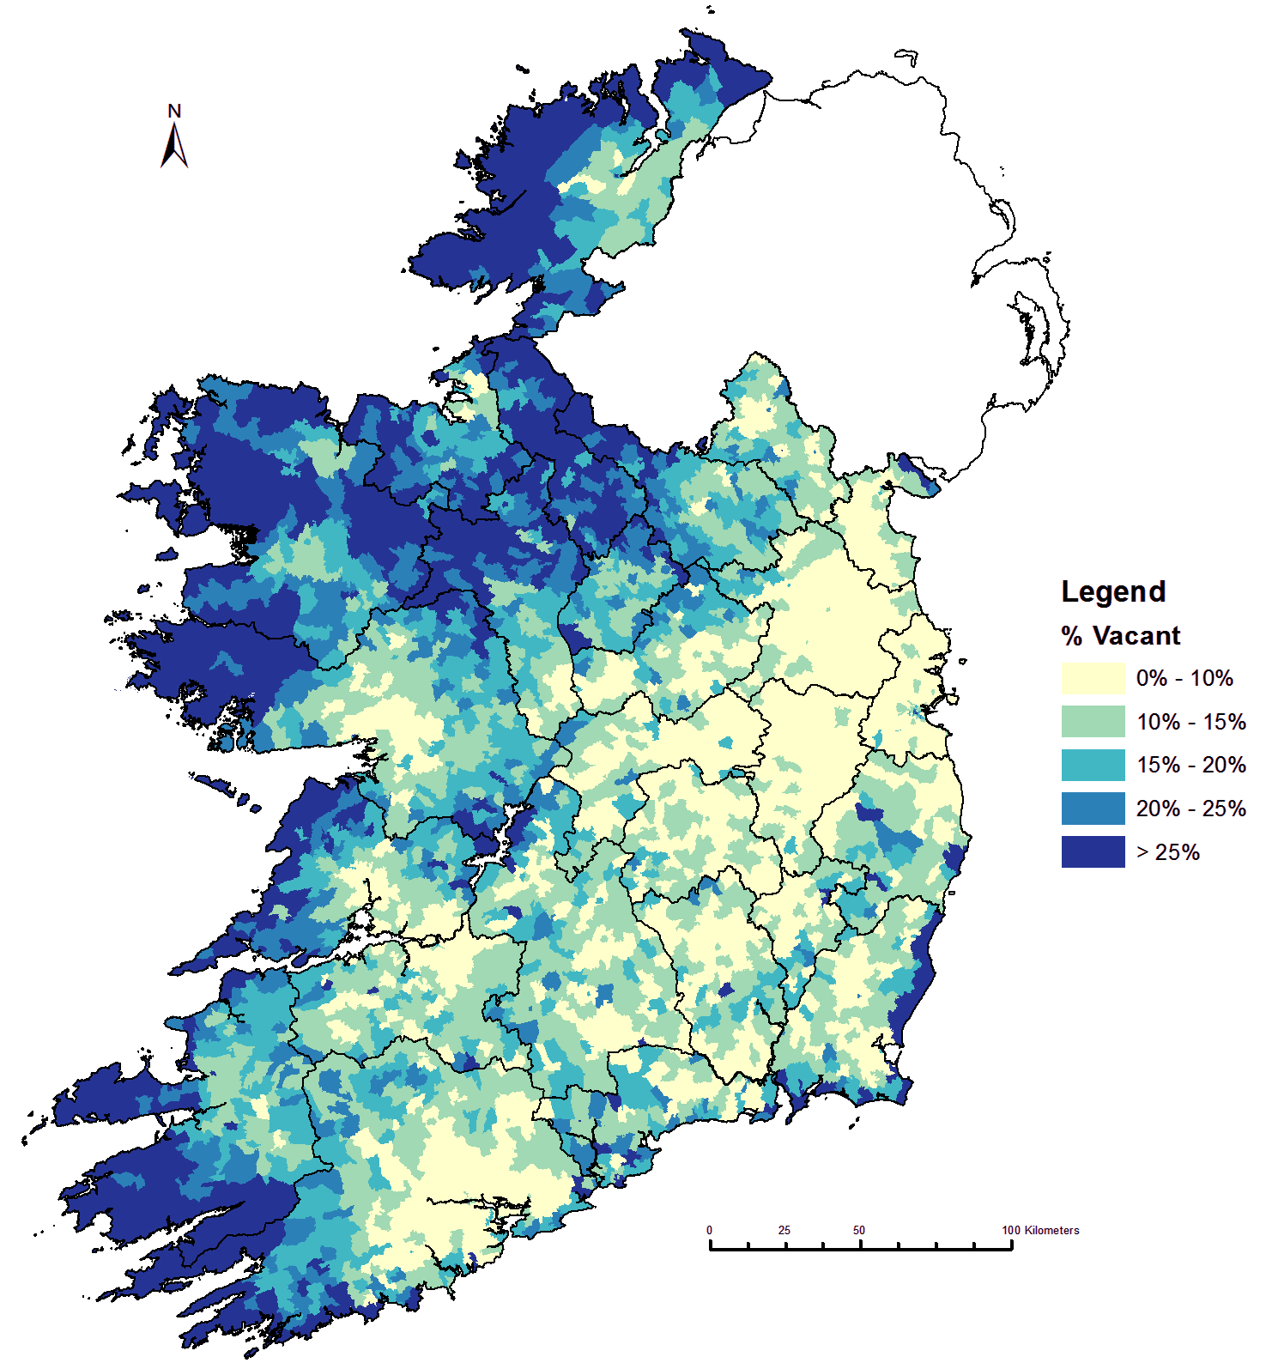
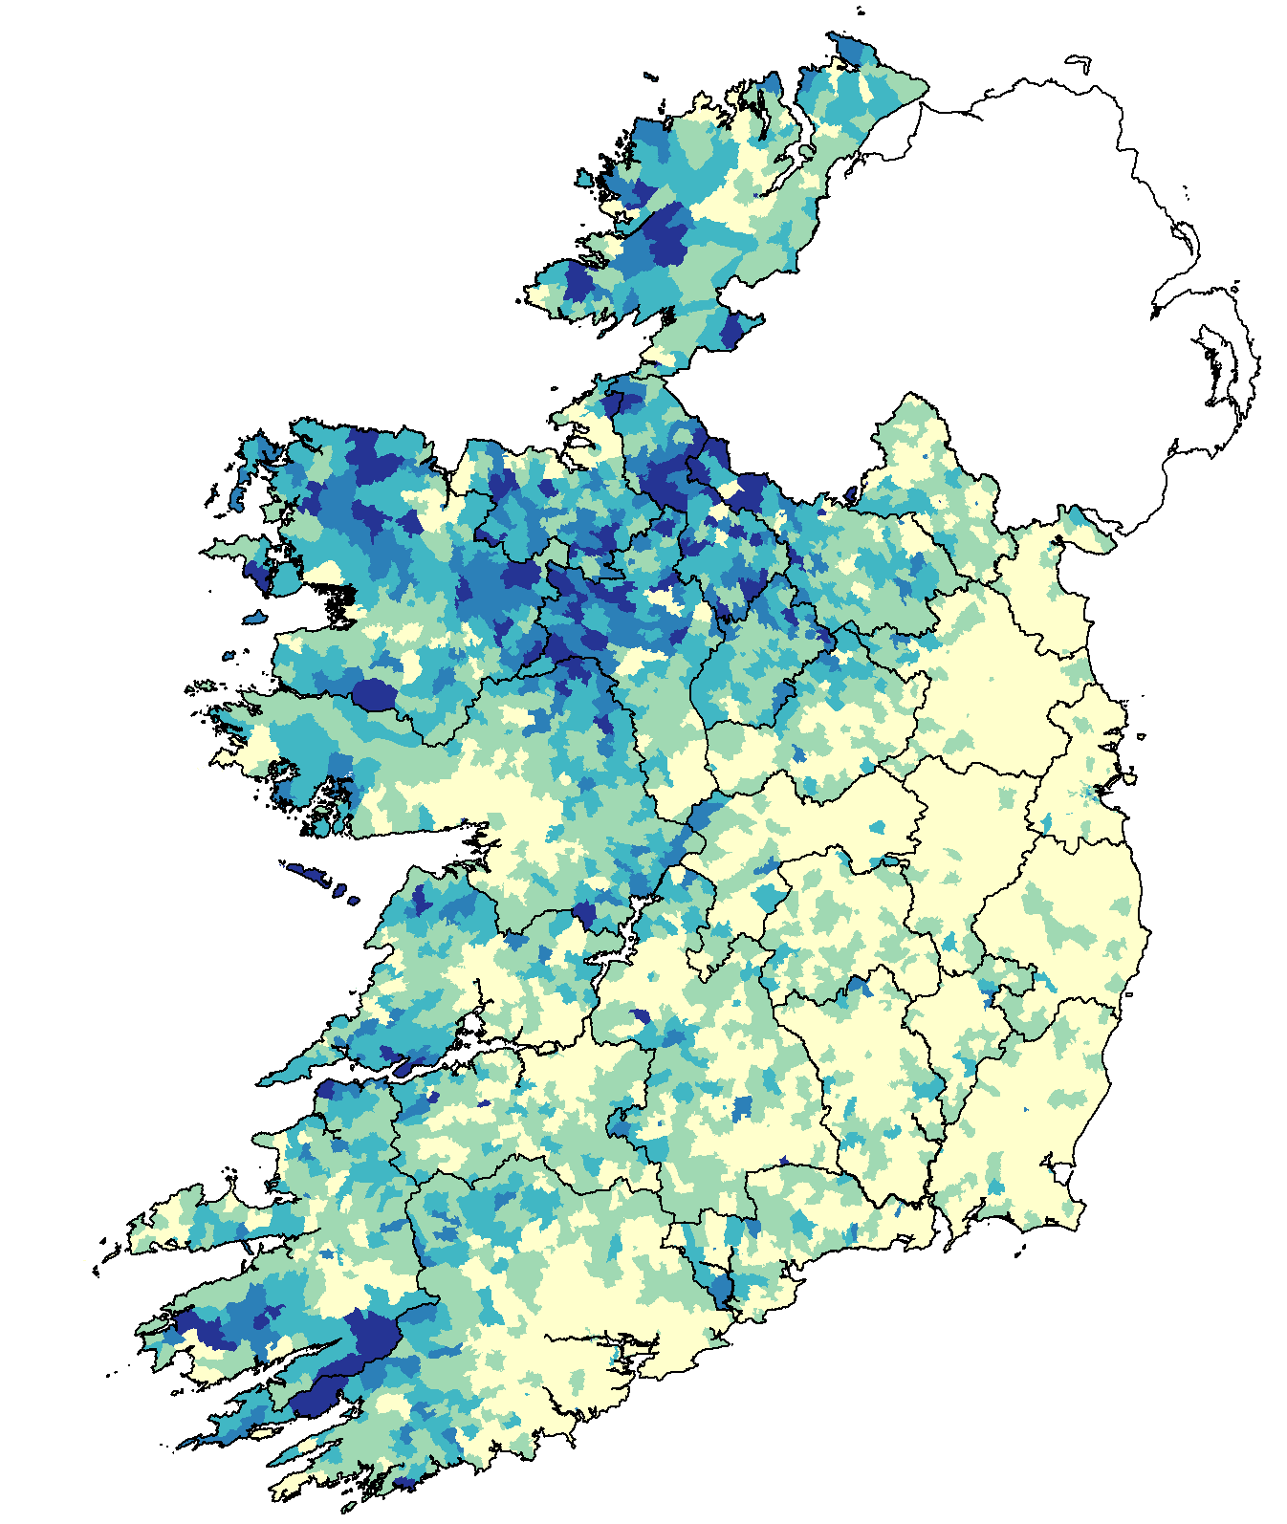
Vacant housing by ED
Vacant housing by ED
All vacant
dwellings
Vacant dwellings
excl. holiday homes

Slide 24
Census 2016 data
Housing release in April 2017 - prioritised
Type, year built, occupancy status, rent, heating, water, sewerage
Household type, size, occupancy - e.g. primary school children in rental accommodation
One year movers and nature of occupancy
All at detailed geography

Slide 25
Vacant properties
2011
  Geography, holiday home, other
2016 - New data
  Type of dwelling - detached, terraced, apartment, etc.
  Vacant in 2011
  Type of building - mixed commercial / residential
  Cluster analysis
  Distance to nearest settlement
  Reasons why dwellings are vacant - caveat - only for about 50% of dwellings

Slide 26
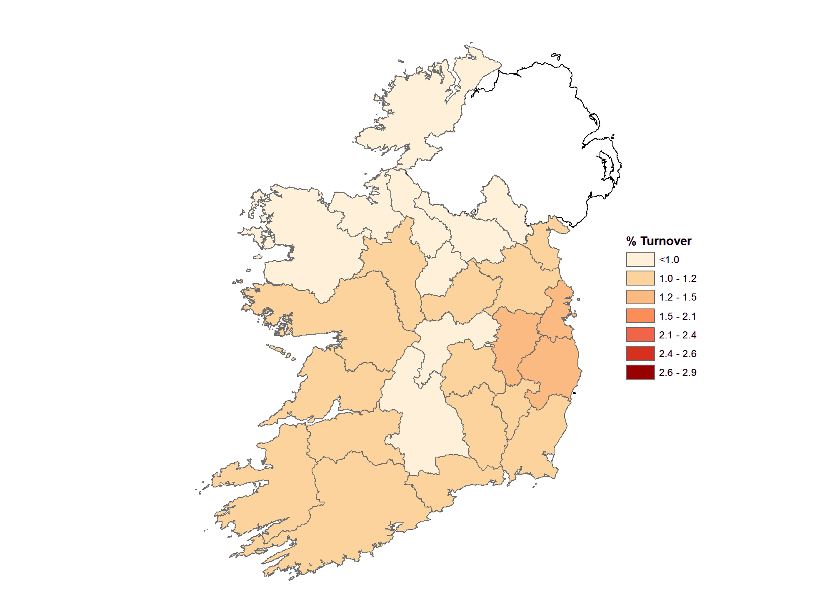
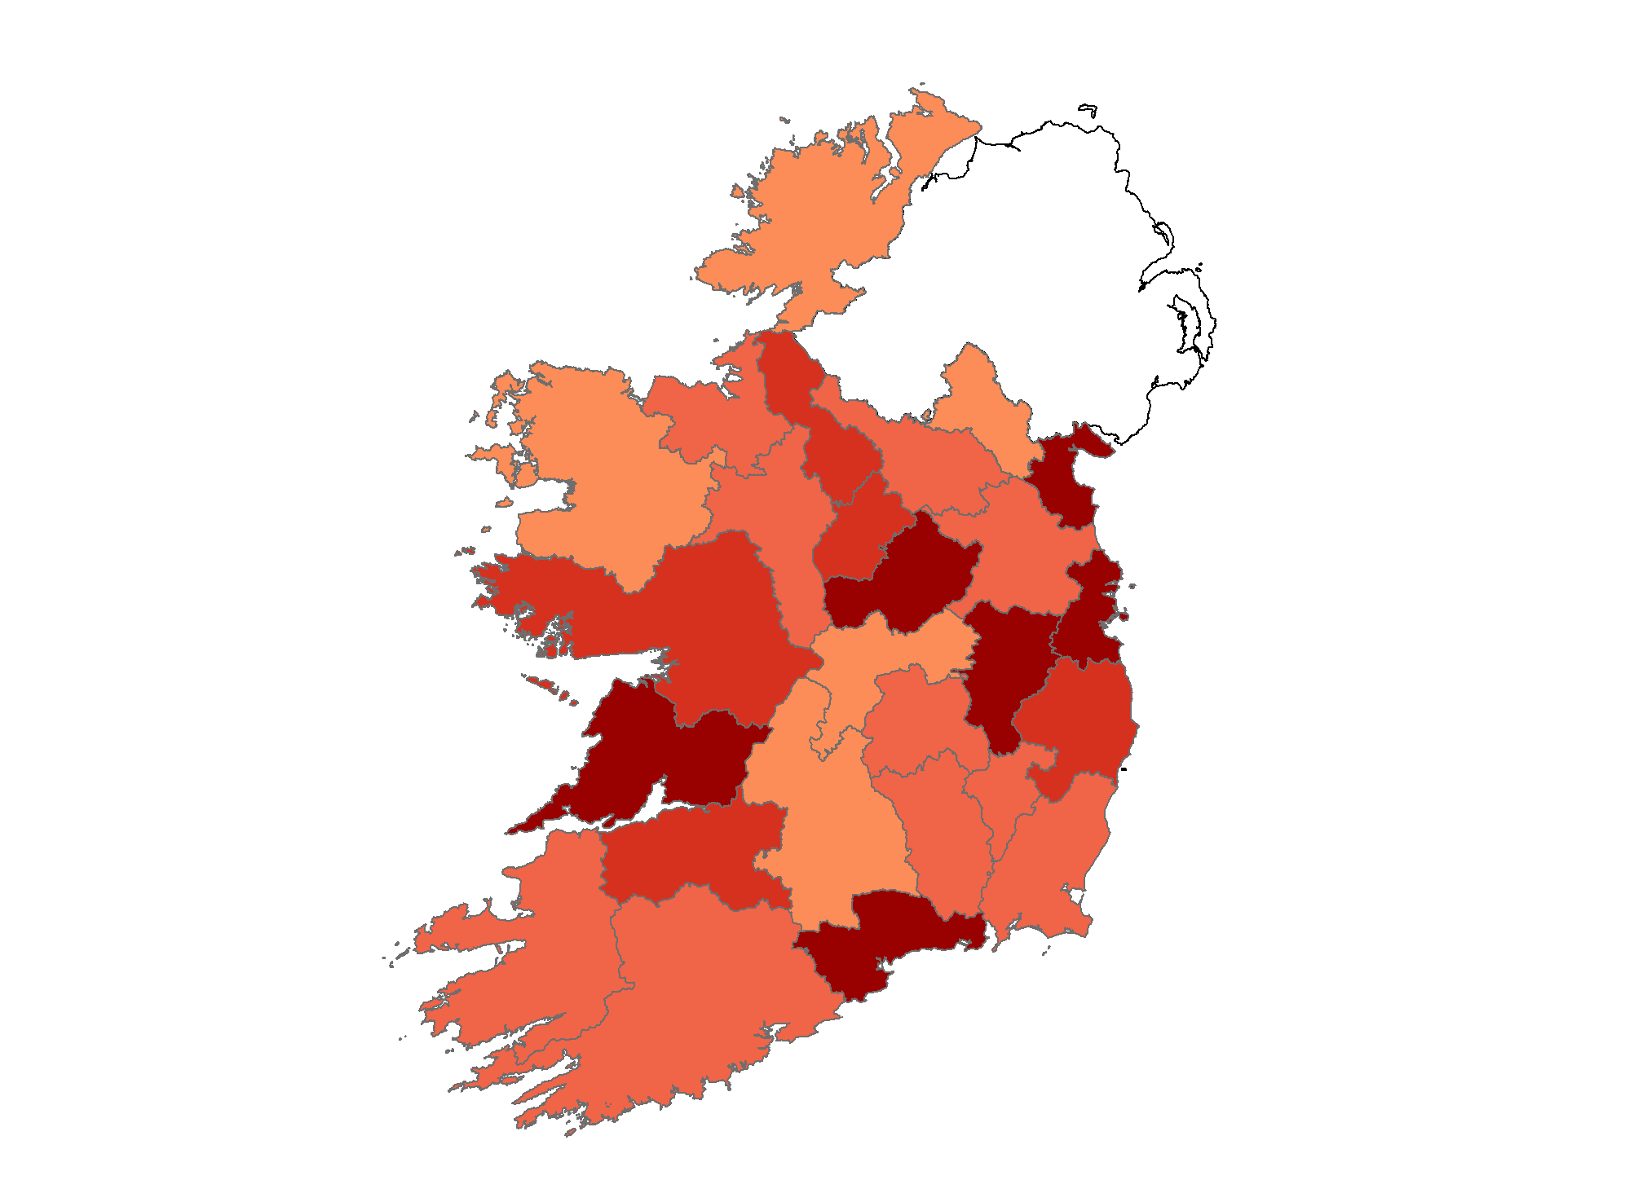
Combining Census and RPPI data
Housing Turnover, 12 months to July
2010/2011
2015/2016
State: 1.2%
State: 2.5%

Slide 27
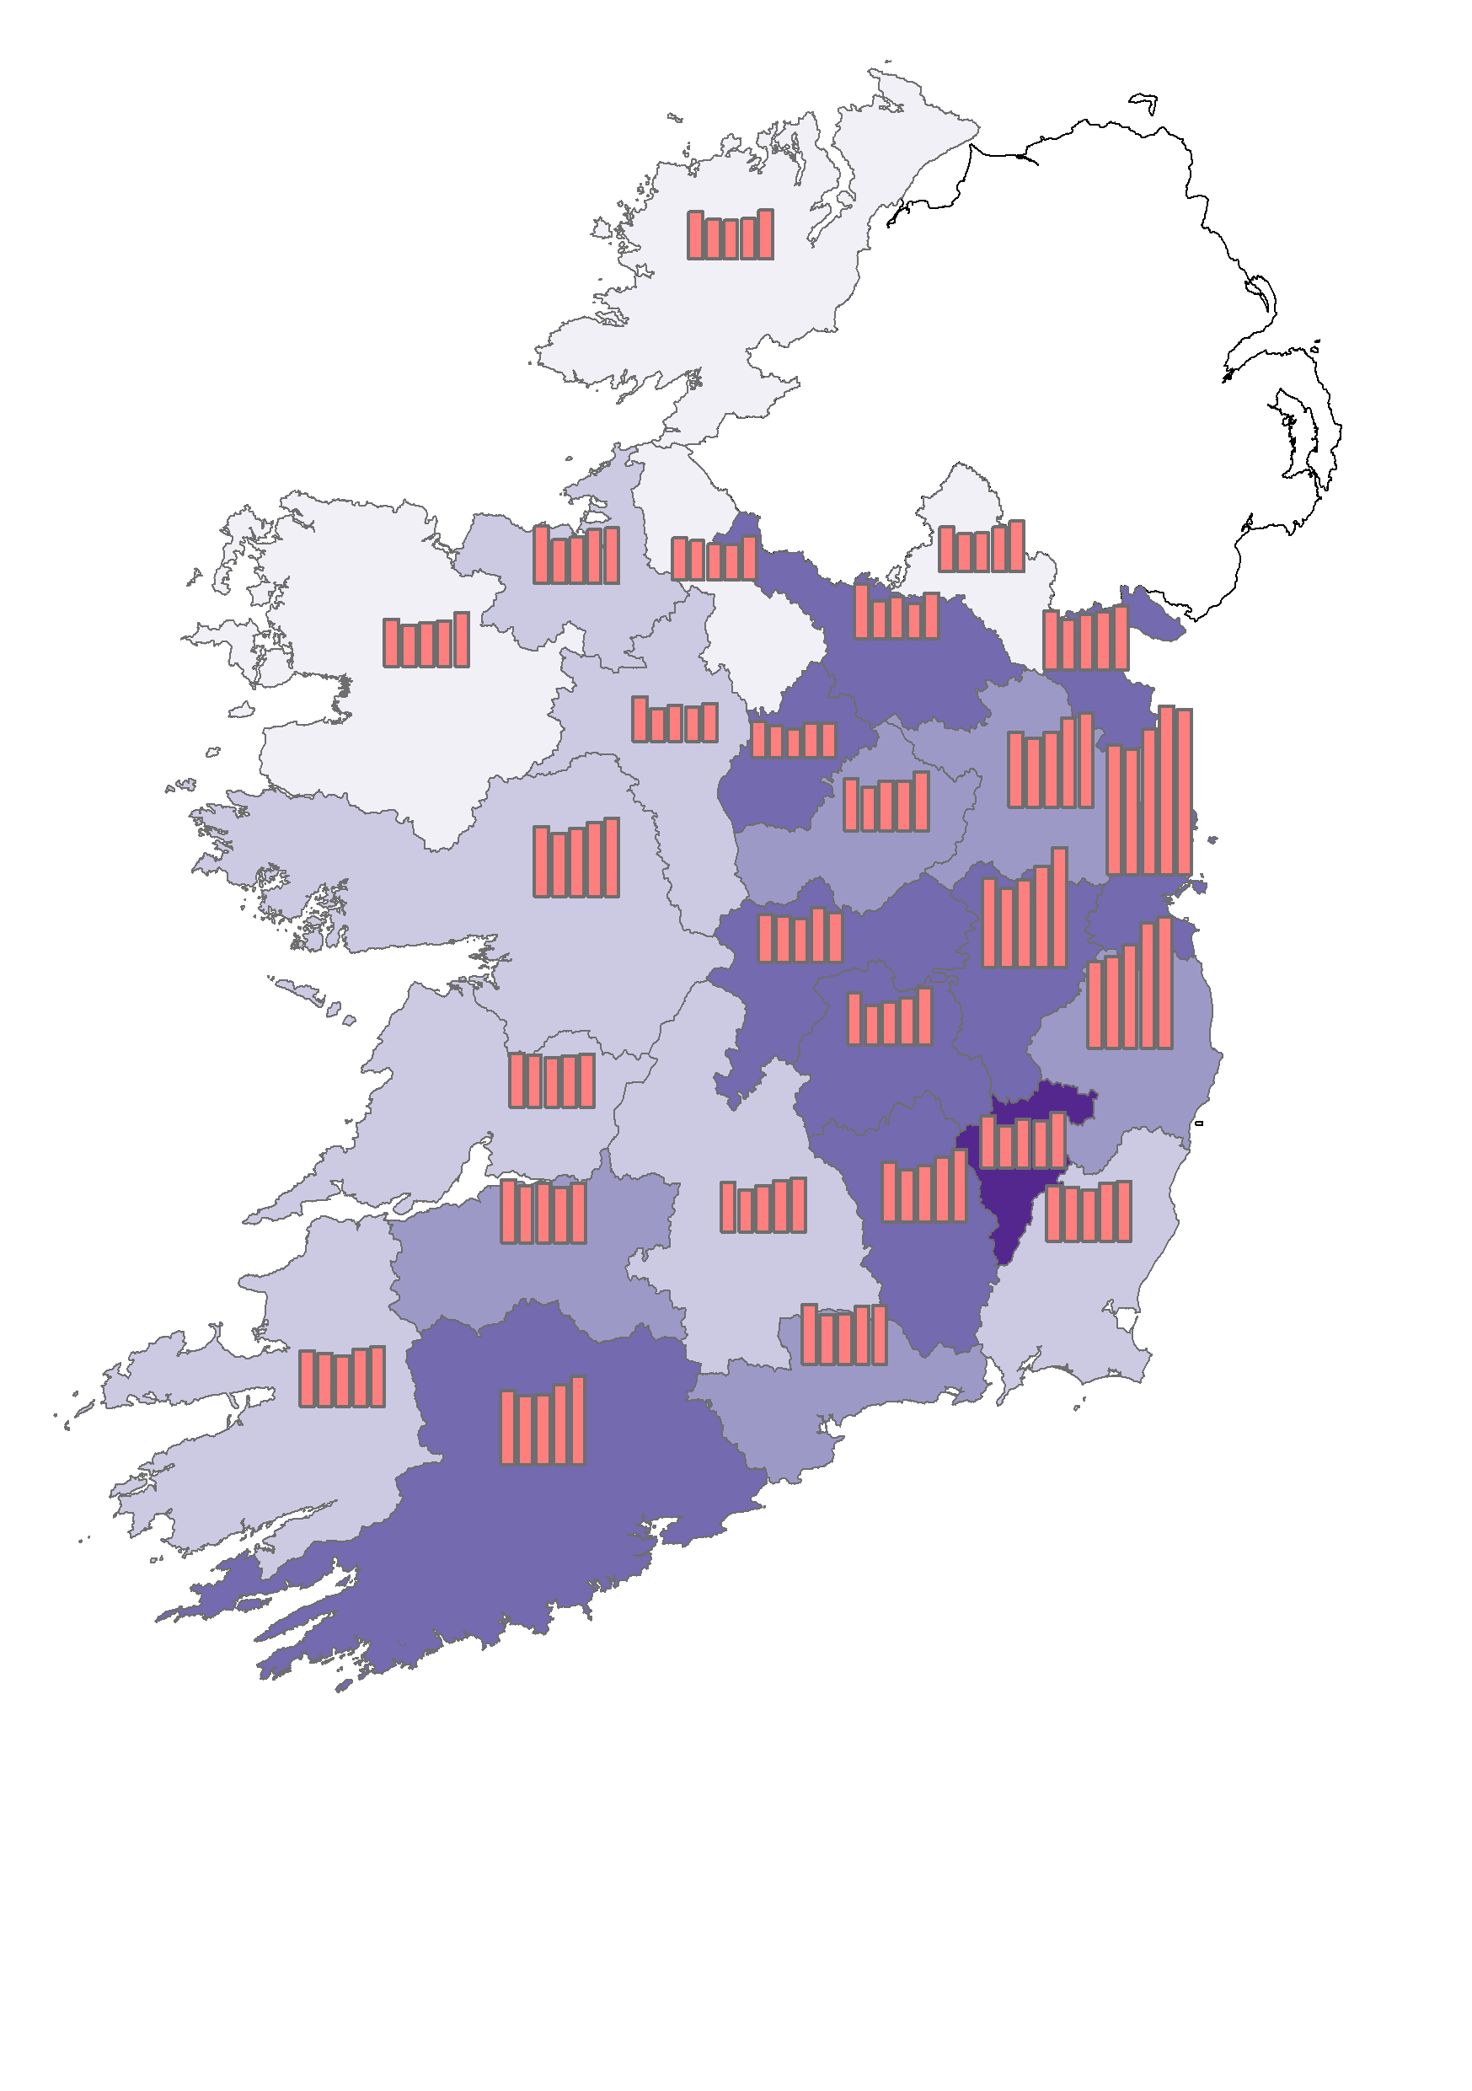
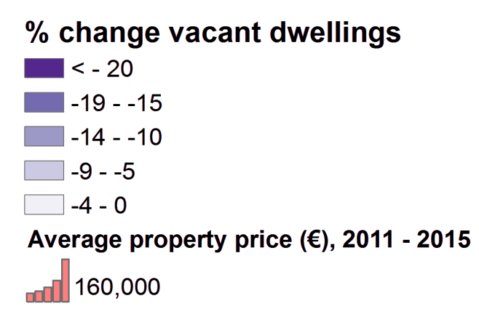
Combining Census and RPPI data
Change in Vacant Dwellings
2011 – 2016
and
Change in Average House Price 2011 - 2015
by County

Slide 28
Available Census Housing Data
Census 2011
  Profile 4 – The Roof over our Heads
  Small area populations statistics (SAPS and SAPMAP)
  AIRO – All-Island Census Atlas
Census 2016
  Census Preliminary Results – Housing
  AIRO – Preliminary Results mapping tool

Slide 29
Thank you
Questions?
Brendan Murphy
Statistician, Census Dissemination & Enquiries
Brendan.Murphy@CSO.ie
01-8951329

