Slide 1
Health Accounts Seminar Welcome & Introduction
Jennifer Banim, Central Statistics Office
Health Accounts Seminar
Royal College of Physicians
10 November 2016

Slide 2
Irish System of Health Accounts
Today’s Programme
9.30 Introduction
9.45 Overview of Published SHA Data and Possible Further Developments
10.15 Health Policy and Service Provider Perspective
11.00 Coffee
11.30 Panel Discussion with Other User Perspectives
12.15 Open Discussion with Floor
1.00 Close

Slide 3
Irish System of Health Accounts
What is the System of Health Accounts?
System of Health Accounts (SHA) is designed to provide information about health care systems:
How much is spent on health care provision?
Where does the money to finance the health system come from?
Who do we pay to provide the services?
What kinds of services are performed & what type of goods are purchased?
Notes:
Can drop if too much overlap with later presentations

Slide 4
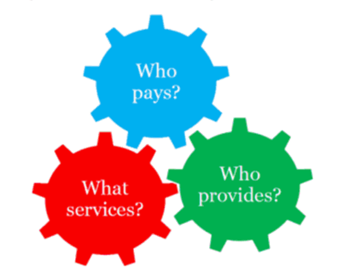
Irish System of Health Accounts
Notes:
Mention Open Policy Debate

Slide 5
Irish System of Health Accounts
Who sets the standards for SHA?
Devised by OECD & built around a set of tables for reporting on health care expenditure
Aims to provide comparable international data & to support national policy making
Standard approach to compiling the tables enables comparability over time and across countries
Detailed manual sets out the definitions & concepts
Manual agreed among the OECD, Eurostat and the WHO

Slide 6
Irish System of Health Accounts
How has the Irish SHA developed?
Reporting of health expenditure aligned with SHA standard from 2000
Limited to high level estimates
In 2012 EU regulation put reporting on a mandatory basis from 2016 for 2014 data
Joint CSO/HSE/Department of Health project operated from 2013-2016 to meet mandatory reporting requirements

Slide 7
Irish System of Health Accounts
International Data Transmission
SHA Publication, Seminar and other analysis
SHA Reporting Database
HSE Financial Data and other Gov. Data
CSO: Data Compilation,
Processing and
Triangulation
Benefacts NPI Database (development)
Survey of Private Health Insurers & Private Hospitals
Analysis of Company Accounts
CSO Data Sources: Revenue Tax Files, HBS, ASI, CPI, Census

Slide 8
Working together … System Health Accounts is an example of what’s possible
Departmental data
Data integration
Analysis

Slide 9
Irish System of Health Accounts - Your Input
SHA tables published for 2013 & 2014
Outputs follow the OECD structure for tables
Consistent with broader National Accounts
Other analyses possible
Input very welcome
Notes:
Mention Open Policy Debate

