Slide 1
Evolution in Ireland’s FDI Intensity
Frank Barry
Professor of International Business
and Development
Trinity College Dublin

Slide 2
Ireland’s current FDI intensity in international comparative context

Slide 3
But Ireland has a longer history of FDI that most people suppose!
Ireland’s first major FDI success
Ford Motor Company began tractor production for export in Cork in 1919
Employed almost 6,000 in 1929
Still employed 1,000 in the 1950s

Slide 4
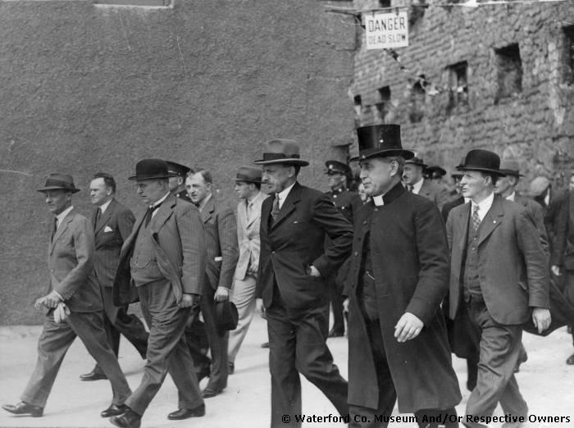
Substantial Tariff-Jumping FDI from 1920s to 1950s

Slide 5
Players and Wills (cigarettes) set up Irish factories in the early 1920s
1,500 employed between them c. 1960
Cadburys (1932)
2,000 employed c. 1960
Irish Dunlop (1934/5)
1,300 employed c. 1960
Clarks Shoes (1938)
1,000 employed in Irish partner firm c. 1960

Slide 6
What was the sectoral distribution of FDI under protectionism?
“Evidence suggests no general principle in sectors attracting outside penetration”
1928 report on foreign ownership by Department of Industry and Commerce
“Expansion of foreign-owned industry in the 1920s resulted from changing market demand, in particular the growing importance of advertising, which led to the emergence of large conglomerates in consumer industries”
Historian Mary Daly (1992)

Slide 7
In fact, exactly as today, FDI congregated in advertising-intensive and R&D-intensive industrial sectors
Even in the protectionist era
Foreign firms accounted for insignificant shares of employment in sectors such as Wood and Furniture, Paper and Printing, Non-Metallic Minerals, Iron and Steel Manufactures
Accounted for the bulk of employment in sectors such as Chemicals, Electrical Equipment and Apparatus, Wireless TV and Telecommunications Equipment

Slide 8
In the mid-1950s (before trade liberalisation), Ireland stumbled on its low corporation tax strategy of attracting export-oriented industry: “export profits tax relief”

Slide 9
New Faber-Castell Factory in Fermoy, mid-1950s

Slide 10
Sectoral distribution of foreign-firm manufacturing employment
 | 1973 | 2010
Food, Beverages and Tobacco | 24 | 11
Textiles, Clothing and Footwear | 19 | 0
Chemicals (including Pharma) | 8 | 24
Machinery and Equipment | 4 | 5
Electrical and Electronic (including Office and Data Processing) | 5 | 21
Medical Devices | 4 | 25
Transport Equipment | 11 | 3
Remainder | 24 | 11

Slide 11
Employment in foreign-owned manufacturing and foreign-owned internationally-traded services
 | 1991 | 2010
Foreign-owned manufacturing | 89,167 | 80,089
Foreign-owned internationally-traded services | 7,398 | 59,110

Slide 12
Interactions between different tax jurisdictions have become increasingly complex
MNC transfer pricing issues
Increasing importance of intellectual property
Rival tax philosophies of Democrats and Republicans in the US
Caribbean tax havens and the geographic architecture of US MNCs

Slide 13
Notwithstanding the fact that foreign MNCs use substantial inputs of Irish services, they are also huge importers of intermediate goods and make huge royalty and licence payments abroad.
For Ireland, royalty and licence payments abroad are about as large as computer services exports

Slide 14
Conclusions
Because of the huge import content associated with global production sharing, export data are much less revealing than they once were
The rules of how we measure revealed comparative advantage need to be rewritten

