Slide 1
Economic Globalization – scene setting
Professor Louis Brennan
Director Institute for International Integration Studies,
Trinity College Dublin

Slide 2
Where in the world???
“An American worker running Oracle’s database software with Windows on a Dell computer with a Pentium IV microprocessor who takes Prozac in the morning and Viagra at night could have received all those products from ….” (Washington Post report, 2001)

Slide 3
Globalization(a la Thomas Friedman)
A dynamic phenomenon
Inexorable integration of markets, nation-states and technologies
Enabling individuals, corporations & nation states to reach around the world further, faster, deeper and cheaper

Slide 4
The Enactment of Globalization
Globalisation is enacted via the flows of materials, investment, information, knowledge, finance and peoples across borders.
International integration represents the ongoing outcome of the process of globalisation.

Slide 5
Enablers and Outcomes of Globalization
Opening, deregulating and privatizing of economies
Advances in Information and Communication technologies
Advances in Transportation Systems
Giving rise to new modes of organising
Outsourcing
Off-shoring
Open-sourcing
In-sourcing
Supplychaining
and Informing and Communicating for free
and with ensuing complexity fuelled by inter-dependencies and blurring of boundaries

Slide 6
The core issue
The world has never been so interconnected and integrated
As a result it has never been so interdependent
Yet, our knowledge around, and understanding of this interdependent world are based on models and insights that reflect a very different reality
For example we still tend to base much of our analysis and thinking on the obsolete and ultimately (in the context of an interdependent world) destructive notion of self-interest leading to disagreement, conflict and war when such interdependency calls for models and systems that are based on mutuality
This is noted in the General Theory where Keynes states that “The mercantilists were under no illusions as to the nationalistic character of their policies and their tendency to promote war.” (pg.348)

Slide 7
The Challenge
The world is paying a heavy price for this knowledge deficit with our global financial system on life support, the sustainability of the planet in question and, as we are now experiencing in Europe, past progress in integration under threat
There is an urgent need for researchers to develop new paradigms and new understandings that can address in their varying ways the challenges of interdependency arising from International Integration
Davos 2012 set as its theme “The great transformation; shaping new models”
“We desperately need new models” - Klaus Schwab

Slide 8
Southern Multinationals* OFDI from developing countries to developed countries
North
South
South
North
Common
OFDI
Conventional
More Recent
Recent
There is a data deficit characterised by a lack of reliable and consistent data in terms of the emergence of Southern Multinationals and their Impact on Europe that needs to be addressed– The Emergence of Southern Multinationals: Their Impact on Europe, L. Brennan (2011)
North: Developed countries
South: Developing countries
*COST Action IS0905: The Emergence of Southern Multinationals and their Impact on Europe.

Slide 9
Global Value Chains
Global Value Chains represent the enactment of globalisation.
Globalisation at its heart is about flows: flows of materials, goods, information, knowledge, finance and people.
Global Value Chains are the basis of such flows.
Ongoing construction, deconstruction and reconstruction of such chains provides the infrastructure through which globalisation is enabled.
The design, configuration and coordination of such chains to achieve maximum business performance are central to the role of MNEs.
Integrating emerging technologies into such chains to create symbiotic business systems that yield maximum performance is the key to competitive advantage in today’s globalised world

Slide 10
GLOBAL VALUE CHAINS
Global value chains make it possible to bring together all the raw materials & components that combine to make a product or service; to deliver it into use through distribution systems; to support users on a 24 hour basis; and to recover and integrate residue into a waste stream.
These chains span the world, so that even mundane items now commonly involve the coordination of flows of goods, information, finance and people across several continents while navigating customs crossings, security screenings and identity verification.
A global value chain may involve American designers, Indian software writers, Asian manufacturers and European system integrators and support provision

Slide 11
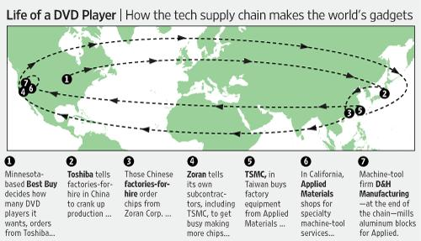
Global Flows – A DVD Player
Source: Wall Street Journal, May 18, 2009

Slide 12
Global Value Chains
Global value chains (GVCs) are ‘organizational systems’
a. that operate across multiple nations;
b. that are integrated
c. whose global integration is complex
d. whose technology base, or ‘engine’, is Information & Communication Technologies
e. that drive firm-level competitive advantage through integrating global and local competitive and comparative advantages (firm specific & location specific advantages)
f. that build & defend longer term competitive advantage through complex and hard to imitate firm-level assets / capabilities
g. that evolve through stages of development, or may be ‘born global’
h. that incorporate ‘traditional’ or ‘conventional’ activities and functions but also involve ‘whole system’ activities from sourcing to customer support and embody materials, information, financial and people flows and assets

Slide 13
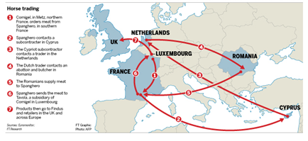
Complexity – the case of Findus UK
Source: FT, February 11, 2013

Slide 14
Complexity of Global Value Chains
The complexity of these chains may be seen, for example, in the activities necessary to bring a new automobile to market.
Flows of ore, steel, petrochemicals, performance plastics, glass, paint, rubber, mechanics, electrics, electronics, software, upholstery, to name just some elements, must be coordinated to take the form of automobile parts, components and sub-systems
And must all converge just-in-time in an assembly plant to be fashioned into an automobile
And then dispersed geographically again through distributors, dealerships and internet vendors into final ownership and continuing service in the hands of individuals throughout the world

Slide 15
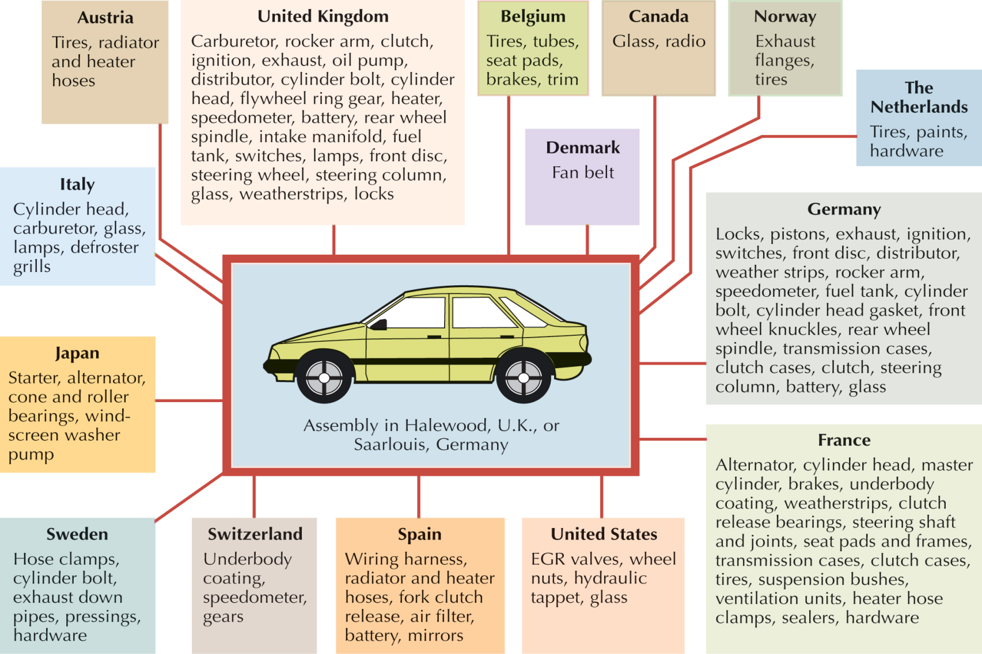
The Global Component Network for Ford’s European Manufacturing of the Escort
Source: International Business, Daniels et al.

Slide 16
UNCTAD’s “Global Value Chains and Development” reports that ..
Some 28% of the value of cross-border trade in goods and services is overstated as a result of double or multiple counting
80% of global trade is accounted for by value chains administered by MNEs such that global investment and trade “are thoroughly entwined international production networks”
Almost half the value added inputs to exports are from service sector activities, although the data on exports lists services as contributing to only 20% of gross exports worldwide

Slide 17
Value
Notes:
17

Slide 18
Value Creation and Capture
Consumer surplus
Value Creation
By meeting customers needs through firm’s value positions.
Profit
Value capture
Contributing to operating profits by charging for firm’s value proposition
Benefit
Total Value
Price
Cost
Value Delivery
Configuration of internal and external capabilities to deliver customer value.
Cost
Notes:
18

Slide 19
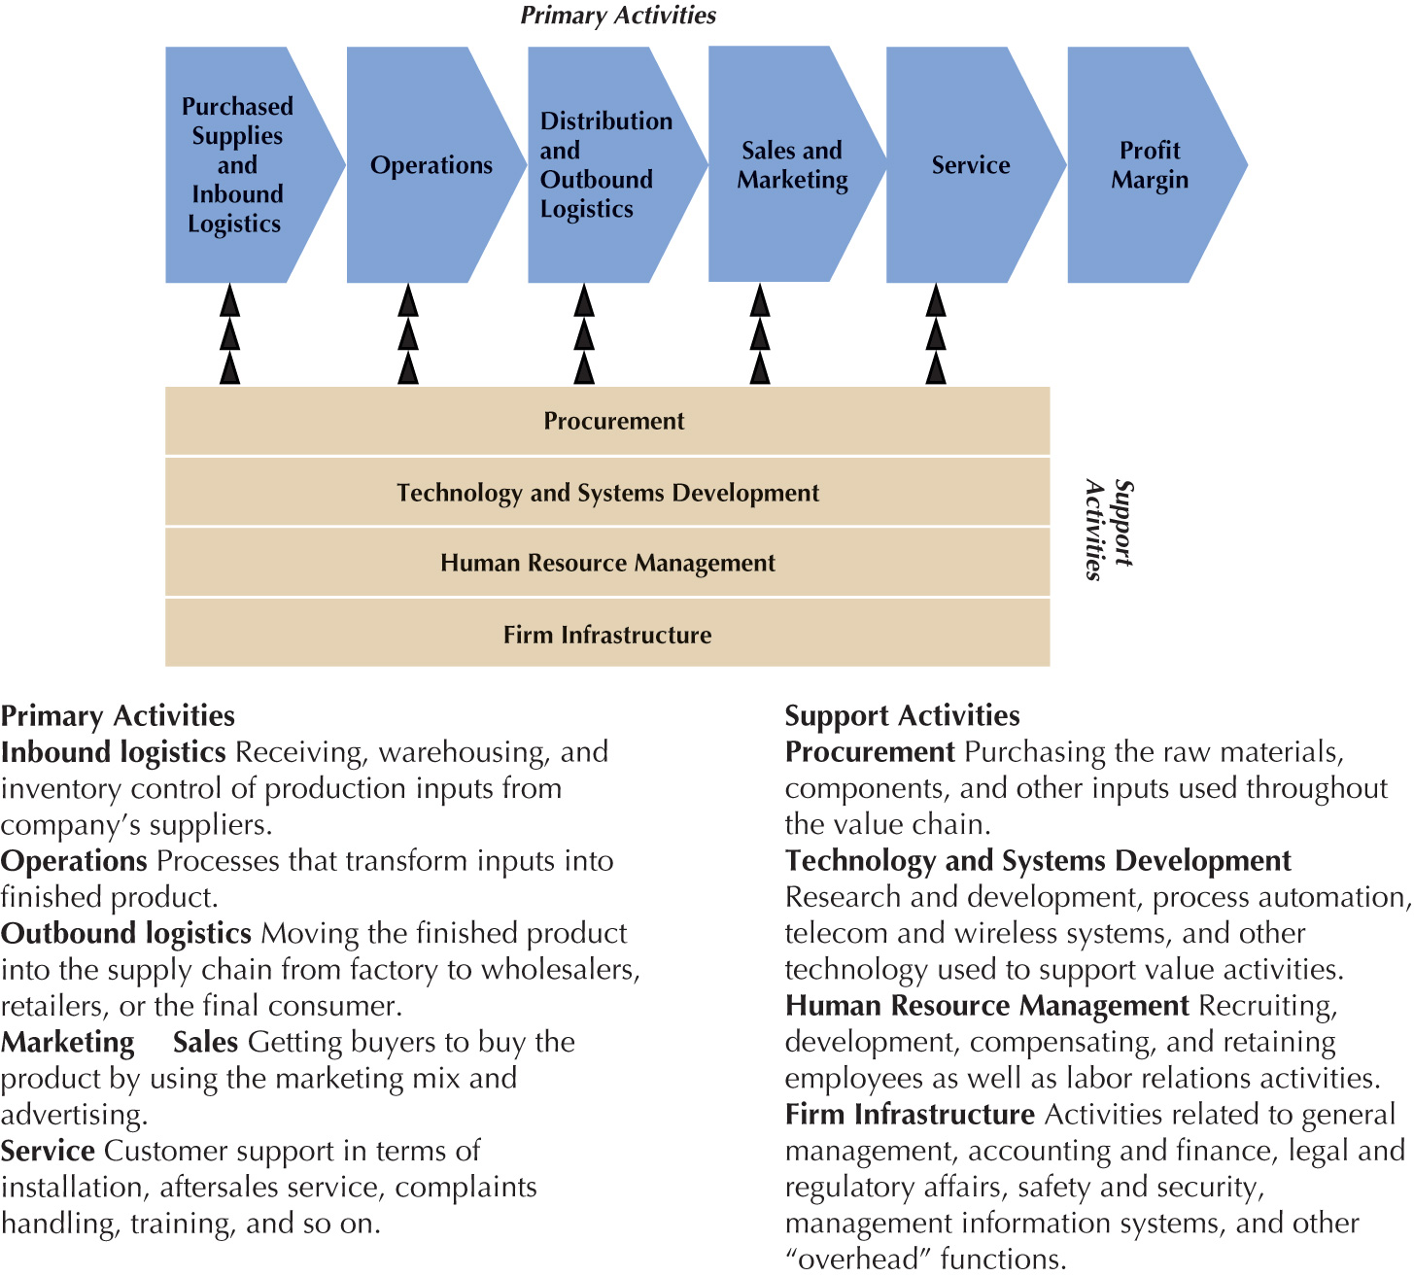
Fig. 11.4: The Value Chain Framework
Source: International Business, Daniels et al.

Slide 20
The Value Chain
Takes an end to end perspective in terms of activities, resources, assets, capabilities, relationships and financial and operating data
Facilitates thinking holistically across the chain and
Identifying opportunities in terms of new ideas and innovations which could emerge from a questioning of what is, what is not and what could be

Slide 21
Capturing Value
Slicing and Dicing the Value Chain
Extracting Value from other stages of the Value Chain - outsourcing
Repositioning on the Value Chain – Stan Shih’s Smiling Curve
Tightly integrate and streamline the Value Chain by collaborating and sharing with Partners to establish a win-win for all.

Slide 22
Stan Shih’s ‘Smiling Curve’
Value
Added
Software
E-commerce
CPU
DRAM
Distribution
LCD
Marketing
ASIC
Monitor
Local Sourcing
Motherboard
Local Assembly
Components | Assembly | Distribution
Source; Shih, Acer.

Slide 23
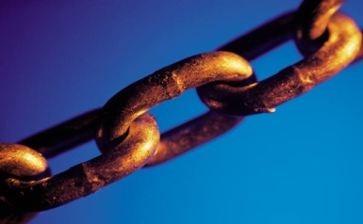
The Multinational Enterprise and Value Chain Configuration
Multinational Enterprises (MNEs) are one of the, if not the most significant actors in today’s globalised world.
MNEs determine Value Chain configurations i.e. the way that the activities of the value chain are spatially arranged taking account of a multiplicity of factors that can include
cost factors [wage rates, productivity, inflation, etc.]
business environments [political & economic risk]
regulatory and tax considerations
technology
cluster effects [related value creation activities]
logistics [value-to-weight ratio, just-in-time practices]
degree of digitization [virtual value creation]
economies of scale [unit cost reductions]
customer needs [buyer-related support activities]

Slide 24
Global Value Chains
Global Fragmentation of Production
Shareholder Value
Offshoring
Internal
Outsourcing
Middle-men
Contractors
Supporting and related services
Opening, Deregulation & Privatization of Economies, Advances in ICT and Transportation

Slide 25
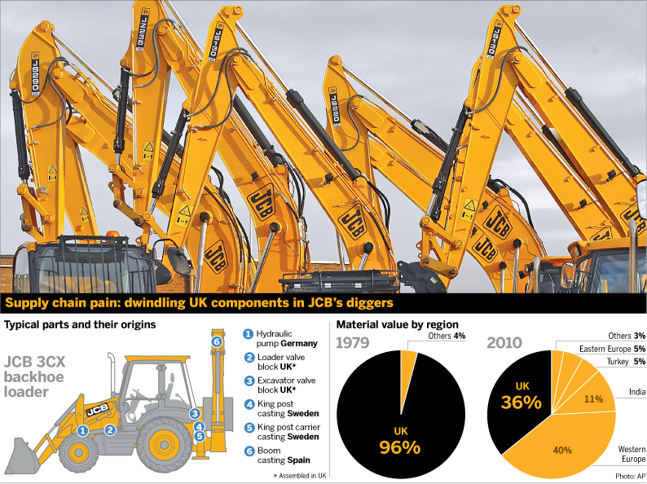
The Globalization of Production
Source: FT, March 3, 2010

Slide 26
Global Production
Captures advantages such as stronger price competitiveness and adaptability to local markets and at the same time
Avoids trade barriers and foreign exchange losses
However, as the production base expands overseas and supply lines become more diverse, difficult to transplant tacit knowledge into overseas production sites and to secure efficiency in inventory and quality control.
Growing risk of technology being leaked.

Slide 27
The Global Fragmentation of Production
Manufacturing has been transformed over recent decades with off-shoring including outsourcing contributing to dramatic changes in the Manufacturing landscape.
Manufacturing has migrated to low cost economies while many established product firms in the developed economies have contracted out their manufacturing to specialist manufacturing firms.
Today we have globalised manufacturing networks involving many source locations and actors so that the concept of “made in the world” has entered the discourse.
Concurrent with the hollowing out of their manufacturing activities, product firms have sought to drive value creation by embracing new business models that incorporate elements of servitization.
At the same time, manufacturing faces challenges in responding to green related issues whether stemming from changes in regulation or customer sentiment while the uptake of 3D/additive manufacturing offers new possibilities for the configuration of manufacturing activities and customer engagement.

Slide 28
Global Fragmentation is not without Risks
The past decades has seen the propagation of value chains to become global multi-tiered in nature. While advantages have accrued to Brand Owners and Original Equipment Manufacturers (OEMs) in terms of lower costs and higher profits, the global propagation and dispersion of value chains is not risk free.
Some recent high profile examples of risks materializing include the spotlight on working conditions at Foxconn Technology – Apple’s major supplier, and the deadly fire at a textile manufacturer in Bangladesh this past November that reportedly made clothes destined for Walmart.
Yet most Brand Owners and OEMs assert that that they take considerations other than cost into account when contracting with suppliers.

Slide 29
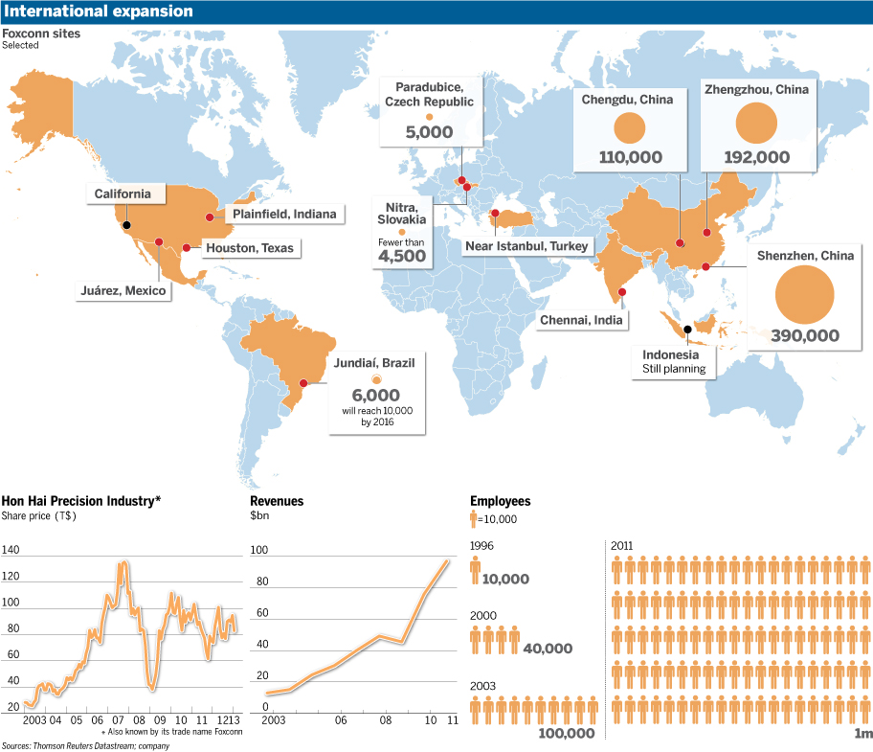
The Foxconn Empire
Source: FT, January 3, 2013.

Slide 30
Fragmentation of production: the example of the Boeing 787 Dreamliner
Wing box: Mitsubishi Heavy Industries (Japan)
Wing ice protection: GKN Aerospace (UK)
Forward fuselage:
Kawasaki Heavy Industries (Japan)
Spirit Aerosystems (USA)
Centre fuselage: Alenia Aeronautica (Italy)
Rear fuselage:
Boeing South Carolina (USA)
Escape slides: Air Cruisers (USA)
Vertical Stabiliser: Boeing
Commercial Airplanes (USA)
Doors & windows:
Zodiac Aerospace (USA)
PPG Aerospace (USA)
Lavatories:
Jamco (Japan)
Flight deck seats:
Ipeco (UK)
Raked wing tips: Korean Airlines
Aerospace division (Korea)
Flight deck controls:
Esterline (USA),
Moog (USA)
Horizontal Stabiliser:
Alenia Aeronautica (Italy)
Engines: GE Engines (USA),
Rolls Royce (UK)
Aux. power unit: Hamilton
Sundstrand (USA)
Centre wing box:
Fuji Heavy Industries (Japan)
Engine nacelles: Goodrich (USA)
Passenger doors:
Latécoère Aéroservices (France)
Tools/Software: Dassault Systemes (France)
Navigation: Honeywell (USA)
Pilot control system: Rockwell Colins (USA)
Wiring: Safran (France)
Landing gear: Messier-Dowti (France)
Electric brakes: Messier-Bugatti (France)
Tires: Bridgestone Tires (Japan)
Cargo doors: Saab (Sweden)
Prepreg composites:
Toray (Japan)
Final assembly: Boeing
Commercial Airplanes (USA)
Source: www.newairplane.com

Slide 31
Boeing and Outsourcing
While Boeing has progressively increased its outsourcing, Japanese suppliers in particular have played an increasingly bigger role in building Boeing aircraft, supplying :
15 percent of the 767 jet,
21 percent of the 777, and
35 percent of the 787.
But the experience with the development and production of the 787 suggests that are limits to the effective management of the complexity that such large scale outsourcing entails especially when modularity involving design and manufacturing is low.

Slide 32
And more broadly the Globalization of Production has been linked to ……
The erosion and in some cases the extinction of the “industrial commons” in some sectors in some geographies
The hollowing out of the middle class and the rise of inequality in the developed world
A rise in unemployment
But with development benefits for many low cost economies

Slide 33
The Smart Phone

Slide 34
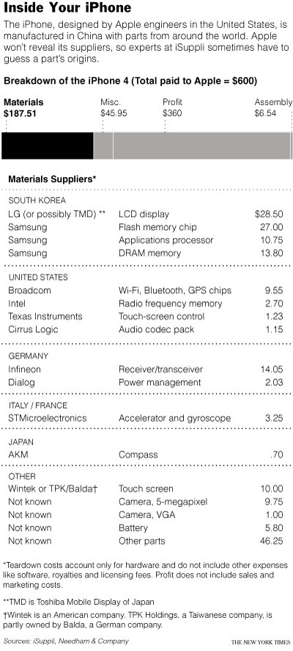
Source: New York Times, July 5, 2010.

Slide 35
The iPhone and the US-China Trade Deficit*
Most of the bilateral deficit associated with iPhone trade does not originate in China as workers there contribute a very small portion of the value-added to an iPhone sold in markets.
Being solely an iPhone assembly center, China first imports all components and then re-exports them as the final assembled product to the US.
It costs only US$6.50 per unit to assemble all parts and components into a ready to use iPhone.
The assembly cost accounts for merely 3.6% of the total manufacturing cost.
The imported components from other countries greatly inflate the export value.
*How the iPhone widens the United States Trade Deficit with the People’s Republic of China, Yuqing Xing and Neal Detert, ADBI Working Paper Series No. 257, December 2010.

Slide 36
Shareholder Value
The Value captured by Apple with its iPhone and other products and services is reflected in its huge profits
While Apple’s level of Value Capture is possible within the context of globalisation, it is driven by the overriding embrace of the primacy of shareholder value and its maximization
Maximizing shareholder value has been core to enterprise strategy for some three decades now
‘While shareholder value continues to have primacy over the interests of other stakeholders, it is axiomatic that income inequality will continue to rise regardless of the pace of globalisation or the rate of technological change.’ – Louis Brennan, Financial Times, February 2007.

Slide 37
Administrative Arbitrage on the part of MNEs creates data measurement challenges
Tax Strategies of MNEs:
Transfer Pricing and the measurement of trade
“Roundtrip” Investments and the measurement of FDI

Slide 38
“Addressing Base Erosion and Profit Shifting” (OECD, 2013)
“by searching through the IMF Co-ordinated Direct Investment Survey (CDIS), it emerges that in 2010:
Barbados, Bermuda and the British Virgin Islands received more FDIs (combined 5.11% of global FDIs) than Germany (4.77%) or Japan (3.76%).
These three jurisdictions made more investments into the world (combined 4.54%) than Germany (4.28%).
On a country-by-country position, in 2010 the British Virgin Islands were the second largest investor into China (14%) after Hong Kong (45%) and before the United States (4%).
Similar data exists in relation to other countries, for example Mauritius is the top investor country into India (24%), while Cyprus (28%), the British Virgin Islands (12%), Bermuda (7%) and the Bahamas (6%) are among the top five investors into Russia.”

Slide 39
Signs of Reversal???
“The ideal strategy for a global company would be to put every factory it owned on a barge and float it around the world, taking advantage of short-term changes in economies and exchange rates” - Jack Welch, former CEO GE.
More recently, there have been suggestions around the possibilities of a manufacturing renaissance in those economies which experienced a hollowing out of manufacturing over the past decades.
An embrace of near-shoring and re-shoring has recently been observed in the case of a number of firms
Apart from cost and nimbleness considerations a number of other factors obtain viz.
an increasing consciousness of the vulnerabilities of globally dispersed value chains
recognition of the benefits of co-location of design and manufacturing functions
an awareness of the limits to manufacturing fragmentation
Suggesting that we are close to a tipping point in terms of the global dispersion of manufacturing activities.

Slide 40
Thank You

