Slide 1
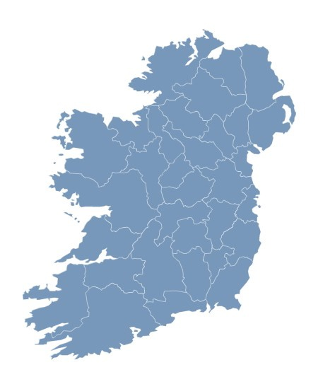
Who are the unemployed?

Slide 2
Background – main recent trends

Slide 3
Duration of unemployment

Slide 4
Duration of unemployment - contd

Slide 5
Who are the unemployed?

Slide 6
Who are the unemployed? - contd.

Slide 7
Who are the unemployed? – Age profile
Figure 7 - Share of unemployed persons by age category – Q1 2008 and Q1 2012

Slide 8
Who are the unemployed? – Focus on youth

Slide 9
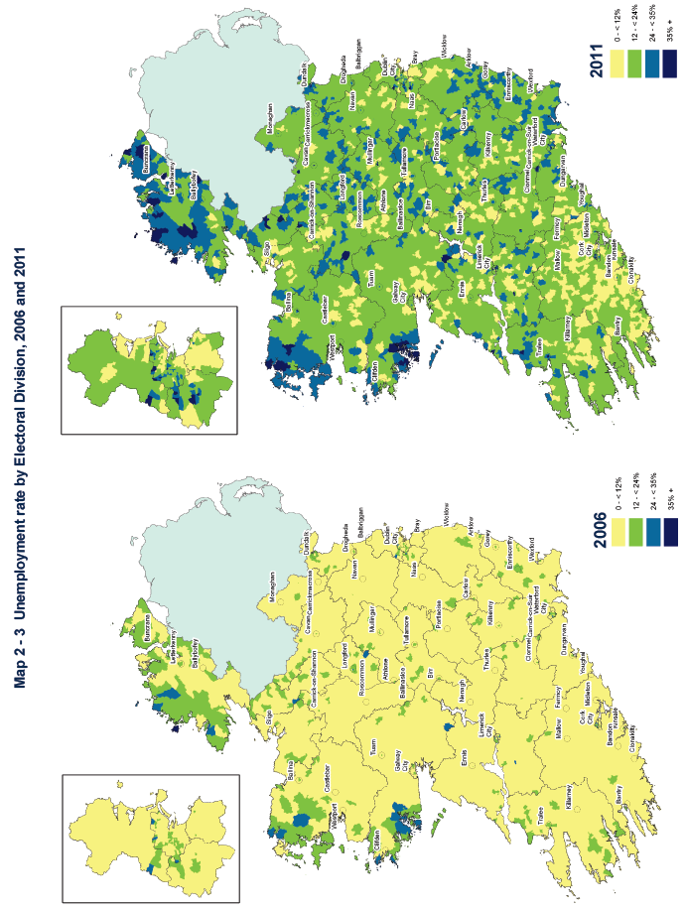
Where are the unemployed?
Figure 9 – Unemployment rates by Electoral Division, 2006 and 2011

Slide 10
Take a closer look
www.cso.ie

