Slide 1
This is Ireland
Part 1
Highlights from Census 2011
Notes:
Introduction
First definitive results of the 2011 census.
This is the first of an extensive range of publications that we will product throughout the rest of the year
This morning we aim to walk you through of some of the more interesting findings.
Wealth of information released this morning, can be found on cso.ie.
Our approach for the 2011 dissemination program is to look more at graphical representations of the data. In past years CSO has been guilty of bombarding users with figures which is not necessarily the most user friendly approach.
More accessible presentation of the data is something we’re striving for across our dissemination programme this year.
This presentation will present highlights on all areas from the report.

Slide 2
Reminder ..........
Census Day : Sunday April 10th 2011
Just under 2 million dwellings visited by 5,000 staff
Preliminary results June 2011
Data captured and processed May 2011 – February 2012
Dissemination phase throughout 2012
Notes:
Before I begin I want to just give you a small bit of context for the Census.
Census was taken on Sunday 10th April which hopefully some of you remember.
During the field operation, Census Enumerators visited just under 2 million dwellings across the country delivering and collecting forms.
At the end of the process, completed questionnaires had been collected from 1.66 million occupied households,
Once the forms were returned to our HQ in Swords we began scanning the forms and capturing the data on them to populate our database.
This was recently completed in February.
Now embarking on publication phase which will last for the whole of 2012

Slide 3
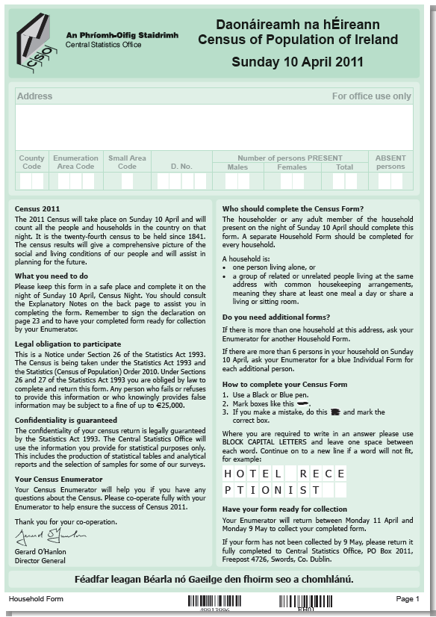
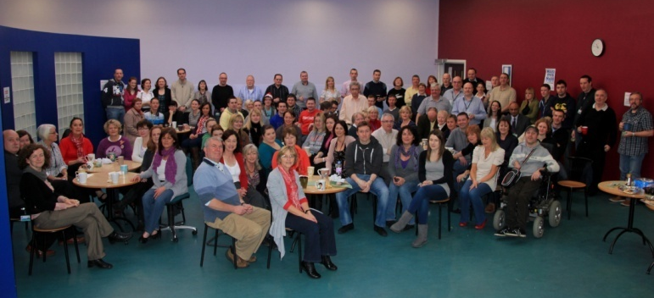
Census Efficiencies
Scanning introduced in 2002
Almost halved staff input down to 340 person years by 2011 (27% increase in pop and more questions).
Preliminary population within 11 weeks
Improved release of economic data from 24 months in 1996 to 15 months in 2011.
England and Wales first results will be 16 July 2012, no preliminary count.
Came in at €51.6M a saving of €11M on original budget, €40M on enumeration
New more detailed geography 18,484 areas
All outputs before end of 2012.

Slide 4
Population change
Population increased by 348,404 or 8.2% since 2006
Annual average increase of 1.6%
Population increased by 30% since 1991
55% since 1951
Natural increase 225,000
Net migration 125,000
Notes:
On April 10th 2011 there were 4,588,252 people counted in the Republic of Ireland.
This marks an increase of 348,404 or 8.2% since 2006
Average annual population growth of the 5 inter-censal years of 1.6%
The population increased by 30% in the 20 years from 1991 to 2011.
Increased by 55% or 1.6 million from 1951-2011
Two components of population change – natural increase and net migration.
Natural increase is births – deaths.
Were 365,000 births in the 5 years and 140,000 deaths, giving a natural increase of 225,000
Net migration is derived as a residual figure – total population change minus natural increase
Residual is 125,000.
Average of 25,000 net immigration each year. Somewhat surprising given economy.
Will come back to this in more detail.

Slide 5
Drivers of population growth
Population change driven by 4 elements
Births
Deaths
Immigration
Emigration
Natural increase of 225,000
Net migration of 125,000
Natural increase
Net migration

Slide 6
Population change by county
Leinster commuter belt counties
Laois the fastest growing way
Cork and Limerick cities declined
Notes:
Big drivers of growth were counties in Leinster.
The population of Leinster accounted for over 60% of the 348,000.
55% of the population was in Leinster
Dublin commuter belt counties prominent.
Loosening of the commuter belt with counties like Laois, Cavan and Longford growing strongly
Only two areas showed falls in population, Cork and Limerick City.
Dublin, Galway & Waterford cities grew modestly

Slide 7
Town & country
Notes:
The number of people in urban areas (towns with a population of 1,500 or more) surpassed 2.8 million.
Now over 60% of our population live in urban areas.
Very clear microcosm of how our country has changed in the last 50 years
In Census 1961, 54% of the population lived in rural areas
In 2011 this had declined to 38%, with 62% living in urban areas.

Slide 8
Age & sex composition
Peak in births in early 80s
Decline from mid 80s...
...low point 1994
Now picking up again
Male 65+ up 17%
Females up 12%
Women in their 30’s
Notes:
Population pyramid represents the number and males and females by single year of age.
Most noticeable feature is the peak for both males and females in the early 30s age brackets.
This was partially attributable to a peak in births which was experienced in the 1980s
This tapered off in subsequent years, as can be seen. Outward migration may also have had an effect on these age groups.
Birth rates have been increasing again in recent years, this is evident from the base of the pyramid
Common feature of most countries’ population pyramids is a tapering off of the population in the older age groups and a reflection of higher male mortality as the ages increase.
The effect of this is a narrowing of the pyramid and an increasingly asymmetrical distribution among older age groups.
One notable feature that is not brought out in this graph is an 18% increase in the male population over the age of 65, compared with a 12% increase for women. This reflects a narrowing gap in life expectancy between the sexes.

Slide 9
Average age
Average age 36.1
Up from 35.6
Older than 2006
Youngest counties
Oldest counties
Notes:
The average age of the population in 2011 was 36.1.
For comparison, the average age of the population in 2006 was 35.6.
So, on that measure it could be concluded that the population is getting older.
The map provides data on the average age broken down by administrative county.
In general you can see that the younger counties, tend to be to the north and west of Dublin, with older counties to the west of the country
The youngest county by average age was Fingal, at 32.2. The next youngest counties were Kildare at 32.8 and South Dublin at 33.1.
The oldest administrative county was Cork City at 38.7, followed by Mayo at 38.6 and Kerry at 38.5.

Slide 10
Elderly living alone
136,295 elderly living alone – 28% of group
Varies by age
...by sex

Slide 11
Elderly living alone
....by county
Highest numbers as % of private households in cities, west, border
Lowest numbers in Dublin commuter counties
Notes:
Almost 30% of people aged over 65 who lived in private households lived alone.
This percentage increased for older age groups, so for example 37% of people aged over 75 lived alone.
The map shows persons aged over 65 living alone as a percentage of those living in private households
We can infer from this that the cities as well as the western and border regions had the highest number of elderly people living alone. The Dublin commuter counties had the lowest number.

Slide 12
Private Households
Household size continues to shrink
Average 2.73
From 2.81
Total households increases by 12.6%

Slide 13
Family Units

Slide 14
215,300
143,600

Slide 15
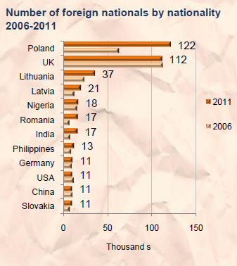
Nationality
Notes:
An analysis of the nationality question brings home some of the trends we have seen in the last couple of slides.
The number of foreign nationals doubled between the 2002 and 2006 Census.
The rate of increase tapered off between 2006 and 2011, growing by 30% to 544,000.
A small number of countries accounted for the majority of the increase.
The number of Polish nationals increased by 93% to 123,000.
This led to Polish nationals becoming the biggest non-Irish group living here, overtaking UK nationals.
Other groups showing big increases were Lithuanians, Latvians, Romanians and Indians.
The number of UK and US nationals declined.

Slide 16
One-year inflows
53,000 people moved to Ireland in year leading up to Census
Slowdown on 2006
Almost 20,000 Irish
34,000 non-Irish

Slide 17
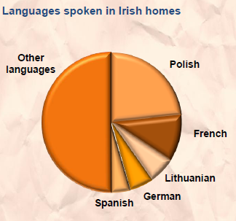
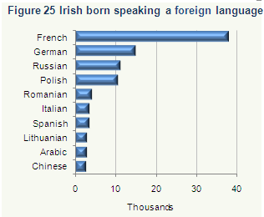
Foreign languages
Half a million spoke a foreign language at home
Dominated by Polish
Irish born & multi-lingual
Notes:
A new question was asked on languages other than English or Irish spoken at home
The results showed that over half a million people spoke a foreign language at home.
The most common was Polish, which was spoken by 120,000 people. Almost 60,000 spoke French and 30,000 Lithuanian.
We also saw interesting data in respect of Irish born persons who spoke a foreign language at home.
Almost 40,000 Irish born persons spoke French at home, 15,000 spoke German and 11,000 Russian. An interesting side note is that the majority of the people who spoke French at home were Irish born.

Slide 18
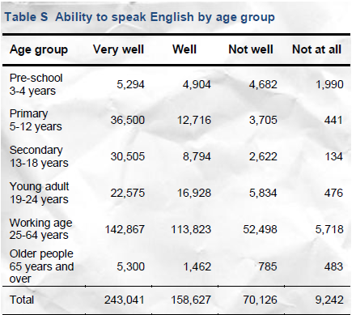
Ability to speak English

Slide 19
Irish Speakers
Total ‘yes’ increased by 7.1 %
To 1.77 million
Frequency
77,185 daily outside education
110,642 weekly
613,236 less often
442,000 never
Irish forms requested up from 3,506 households in 2002 to 7,751 in 2011

Slide 20
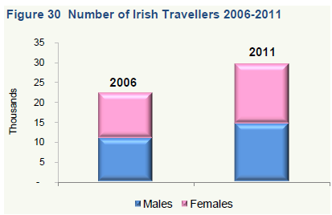
Irish Travellers
Increase 32% on 2006
Total 29,573
Cavan largest increase
12% in temporary accommodation
Down from 25% in 2006
Cavan highest in permanent housing 97%

Slide 21
Housing Types
1.66 million occupied homes
13% more than in 2006
Most common detached house
Biggest growth in flats/apartments
Bedsits disappearing
Notes:
I’m again going to skip a number of areas in the report to come to the final area I want to address today. These areas are ethnicity, the Irish Traveller community and the Irish language. Again lots of interesting stuff on these areas on our website.
The final area I want to look at is housing.
The first slide looks at the changing nature of the housing stock over time.
There were 1.65 million occupied homes in Census 2011. This marks an increase of 13% on 2006.
The most common type of home remains the detached house, where 42% of households live. This is driven by rural areas where the majority of households live in detached homes.
The biggest growth has been in households living in flats and apartments, where there has been a 37% increase.
Interesting to look at these results on a county by county basis.
Laois has shown a 116% increase in the number of occupied flats/apartments in custom built blocks, which to all intents in purposes means modern apartments. This tallies with the big growth in population we’ve already seen for that county.
Also increasing rapidly was the share of apartments in South Dublin and Meath.
One other notable development has been the almost disappearance of bedsits as a form of accommodation. The numbers of households living in them has fallen to only 5,700. It seems students are no longer sharing their bedroom with their cookers!

Slide 22
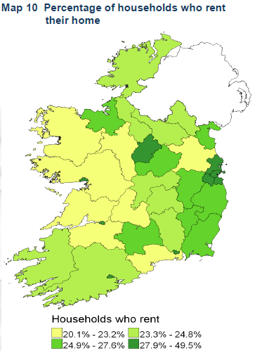
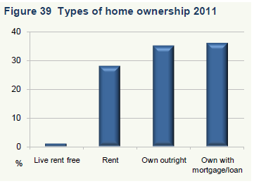
Renting
Total of 475,000 renting
Sharp increase on 2006 figure of 300,000.
Up 57.6%
Data by county …
Notes:
Much more detail and analysis on all the areas I have touched upon today as well as several other areas questioned in the Census can be viewed by downloading the report on www.cso.ie/census.
There will be 11 further releases throughout the year, pretty much monthly until December. These will cover a range of different areas in depth. As with this publication our intention is to do more analysis work on the figures and to present them in a more user-friendly format.
The next publications slated for release will be Population classified by area on April 26th. This will provide analysis of population changes at local levels
The full publication schedule for 2012 can be found on www.census.ie

Slide 23
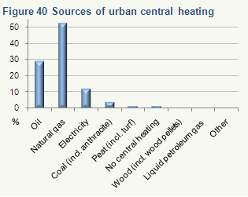
Central heating
Oil, natural gas dominant
Urban v rural
Fossil fuel reliance
Notes:
For the first time on Census 2011 we asked a question on the type of central heating households had in their home.
The most popular type of central heating system was oil, which heated 43% of homes. Natural gas heated a third of homes.
The results also showed a very clear disparity between urban and rural households.
In rural areas just under 70% of homes were heated by oil, with natural gas barely registering on the scale. The second most common fuel type was peat at just over 11%.
Conversely in urban areas, over half of homes were heated by natural gas with just under 30% heated by oil.
One of the most startling facts to emerge from these data is the still overwhelming reliance on fossil fuels in Ireland. Between them, oil, natural gas and coal heated 80% of homes in Ireland.
There is some debate as to whether peat is classifiable as a fossil fuel, but if it is included, then the percentage of homes heated by fossil fuels rises to 86%.

Slide 24
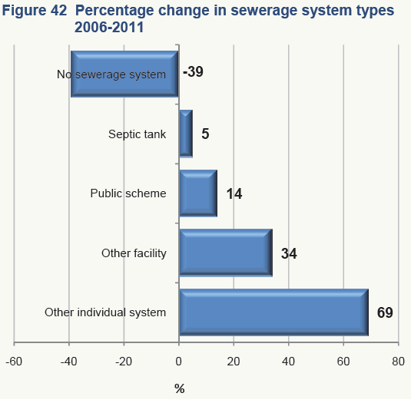
Sewerage facility
Two thirds of households use public sewerage scheme
Increase of 70% in use of other individual systems

Slide 25
Thank you
Notes:
Much more detail and analysis on all the areas I have touched upon today as well as several other areas questioned in the Census can be viewed by downloading the report on www.cso.ie/census.
There will be 11 further releases throughout the year, pretty much monthly until December. These will cover a range of different areas in depth. As with this publication our intention is to do more analysis work on the figures and to present them in a more user-friendly format.
The next publications slated for release will be Population classified by area on April 26th. This will provide analysis of population changes at local levels
The full publication schedule for 2012 can be found on www.census.ie

