Slide 1
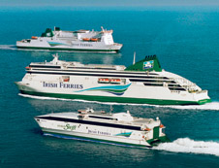
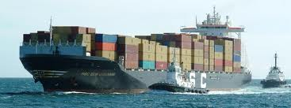
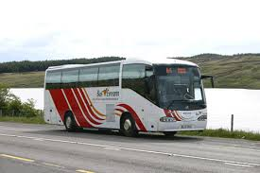
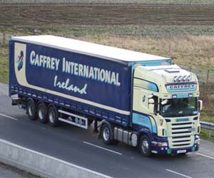
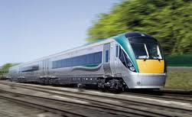
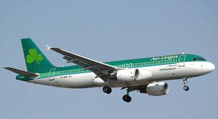
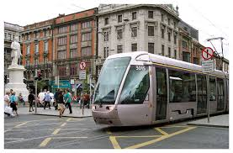
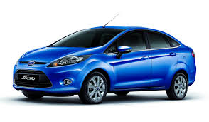
Transport Statistics Liaison Group

Slide 2
Transport Statistics Liaison Group
The Transport Statistics Liaison Group was established in March 2010 with the broad aim of improving communications with our key stakeholders, both users and data respondents.
The group will play an important role in helping to set national priorities for transport statistics.
facilitate the effective exchange of information on all areas of transport statistics

Slide 3
Role of the Group
Advise on the transport statistics required to support national and regional policy needs;
Examine and make recommendations on all quality aspects of transport statistical outputs, such as timeliness, relevancy, consistency, formats, future plans etc;
Promote best practice in the compilation of transport statistics;
Investigate alternative sources for transport statistics;
Provide and share information on progress regarding all transport surveys/data projects and other relevant issues relating to transport statistics;
Consider other statistical and measurement issues as necessary.

Slide 4
Last meeting of July 2011
> 4 formal Liaison Groups within Business Statistics
Enterprises
All Island Tourism Statistics
Transport
Agriculture
Of which I have responsibility for 3 under my remit - Ag/Tourism/Transport

Slide 5
Changes in Personnel at senior level
Director (Steve MacFeely) -> ADG Social Statistics
Head of Division(Margaret McLoughlin) -> retired 27-2-2012
Stat (Gregg Patrick) -> House Price Index May 2013
Stat (Mairead Griffin) -> Tourism Statistics end 2011
HEO (Anne Ross) -> CPI - end of 2012.
Organisation within the Central Statistics Office

Slide 6
Business Statistics Directorate
Agriculture, Tourism & Transport Division
Director – Kieran Walsh - also responsible for SBS/STS/Prices/ATT
Head of Division – Paul J Crowley - Head of Prices/International Relations 2007-2012
Jim Dalton Stat (previously Tourism) RFS/Vehicle Licensing/Rail/Omnibus
Olive Loughnane Stat (April 2013) – Maritime/Aviation/NTS/New Developments
Noreen Dorgan (HEO/Section Manager) Jan 2013
Organisation within the Central Statistics Office

Slide 7
Resources
0.2 Sen Stat
2.0 Stats
1.0 HEO
0 EO
1.2 (0.7+0.5) SO
7 CO = 5.3 FTE
9.7 FTE of which
4.4 Statistical/Managerial 45%
5.3 Data Collection/Processing 55% - > 80% of time devoted to RFS
Organisation within the Central Statistics Office

Slide 8
Transport
At EU level tends to be organised by mode
Road
Aviation
Maritime
Inland Waterways (not relevant to Ireland)
Rail
At National level (CSO)
Vehicle Licensing
Vehicle Kilometres
National Travel Survey
Omnibus Transport Publication

Slide 9
Most of our effort is devoted to satisfying the following:
-> EU requirements
- Compliance with EU requirements - regulations
- transmission of data sets
- participation at EU level in subject matter statistical working groups - 5 domains - 2 subject matters a year, every 2nd year
- As Head of Transport Statistics - annual meeting CGST - Co-ordinating Group on Statistics in Transport
-> national publication requirements & user needs
- Vehicle Licensing
- RFS
- Maritime
- Omnibus

Slide 10
Current Statistical Priorities in Transport
Meeting EU requirements - compliance & timeliness
Statistical Quality - improving methods & procedures
Improvements to publications & access to data – format/content/technology
Meeting user needs where possible - accessibilty, additional analysis but not necessarily new surveys/data -> issue of resources and priorites
Awareness of transport policy at national and EU level and related developments

Slide 11
Any Questions

