Slide 1
Accessing data – Statbank, PC Axis and the Public Sector Statistics Network
Eoin MacCuirc
Databank and Dissemination Unit
Central Statistics Office, Cork City
eoin.mccuirc@cso.ie

Slide 2
Freely available facts and figures are essential for driving improvements in public services. It puts information, and therefore power, in the hands of the public and the service providers to challenge or demand innovation in public services.

Slide 3
CSO Dissemination direction
Emphasis on web based dissemination
All CSO data disseminated to the general public must be on the Statbank
More efficient publication processes driven from Statbank
Quality and accessibility of data

Slide 4
  StatCentral – Where do I find out about the data? www.statcentral.ie
StatCentral – the portal to Ireland’s official statistics
It provides information about statistics produced by government departments and state organisations
Classified by:
  Statistic Name
  Department/Agency
  Theme

Slide 5
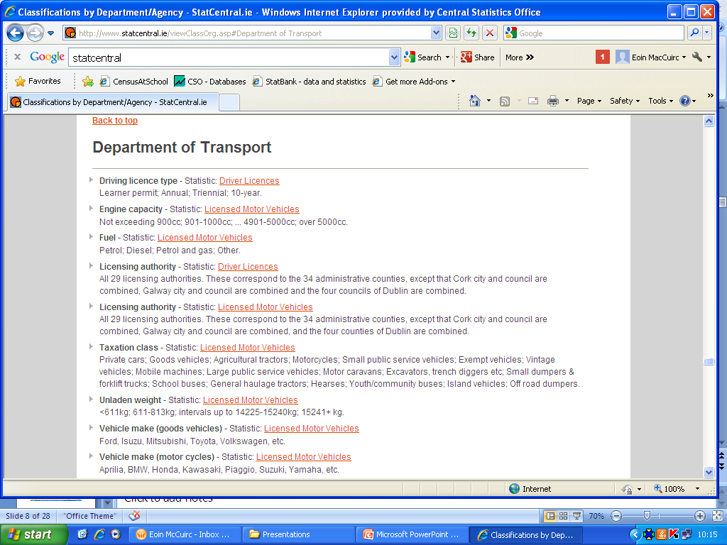
StatCentral – Dept of Transport, Tourism and Sport http://www.statcentral.ie/viewClassOrg.asp#Department of Transport

Slide 6
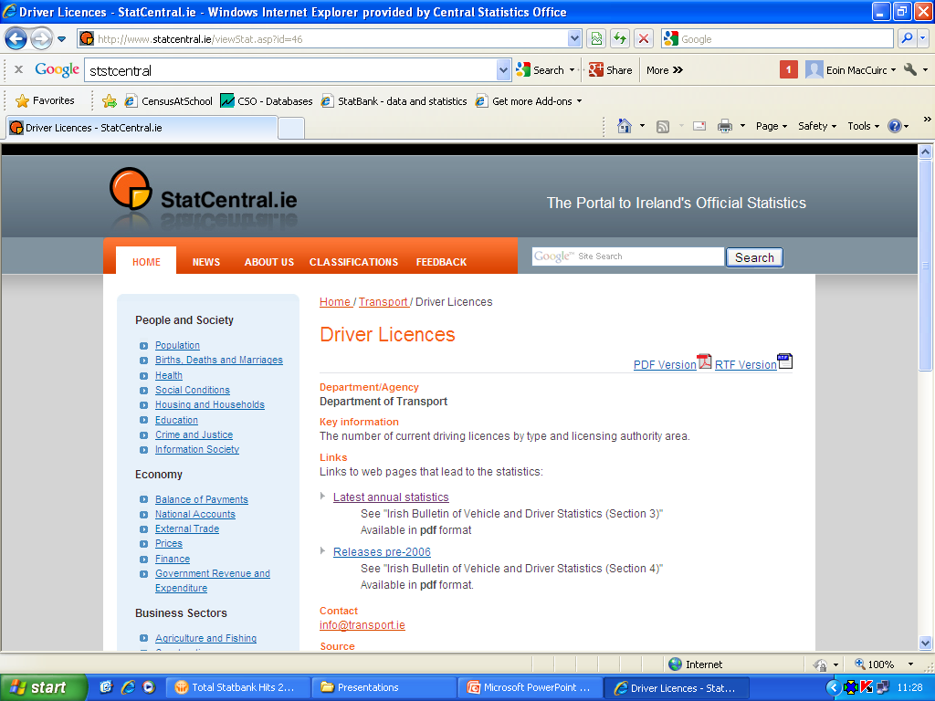
StatCentral – Dept of Transport, Tourism and Sport http://www.statcentral.ie/viewStat.asp?id=46

Slide 7
Statbank - Making CSO datasets public
greater access to “chunks” of reliable data
informs policy making
promote innovation though encouraging the use and re-use of datasets
helps people understand how policies are made
easier for people to make decisions and suggestions based on detailed information
people can find the data they need themselves

Slide 8
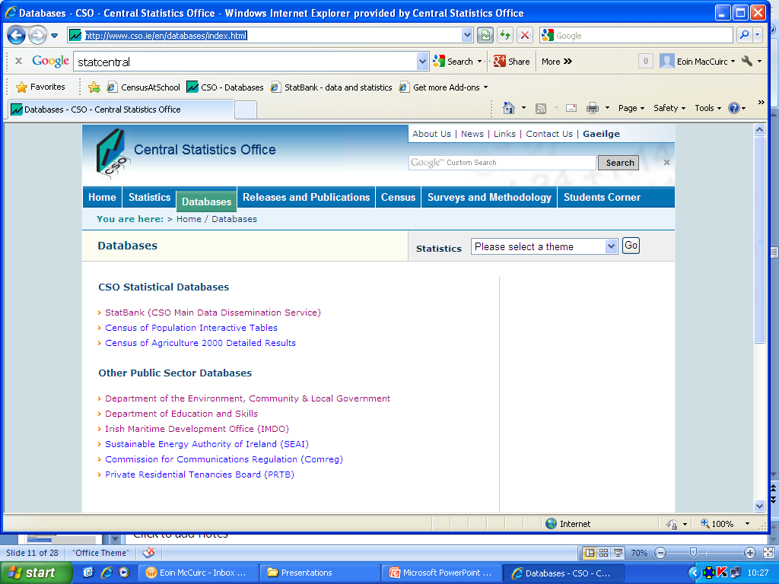
StatBank - Creating public access http://www.cso.ie/en/databases/index.html

Slide 9
Statbank
Access to time series of data “slice and dice”
Multiple download formats
Drives our “quicktables” facility
Maps and graphs
Multiple language facility (English and Irish)
Both file and database versions of PC Axis up on our website
Drives our new automatically updated key indicators page
Driver for future electronic releases as our “single source of data”

Slide 10
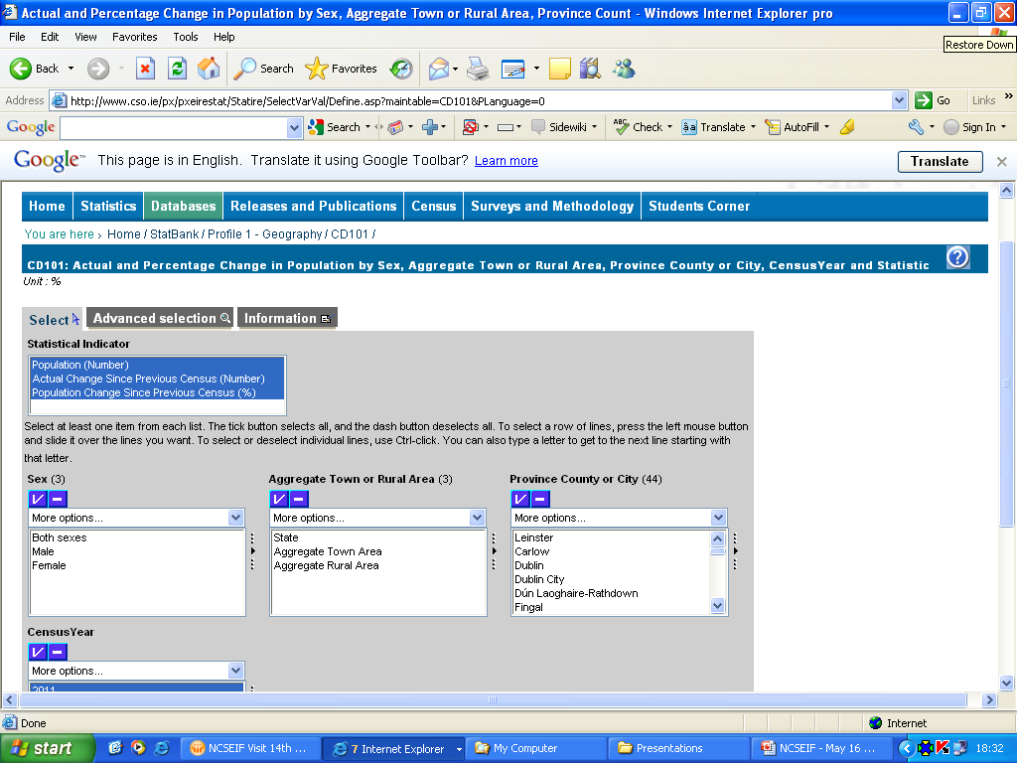
Slice and dice

Slide 11
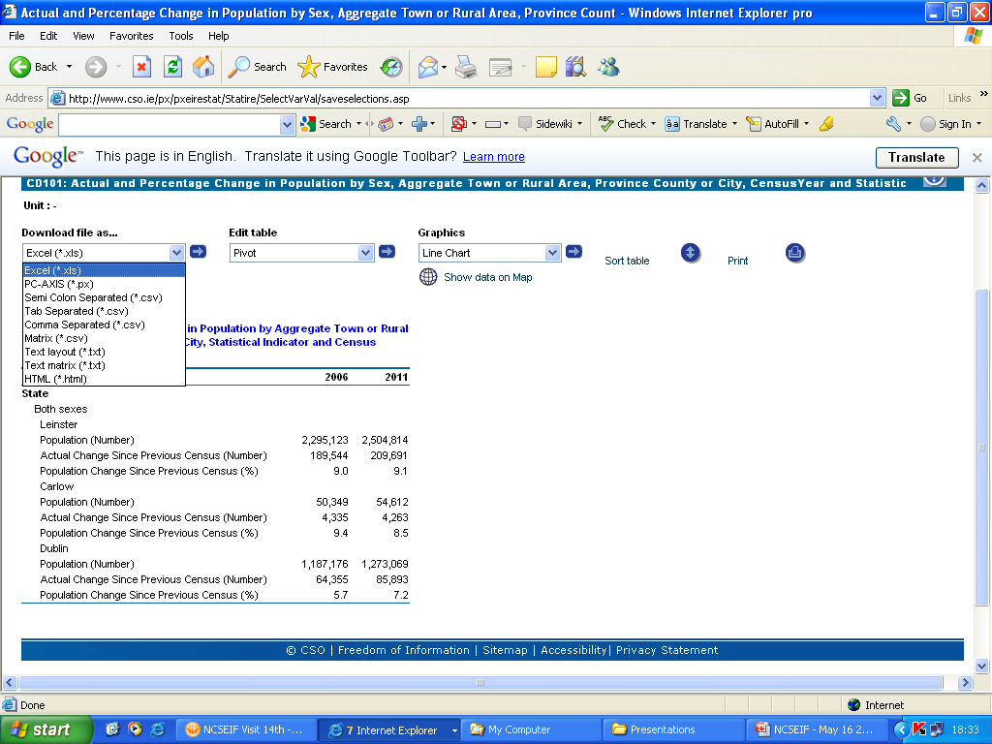
Multiple download formats

Slide 12
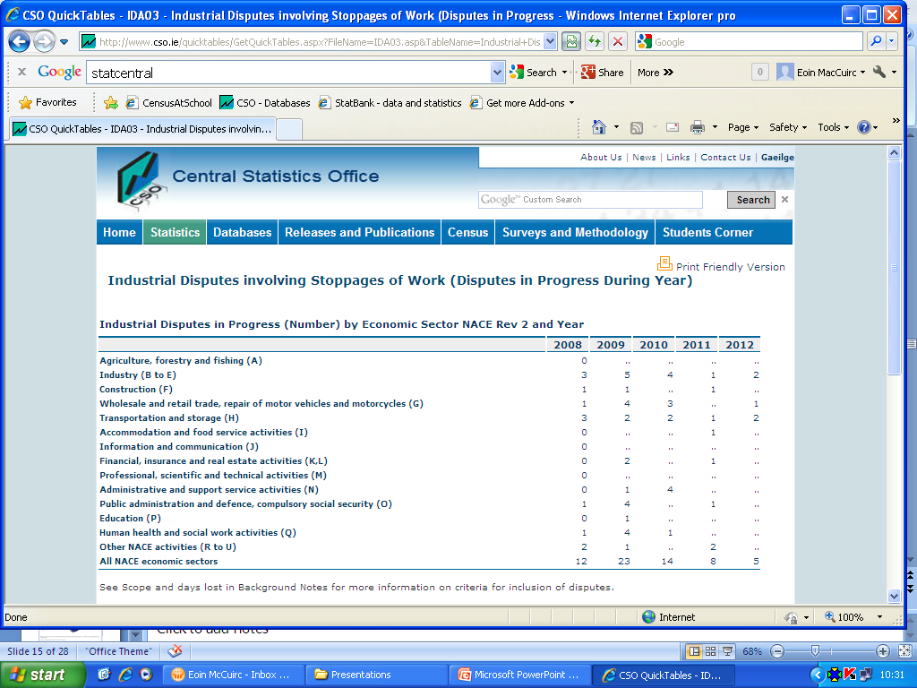
Quicktables

Slide 13
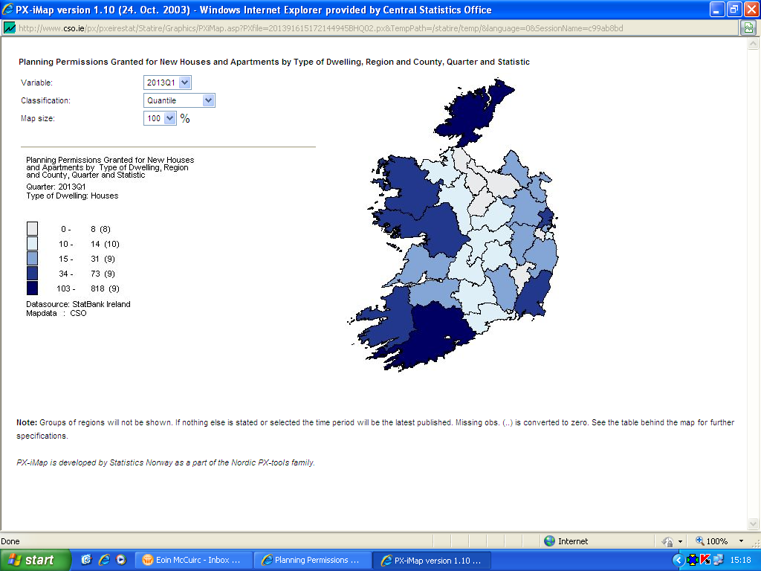
Maps and graphs data

Slide 14
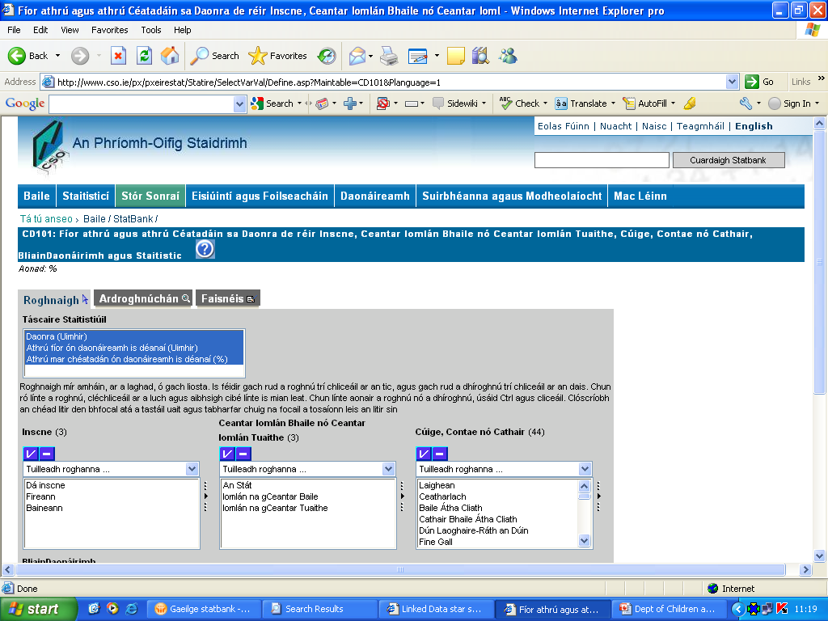
Multiple language facility

Slide 15
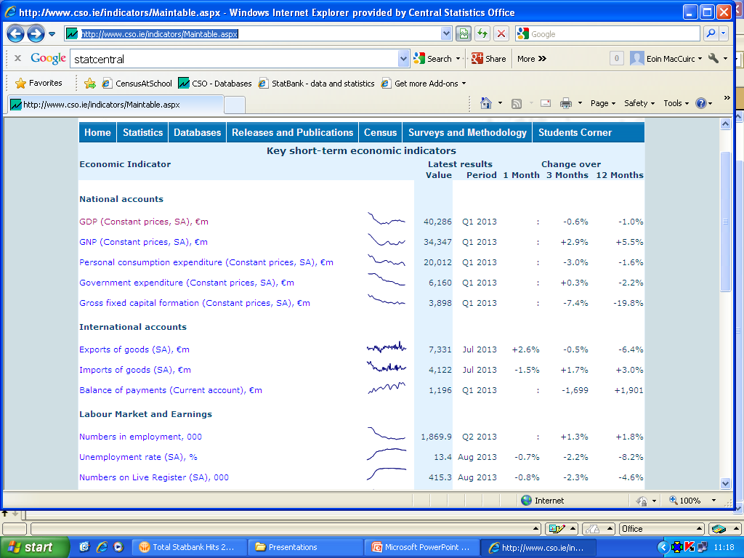
Key Economic Indicators http://www.cso.ie/indicators/Maintable.aspx

Slide 16
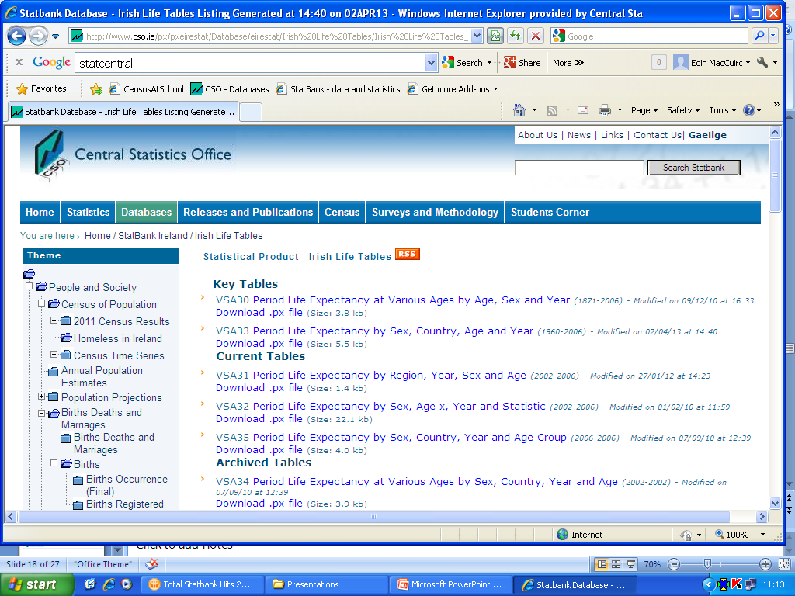
File and database versions of PC Axis
(Tables sorted as Key, Current and Archived)

Slide 17
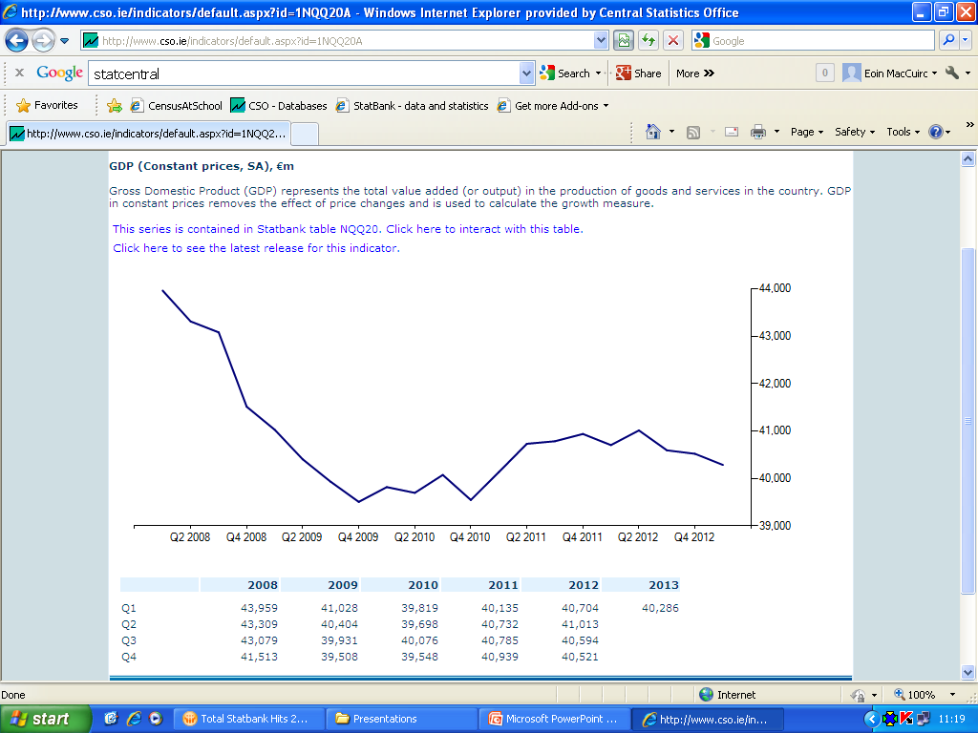
Key Economic Indicators (Details) http://www.cso.ie/indicators/Maintable.aspx

Slide 18
Public Sector Statistics Network - making other public data available
PC-Axis based Database Service
CSO offers to host Public Sector Data
Public sees data owner “skin”, links to CSO

Slide 19
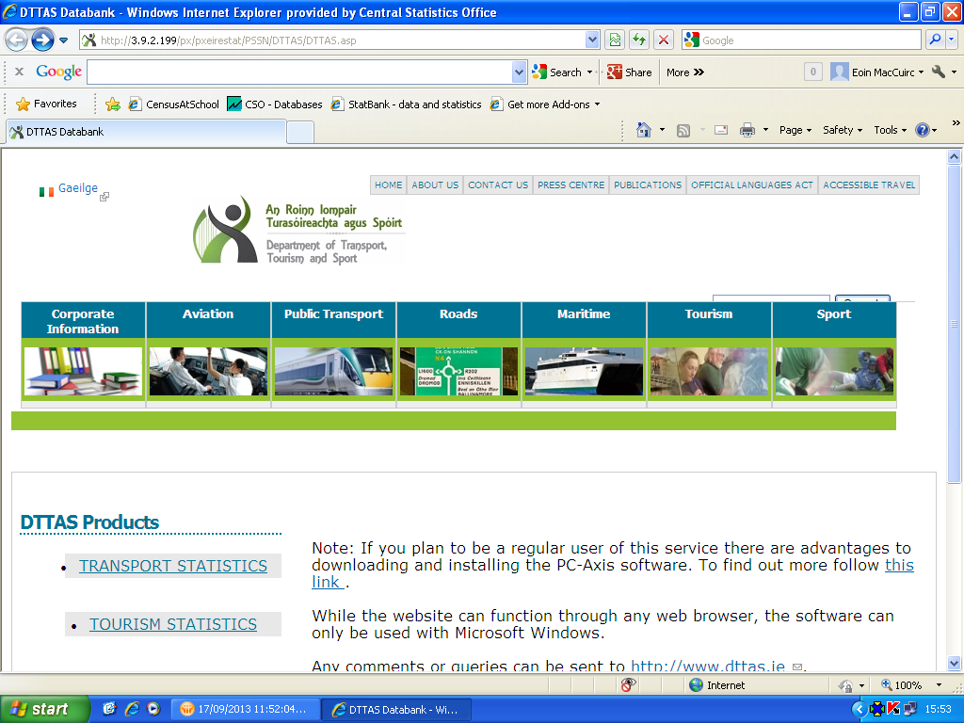
PSSN – Department of Transport, Tourism and Sport http://3.9.2.199/px/pxeirestat/PSSN/DTTAS/DTTAS.asp

Slide 20
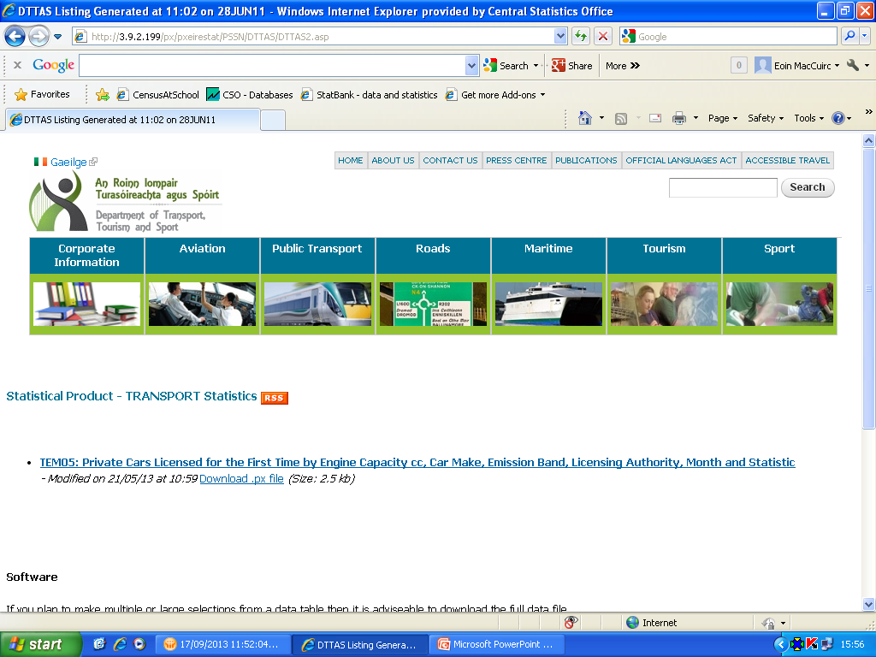
DTTS - Sample Statistics Selection Screenhttp://3.9.2.199/px/pxeirestat/PSSN/DTTAS/DTTAS.asp

Slide 21
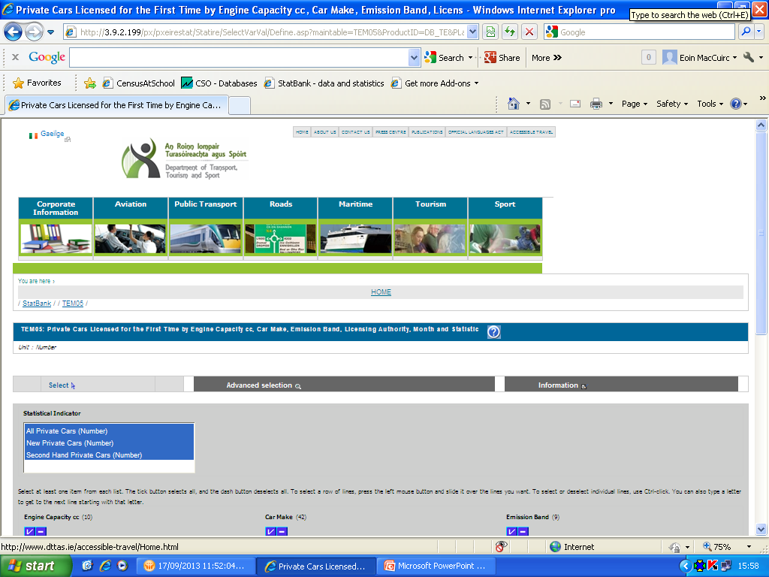
DTTS – Sample data selection screen

Slide 22
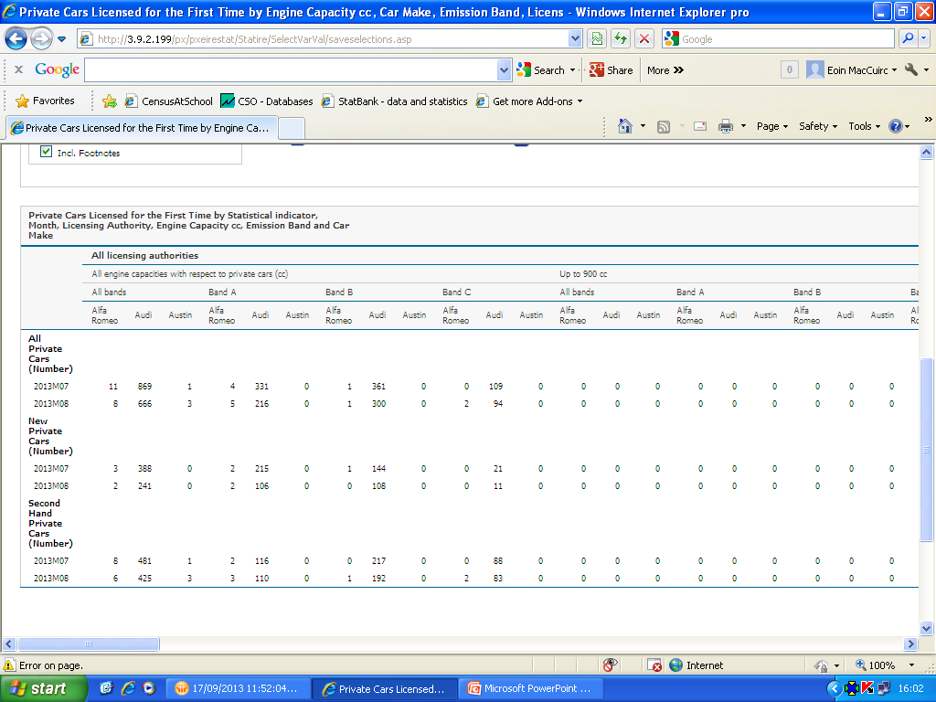
DTTS – sample data table

Slide 23
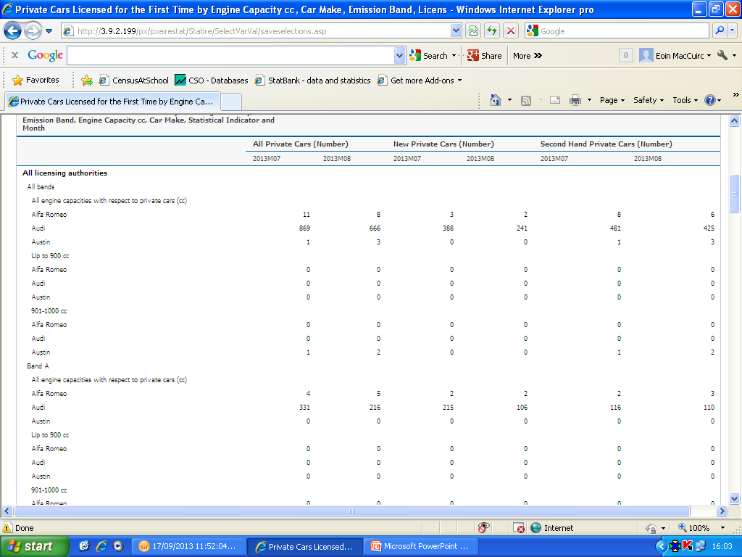
DTTS Pivot clockwise

Slide 24
StatBank usage
2013 to end of August
Total Number of Statbank web hits
Start Date (yyyy-MM-dd) : 2013-01-01
End Date (yyyy-MM-dd) : 2013-08-31
Total number of web hits: 821,827
2012
Total Number of Statbank web hits
Start Date (yyyy-MM-dd) : 2012-01-01
End Date (yyyy-MM-dd) : 2012-12-31
Total number of web hits: 1,042,750

Slide 25
Summary
greater access for users to volumes of your data (ticks the Open Data box)
people can find the data they need themselves
reduces the query burden on your organisation
CSO offers to work with you to create this possibility (you choose the extent of the data)
easy, cost effective solution, common tool
one stop shop for official Irish data (StatCentral)

Slide 26
Questions
Thank You

