Slide 1
Transport Statistics Liaison Group
Transport Statistics
Agriculture, Tourism & Transport Division
Business Statistics Directorate
Notes:
There are seven layouts pre-set in this PPT add additional layouts slides from the home tab by clicking the new slide drop arrow . Black text reads best in most situations, use bold colours to retain readability in bright conditions.
Consider animations with care they can become repetitive or visually disruptive.

Slide 2
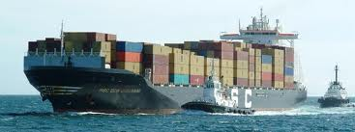
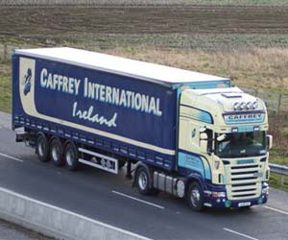
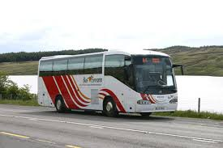
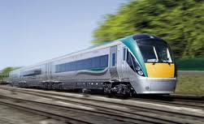
Transport Statistics

Slide 3
Senior Stat Paul J Crowley
Stat Brendan Curtin
Survey/Section Manager
Noreen Dorgan

Slide 4
CSO Presentations
Transport Statistics in the European Statistical System
Transport Statistics in the CSO
National Travel Survey

Slide 5
European Statistical System
The European Statistical System (ESS) is the partnership between the Community statistical authority, which is the Commission (Eurostat), and the national statistical institutes (NSIs) and other national authorities responsible in each Member State for the development, production and dissemination of European Statistics.

Slide 6
Air passenger transport, 2014 (passengers per inhabitant)

Slide 7
Top Airports in the EU –Passenger Numbers

Slide 8
Transport Statistics
5 Domains
Road
Rail
Aviation
Maritime
Inland Waterways - n/r to Ireland
Subject to Regulation - data requirements & transmission of data to Eurostat

Slide 9
Transport Statistics
EU Requirements
Back-bone of our core work
but
Also serve national needs

Slide 10
Transport Statistics
Number of Research Topics - under development/undertaken directly by Eurostat/additional EU requirements
Big Data - administrative systems - Amadeus
Intermodal - is the movement of goods (in one and the same loading unit or vehicle) by successive modes of transport, without handling of the goods themselves when changing modes.
Modal Split - building distance matrices for certain transport modes that would allow the calculation of the indicators by distance classes

Slide 11
Freight transport: modal split at EU level

Slide 12
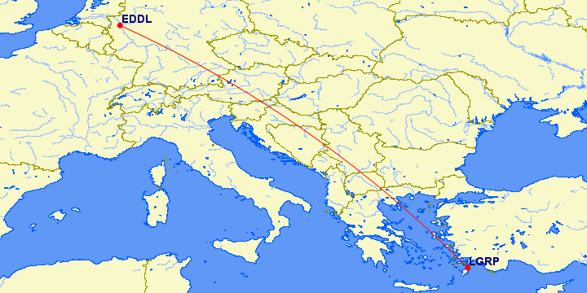
Example of calculation and allocation of tkm/pkm
International intra-EU
Flight from
EDDL Düsseldorf to LGRP Ródos Total distance: 2365 km

Slide 13
IV. Territorialisation of air transport (5 of 11)
Distance over:
Germany 557 km
Austria 255 km
Slovenia 58 km
Croatia 188 km
Bosnia&Herz. 177 km
Serbia 272 km
Macedonia 147 km
Greece 473 km
Turkey 120 km
Total countries: 2247 km
sea : 118 km
Allocated pkm to:
16 463 249 pkm to DE (23.5%)
7 565 085 pkm to AT (10.7%)
1 720 686 pkm to SI (2.5%)
5 577 396 pkm to HR (7.9%)
5 251 059 pkm to BA (7.5%)
8 069 424 pkm to RS (11.5%)
4 361 049 pkm to MK (6.2%)
14 032 491 pkm to EL(20.1%)
3 560 040 pkm to TR (5.1%)
3 500 706 pkm (5.0%)

Slide 14
Transport Statistics
Number of Research Topics - under development/undertaken directly by Eurostat/additional EU requirements
Road Traffic Statistics (Vehicle Km) - pilot collection
Road Accidents - streamline data collection
Passenger Mobility – National Travel Survey
Emissions from Transport
8. Transport Safety

Slide 15
Eurostat Transport Statistics - Priorities for 2016
Proposal for amending Regulation (EC) No 1365/2006 on statistics of goods transport by inland waterways
Proposal for amending Regulation (EC) No 91/2003 on statistics of goods and passengers transport by Rail
The ESS will continue to develop and produce statistics needed to assess progress in meeting quantitative targets set in the 2011 White Paper on emissions from transport, volume and performance of transport, as well as passenger mobility. Based on the developed Guidelines on Passenger Mobility and harmonised indicators, a pilot data collection exercise is foreseen in 2016. In addition, the Guidelines on the compilation of intermodal statistics at national level using the ‘German Approach’ will be used for a pilot collection of intermodal indicators. In the framework of modal split indicators, the development of methodology for territorializing freight volumes transported by all transport by distance class will continue and will be extended to passengers' data.“
Continued streamlining and harmonisation of transport in particular the two voluntary data collections

Slide 16
Commission DG MOVE Statistical/Data Needs
Energy, emissions & Transport Statistics: growing interest for energy efficiency indicators in the transport sector, as well as activity-based emissions.
Passenger mobility data: need for monitoring urban mobility and passenger mobility by distance classes, also within the framework of "smart cities".
Alternative fuels: monitoring of alternative fuel infrastructure and vehicle stock deployment is important in the context of a cleaner and a more sustainable transport system.
Transport infrastructure: to observe the promotion of the 'user pays' and ‘polluter pays’ for the internalisation of external costs related to road transport, such as those generated by the use of infrastructure or its environmental and social impacts.
Internal Market and Competitiveness: how it could be possible to measure the development of a deeper and fairer transport internal market and the competitiveness of EU transport companies?

Slide 17
Current Eurostat Statistical Developments
Task Force on Road Freight
2 Regulations on Rail & Inland Waterways
Data Transmission & Statistical Outputs at EU level
Research Projects (Eurostat) – Big Data/Alternative Sources of Information - e.g. Rail Accidents;
Task Force on Intermodal - pilot testing at national level with grants
Modal Split - new distance matrix/territorialisation tool for air and the proposed methodology for territorialisation of air transport at MS level

Slide 18
Current Eurostat Statistical Developments
Road Traffic - pilot exercise on Vkm & indicators
Passenger Mobility - pilots - project on passenger mobility statistics was launched due to difficulties in finding comparable and EU-policy relevant data
Emissions from Transport - internal Eurostat project
Streamlining - Main achievement of the 2015 is the agreement signed with European Air Safety Agency (EASA) - data on air accidents
eMaritime: Simplification of maritime data collection in all EU and EEA countries = National Single Windows (NSW) for receiving electronic data from vessels by 1 June 2015. AIS – Automatic Identification System (Big Data)

Slide 19
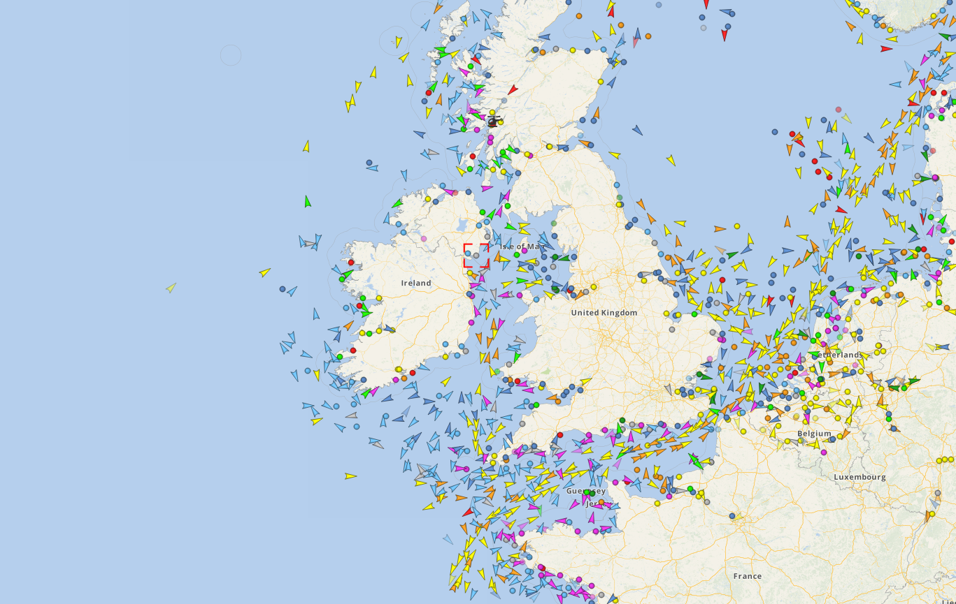
AIS – Automatic Identification System

Slide 20
AIS – Example
STAR OF ABU DHABI Bulk Carrier
TRACKMORE INFOUPLOAD PHOTO
MAY 13, 2016 11:33 UTC
Sailing to / ETAPORT TALBOT U.K. / May 13, 05:00
Course76° | Speed11.4 kn | Current draught13.6 m
Gross Tonnage42751 t | Built2009 | IMO number9375927

Slide 21
Investigating the statistical potential of Big Data

Slide 22
Conclusions
Eurostat Transport Unit – very active in research, testing, identifying alternative data sources
No new obligations arising at the present time
Resources at national level limited
Monitor EU projects as they progress

Slide 23
Conclusions
5. Primary objective - to meet our existing EU obligations

