Slide 1
Northern Ireland Tourism Update
Northern Ireland Statistics and Research Agency, NISRA

Slide 2
Publications released
Annual 2018 statistics released 6th June 2019
Upcoming releases
Tourism by local council area – end of July 19
Quarter 1 2019 – August/Sept
Day trips – Autumn?
Annual tourism publication
External overnight trips
Domestic overnight trips
Visitor attraction survey
Hotel Occupancy survey
Guest house, B&B and other occupancy survey
Self catering occupancy survey
Air Passenger Flow statistics

Slide 3
Key results

Slide 4
Overnight Trips
2017: 4.9m
2018: 5.0m (+3%*)
2017: 2.7m
2018: 2.8m (+6%*)
2017: 2.2m
2018: 2.2m (0%*)

Slide 5
Spend by visitors on overnight trips
2017: £926m
2018: £968m (+6%*)
2017: £657m
2018: £669m (+2%*)
2017: £270m
2018: £299m (+11%*)

Slide 6
Holiday makers
1. interim data that may be subject to future revision

Slide 7
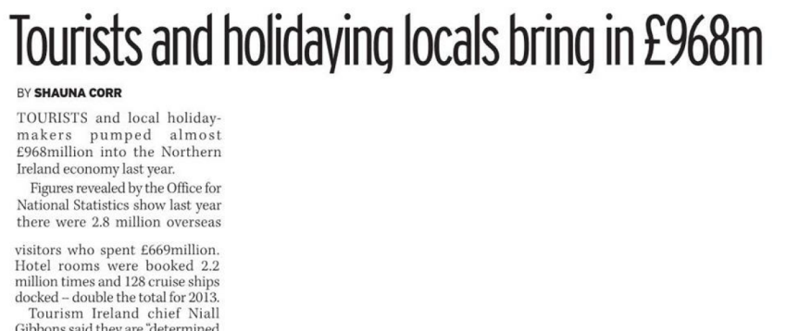
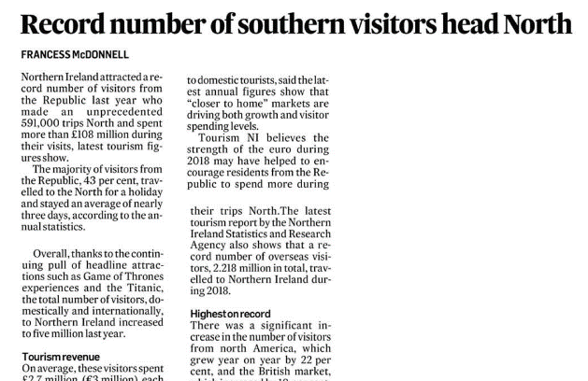
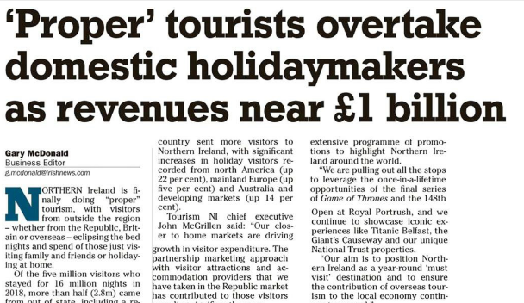
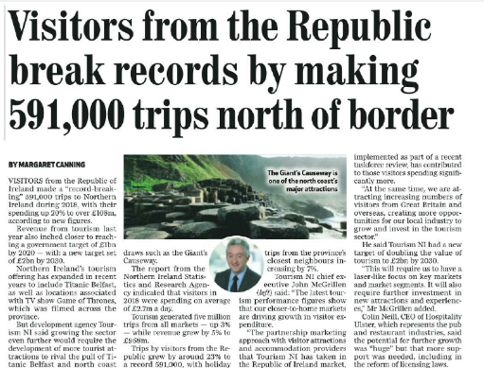
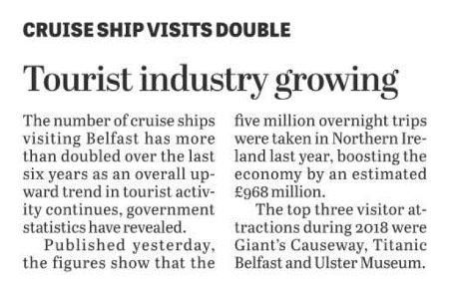
Notes:
Well received in the media

Slide 8
Cross border overnight visits
1. interim data that may be subject to future revision

Slide 9
Expenditure by ROI visitors
2017: £90m
2018: £108m¹ (+20%*)
1. interim data that may be subject to future revision

Slide 10
Cross border overnight visits
¹
1. interim data that may be subject to future revision

Slide 11
Accommodation statistics

Slide 12
Number of rooms (November each year)
+13%
+28%
+14%

Slide 13
Hotel occupancy

Slide 14
Guesthouse, B&B and Guest Accommodation

Slide 15
Self-catering

Slide 16
Development work

Slide 17
Current development work
Increased user engagement
Mailing list
Online survey
User group meeting
External spend in real terms
Draft Programme for Government
Occupancy survey improved response rates

Slide 18
Response rates

Slide 19
Current projects
Economic contribution of tourism to NI economy
Tourism satellite accounts
Last report in 2007
NI Tourism Investment Research Project
Link investment and marketing to headline figures
Causeway Coastal Route area study

Slide 20
Plans for 2019/20
New statistics
Day trips
Domestic
External
Northern Ireland residents external trips
Methodology
Domestic tourism multiplier review
Confidence intervals

Slide 21
Challenges
Sample sizes
Increased demand for further breakdowns
Response rates for surveys
The Open - July 2019
Brexit

Slide 22
Questions?

