Slide 1
Tourism Action Plan 2019-2021
Maria Melia - Tourism Policy and Marketing Division

Slide 2
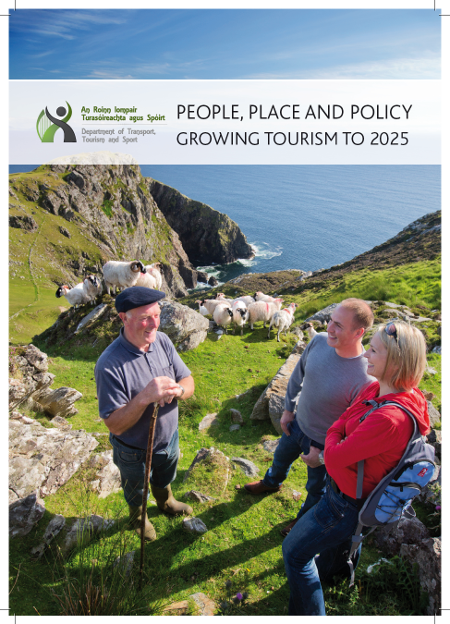
Tourism Policy Statement
The Government's Tourism Policy Statement People, Place and Policy – Growing Tourism to 2025 was published in March 2015
The policy statement confirmed that the Government's aim was that by 2025, Ireland would have a vibrant, attractive tourism sector that makes a significant contribution to employment across the country, is economically, socially and environmentally sustainable, helps promote a positive image of Ireland overseas, and is a sector that people wish to work in.

Slide 3
Tourism Performance
Total expenditure by overseas visitors in Ireland (excluding fares) was €5,149 million in 2018, an increase of over 45% on 2014. There were 10,616,300 overseas visits to Ireland during 2018, representing an increase of over 39% on 2014.
Central Statistics Office
Fáilte Ireland estimates that the tourism is now supporting the employment of 260,000, an increase of almost 27% on 2014.
Fáilte Ireland Tourism Facts 2014
Notes:
For H1-2014, total expenditure by overseas visitors in Ireland (excluding fares) was €1,535 million.
For H1-2018, total expenditure by overseas visitors in Ireland (excluding fares) is €2.27 billion, an increase of almost +48% on the first half of 2014.

Slide 4
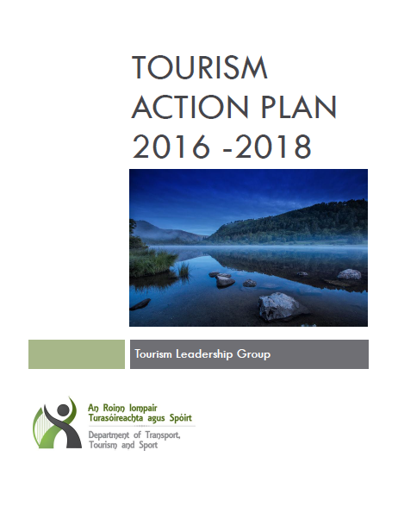
Tourism Action Plan 2016-2018
Significant achievements:
The development of Culinary Apprenticeships and investment in tourism and hospitality education;
Dublin accommodation capacity issue examined;
Launch of Dublin marketing brand;
Government investment in Regional Co-operative Marketing;
Strategy for New and Developing Markets completed by Tourism Ireland;
Progress in developing Ireland as a food tourism destination;
Increased collaboration with Local Authorities, including the creation of CCMA Tourism Sub Group, a successful LA Tourism conference, and tourism Statements of Strategy and Action Plans developed by all Local Authorities;
Fáilte Ireland collaboration with LEOs and ETBs to deliver a community-based shared knowledge and business supports programme that included one-to-one mentoring in marketing, business development and cross-selling;
The Tourism Action Plan 2016-2018 contained 23 separate actions and most of these were completed ahead of schedule.

Slide 5
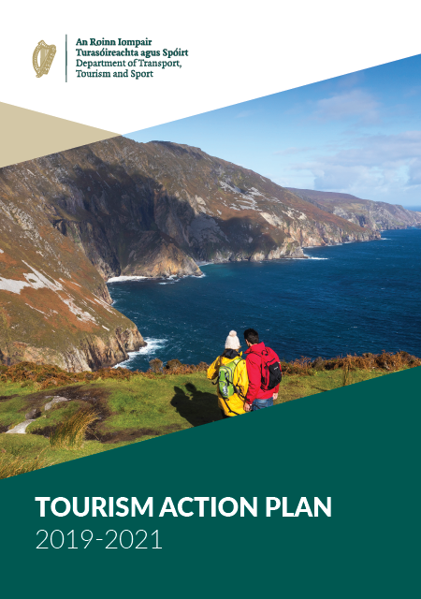
Tourism Action Plan 2019-2021

Slide 6
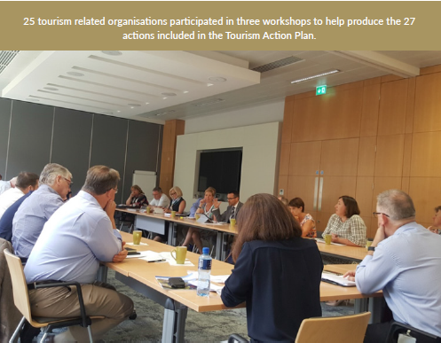
Tourism Action Plan 2019-2021
Following stakeholder workshops, the resulting plan contains 27 actions focusing on:
Policy Context
Marketing Ireland as a Visitor Destination
Enhancing the Visitor Experience
Research in the Irish Tourism Sector
Supporting Local Communities in Tourism
Wider Government Policy
International Context

Slide 7
Tourism Growth Targets
The Governments Tourism Policy Statement commits to the following specific targets being reached by 2025:
Revenue from overseas visitors will increase to €5 billion.
Employment in the tourism sector will be 250,000
There will be 10 million visits to Ireland annually.
Recently released figures show that these targets were met in 2018. In anticipation of these targets being met ahead of schedule the following action was included in the Tourism Action Plan 2019-2021:
“A working group has been established to review current tourism performance and the potential for recalibrated growth targets while retaining a focus on overseas visitor revenue.”
Visitors
Revenue
Jobs

Slide 8
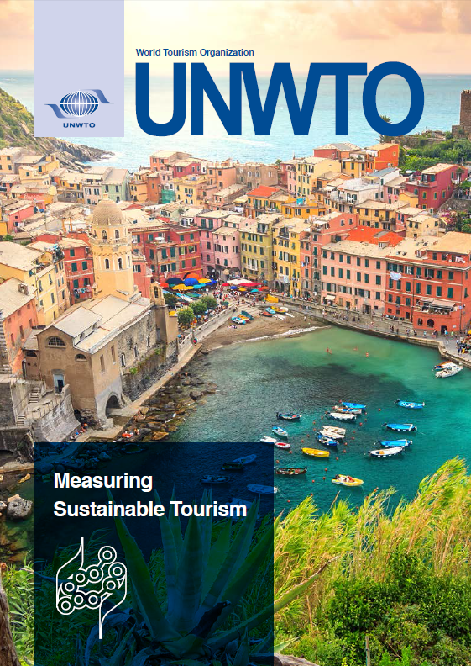
Sustainable Tourism Development
Environment
Social
Economic
Tourism Action Plan 2019-2021:
“A working group has been established to review policy and best practise in sustainable tourism and propose guiding principles for sustainable tourism development in Ireland.”
The group will research international sustainable tourism policies and initiatives and make recommendations on a framework for sustainable tourism development in Ireland and how it would be successfully implemented.
"Tourism that takes full account of its current and future economic, social and environmental impacts, addressing the needs of visitors, the industry, the environment and host communities“
UNWTO Definition of Sustainable Tourism

Slide 9
Marketing Ireland as a Visitor Destination
- Regional growth &
Season extension
- GB market
- Global Ireland 2025
- Regional Access

Slide 10
Enhancing the Visitor Experience
- Tourism experiences
- Food tourism
- Sustainable employment
- Accessible tourism
- Quality accommodation

Slide 11
Research in the Irish Tourism Sector
- Competitiveness of our tourism sector
- Economic Contribution of Tourism
- Measuring tourism performance

Slide 12
Supporting Local Communities in Tourism
- Local Authorities
- LA Tourism Officer
- Community activation &
participation

Slide 13
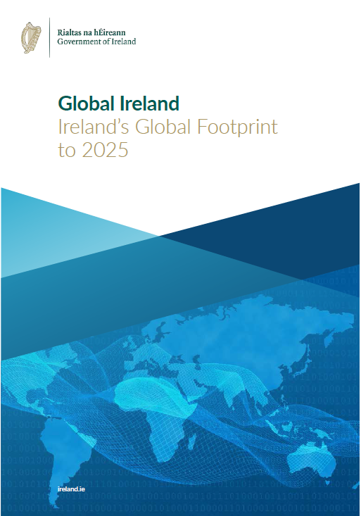
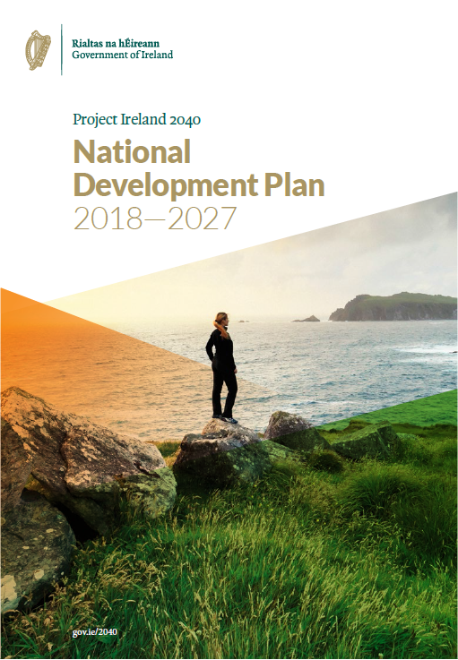
Wider Government Policy

Slide 14
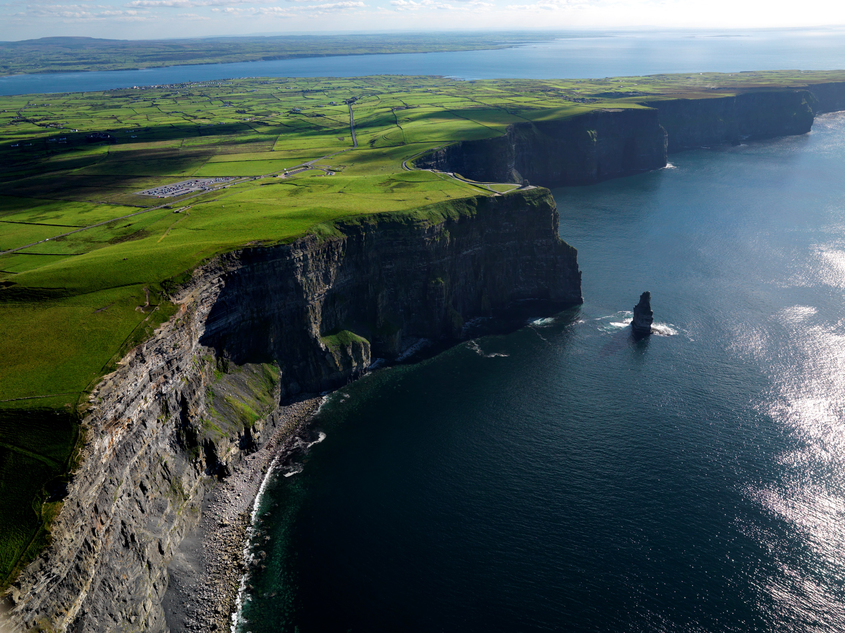
Thank You
Maria Melia - Tourism Policy and Marketing Division

