Slide 1
Estimate of Overseas Travellers to Northern Ireland through RoI ports Comparison of PCI and SOT

Slide 2
Estimates of Visitors to NI through RoI ports
3 surveys collect information on Visitors to Ireland
(2 specifically ask questions for NI)
Country of Residence Survey
Passenger Card Inquiry
Survey of Overseas Travellers
This Presentation looks at
Methodology of 3 surveys
Similarities and Differences of PCI and SOT
Options for NI estimates

Slide 3
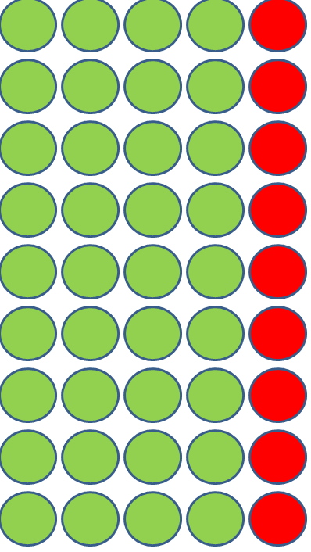
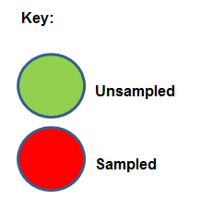
Country of Residence Survey (CRS)
- 1 in 5 IN and OUT bound passengers asked Country of Residence
- Grossed to ‘Population Total’ (Airport and Ferry companies provided)

Slide 4
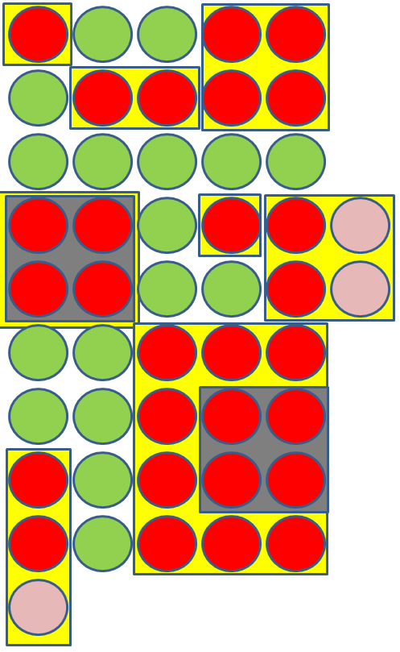
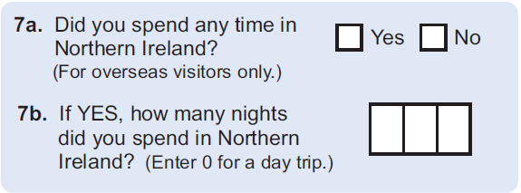
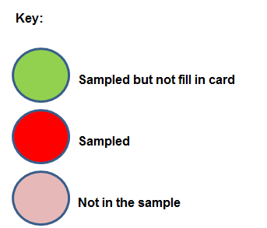
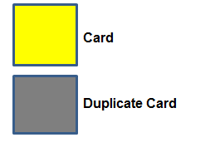
Passenger Card Inquiry (PCI) Outbound
Card given to everyone on shift -filled in by Passengers living outside the Republic of Ireland (NI removed at later question)
Two questions for those visiting NI (no data on expenditure)
Important question
The number of people covered by cards grossed to CRS

Slide 5
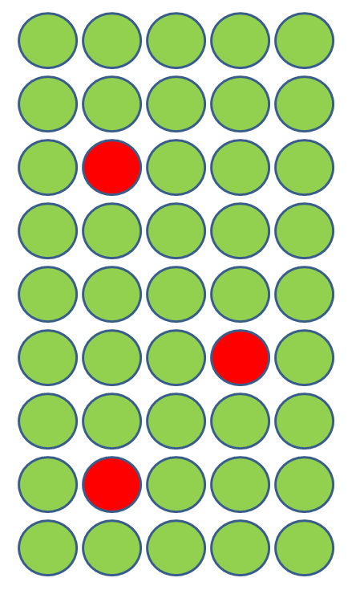
Survey of Overseas Travellers
16+ only
Quota Sample
Filter questions:
How many nights in RoI
How many nights in NI
Grossed to CRS minus RoI residents, NI residents minus Day Trips
Things to note:
oversampling in Continental routes,
‘maximum’ weight applied,
NI only weight ?
Despite sample 16+- weighted to All

Slide 6
Similarities and Differences between SOT and PCI - Methodology
SAMPLE
Sample size
SOT (6,500)
PCI (63,300 Cards – 126,000 people)
Same population (PCI 99% coverage ports, SOT 97% coverage)
DATA COLLECTION
SOT – CAPI
(map of Ireland including NI)
On spot error checks
PCI – Cards
(duplication, paper based – limited direct validation)
WEIGHTING/GROSSING
SOT – weight all interviews (16+) to ‘population’ (CRS minus day trips and residents of Ireland)
Maximum weights
PCI
-weight all people covered on cards
Both grossed to CRS
(so no difference for all Ireland estimates)

Slide 7
Northern Ireland VIAs
Visitors to Northern Ireland
who depart from RoI ports (2013)
Survey of Overseas Travellers
-unweighted sample size 6,500
- 7% visit NI
Passenger Card Inquiry
unweighted sample size 63,300 cards (representing 126,000 people)
8% cards reported visit NI
10% people covered on cards visit NI
Similar unweighted proportion of sample size

Slide 8
Impact of Differences in Results (2013)
Larger estimate of trips to NI if NISRA was to use the PCI
- equates to 7% difference to the overall estimate of ALL overnight trips in NI
If / when NISRA changes source for data – there will be a break in series
- consequences for any targets (baseline changes)

Slide 9
Options for NI estimates
Continue using SOT
- trendline
Switch to PCI from 2015
- break in series
- model expenditure/missing variables (?)
- potentially another break in series when CSO change methodology
Continue using SOT until PCI methodology changes (CAPI)
- break in series
- collection similarities to NIPS

Slide 10
Selected Option
Continue using SOT until PCI methodology changes (CAPI)
- break in series
- methodology
- no need for a model
- expenditure will be collected

Slide 11
NISRA – June 2015

