Slide 1
Tourism Northern Ireland
Use of data/Research
25 June 2015
Anne-Marie Montgomery

Slide 2
Use of Data/Research
Strategic planning
Product development
Market planning
Informing/shaping policy
Produce summary reports
Conduct additional research

Slide 3
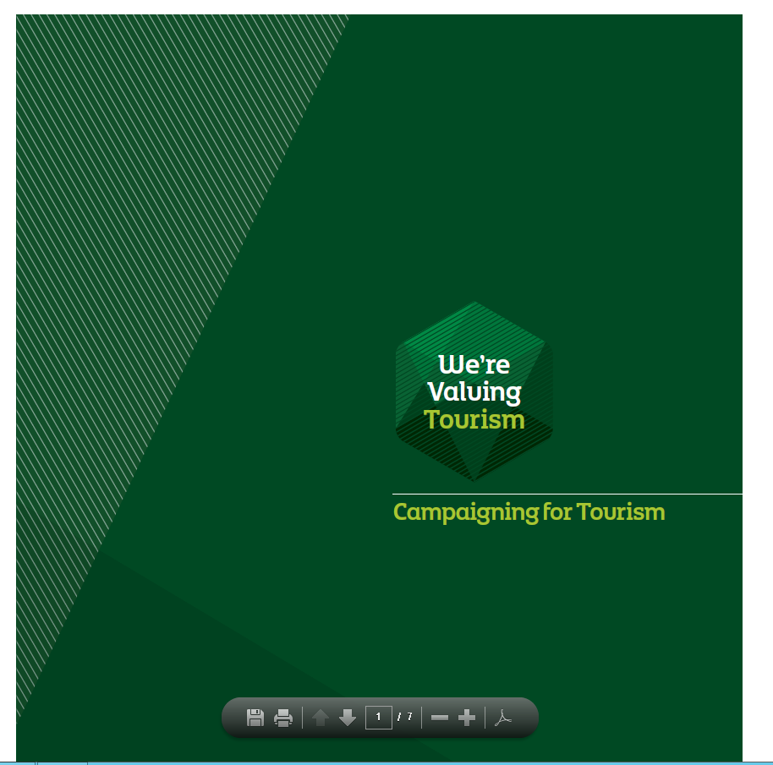
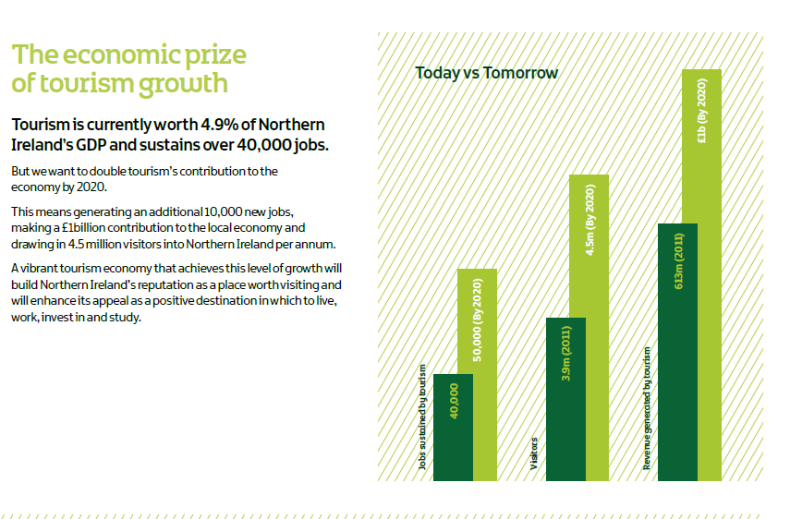
Strategic Development
E.g. data used to:
Highlight the value of tourism to the economy
Set targets
Monitor performance against targets
Monitor trends
The 2014 PfG targets of 1.934m for domestic trips and £175m for spend were significantly exceeded (by over 400,000 trips and £63m)

Slide 4
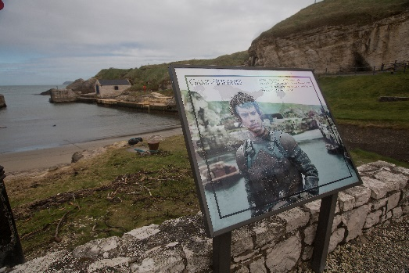
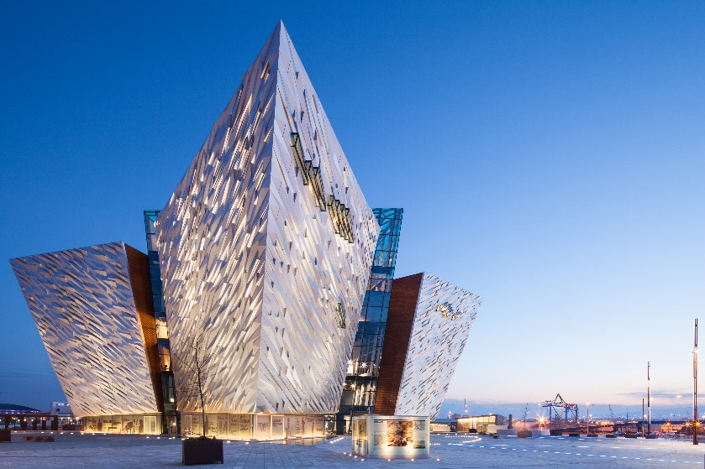
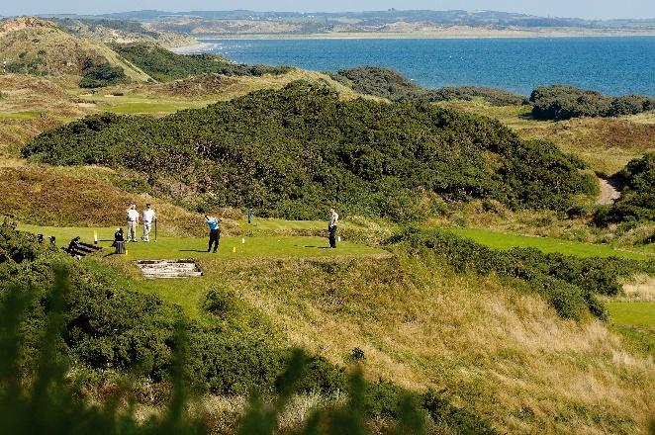
Product Development
Data used at both ends of product life cycle, e.g.
Applications for funding to develop/build product
Business case/ economic appraisal
Once developed - monitor performance/visitor numbers

Slide 5
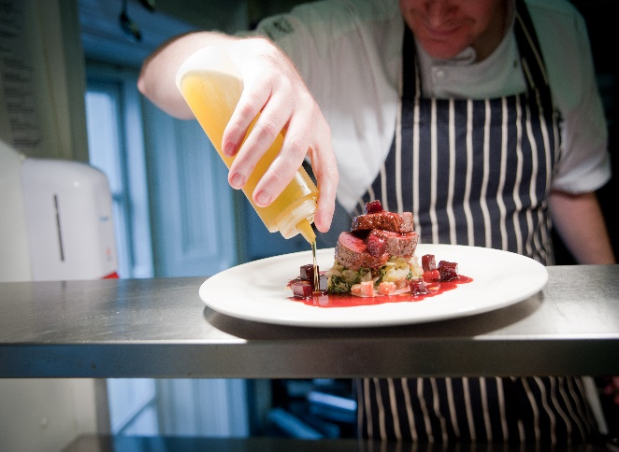
Developing the Food Experience
In 2014 NI residents spent £282m on domestic tourism day trips, of which 42% was spent on food and drink.
Source: NISRA
Currently use data to ‘set the scene’ in industry toolkits – combined with information from TNI research (Visitor Attitude Survey, Consumer Barometer)
2016 – NI ‘Year of Food’
Food data will feed into various documents/ publications

Slide 6
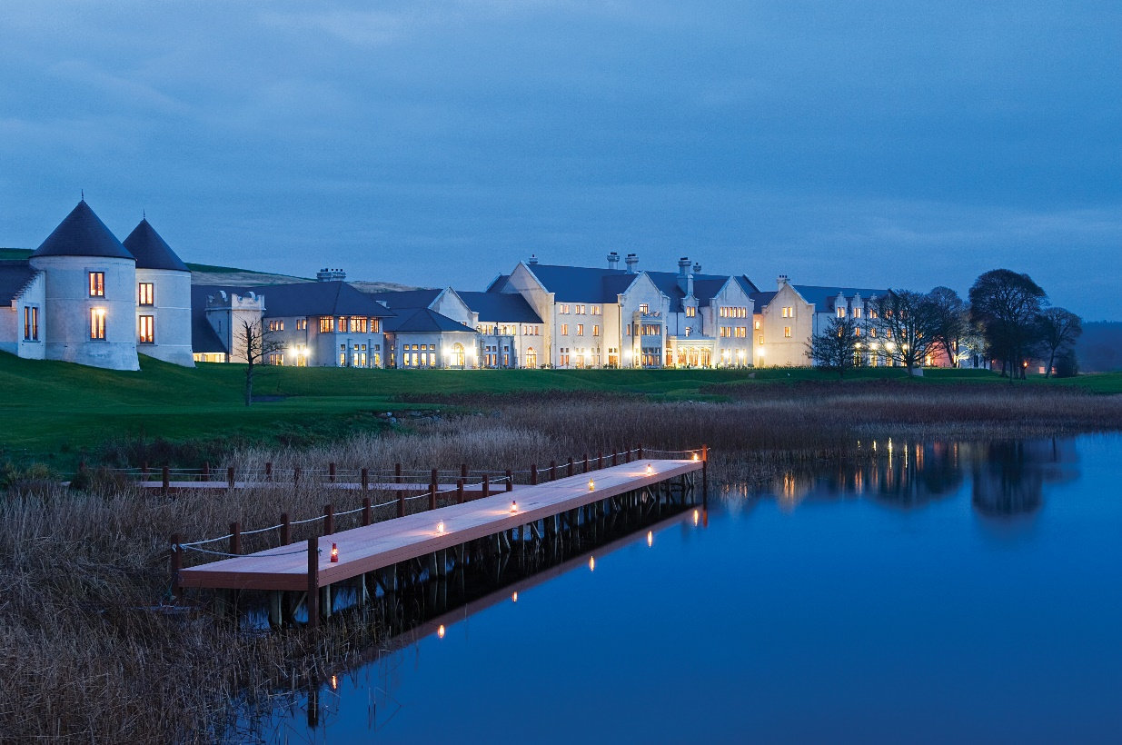
Market Planning
Policy
Data used to:
Understand key markets
Identify best prospects
E.g. accommodation and performance stats help to inform response to planning queries
in conjunction with segmentation data

Slide 7
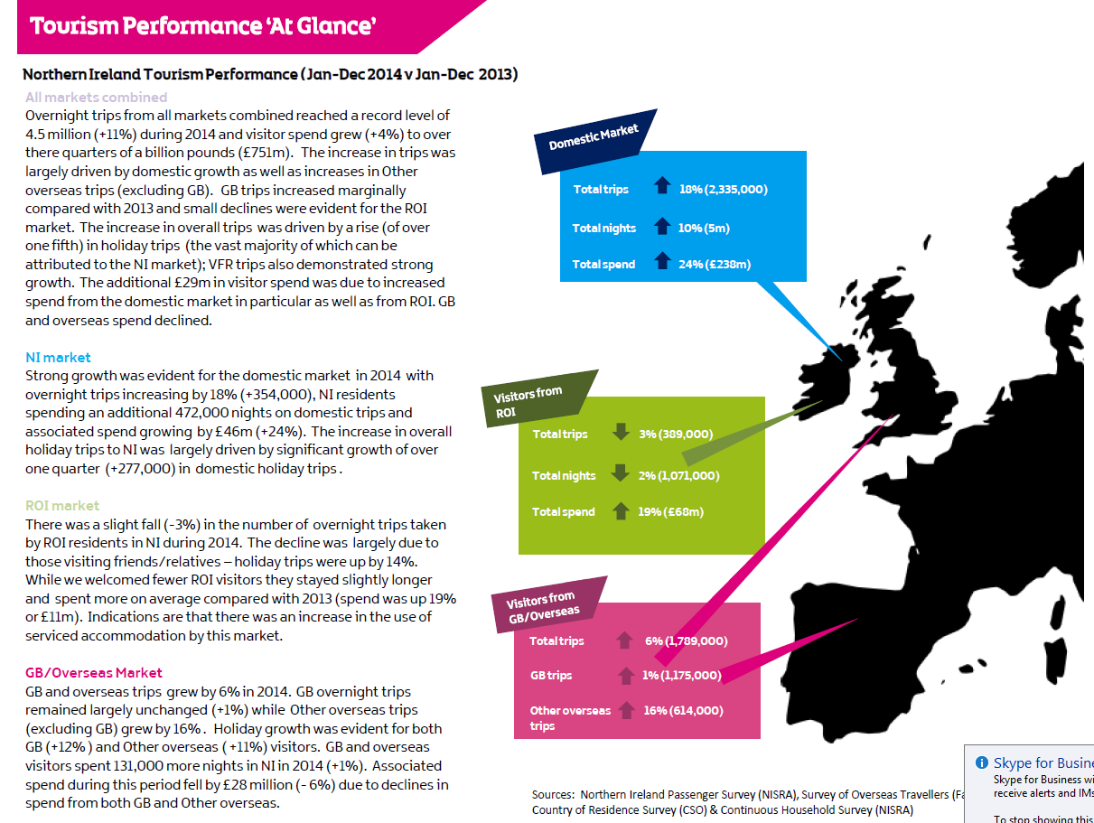
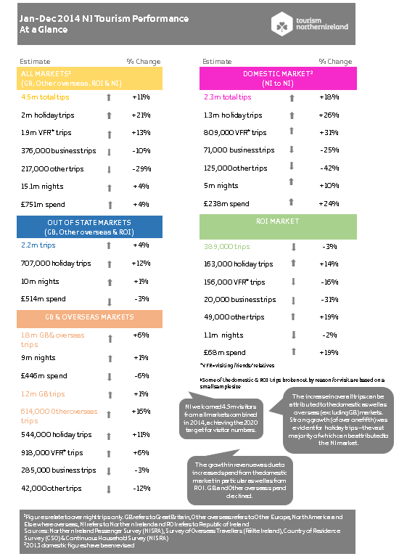
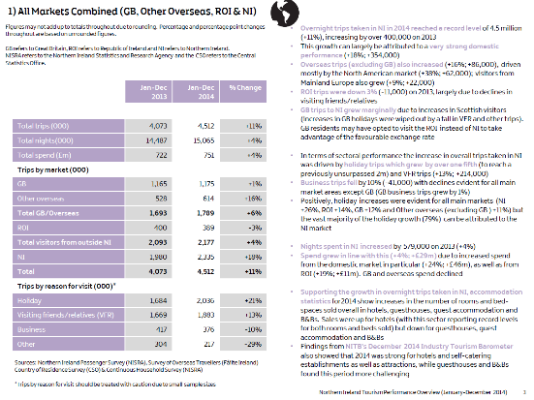
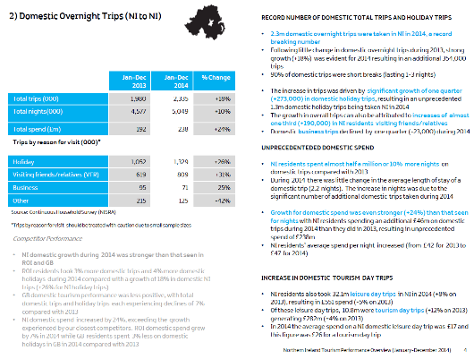
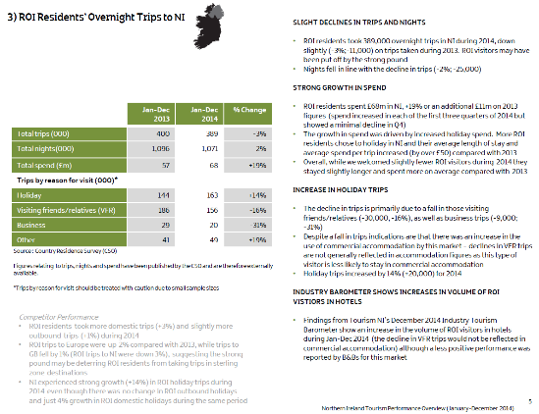
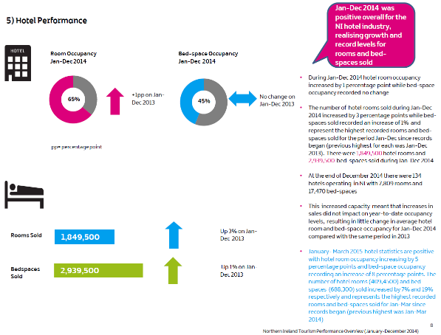
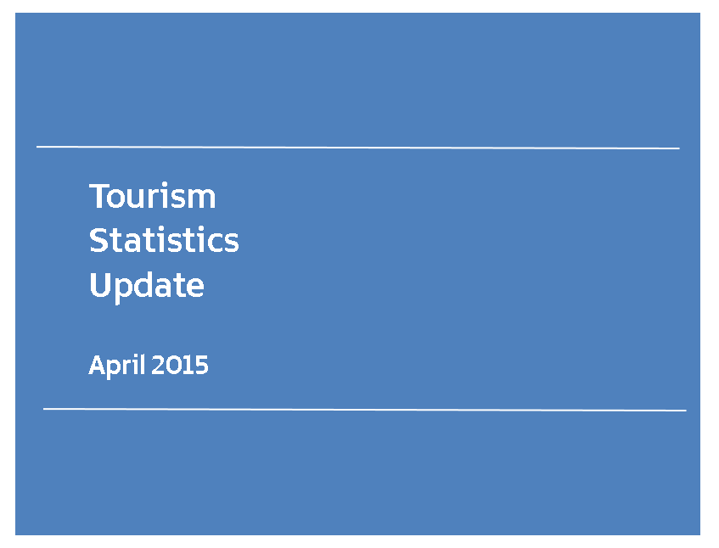
Tourism Performance Reports

Slide 8
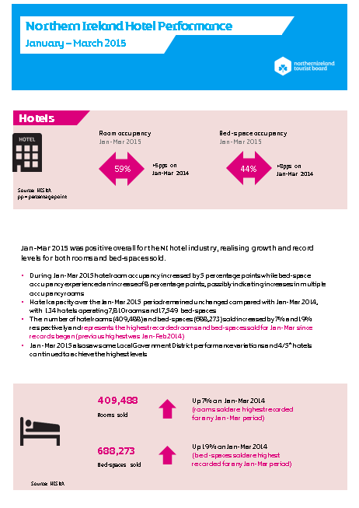
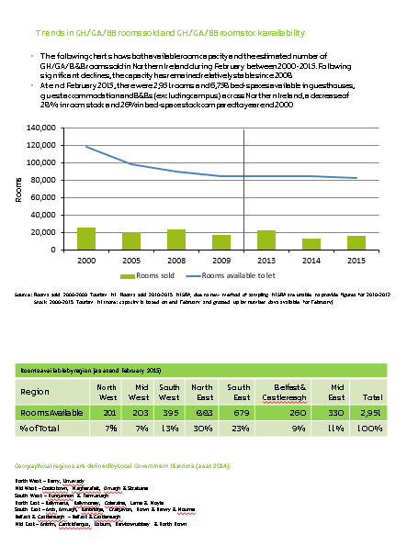
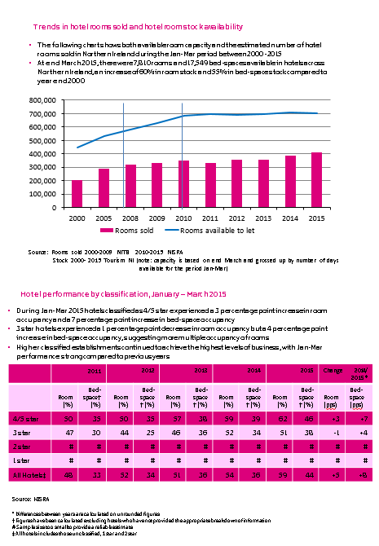
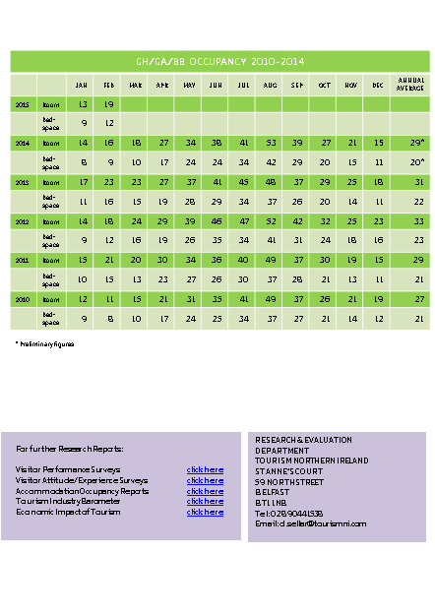
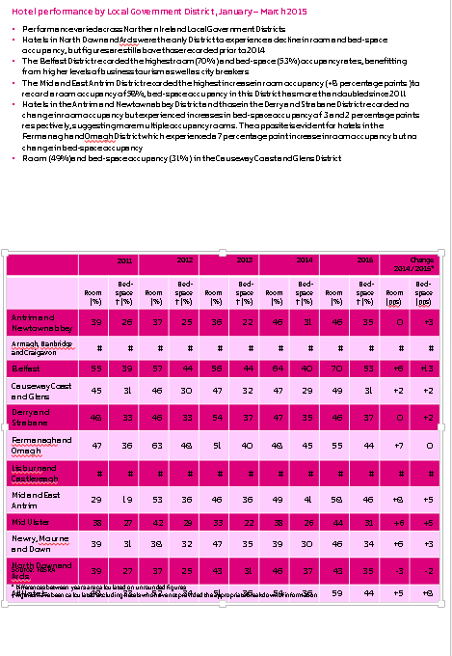
Accommodation Reports

Slide 9
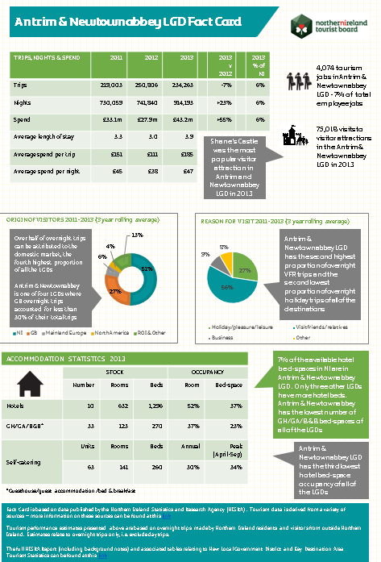
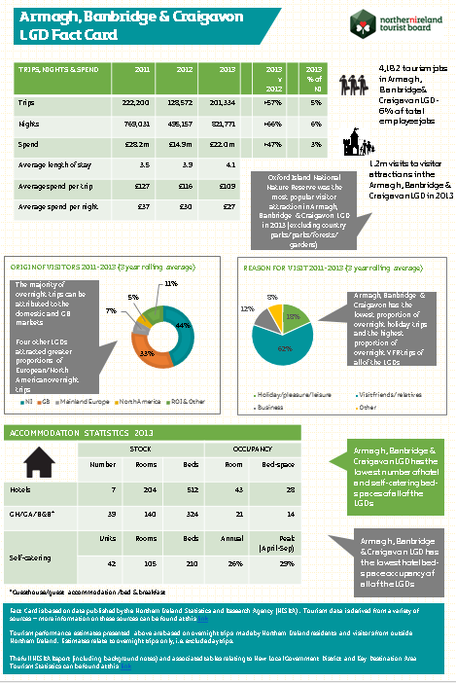
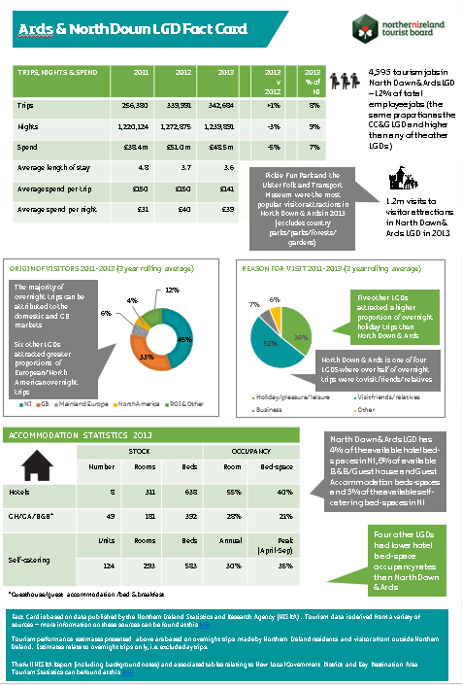
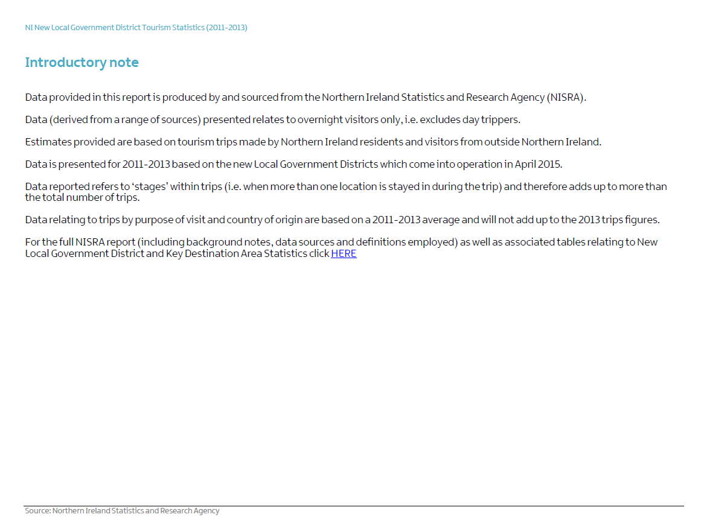
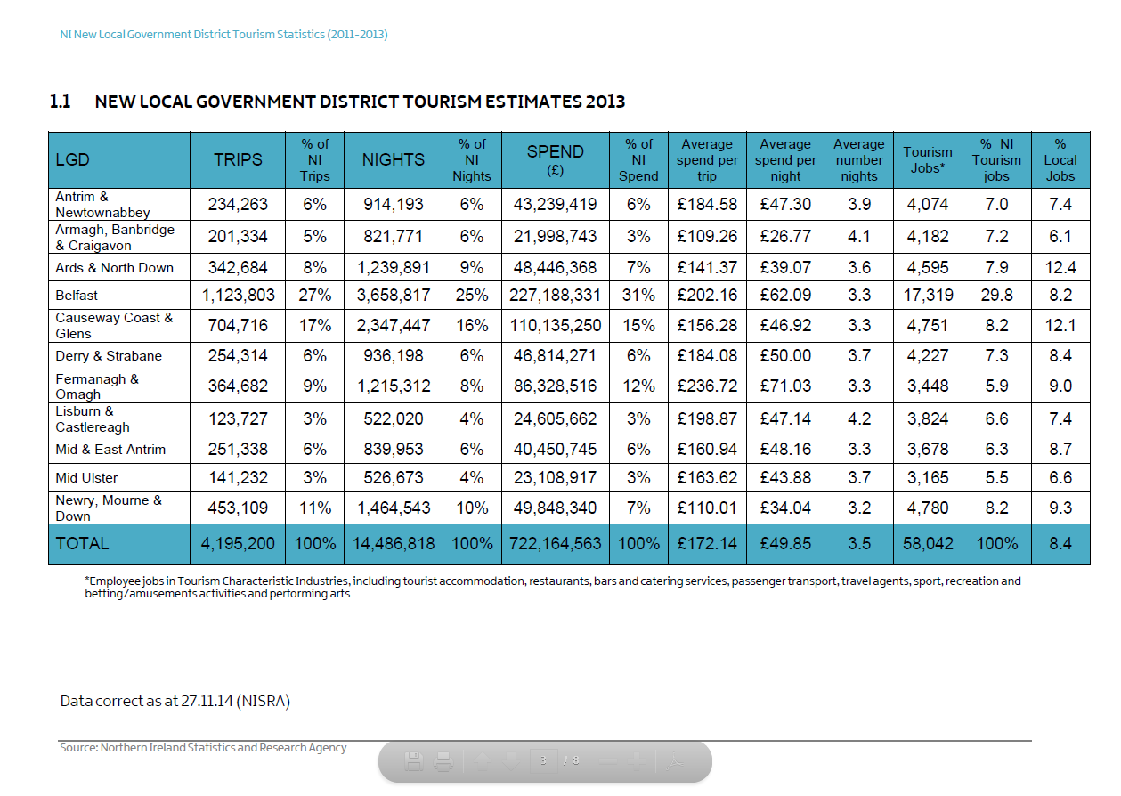
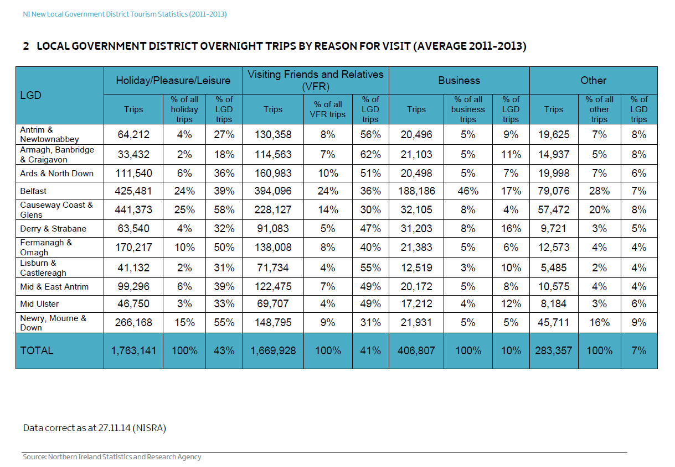
LGD Report/Fact Cards
trips/nights/spend data
where visitors came from
accommodation statistics (stock and occupancy)
tourism job numbers
visits to visitor attractions in each of the 11 LGDs
Replicated for 9 key tourism destinations

Slide 10
Examples of TNI Research
Tourism Northern Ireland conducts a variety of research & event evaluation
Industry Tourism Barometer
Accommodation providers/attractions/golf clubs/ activity providers
Volume of bed nights
Volume of overall business
Market/regional breakout
Outlook/expectations
Ad hoc questions

Slide 11
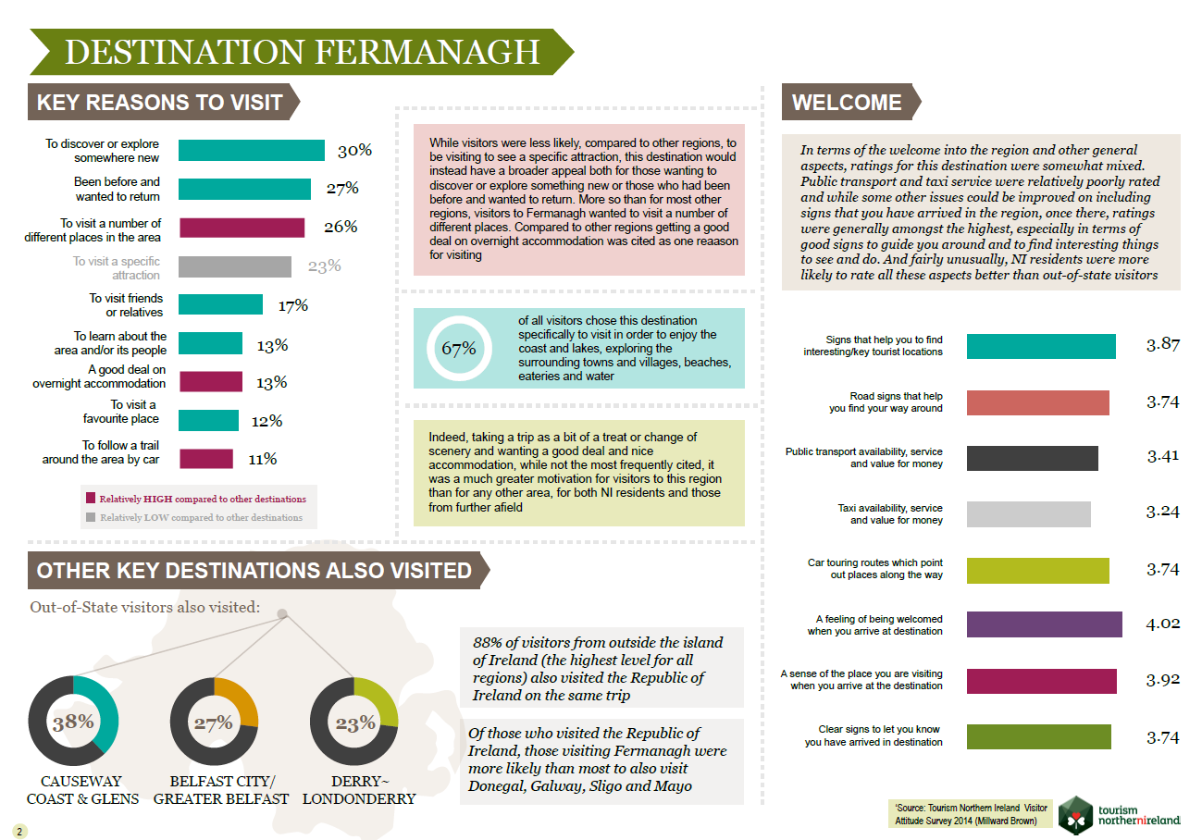
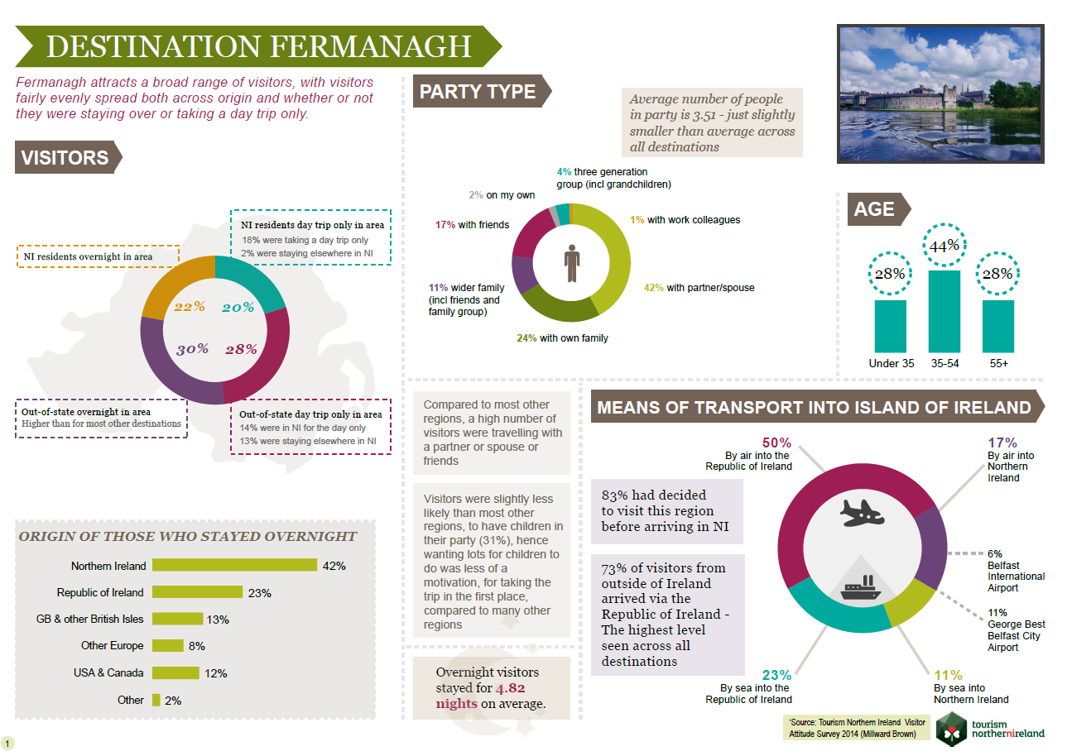
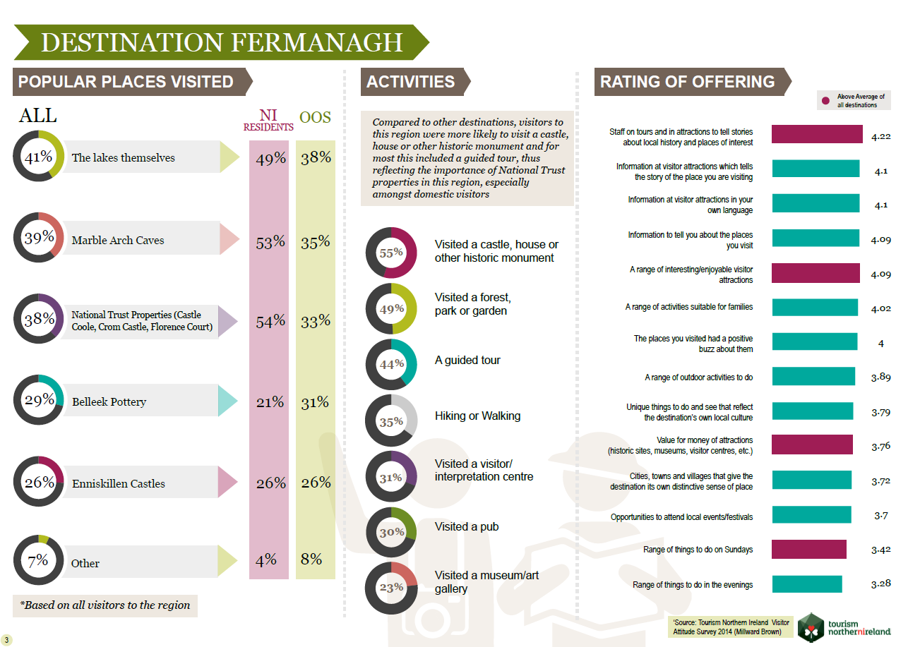
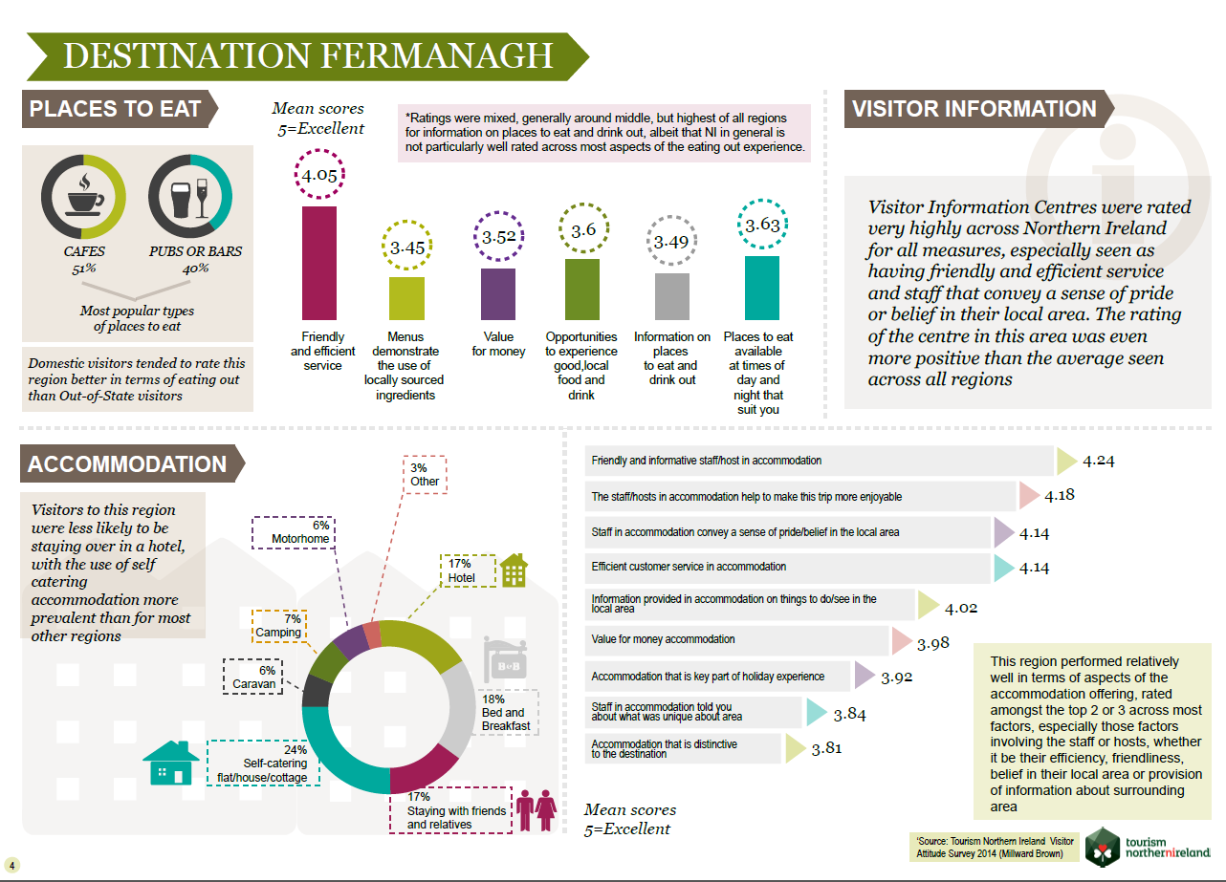
VAS Reports/Fact Cards
Visitor behaviours and attitudes towards their destination experience.
Reasons for visit, profile data, type of accommodation used in the destination, activities participated in/attractions visited, how visitors rated different aspects of their destination experience, as well as overall satisfaction levels.

Slide 12
The end!

