Slide 1
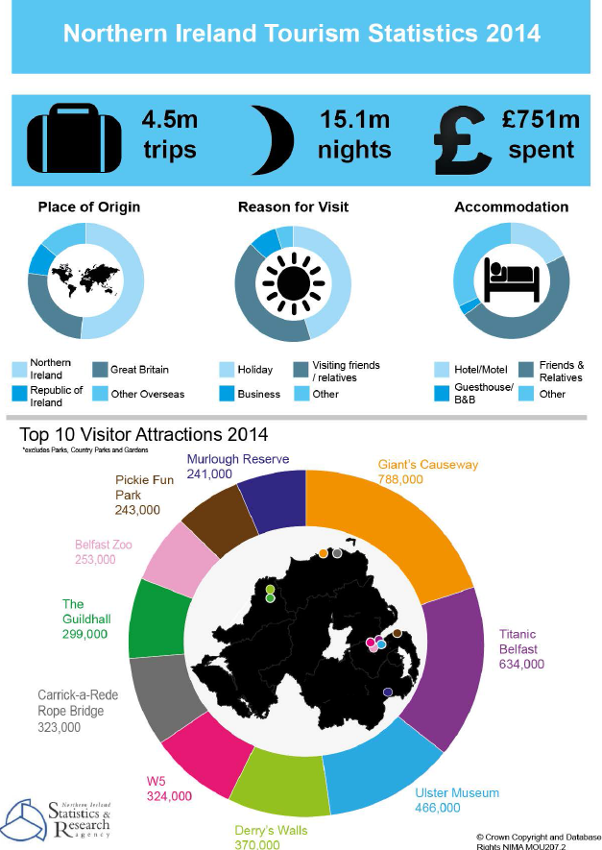
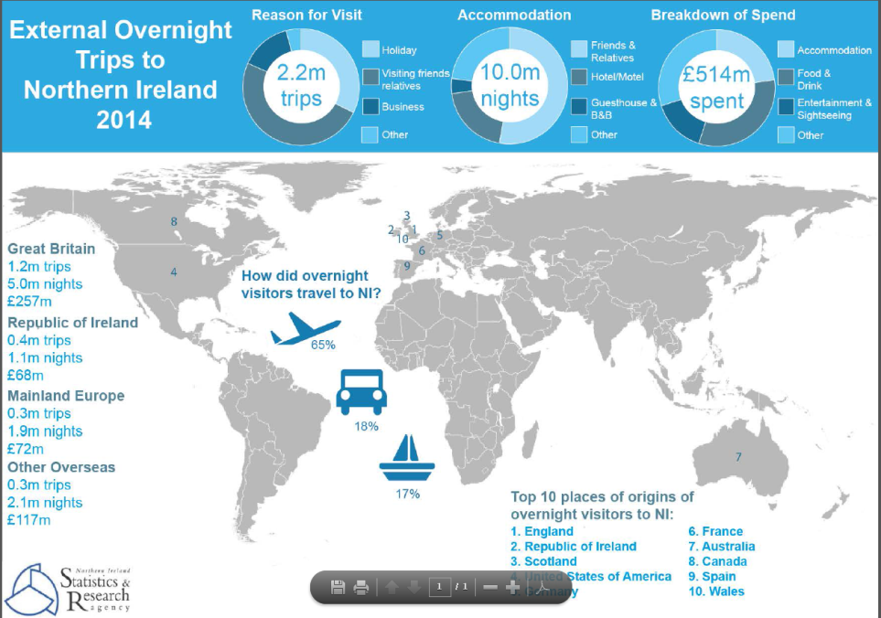
NISRA – Update
Annual 2014 statistics published 28th May
Summary Report
Satellite reports
‘External Visitors’
‘Domestic tourism’,
‘Occupancy statistics’
‘Self-catering’
‘Visitor Attraction’
Infographics
Tables
Quarter 1 2015 and LGD to be published 30th July

