Slide 1
Household Travel Survey 2018
All-Island Tourism Statistics Liaison Group
Donal Kelly

Slide 2
Household Travel Survey 2018
Q2 2018 publication cancelled
  Implausible estimates
  Bias observed in the data
  Falling response rate
  Changes to survey form

Slide 3
Review and analysis
Comprehensive review of …
  survey processes
  sampling
  estimation methodology

Slide 4
Issues observed
Changes to survey form
  Inclusion of same-day visit questions
  Removal of questionnaire instruction
Inclusion of GDPR insert
Change in sampling frame

Slide 5
Falling Response Rate – postal survey
Quarter | 2017 | 2018 | 2019
Q1 | 45% | 38% | 40%
Q2 | 43% | 35%
Q3 | 42% | 36%
Q4 | 39% | 33%
Year | 42% | 35%

Slide 6
Non response bias - % of persons with trips
 | Q1 | Q2 | Q3 | Q4
2012 | 18% | 23% | 30% | 20%
2013 | 16% | 22% | 29% | 19%
2014 | 16% | 23% | 29% | 20%
2015 | 17% | 23% | 31% | 20%
2016 | 19% | 23% | 31% | 21%
2017 | 20% | 25% | 32% | 23%
2018 | 21% | 31% | 39% | 28%

Slide 7
Other data sources
Review of data from other sources
  Labour Force Survey
  Monthly Services Inquiry
  FI Accommodation Survey
  All indicated varying levels of growth in 2019

Slide 8
Methodological adjustment
Classic non-response bias adjustment not possible
  No auxiliary data available
Adjusted weights using a statistical technique
  Based on previous six years worth of HTS data
  New data mirrors response pattern of previous years

Slide 9
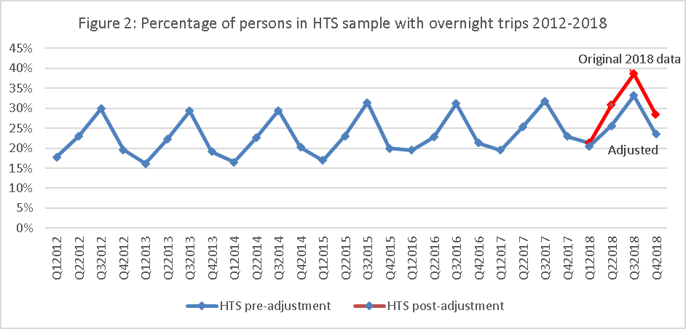
Response Bias

Slide 10
HTS release
2018 data published on 19th June
All 4 quarters published – including revised Q1 2018
Adjustment made to 2018 data

Slide 11
HTS – Same-day visits
Started collecting data in January 2018
Extra questions on HTS form
Collecting and processing of data going well
Some missing data – for all SDV questions
  we estimate/impute missing data
Results – no resources to work on this since last All Island meeting ;
Results – hope to have some results by end of 2019

Slide 12
HTS- detailed review
  Detailed internal review of HTS – to be completed in 2019
  Recommendations will be made for
    sampling frame
    design of sample
    non-response calibration methodology
    calculation of standard errors for the estimates

Slide 13
HTS- sample
  HTS sample came from electoral register
  ER no longer available – have sample for all quarters in 2019
  Need new sample for 2020 onwards
  Looking at options

Slide 14
Update on Releases
Overseas Travel
  May 2019- published 26th June
  Publishing monthly data from January 2018 onwards
  Seasonally adjusted monthly data also published as well as unadjusted data

Slide 15
Any Questions?

