Slide 1
Feasibility Study: Compilation of a Tourism Satellite Account for Ireland
All Island Tourism Statistics Liaison
Group 26.06.2019
Lou-Ellen Kiely CSO

Slide 2
What is a Tourism Satellite Account (TSA)?
Satellite account - term developed by the UN to measure economic sectors that are not generally defined as industries such as agriculture, forestry etc.
TSA - set of detailed tables, consistent with national accounts, focused on estimating flows of money relating to tourism activity

Slide 3
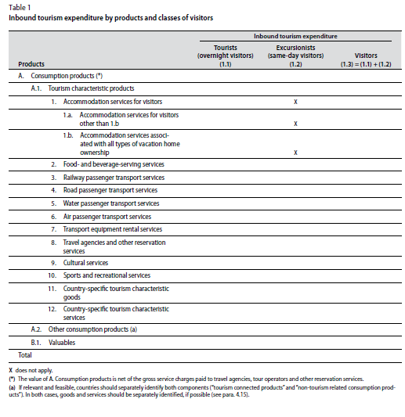
Structure and Framework of a TSA
TSA:RMF 2008: Recommended Methodological Framework using international standards of concepts, classifications and definitions
Framework generally revolves around construction of 10 tables
Demand Side Data (Tables 1-4) - How much do tourists spend and consume?
Supply Side Data (Tables 5-7) - Production accounts of tourism industries and labour supply
Tourism Gross Fixed Capital Formation, Collective Consumption and Non-Monetary data (Tables 8, 9 and 10)

Slide 4
Why Ireland needs a TSA
Provides a data framework on the impact of tourism to the economy
Instrument for designing more efficient policies
Provides evidence of return on investment in tourism
Industry across all sectors would welcome a more robust assessment of tourism as an economic activity
Submission of data to Eurostat may become mandatory in the future

Slide 5
Data Gaps and issues-Demand Side Data (Tables 1-4)
Domestic Same Day Visits (all aspects)
Breakdown of total expenditure into sub-categories
Business Tourism Expenditure and Consumption - How to capture and record separately?
Travel Agencies - breakdown between commission, airfare, package tours etc.
Proportion of international trip spent on Domestic territory (nights & expenditure) - e.g. driving to Dublin airport from Cork - Diesel costs and/or overnight stay
Brexit “may” become an issue for cross border traffic

Slide 6
Data Gaps and issues-Supply Side Data & Employment (Tables 5-7)
Expert knowledge of Supply and Use and Input/Output tables will be required for these tables
Experts from other areas such as National Accounts and Balance of Payments will be required to complete some tables
The complexity of measurement of employment in Tourism Characteristic Industries V’s Non Tourism Characteristic Industries
Calculation of Full-Time Equivalent labour units (FTEs)
Notes:
The measurement of employment is a key variable in the economic analysis of production activities. As per the TSA-RMF employment should be broken down by the number of establishments, jobs and employed person in tourism industries. Jobs are broken down by status in employments (employee and self-employed) and each category is broken down by gender. It’s intrinsically difficult to directly observe employment that is strictly related to the goods and services acquired by visitors and produced either by tourism industries or other industries. For this reason, the TSA: RMF 2008 recommends only the estimation of employment in the tourism characteristic industries (UNWTO, 2010, p. 48). This means that only tourism employment that is directly associated with the tourism production account of the characteristic activities in table 5 are measured

Slide 7
Data Gaps and issues - GFCF, Collective Consumption and Non-Monetary Indicators (Tables 8-10)
Gross Fixed Capital Formation (GFCF) - Lack of suitable data relating to GFCF and how it relates to tourism supply
Local and Central Government spending that relates specifically to tourism products – how to develop this
Complex methodology work will be required for all of the tables
Notes:
The measurement of employment is a key variable in the economic analysis of production activities. As per the TSA-RMF employment should be broken down by the number of establishments, jobs and employed person in tourism industries. Jobs are broken down by status in employments (employee and self-employed) and each category is broken down by gender. It’s intrinsically difficult to directly observe employment that is strictly related to the goods and services acquired by visitors and produced either by tourism industries or other industries. For this reason, the TSA: RMF 2008 recommends only the estimation of employment in the tourism characteristic industries (UNWTO, 2010, p. 48). This means that only tourism employment that is directly associated with the tourism production account of the characteristic activities in table 5 are measured

Slide 8
Recommendations arising from the study
Establish a mechanism for the development of compiling Same Day Visitor (SDV) data from a domestic perspective
Look at the possibility of surveying cruise ships as part of same day visitor data
Collect more complete data on expenditure for both domestic, inbound and possibly outbound tourism (surveys)
Consult with National Accounts and Balance of Payments divisions for the compilation of Table 5 & 6 (Supply side data)
Separate data needs to be collected on business expenditure i.e. who pays first - employee or employer
Create a specialist group from various divisions in the CSO including tourism, national accounts and labour market to address the various methodological issues

Slide 9
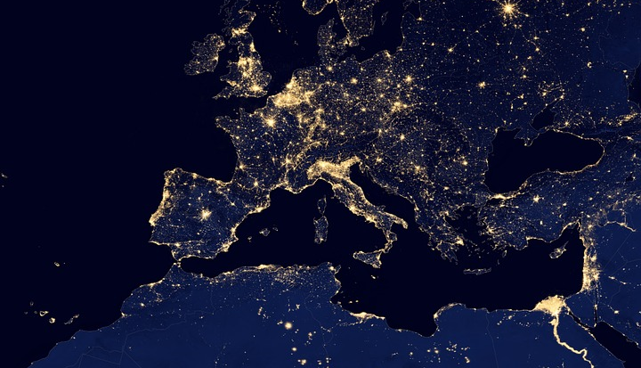
Thank you.
Any Questions?

Slide 10
Appendix – List of tables
Inbound Tourism Expenditure by product - non resident expenditure in Ireland including overnights and same day visitors.
Domestic Tourism Expenditure - the expenditure of domestic (Irish Resident) tourism, which may occur within Ireland either as Irish residents travel within Ireland or make expenditure in Ireland for the purpose of travelling abroad.
Outbound Tourism Expenditure - measures the total tourism consumption expenditure of Irish residents when they are abroad.
Internal tourism consumption - combination of inbound tourism expenditures from table 1 and domestic tourism expenditure from table 2, and, once merged with other components of tourism consumption make up the total internal tourism expenditure.
Production accounts of tourism industries and other industries - the preparation and compilation of data on gross value added (GVA) for various industries is the main purpose of this table. Products are at the core of this table.
Total domestic supply and internal tourism consumption - Core table of the TSA framework. Domestic supply and internal tourism consumption are amalgamated in order to compile the tourism share of each TSA product (specific and non-specific).
Employment in tourism industries.
Tourism gross fixed capital formation - From a tourism perspective Tourism Gross Fixed Capital Formation (TGFCF) relates to investments in basic infrastructure as transport, accommodation, recreation, centres of interest amongst others.
Tourism collective consumption - Provides tourism collective consumption by functions and levels of government e.g. Tourism promotion services.
Non-monetary indicators - some of the physical non-monetary indicators relating to the demand side tables from the TSA e.g. number of trips and number of establishments.

