Slide 1
Thematic Enterprise Statistics
Joe Madden
Head of SBS Division
Central Statistics Office, Ireland

Slide 2
Thematic Enterprise Statistics
1. Access to Finance
2. Energy statistics
3. Financial sector statistics
4. Foreign affiliates statistics (FATS)
5. ICT Enterprise statistics
6. Innovation and R&D statistics
7. Outsourcing statistics
8. Waste statistics

Slide 3
Access to Finance (ATF)
Requirement :- EU regulation (ad hoc module SBS)
Sample size 3K (900 responses required EU)
Forms issued 10th Sept 2010
Results to Eurostat by March 2011
National publication planned
Comments and views aspect

Slide 4
Energy Statistics
Legal requirement:-
Regulation (EC) No 1099/2008 of the European Parliament and of the Council of 22 October 2008 on Energy Statistics establishes a common framework for the production, transmission , evaluation and dissemination of comparable energy statistics in the Community.

Slide 5
Previous arrangements

Slide 6
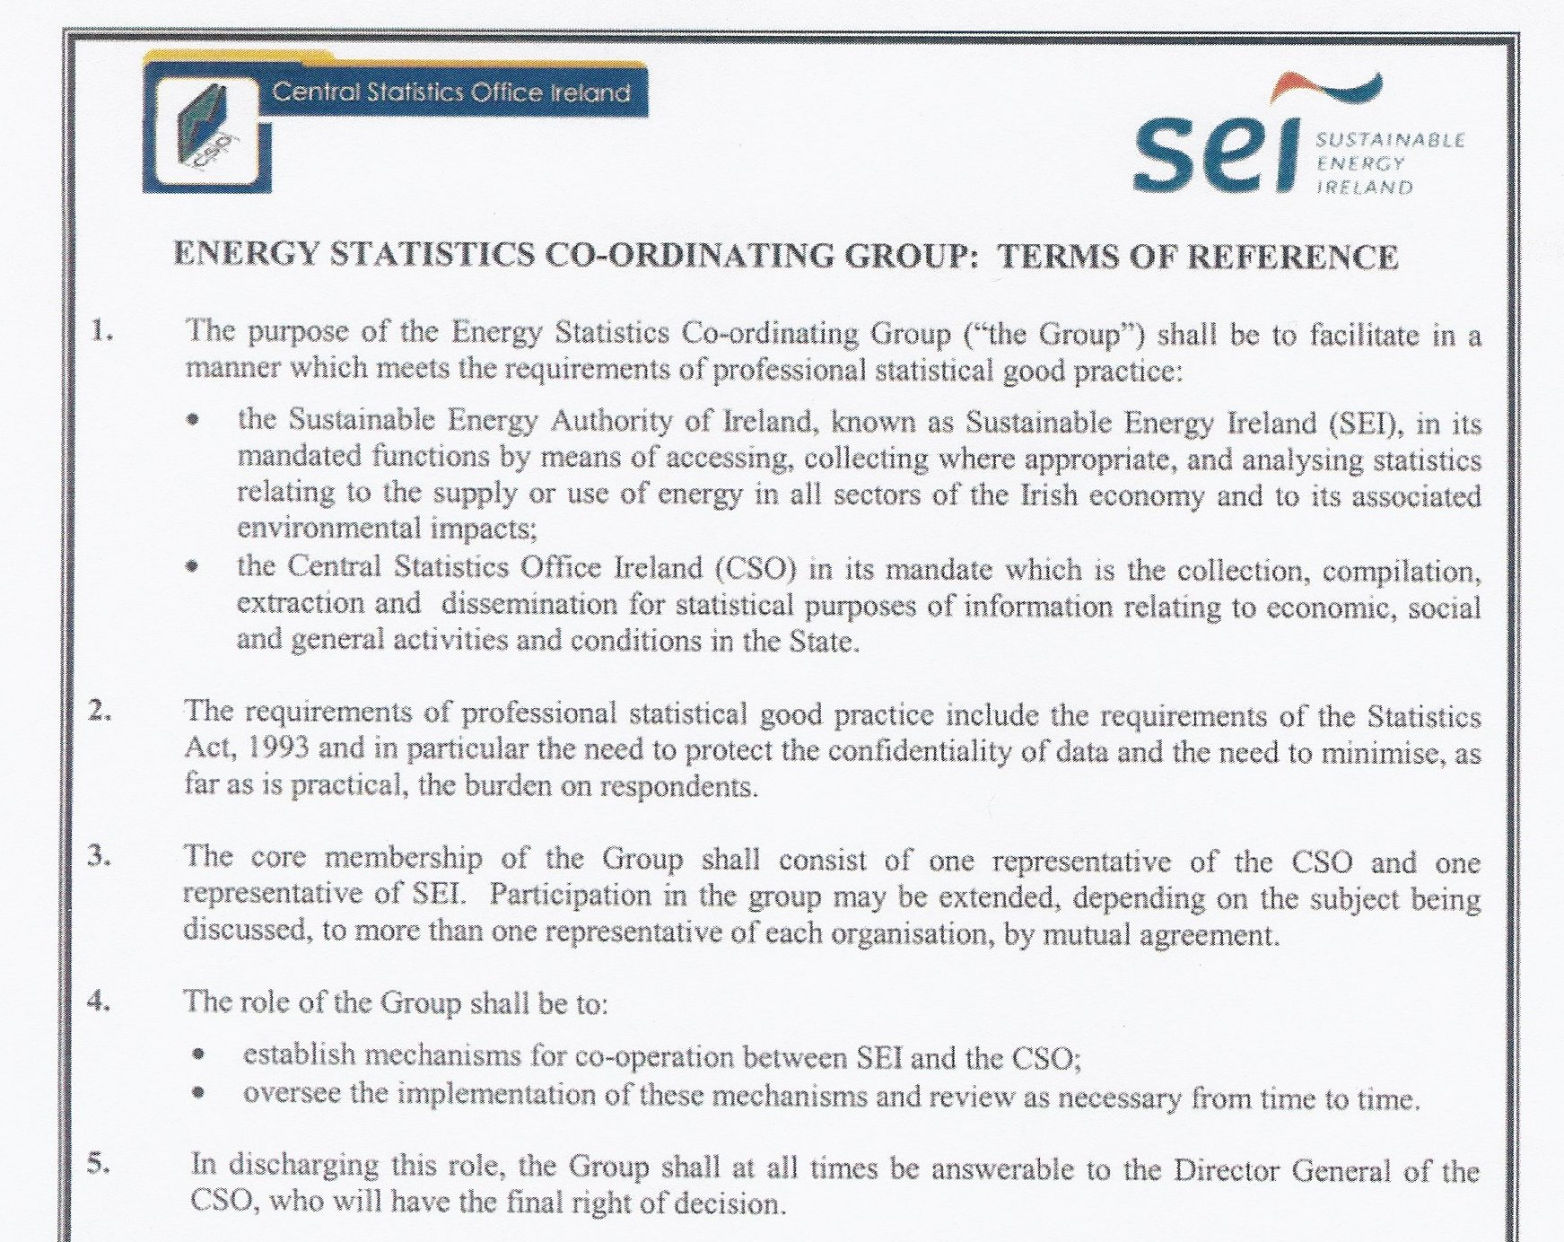
Energy Statistics coordinating group

Slide 7
New Survey on Energy End Use (BEEU)

Slide 8
Financial Sector Statistics
Extra resources put into this area in recent years as a result of:
  Extra demand for statistics on the financial sector
  New statistical Regulation at the European level
Parts of the financial sector we are concentrating on:
  Credit institutions
  Insurance (Life, Non-Life and Reinsurance)
  Pension Funds

Slide 9
Financial Sector Statistics
Data is taken from existing sources (CSO, Central Bank, Financial Regulator, Pensions Board etc) therefore there is no extra burden put on the respondents.
First statistics due to be published mid-year 2011 on production account and generation of income account – reference years 2008, 2009 and 2010.
Profit & Loss type data used to calculate production value, value added at factor cost and gross operating surplus for credit institutions and insurance companies resident in Ireland.

Slide 10
Financial Sector Statistics
Pension fund statistics lag behind the statistics in other parts of the financial sector.
However, CSO are currently developing a new reporting system in conjunction with the Pensions Board for all occupational pension funds – the Pensions Board have made this new return a mandatory requirement for all Registered Administrators of pension funds.
Good progress made to date but the system will take time to develop.

Slide 11
Foreign Affiliates Statistics (FATS)
New European Regulation for Foreign Affiliates Statistics (FATS) (1st ref year 2007)
This area can be split into:
    Inward FATS – activity of foreign affiliates resident in the compiling country
    Outward FATS – activity of foreign affiliates abroad controlled by the compiling country
Inward FATS breaks down the Annual Services Inquiry (ASI) and Census of Industrial Production (CIP) statistics by the country of the parent of the reporting enterprise - published as part of the normal tables of the ASI and CIP –confidentiality issues

Slide 12
Foreign Affiliates Statistics (FATS)
There is a new standalone survey to estimate the Outward FATS data – pilot survey ran in 2007 and subsequently was maintained for 2008 and 2009.
Census of Irish multinationals (or group heads) about the activity of their affiliates abroad – variables include number of affiliates, turnover and employment (~600 firms)
Methodologies are currently being developed but should be ready to publish the data at the end of next year.

Slide 13
ICT Enterprise Statistics
Legal basis:
Framework Regulation 808/2004 concerning community Statistics on the Information Society
Annual implementing Regulations
e.g. Commission regulation 847/2007 for the 2008 survey
2 annual surveys on ICT usage
- in enterprises
- in households and by individuals

Slide 14
ICT Enterprise Survey
Core variables
- Basic connectivity and ICT adoption
Specific modules
- Interaction with public administration
- Skills and digital literacy (2007)
- e-Business (2008)
- e-Commerce (2009)
- Security (2010)

Slide 15
ICT enterprise survey
Sample size ~7K
Response rate ~ 50%
Voluntary inquiry
Results to Eurostat in T+10m !
Publication of enterprise results in T+12m
Demand for micro data
Integrate with other surveys ?

Slide 16
Innovation and R&D Statistics
Biennial surveys involved here conducted in alternate years
Community Innovation Survey (CIS)
Business Expenditure on Research and Development (BERD)

Slide 17
Innovation and R&D Statistics - CIS
Legal basis:- Commission Regulation (EC) No 1450/2004
Survey collects information about the innovation activities of enterprises across all business sectors of economy
Collaborative action by CSO and Forfas underpinned by written agreements (MOUs and access to RMF agreements)
1st joint survey covered the period 2004-2006
Latest results relate to the period 2006-2008 published in April 2010
Sample size for 2006-2008 survey was 4.7K
Random sample of enterprises with 10 or more persons engaged

Slide 18
Innovation and R&D Statistics - BERD
Legal basis:- Commission Regulation(EC) No 753/2004
Survey collects information about R&D activities (R&D expenditure, of enterprises across all business sectors of economy
Collaborative action by CSO and Forfas underpinned by written agreements (MOUs and access to RMF agreements)
1st joint survey covered the period 2007-2008
Results published in July 2009
Sample size for BERD 2008-2009 was 3.6K
Census of enterprises involved in R&D

Slide 19
Statistics on Outsourcing
Requirement:-
to establish data on the phenomenon of international sourcing
(on the movement of Irish business activity abroad)
CSO in conjunction with Eurostat and a number of NSIs conducted an ad-hoc survey
Ref periods 2001-2006 for actual data and 2007-2009 for future plans
Coverage:- Census of firms in the Business Economy with 100+ employees
Report published in 2008
Latest initiatives
Ad-hoc survey on international sourcing conducted in 2007

Slide 20
Waste Statistics
Waste statistics currently compiled by EPA
Liaison group set up
Assistance provided by CSO
- quality reports
- register aspects
Resource issue for CSO

Slide 21
End
Comments or Questions?

