Slide 1
Burden & Costs
Steve MacFeely
Director of Business Statistics & Innovation

Slide 2
Outline of Presentation
1. CSO
2. Burden Reduction
3. Costs
4. Blockages & Risks

Slide 3
CSO - Mandate
Statistics Act, 1993
To collect, compile, extract and disseminate for statistical purposes, information
relating to economic, social and general activities and conditions in the State

Slide 4
CSO – 5 High Level Goals
1. Improvement in the scope, quality and timeliness of our statistics
2. Minimising the burden on survey respondents
3. Increasing the use of administrative data for statistical purposes
4. Achieving greater efficiencies using best practices
5. Raising public awareness and use of statistics

Slide 5
CSO - Organisation

Slide 6
Burden Reduction - Background
2007 – European Commission - Action Programme for Reducing Administrative Burdens:
reduce burden by 25%
2007 – Business Regulation Forum – Administrative Burden in Ireland costing business €2bn
2007 – High Level Inter-Departmental Group on Regulatory Burden established
2008 – Irish Government adopts 25% target (€500m)
2008 – Transforming Public Services
2010 – Public Service Agreement 2010 - 2014

Slide 7
Burden Reduction – EU Legislation
Data Requirements
Domestic
EU/International

Slide 8
Burden Reduction – Measurement (CSO & SCM)
CSO Approach
2004 – Pilot burden measurement
2008 – 1st Report on Response Burden
€6.7m (forms returned)
2010 – Response Burden Barometer
Standard Cost Model
2010 – SCM Report
€10.8m (forms issued)
0.5% of total admin burden

Slide 9
Burden Reduction - Actions
Internal
- Reduce sample sizes
- Re-engineer questionnaires/small business forms
- Terminate surveys
- Data matching
- Reorganise production system
External
- Joint Surveys
- Formal MOUs
- Increased use of administrative data
- Automatic data extraction
- Statistical Infrastructure

Slide 10
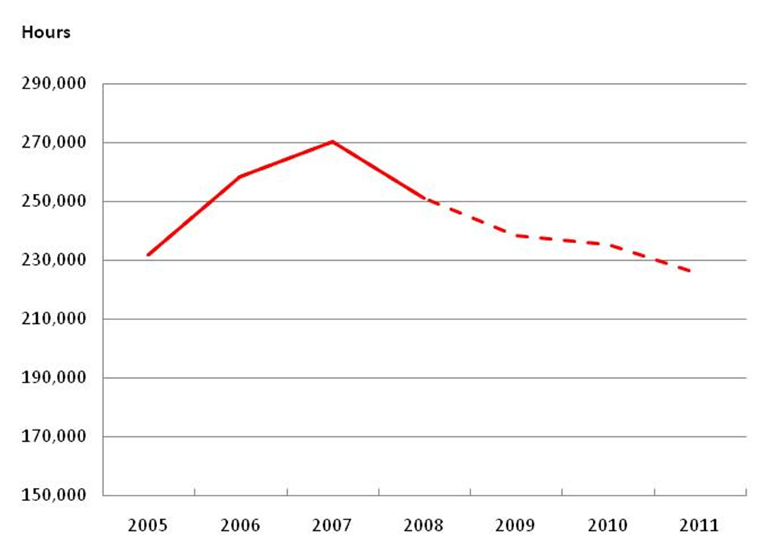
Burden Reduction – Forecasted change in NET burden
2006 – EHECS, NES
2007 – CIS, EHECS
2008 – BERD, FATS,
SPPI, IPI
2009 – STI
2010 – BEEU, ATF

Slide 11
Costs
Expenditure € million (2009)
Agriculture 1.43
Prices 2.08
Services 3.26
Industry & Building 2.42
Sub-Total 9.19
CSO Total 48.50
Productivity
2007 2010 Change
Staff 196 165 - 16%
Outputs 188 210 + 12%
PCO 0.96 1.27 + 32%

Slide 12
Blockages to progress
Poor statistical infrastructure:
- Unique Business Identifiers
- Postal/Spatial codes
- Harmonised Accounting taxonomy

Slide 13
Risks
Dependence on administrative data holders
Data Protection legislation
Ability to control staff profile
No change in perception

