Slide 1
Agricultural waste statistics
Requirement to report for the Waste Statistics Regulations (WStatR, 2150/2002)
Ireland does not report on NACE Rev.2 Section A: Agriculture, forestry and fishing 01+02+03.
Data not collected specifically on these economic activities therefore require models to estimate quantities of waste generated per year
England, Wales, Scotland and Northern Ireland use a model developed by the UK Environment Agency with slight variations

Slide 2
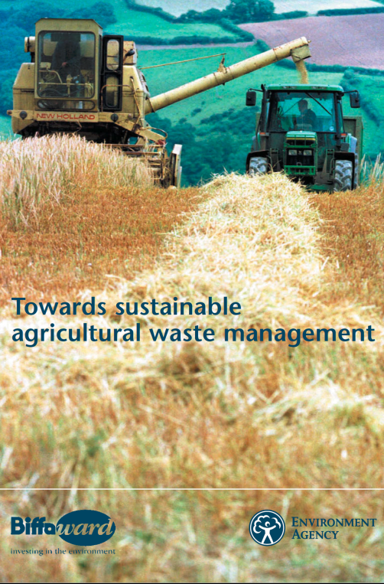
UK Agricultural Waste Estimates Model
Based on research work undertaken Marcus Hodges and BDB Associates (2001)
Later expanded with on-farm surveys in 2003.

Slide 3
UK Model Approach
Data Inputs
Data Outputs
¹National Datasets
²Data from literature, research, trade suppliers, agricultural advisors and farmers
Microsoft Excel
Worksheets
Top down approach
and/or
Bottom up approach
National agricultural waste estimates
(tonnes per annum)
CSO Agricultural Census
Farm Data Surveys

Slide 4
Calculation methodologies
Using Microsoft Excel
Top down mass balance approach and bottom-up farm practice approach to derive unit weight estimates
Top down approach e.g., quantity of agrochemical packaging placed on the market on a specific year giving unit weight estimate placed per hectare of cropping area
Bottom-up approach e.g., use figures for pesticide washings per hectare then x by the hectares of each crop type to gives tonnes per annum; sheep dip – gm of a.i. Per sheep x number of sheep etc; scrap tyres based on new tractor sales and scrap page rate etc
See summary sheet for data requirements

Slide 5
Summary Table (Hand-out)
Thank you
Jane Brogan
Resource Use Unit
OCLR
j.brogan@epa.ie
053 9167251

