Slide 1
NISRA Tourism Statistics Branch
Experimental Statistics (J. Gillan)

Slide 2
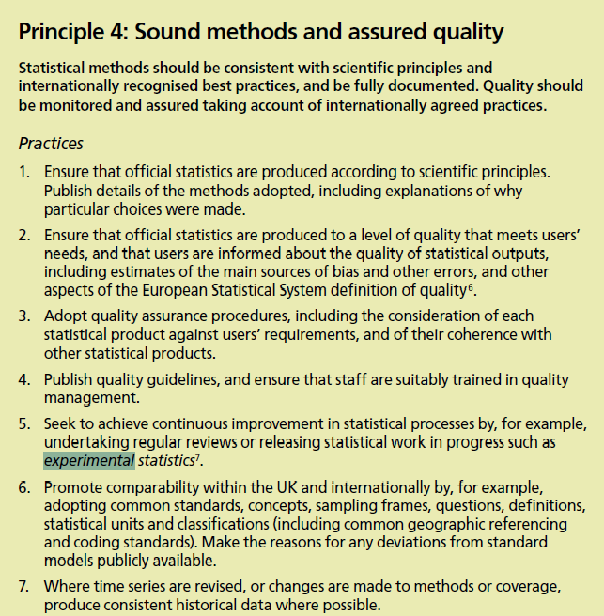
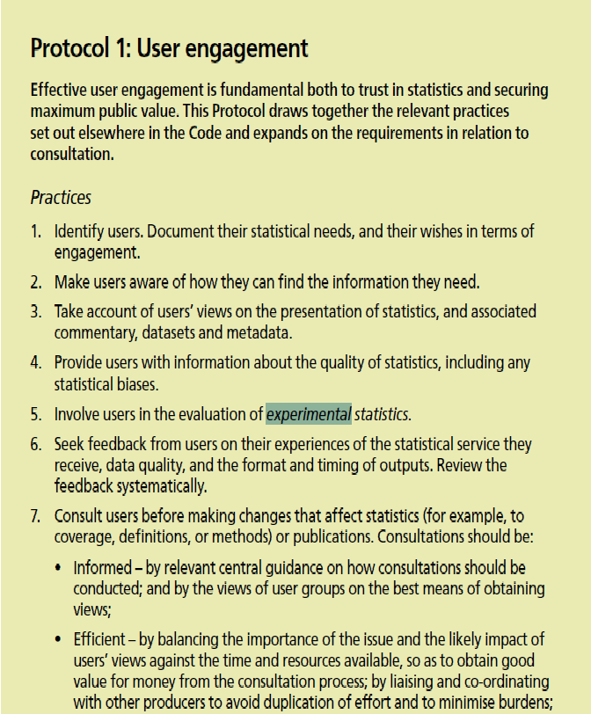
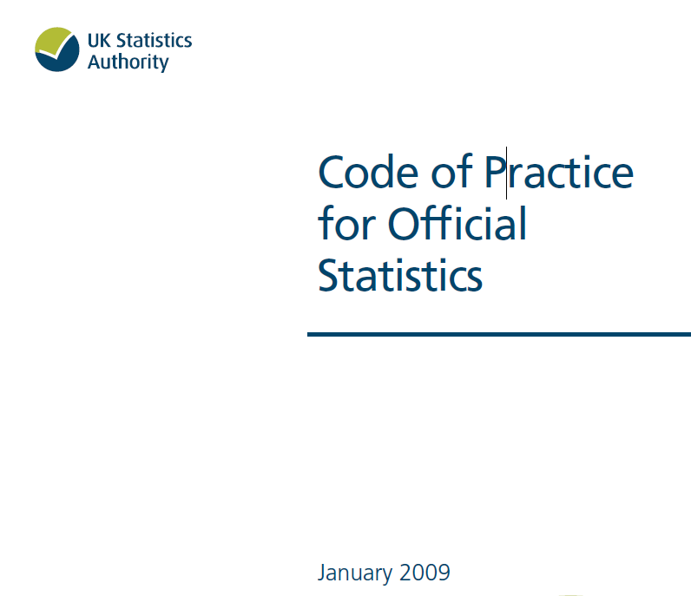
Experimental Statistics
Experimental statistics are defined in the Code of Practice for Official Statistics as "new official statistics undergoing evaluation. They are published in order to involve users and stakeholders in their development and as a means to build in quality at an early stage."

Slide 3
The Code of Practice requires the statistics to be produced, managed and disseminated to high professional standards. The statistics must be well-explained and meet users' needs. The 'National Statistics' standard has statutory backing.

Slide 5
Latest results - 2013 Annual
NI residents took an estimated 7.5m leisure day trips within NI, spending an average of £20 per trip.
NI residents took around 400,000 leisure day trips to RoI, spending an average of £34 per trip.
Hotel room occupancy decreased slightly to 64% while bed space decreased to 44%.
Occupancy in B&B/guesthouse/guest accommodation decreased to 31% and bed space occupancy decreased to 22%.
The annual self-catering unit occupancy for 2013 was 31%, an increase of 4 percentage points.
The seasonal (April-September) self catering unit occupancy increased by 1 percentage point to 42%.
Notes:
During 2013, NI residents took an estimated 7.5m leisure day trips within NI, spending an estimated £146m (Table 4). The average spend per leisure day trip within NI was £20.
During the same period, NI residents took an estimated 0.4m leisure day trips to RoI, spending an estimated £13m. The average spend per leisure day trip to RoI was £34.
The room occupancy rate for hotels in NI for the 12 month period January - December 2013 (64%) showed a slight decrease of 1 percentage point on the same period in the previous year whereas the bed-space occupancy showed a 2 percentage point decrease (to 44%).
In the period January to December 2013 the room occupancy in B&B/guesthouse/guest accommodation sector saw a decrease of 1 percentage point (to 31%) and bed space occupancy decreased by 2 percentage points (to 22%) when compared with the same period of 2012.
The annual self-catering unit occupancy for 2013 was 31%, showing an increase of 4 percentage points since 2012. The seasonal (April-September) unit occupancy for 2013 was 42%, an increase of 1 percentage point since the same period a year ago (Figure 11).
Figures show that 13.4m visits were made to visitor attractions during 2013, a 6.5% increase on the previous year.
Country parks/parks/forests/gardens accounted for the largest proportion of visitors (21%).
When Country parks/parks/forests and gardens were excluded the number one visitor attraction in NI in 2013 was the Giant’s Causeway World Heritage Site (753,929 visitors).
38% of all visits in 2013 were made by visitors from outside Northern Ireland.

Slide 6
Latest results - 2013 Annual
13.4m visits made to visitor attractions during 2013 with more than one third made by visitors from outside NI.
At 21%, the largest proportion of visitors visited country parks/parks/forests/gardens.
Excluding country parks, the most popular visitor attraction in NI in 2013 was the Giant’s Causeway World Heritage Site.
Notes:
Figures show that 13.4m visits were made to visitor attractions during 2013, a 6.5% increase on the previous year. 38% of all visits in 2013 were made by visitors from outside Northern Ireland.
Country parks/parks/forests/gardens accounted for the largest proportion of visitors (21%).
When Country parks/parks/forests and gardens were excluded the number one visitor attraction in NI in 2013 was the Giant’s Causeway World Heritage Site (753,929 visitors).

Slide 7
Proportion of overnight trips by country of residence 2013

Slide 8
Visitor Numbers - Seasonal adjustment

