Slide 1
New CSO Enterprise Statistics
Barra.Casey@cso.ie

Slide 2
New CSO Enterprise Statistics
Business in Ireland 2010
Foreign Affiliates Statistics (FATS)
Monthly Services Index
Response Burden Barometer 2011

Slide 3
Business in Ireland 2010
Flagship publication for structural business statistics
First published January 2012 for 2009 reference year – most recent edition for 2010 was published earlier this month.
Gives an overview of the entire business economy in Ireland – traditionally CSO published by sector.
Provides the reader with an easy introduction to annual enterprise statistics before tackling StatBank (CSO online database).
Notes:
Most of the statistics in the Business in Ireland book are on Statbank however some bespoke graphs are produced especially in order to extend the analyse around particular themes.

Slide 4
Business in Ireland 2010
Allows CSO to focus on themes where the user has a particular interest
2010 report focused on small and mediums enterprises (SMEs)

Slide 5
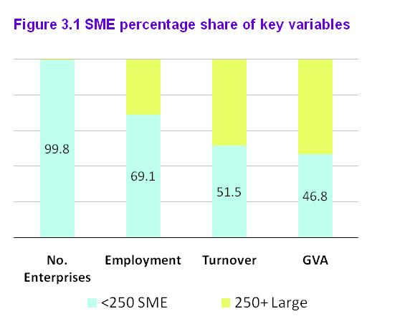
Key Message on SMEs in 2010

Slide 6
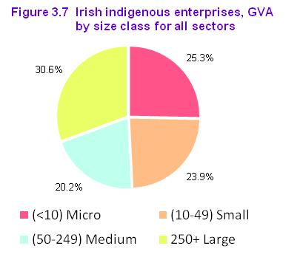
Indigenous SMEs in Ireland
Notes:
This picture is more consistent with what you see at a European level where SMEs account for about 70 per cent of GVA.
The approach of removing the foreign enterprises is something that we have done throughout the book in order to reflect what is happening in the indigenous business economy.

Slide 7
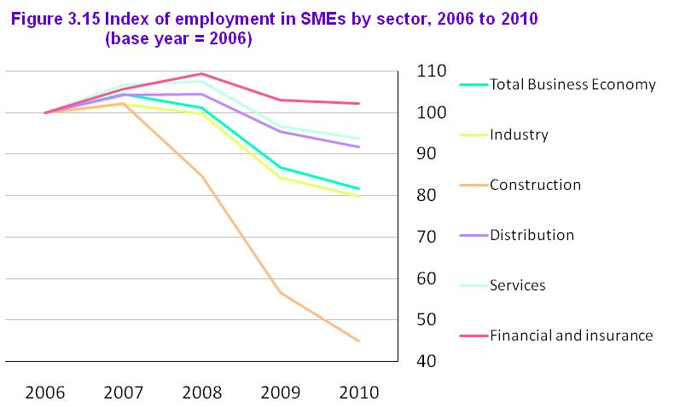
Impact of the recession on SME employment

Slide 8
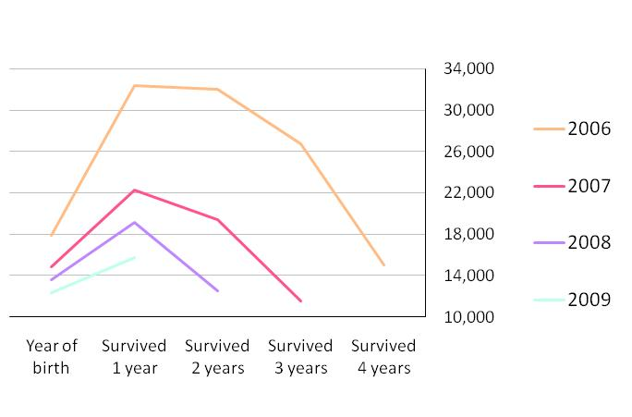
Tracking employment in surviving enterprises

Slide 9
Developing the Business in Ireland report
Introduce a chapter on short term indicators with a link to the website to access real-time tables
Include international comparisons in every chapter rather than a chapter on its own
Introduce a chapter on trade data
Other suggestions?

Slide 10
Foreign Affiliates Statistics (FATS)
Measures the activities of the affiliates of Irish multinationals abroad (outward FATS) and the activities of the affiliates of foreign multinationals in Ireland (Inwards FATS) – derives from an EU Regulation
Key concept relates to the “Ultimate Controlling Institution”.
An outward FATS survey of Irish multinationals is completed every year – Inward FATS is derived from the annual structural surveys

Slide 11
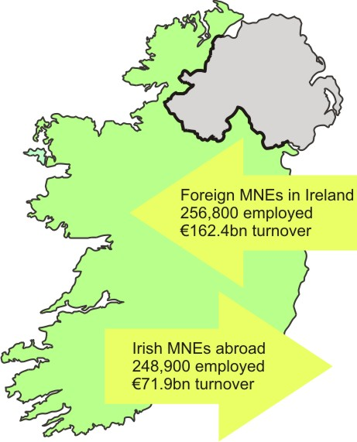
Multinationals: An Irish Perspective
Special article in Business in Ireland 2010 on how FATS data is compiled

Slide 12
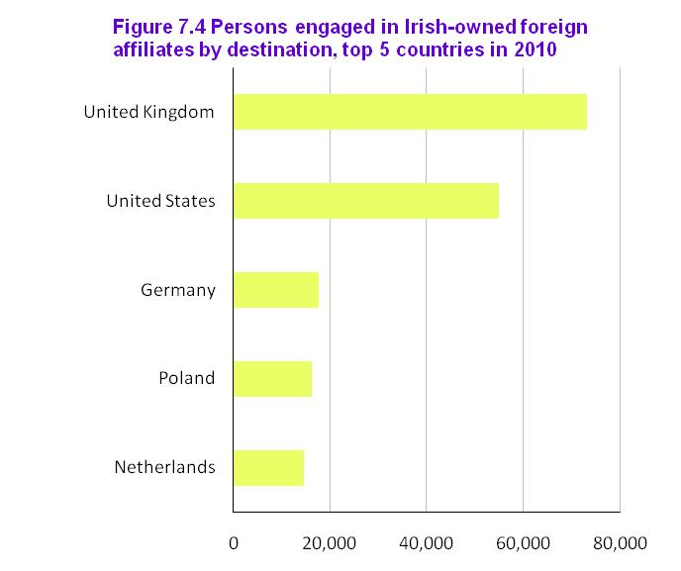
Affiliates of Irish Multinationals Abroad
73,000
55,000
18,000
16,000
15,000

Slide 13
Developing a Monthly Index of Services Production
Need for short-term indicator for the Services sector
External:
Services Strategy Group recommendation, Nov 2008
New EU Regulation
Policy makers, economists etc.
National Accounts:
Production
Household Consumption of Services

Slide 14
Monthly Services Inquiry
Internet / postal survey launched Jan 2009
Collects reference dates and turnover
Purpose is to measure trend in GVA at constant prices
Coverage: non-financial traded services sector
Sample = 4000 - all enterprises 100+ EMP or €20m+ TURN
stratified by economic activity and employment size

Slide 15
Monthly Services Index
Interim measure =
output measure at current prices
Long term objective =
volume index of service production

Slide 16
Response Burden Barometer 2011
Measurement of administrative burden imposed on Irish business by CSO inquiries
Burden 19% (2005 – 2011)
Efficient sampling – reduction in content of questionnaires
The National Employment Survey discontinued in 2011
EHECS – reduction in time taken to complete return
CIP – use of administrative data from Revenue has reduced need to send small enterprises a survey form

Slide 17
New CSO Enterprise Statistics
Any questions or suggestions?

