Slide 1
Dissemination strategy for CSO outputs
Brian Costello
Dissemination and Multi-theme Reporting Division
Central Statistics Office
Ireland

Slide 2
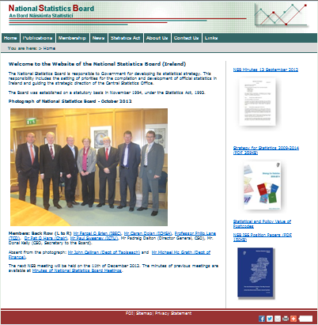
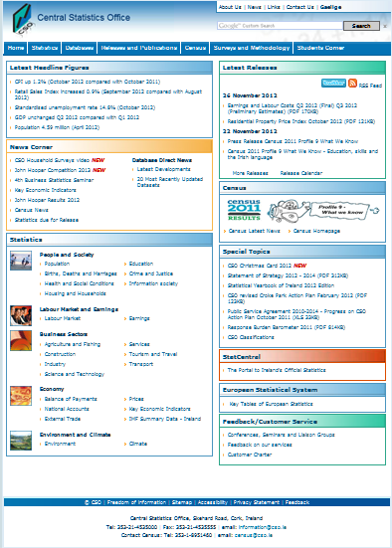
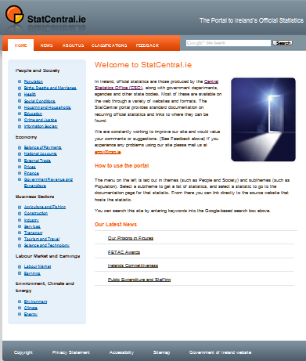
The Web Sites
www.nsb.ie
www.cso.ie
www.statcentral.ie

Slide 3
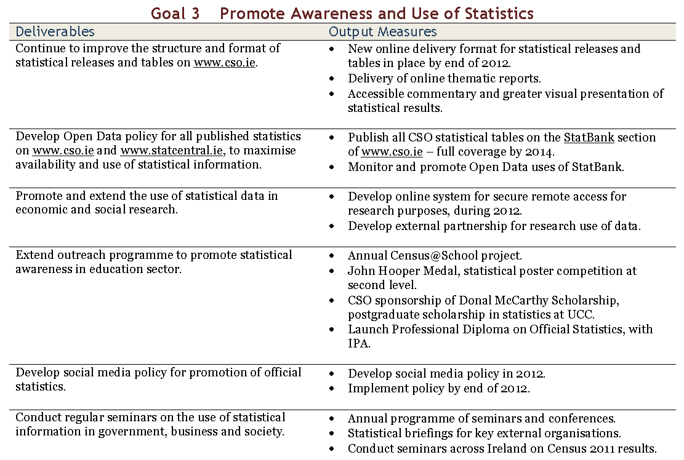
Statement of Strategy 2012-2014

Slide 4
What we deliver on CSO.ie
Statistical Releases and Publications
Multi-theme Reports
Key Economic Indicators
Interactive
StatBank
Principal Statistics Tables
RSS and Twitter Feeds
Census Reports and SAPMAP
Surveys and Methodologies

Slide 5

Case Study - Baby Mugs
?
RSS and Twitter Feeds

Slide 6
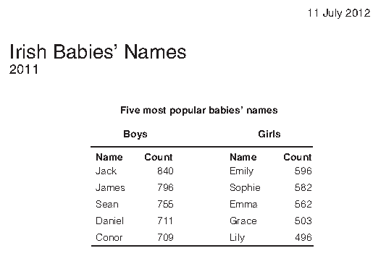
Case Study - Baby Mugs
Jack
Statistical Releases and Publications

Slide 7
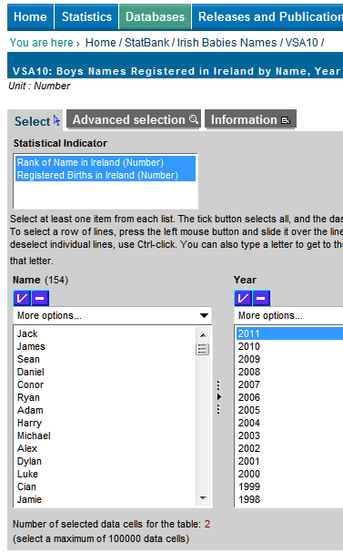
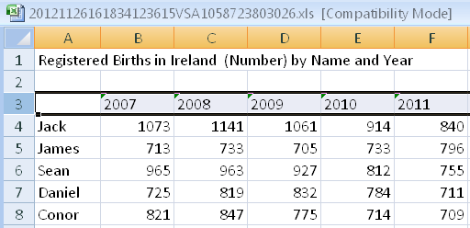
Case Study - Baby Mugs
Jack
Interactive
StatBank

Slide 8
Making the connections
Statistical Releases and Publications
Multi-theme Reports
Key Economic Indicators
Interactive
StatBank
Principal Statistics Tables
RSS and Twitter Feeds
Census Reports and SAPMAP
Surveys and Methodologies

Slide 9
Making the connections on a wider scale
Other official
statistics
Public Sector
Statistics Network
CSO
statistics
Other official
statistics
Other official
statistics
Other official
statistics
Interactive
StatBank
StatCentral.ie
Open and Linked
Data

Slide 10



Using StatBank as a source of information
Interactive
StatBank
Linked Data
Public Data
Explorer
Key Economic
Indicators

Slide 11
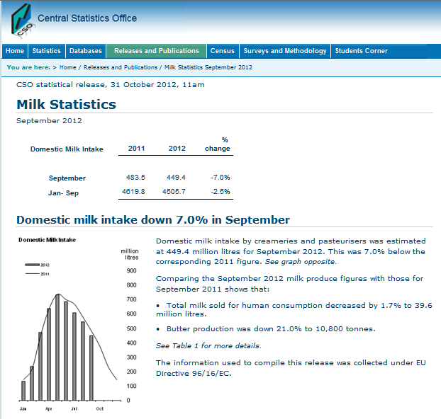
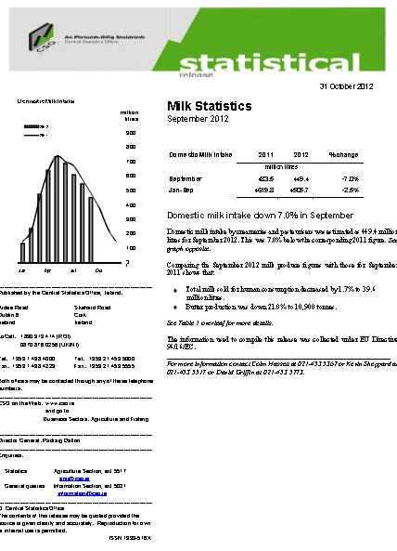
Moving from PDF to web page Releases

Slide 12

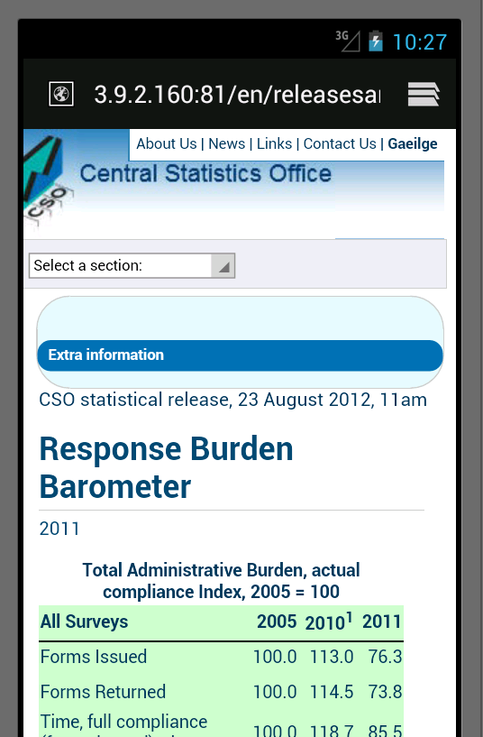
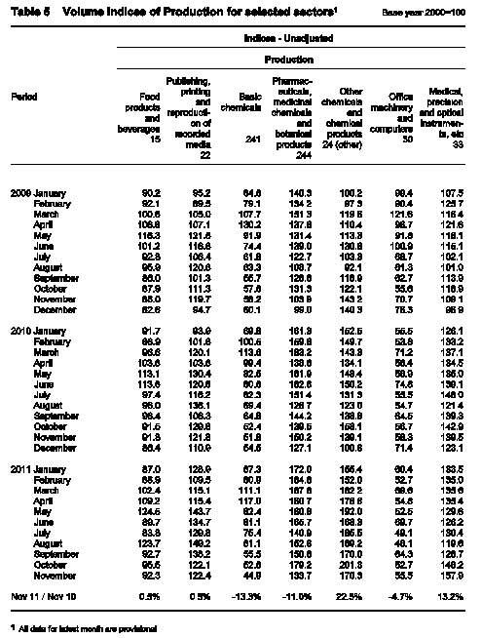

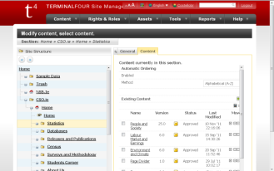
The new process
Release edited directly
in SiteManager
CMS with tables and
graphs imported to
its media library
.png
TerminalFour
SiteManager
.xls

Slide 13
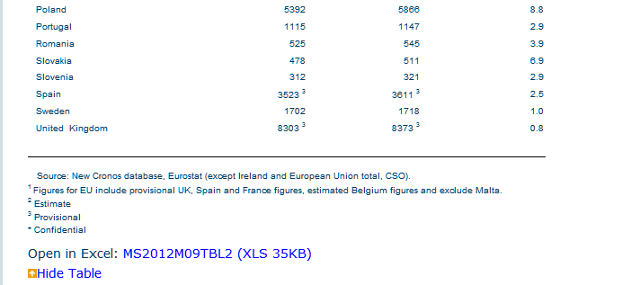
Tables can be downloaded as Excel files

Slide 14
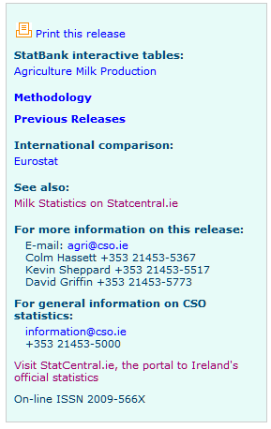

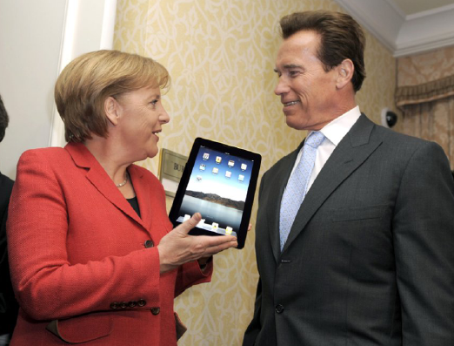
Links to StatBank and other relevant pages

Slide 15
Pyramid of Information (and interest)
Density of Users
People
Release
Details
Intensity of Technology
Density of Information

Slide 16
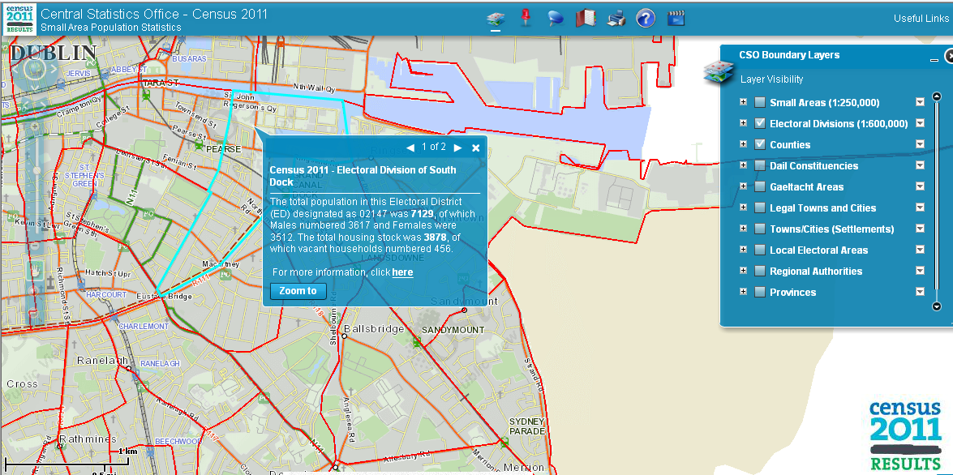
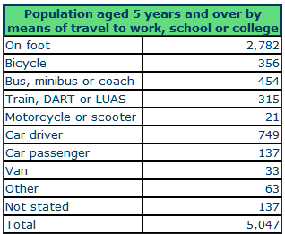
Mapping of Information
Census 2011 SAPMAP

Slide 17
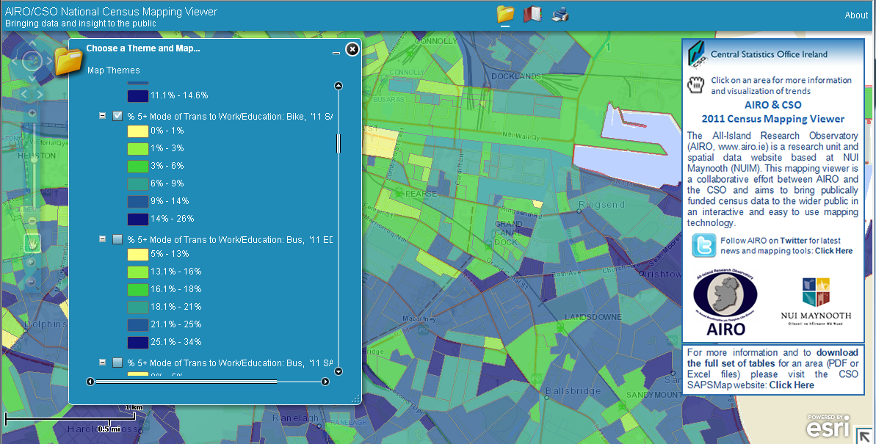
AIRO/CSO 2011 National Census Mapping Viewer
All-Island Research Observatory AIRO Census Mapping Tools

Slide 18
Experimental Visualisations
Exploring Job Churn by age and sex
Using Google Maps and Charts Live Register
Inclusion of Interactive Charts in statistical releases
Investigation of interactive visualisation packages
Sourcing interactive visualisations out of StatBank

Slide 19
Social Media
Conservative policy on what we push out and our interactions
Twitter – all press releases, statistical releases and publications headlines are tweeted
YouTube – Instructive videos and events
FaceBook – Under construction, newsworthy items
Blogs, discussion forums – Under consideration.

Slide 20
Challenges
CSO.ie Site Navigation
Search

Slide 21
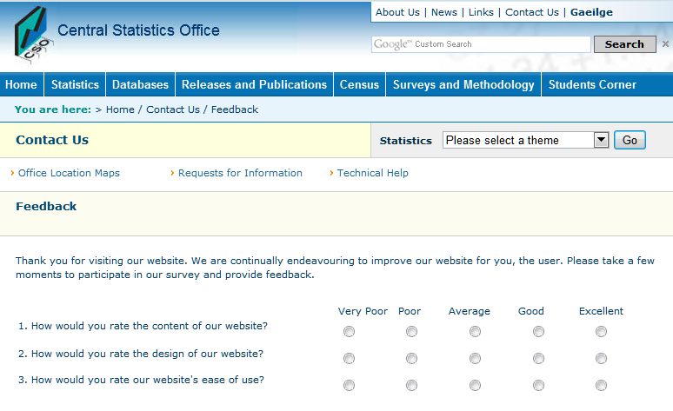
Questions? – Feedback?

