Slide 1
Income Estimates for Irish Farmers using self-assessment income tax returns
John Hayes
Central Statistics Office, Ireland
Agricultural Statistics Seminar,
22 November, 2012, Dublin

Slide 2
Introduction
This paper details an analysis of Irish farmer incomes in 2010, conducted by the Central Statistics Office (CSO) using self-assessment income tax returns to the Revenue Commissioners.
Notes:
This paper details an analysis of Irish farmer incomes in 2010, conducted by the Central Statistics Office (CSO) using self-assessment income tax returns to the Revenue Commissioners.
The analysis arose out of a request to the CSO by the Department of Agriculture, Food and the Marine for information on the relative incomes of farmers in Disadvantaged Areas and non-Disadvantaged Areas.

Slide 3
Project initiation
The primary provider of administrative data for statistical purposes to the CSO is the Office of the Revenue Commissioners (Revenue).
Amongst the data holdings supplied is Income Tax Form 11 returns, the annual tax return of persons chargeable under self-assessment (in the main, self-employed persons).
The CSO was approached by the Department of Agriculture, Food and the Marine (DAFM) to investigate whether income tax filings could be used to obtain information on the relative incomes of farmers in Disadvantaged Areas and non-Disadvantaged Areas.
The analysis focussed on reference year 2010, and on the following components of the Form 11 return: trading income, rental income, income from employment, social welfare transfers, and pension income.
Notes:
The primary provider of administrative data for statistical purposes to the CSO is the Office of the Revenue Commissioners (Revenue). Amongst the data holdings supplied is Income Tax Form 11 returns. IT Form 11 is the annual tax return of persons chargeable under self-assessment (in the main, self-employed persons). For any particular reference year, the CSO receives, at twelve-month intervals, three versions of the Form 11 data holding, each version being progressively more complete.
In summer of 2012, the CSO was approached by the Department of Agriculture, Food and the Marine (DAFM) to investigate whether income tax filings could be used to obtain information on the relative incomes of farmers in Disadvantaged Areas and non-Disadvantaged Areas.
The analysis focussed on reference year 2010, the latest year for which the CSO had received any Form 11 data, and on those components of the Form 11 return believed to be significant contributors to farmer income, viz., trading income, rental income, income from employment, social welfare transfers, and pension income.
It was agreed that a “farmer” for the purposes of this exercise would be any Form 11 filer (i) who had identified himself or herself as a farmer on the Form 11 return, or (ii) whose Personal Public Service Number (PPSN) was on a list of farmer PPSNs to be provided by the DAFM. The DAFM also agreed to provide a PPSN list of those farmers living in Disadvantaged Areas.

Slide 4
The analysis dataset
The analysis dataset was 81,143 farmer filers.
Of this number, 75,646 filers had identified themselves as farmers on the Form 11 return, while another 5,497 Form 11 filers were identified as farmers from the DAFM list.
Note that the size of the analysis dataset reflects the fact that the analysis was performed on the earliest version of the Form 11 data holding received for reference year 2010.
Note also that many farmers deriving a low income from farming are not required to make Form 11 returns, as, with the agreement of Revenue, their PAYE credits (for example) are instead decreased to reflect the taxable element of farm income.
Notes:
81,550 farmer filers were identified. To mitigate against bias due to outliers, the top 0.5% (or 407) of these, in terms of income, were eliminated, leaving an analysis dataset of 81,143.
Of this number, 75,646 filers had identified themselves as farmers on the Form 11 return, while another 5,497 Form 11 filers were identified as farmers from the DAFM list.
Note that the size of the analysis dataset reflects the fact that the analysis was performed on the earliest version of the Form 11 data holding received for reference year 2010; a later, more complete version of this data holding would have resulted in a correspondingly larger analysis dataset. (A second version of the Form 11 data holding for reference year 2009, for example, would have yielded an analysis dataset of 92,917 farmer filers.)
Note also that many farmers deriving a low income from farming are not required to make Form 11 returns, as, with the agreement of Revenue, their PAYE credits (for example) are instead decreased to reflect the taxable element of farm income.

Slide 5
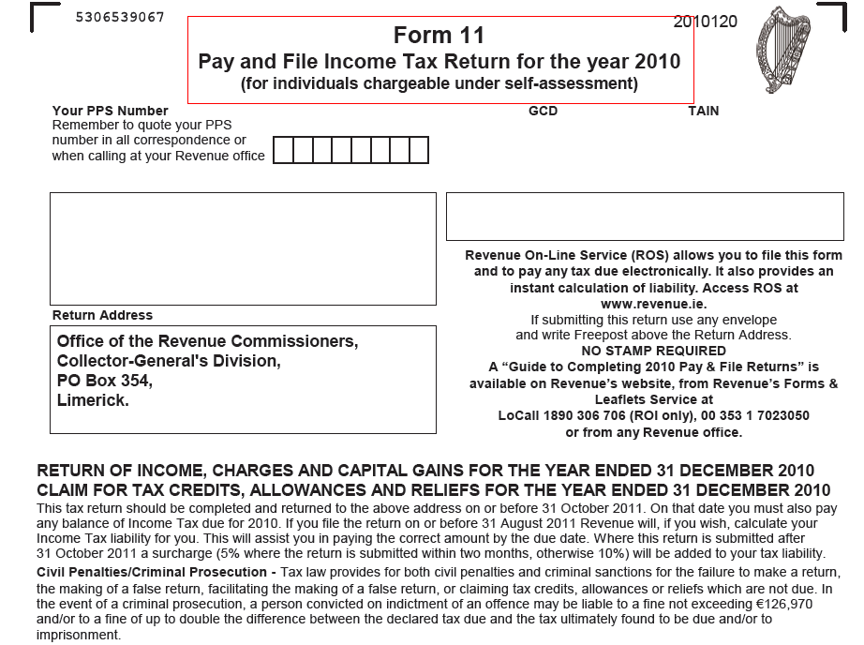
IT Form 11
Notes:
The Revenue IT Form 11 (first page)

Slide 6
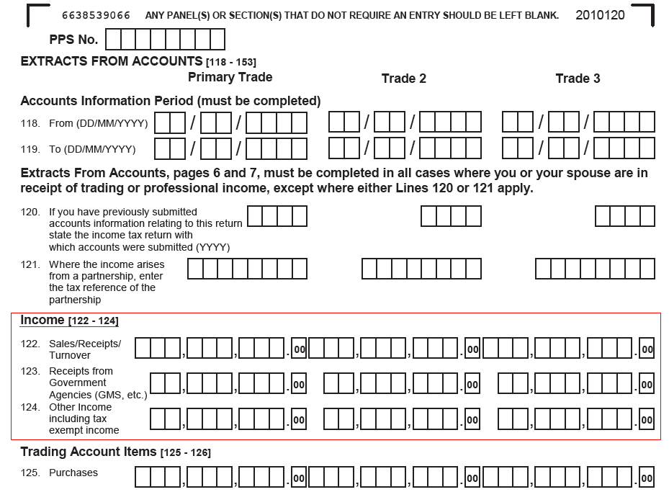
Form 11 Extract from Accounts (first page)
Notes:
IT Form 11 Extract from Accounts (first page), showing the three elements making up the Income from trade (lines 122-124). Note also that information for up to three trades may be entered, and farm trade may not be the trade providing the largest income.

Slide 7
Some definitions/notes
Farmer: For the purposes of this paper, a farmer is any Form 11 filer (i) who identified himself or herself as a farmer on the Form 11 return, or (ii) whose Personal Public Service Number (PPSN) was on a list of farmer PPSNs provided by the DAFM
Disadvantaged Area: A Disadvantaged Area is a townland designated as one in which the ability to farm is restricted by the physical environment.
Income from Trade: Filers are allowed to make returns for up to three separate trades on the Form 11. The term Income from trade, as used in this paper, means income before any deductions for intermediate consumption or other expenses/inputs. It represents the combined, gross income from all types of trading activity, not just farming.
Assessable profit: the amount on which the filer is assessable for tax.
Only the taxable element of social welfare benefits is to be entered on the Form 11. Thus, Back to Work Allowance, Jobseekers Allowance, and Maternity Benefit, which are all exempt from income tax, should not be entered in the Form 11 return.
Notes:
Farmer: For the purposes of this paper, a farmer is any Form 11 2010 filer who satisfies one or more of the following conditions: (i) the filer has indicated, in the “Personal Details” section of the Form 11 return, that he/she or his/her spouse, or both, are farmers; (ii) the filer, in the “Income From Trades” section of the Form 11 return, has described any one of his/her trades as “farming” or “farmer”, or described any one of his/her spouse’s trades as “farming” or “farmer”; (iii) the filer’s Personal Public Service Number (PPSN) appears on a list of farmer PPSNs maintained by the Department of Agriculture, Food and the Marine (DAFM).
Disadvantaged Area: A Disadvantaged Area is a townland designated as one in which the ability to farm is restricted by the physical environment. A farmer in a Disadvantaged Area may benefit from transfers under the Disadvantaged Areas Scheme, if he or she meets certain criteria, such as maintaining a minimum stocking density. The DAFM maintains a PPSN list of those farmers living in Disadvantaged Areas.
Income from Trade: Filers are allowed to make returns for up to three separate trades on the Form 11. (If more than three trades are conducted, then the third and subsequent trades are combined.) The term Income from trade, as used in this paper, refers to the combined income from all trades (not just farming). Income from trade comprises the following three elements of the “Extracts From Accounts” section of Form 11: Sales/Receipts/Turnover; Receipts from Government Agencies; and Other Income including tax exempt income.
Note: Income from trade is income before any deductions for intermediate consumption or other expenses/inputs. It represents gross income from all types of trading activity, not just farming. Income from farm trade, as used in this paper, appears to be equivalent to the National Farm Survey category “Gross Output”.
Assessable profit: the amount on which the filer is assessable for tax. Assessable profit from farm trade may not be equivalent to the National Farm Survey category of “Family Farm Income”, but the two concepts would appear to be closely related.
Only the taxable element of social welfare benefits is to be entered in the Form 11. Thus, Back to Work Allowance, Jobseekers Allowance, and Maternity Benefit, which are all exempt from income tax, should not be entered in the Form 11 return. Certain elements of other benefits, such as the child benefit component of Jobseekers Benefit, are also exempt from income tax and therefore should be excluded from the return.

Slide 8
Relative importance of each component of income, and income differences between non-Disadvantaged and Disadvantaged Areas
Table 1 2010 Income Tax Farmer filer gross income, by non-Disadvantaged Areas and Disadvantaged Areas, Means
Component | non- Disadvantaged Areas, € | Disadvantaged Areas, € | State, €
Income from trade | 80,092 | 70,201 | 73,959
Gross rent receivable | 6,517 | 3,173 | 4,444
Income from employment in Ireland | 20,829 | 20,615 | 20,696
Taxable social welfare payments | 4,017 | 3,707 | 3,825
Irish pensions (non-social welfare) | 1,964 | 1,236 | 1,513
Summed Income | 113,418 | 98,933 | 104,436
Income from trade accounts for almost 71% of Summed Income at state level. Income from trade in non-Disadvantaged Areas was 14% higher than that for Disadvantaged Areas.
Income from employment in Ireland, which is almost 20% of Summed Income, is relatively more important in Disadvantaged Areas (almost 21% of Summed Income) than in non-Disadvantaged Areas (over 18% of Summed Income).
Summed Income of farmer filers in non-Disadvantaged Areas was almost 15% more than that of those in Disadvantaged Areas.
Notes:
The biggest income component for farmer filers in the state is income from trade, which accounts for almost 71% of Summed Income; no appreciable difference in this proportion between the non-Disadvantaged Areas and the Disadvantaged Areas. Income from trade in non-Disadvantaged Areas was 14% higher than that for Disadvantaged Areas.
Income from employment in Ireland, which is almost 20% of Summed Income, while virtually the same in absolute terms for non-Disadvantaged Areas and Disadvantaged Areas, is relatively more important in Disadvantaged Areas, where it accounted for almost 21% of Summed Income, as against over 18% in non-Disadvantaged Areas.
Summed Income of farmer filers in non-Disadvantaged Areas was almost 15% more than that of those in Disadvantaged Areas. This difference was primarily in the income from trade component, where farmers in non-Disadvantaged Areas earned 14% more than their counterparts in Disadvantaged Areas.

Slide 9
Income, profit from farm trade, by non-Disadvantaged Areas and Disadvantaged Areas
Income from farm trade of farmer filers accounted for almost 79% of income from all trades (see Table 1).
The income from farm trade of farmers in non-Disadvantaged Areas was almost 17% higher than that of farmers in Disadvantaged Areas.
Assessable profit from all trades was almost 33% higher in non-Disadvantaged Areas; in terms of farm trade alone, profit for farmers in non-Disadvantaged Areas was more than 31% higher than for Disadvantaged Areas.
Table 2 2010 Income Tax Farmer filer gross income and profit categories, by non-Disadvantaged Areas and Disadvantaged Areas, Means
Component | non- Disadvantaged Areas, € | Disadvantaged Areas, € | State, €
Income from farm trade | 63,981 | 54,719 | 58,238
Income from other sources | 49,438 | 44,214 | 46,198
Assessable profit from trade | 22,493 | 16,925 | 19,040
Assessable profit from farm trade | 16,979 | 12,936 | 14,472
Assessable profit from non-farm trade | 5,514 | 3,989 | 4,568
Notes:
Income from farm trade of farmer filers accounted for almost 79% of income from all trades (see Table 1).
The income from farm trade of farmers in non-Disadvantaged Areas was almost 17% higher than that of farmers in Disadvantaged Areas.
Assessable profit from all trades was almost 33% higher in non-Disadvantaged Areas; in terms of farm trade alone, the profit figure for farmers in non-Disadvantaged Areas was more than 31% higher than that for Disadvantaged Areas.

Slide 10
Summed Income quintile analysis, State level
Table 3 2010 Income Tax Farmer filer gross income, by summed income quintile group, Means
Component |  | 1st Quintile < €37787, € |  | 2nd Quintile < €61277, € |  | 3rd Quintile < €89879, € |  | 4th Quintile < €142654, € |  | 5th Quintile ≥ €142654, € |  | State, €
Income from trade |  | 12,372 |  | 26,837 |  | 41,857 |  | 72,725 |  | 215,996 |  | 73,959
Gross rent receivable |  | 1,267 |  | 1,676 |  | 2,308 |  | 3,963 |  | 13,004 |  | 4,444
Income from employment in Ireland |  | 4,347 |  | 13,824 |  | 24,596 |  | 31,407 |  | 29,307 |  | 20,696
Taxable social welfare payments |  | 4,762 |  | 5,506 |  | 4,000 |  | 2,734 |  | 2,123 |  | 3,825
Irish pensions (non-social welfare) |  | 602 |  | 1,550 |  | 2,014 |  | 1,791 |  | 1,606 |  | 1,513
Summed Income |  | 23,350 |  | 49,393 |  | 74,774 |  | 112,621 |  | 262,036 |  | 104,436
Summed income for the lowest quintile of farmer filers in Ireland was over 22% of the State average and just 9% of summed income in the highest quintile.
In terms of income from trade, the disparity between lowest and highest quintiles is greater, with the lowest quintile figure being less than 6% of that for the highest quintile.
Notes:
Summed income for the lowest quintile of farmer filers in Ireland was over 22% of the State average and just 9% of summed income in the highest quintile.
In terms of income from trade, the disparity between lowest and highest quintiles is greater, with the lowest quintile figure being less than 6% of that for the highest quintile.

Slide 11
Marital characteristics, by non-Disadvantaged Areas and Disadvantaged Areas
Table 4 2010 Income Tax Farmer filings, marital characteristics, by non-Disadvantaged Areas and Disadvantaged Areas
Component | non- Disadvantaged Areas, % | Disadvantaged Areas, % | State, %
Percentage of filers who are single | 20.4 | 23.2 | 22.1
Percentage of filers who are married | 71.6 | 70.9 | 71.2
Percentage of filers with other marital status | 8.1 | 5.9 | 6.7
Percentage of filings showing spousal income from farming | 6.5 | 4.3 | 5.1
Percentage of filings showing spousal income from any source | 52.5 | 52.3 | 52.4
Over 22% of income tax farmer filers for 2010 were unmarried.
The percentage of farmer filings showing spousal income was over 52%; however, only 5% of filings showed spousal income from farming.
Notes:
Over 22% of income tax farmer filers for 2010 were unmarried.
The percentage of farmer filings showing spousal income was over 52%; however, only 5% of filings showed spousal income from farming.

Slide 12
Conclusions
As many farmers deriving a low income from farming are not required to make Form 11 returns, more weight should be attached to componential comparisons than to the absolute figures produced.
The analysis shows that there is a significant difference in farmer incomes between non-Disadvantaged Areas and Disadvantaged Areas.
The analysis also shows a wide disparity in incomes between farmers in the lowest income quintile and those in the highest income quintile.
A corroboration exercise was conducted using reference year 2009, which produced similar results for absolute income levels and componential breakdowns. However, the two years are not directly comparable because of changes in the content of Form 11 from one year to the next.
Notes:
As many farmers deriving a low income from farming are not required to make Form 11 returns, more weight should be attached to componential comparisons than to the absolute figures produced.
The analysis shows that there is a significant difference in farmer incomes between non-Disadvantaged Areas and Disadvantaged Areas.
The analysis also shows a wide disparity in incomes between farmers in the lowest income quintile and those in the highest income quintile.
A corroboration exercise was conducted using reference year 2009, which produced similar results for absolute income levels and componential breakdowns, e.g., Summed Income for the State in 2009 was €103,438, compared to €104,436 for 2010. However, the two years are not directly comparable because of changes in the content of Form 11 from one year to the next. This also creates difficulties in producing a time series.

