Slide 1
Tracking the performance of Irish Food and Beverage exports
Peter Duggan, Bord Bia
22nd November 2012

Slide 2
Outline
Irish Farms
Export performance
Livestock Developments
Meat Supply Outlook
Meat exports
Summary

Slide 3
Irish Farms

Slide 4
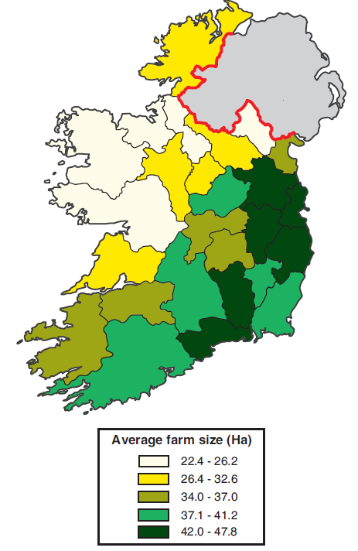
Irish Farms
4.6 million hectares of farmland; >80% in grassland
139,800 Farm Holdings
Average farm size: 33 hectares
Largest farms in the East
79% have cattle
Cork holds almost 1 million cattle
Notes:
4.6 million hectares excludes commonage
Over 400,000 hectares in commonage
111,000 farms have cattle
Waterford has the highest number of cattle per farm at 110 head.

Slide 5
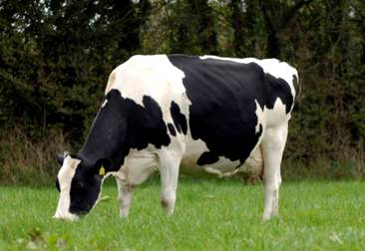
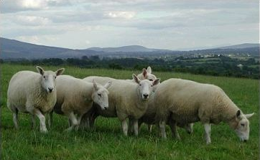
Irish Farms
18,500 commercial dairy holdings
Average dairy cow herd 63 hd.
32,200 sheep flocks down 26% on 2000 levels
Donegal holds almost 622K of sheep.
Average sheep flock is 158 hd.
1,200 pig holdings
Production centres around key meat processors
Notes:
4 sheep in dongeal to every dongeal citizen.
Wicklow has about 263 head per farm
Average pig farm size is 1,250 head. Highest pig prouction in counties like longford cavan and offaly.

Slide 6
Export performance

Slide 7
Export Performance 2011
Hort. & Cereals.
€210m
Seafood €420m
Beverages €1,220m
Meat & Livestock
€2,795m
Prepared Foods
€1,540m
Dairy
€2,665m

Slide 8
Trend in exports by region
Exports by region, 2011 vs. 2010 (% Change)

Slide 9
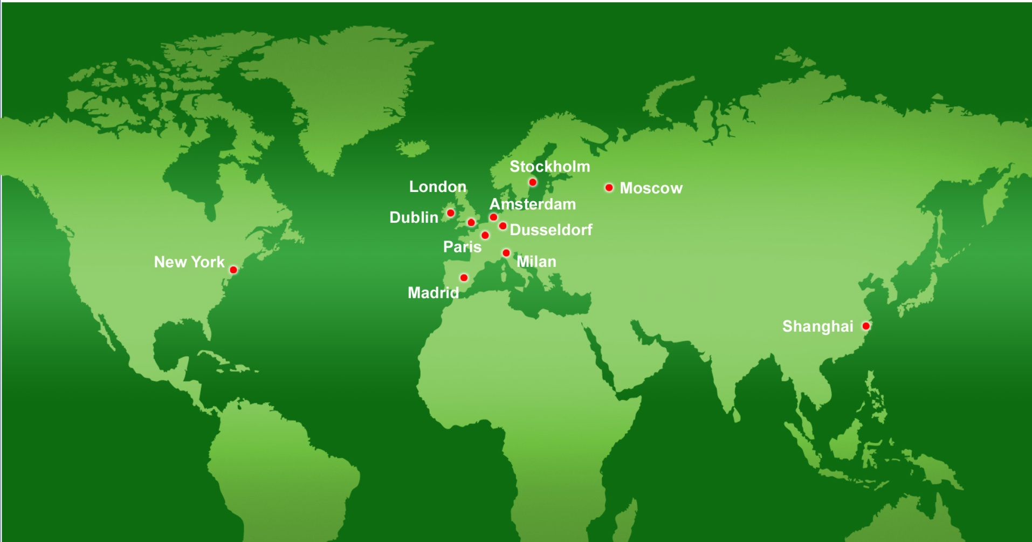
Distribution of Food & Drink Exports (%)

Slide 10
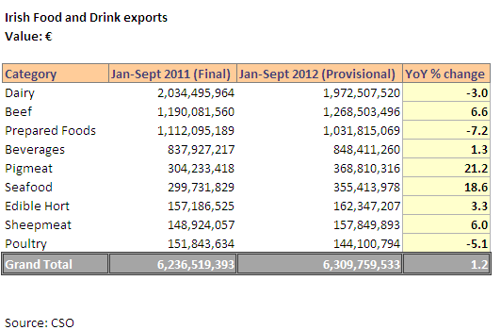
2012 Performance to data

Slide 12
Notes:
Makes up to 87% of total exports

Slide 14
Livestock developments

Slide 15
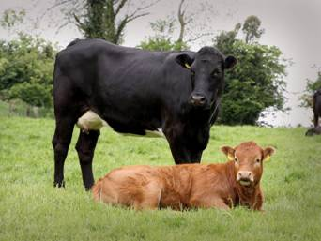
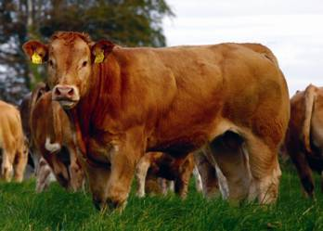
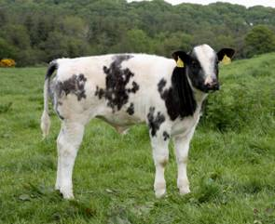
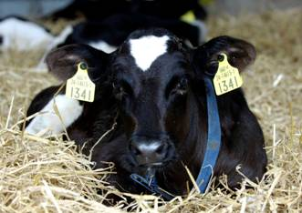
Irish Cattle Herd (June ’12 survey)
1.14m. Beef suckler cows
1.15m. Dairy cows
…and the calves from these:
Beef-bred cattle
50% Beef Crosses
Dairy-bred animals

Slide 16
Continued Growth within Irish Sheep Sector
Total Flock
Breeding
Flock
5.15
5.6
4.6
5.1
2.5
2.6
2005
2010
2012 (e)
Source : CSO

Slide 17
‘000 head

Slide 18
Meat Supply Outlook

Slide 19
Source: CSO

Slide 20
Source: CSO

Slide 22
Meat exports

Slide 23
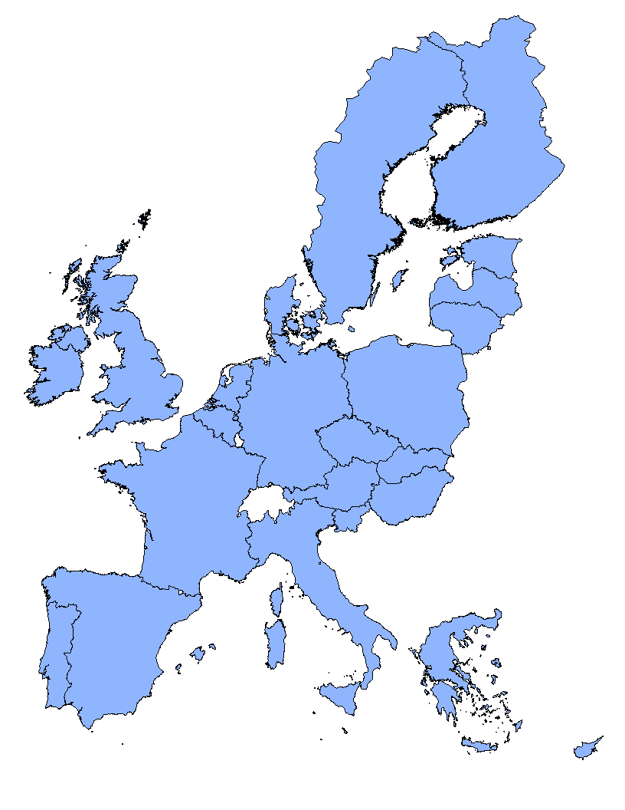
Irish Beef Markets
Export Volumes by Destination (2011)
Scandinavia 46,000
96% of Irish beef exports
destined for high value EU markets
Exports 510,000
UK 254,000
Holland 42,000
Germany
15,000
France 55,000
Italy 42,000
Spain 15,000
Portugal 5,000
Notes:
And this is where Ireland is exporting its beef to:
Almost 50% of exports destined for the UK market
The vast majority of the remainder is exported to Continental EU markets including France, Italy, Holland, Scandinavia, Germany and Spain.
Just 20,000t of Irish beef was exported outside of the EU in 2011, and the majority of this went to Russia and Switzerland.

Slide 24
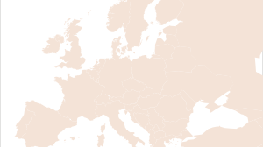
Boost in 2011 exports
SWEDEN
2,000t (33%)
VOLUME
37,000t
VALUE
€180m
DESTINATIONS
24 individual markets
EU – 97%
International – 3%
KEY MARKETS
UK & France
GROWTH MARKETS
Belgium
Germany
Sweden
UK
11,000t
BELGIUM
1,600t (25%)
GERMANY
2,000t (25%)
FRANCE
18,000t
ITALY
1,500t
Source: CSO
Notes:
On another positve note, exports of Irish sheep meat registered a solid performance in 2011 where total value rose by 10% to €180m. With 70% + of our production destined for export markets just over 40,000 tonnes were exported to over 24 individual markets across the globe. The vast majority of theses exports were destined for customers within the EU.
France and the UK continue to be our core export markets representing 76% of our volume exports. Strong increases in shipments were recorded in Belgium, Germany and Sweden as exporters continue to secure new business and grow business with existing customers in these markets.

Slide 25
Irish Pigmeat Exports in 2011 ~ 168,000 tonnes / €395 m
International Markets
32%
UK
43%
Cont. EU
25%
Notes:
Ireland is approx 150% self sufficient in pigmeat and annually export in the region of 130,000 tonnes. We export everything from carcases and primal cuts to value added cooked products.
UK remains the principal destination accounting for more than 60% of shipments, followed by Germany, with Russia and Japan the leading international markets. We have an excellent record in export markets worldwide.

Slide 26
Summary

Slide 27
Summary
Census of agriculture helps Bord Bia monitor the developments that have taken place in the livestock sector
CSO data helps track the performance of food and drink exports
In tandem with the DAFF, livestock surveys help Bord Bia make projections
Livestock slaughtering report is used as a guide for meat balance sheets
CSO figures used to estimate meat exports

