Slide 1
Balance of Payments Outputs of the Balance of Payments Division
CSO 23/2/2012
Stephen Treacy & Stephen McDonagh
Balance of Payments
Analysis & Dissemination

Slide 2
What this presentation will cover
Balance of Payments (BoP) statistics – ST
International Investment Position (IIP) and related statistics – ST
Resident holdings of foreign Portfolio Securities – ST
International Trade in Services – SMcD
Foreign Direct Investment – SMcD

Slide 3
BoP division outputs and releases
Much of our data is produced for International Organisations; Eurostat, ECB, OECD, IMF, World Bank, UN
Monthly estimates t+6 weeks, Quarterly data t+90 days, semi-annual t+6 months, Annual data t+9 months
Main use of this data is to compile EU/Euro-Area aggregates and is generally at EU/extra-EU, Euro area/extra Euro-Area level
National publications geared towards what users have requested
National Releases contain IFSC/non-IFSC splits to help users understand what’s happening in the core economy
Revisions annually going back two years at a minimum, in conjunction with National Accounts (Financial, non-Financial, Sector Accounts)
Revisions include corrections, annual data and new data sources

Slide 4
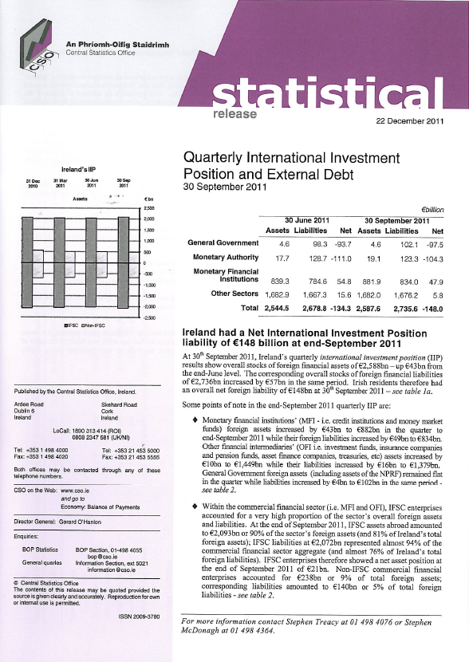
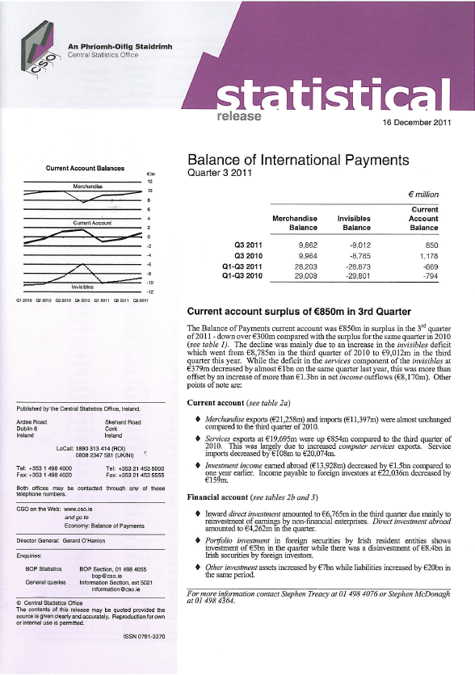
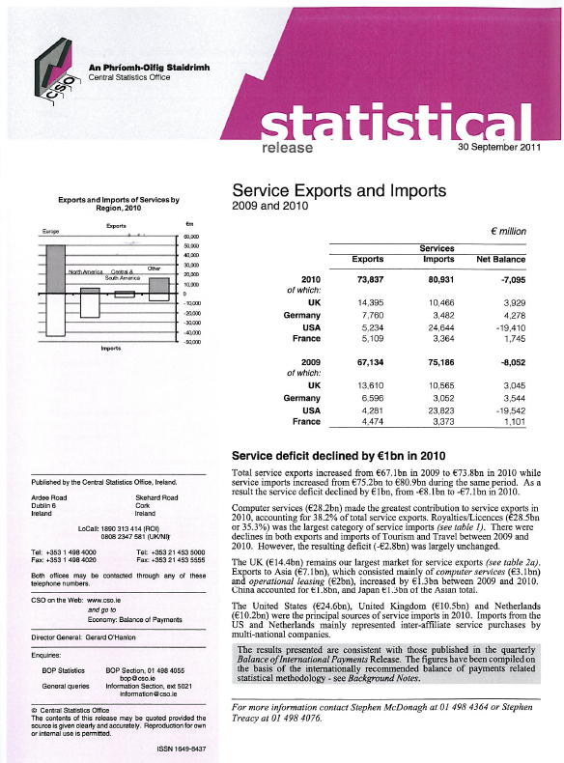
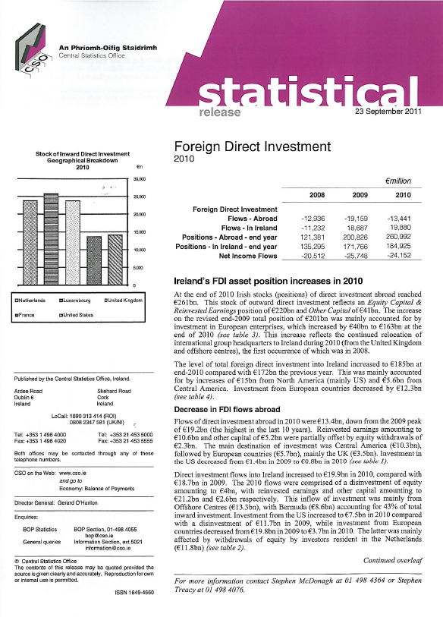
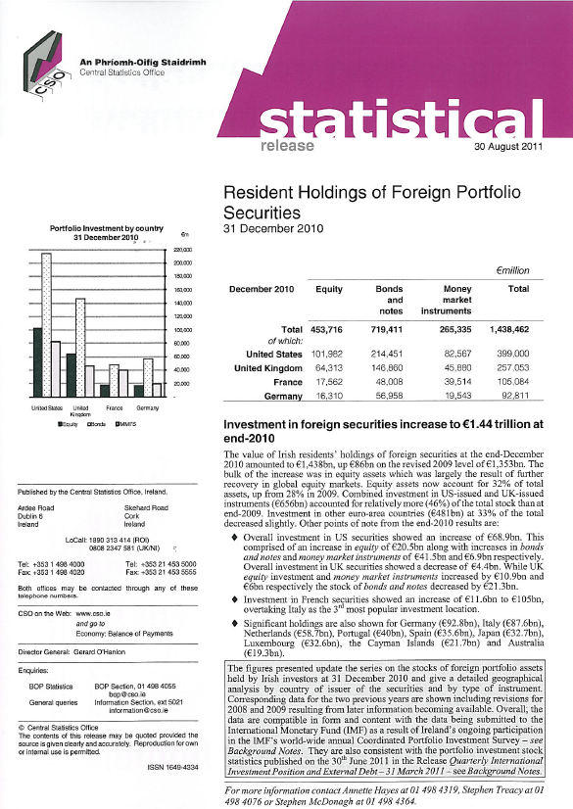

Slide 5
Quarterly Current Account Balance 2001q1 - 2011q3

Slide 6
Current Account comparison q3 2011: Ireland, New Zealand and the Netherlands

Slide 7
Financial Account Flows 2004q1 – 2011 q3

Slide 8
Breakdown of Annual Financial Account Flows

Slide 9
International Investment Position comparison end September 2011 data
€ Millions

Slide 10
Net International Investment Position 2000 – quarter 3 2011

Slide 11
Quarterly External Debt Statistics

Slide 12
IFSC/Non-IFSC External Debt q3-2011

Slide 13
Co-ordinated Portfolio Investment Survey

Slide 14
CPIS comparison between Irish and World data

Slide 15
Annual International Trade in Services

Slide 16
Growth of Services
Growth of Services

Slide 17
Alternative
Growth of Services (2)

Slide 18
Top 10 EU countries’ trade in services (2010)
€bn

Slide 19
Main Service Categories

Slide 20
Country comparison - computer/Insurance service exports (2010)
€bn

Slide 21
Country comparison Insurance/Royalties service imports (2010)
€bn
€bn

Slide 22
Main partner countries (2010)

Slide 23
Annual Foreign Direct Investment

Slide 24
Definition
Direct Investment is a category of international investment in which a resident entity in one economy (the direct investor) acquires a lasting interest in another economy (the direct investment enterprise).
Lasting interest is defined as 10% or greater holding of equity (ordinary shares/voting power)
10% or more -> Direct Investment
<10% -> Portfolio investment

Slide 25
Directional principle
€30m loan
Country: US
Company A
€100m equity
Country: Ireland
Company B
Country: France
Company C
Loan €25m
Direct Investment in Ireland:
€100m (€100m)
€70m (€100m - €30m)
€45m (€100m - €30m - €25m)

Slide 26
Direct Investment Positions

Slide 27
Composition of FDI (Positions)
€bn
2007

Slide 28
Destination/Source of Investment (2010)

Slide 29
DIA by resident enterprise’s NACE sector (2010)

Slide 30
DII by resident enterprise’s NACE sector (2010)

Slide 31
What is an Irish company?
Irish owned?
Head-quartered in Ireland?
Listed on the Irish Stock Exchange?
Combination of the above?
Other?

Slide 32
Thank you for your attention

