Slide 1

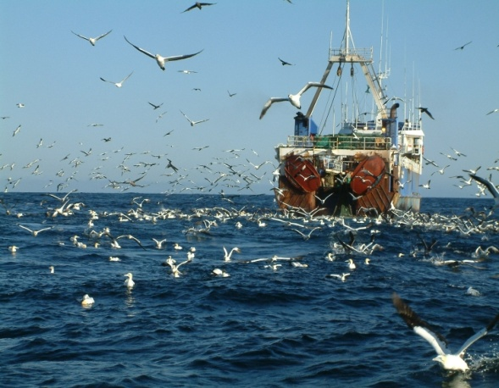
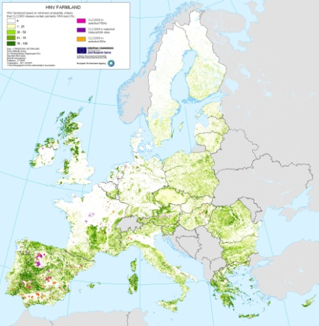
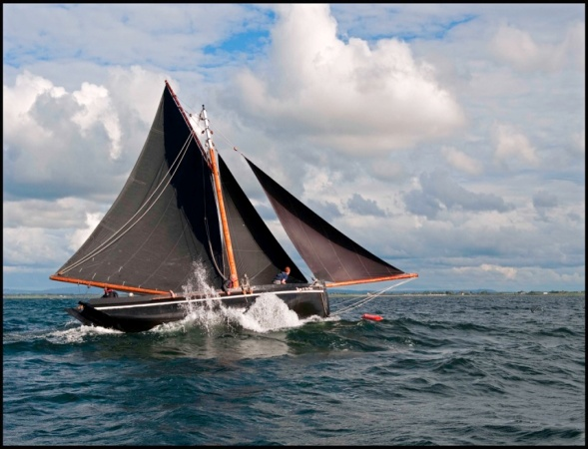
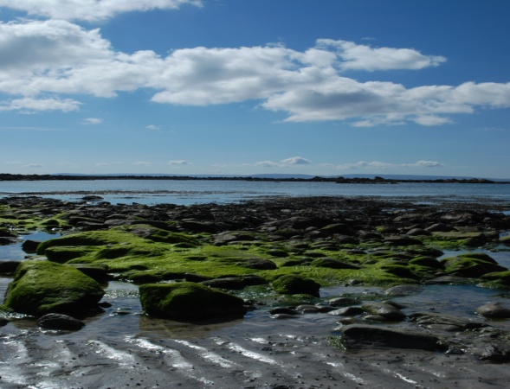
Socio-Economic Marine Research Data kkkk
Stephen Hynes

Slide 2
Overview
Ireland's Ocean Economy
  Provide estimates for turnover, GVA and employment FTE for the 2008-2016 period
  Assist in monitoring progress of a number of targets set out in the IMP-HOOW
Ireland's Blue Economy
  Marine ecosystem service benefit values

Slide 3
Multiple Lenses on the Blue Economy
Ecosystem Service Accounts
Environment & Ecosystem Accounts
National Income Accounts
Ocean Economy
Provisional, Regulating, Cultural
Ecosystem Stocks and Flows
Natural Capital
Accounts
Environmental
Expenditures
Blue Economy
Adapted from Colgan (2016)
Notes:
Environmental Service Expenditures
– Pollution control; Remediation; Conservation; Self-generated energy
• Resource Management; Internal Expenditures

Slide 4
Ireland’s Ocean Economy
Latest SEMRU report on Ireland’s Ocean Economy
  Launched in June 2017
  Funded under the Marine Research Sub-Programme PBA/SE/16/01 Valuing and Understanding the Dynamics of Ireland’s Ocean Economy
Annual update including analysis of trends and changing dynamics.

Slide 5
Ireland’s Ocean Economy
Data Sources
  Annual Service Inquiry (ASI), CSO
  Census of Industrial Production (CIP), CSO
  Building & Construction Inquiry (BCI), CSO
  Business Register, CSO
  SEMRU company survey

Slide 6
Direct Turnover, GVA and Employment by Category
2016 | Turnover € Millions | GVA € Millions | Employment (FTEs)
Shipping & Maritime Transport | 2,123.27 | 533.15 | 4,666
Marine Commerce | 140.73 | 41.76 | 342
Tourism in Marine and Coastal Areas | 1,304.29 | 489.65 | 14,891
International Cruise | 25.94 | 9.76 | …
Sea Fisheries | 279.80 | 187.00 | 2,536
Marine Aquaculture | 167.17 | 71.53 | 1,030
Seafood Processing | 537.11 | 140.46 | 3,029
Marine Advanced Technology | 139.68 | 60.63 | 695
Marine Biotechnology and Bio-products | 43.61 | 16.99 | 453
Oil and Gas Exploration and Production | 597.28 | 71.67 | 265
Manufacturing, Construction and Engineering | 132.23 | 70.99 | 1,023
Marine Retail Services | 162.38 | 63.89 | 790
Marine Renewable Energy | 59.00 | 38.10 | 454

Slide 8
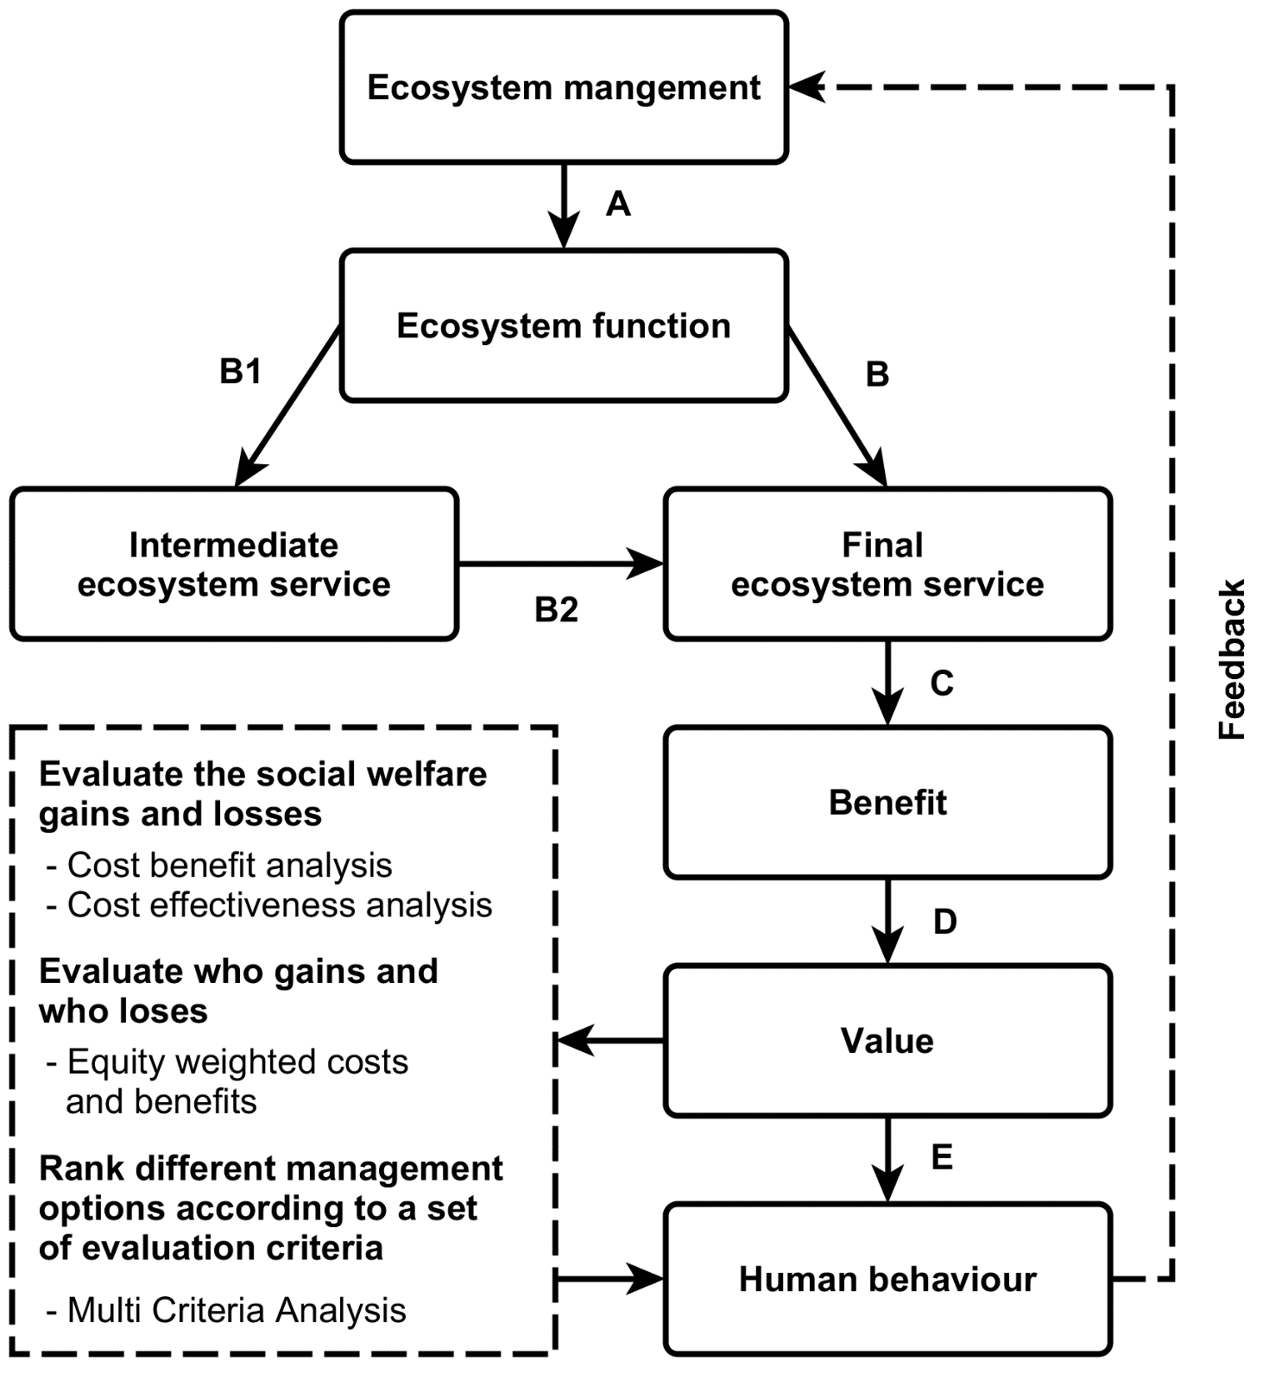

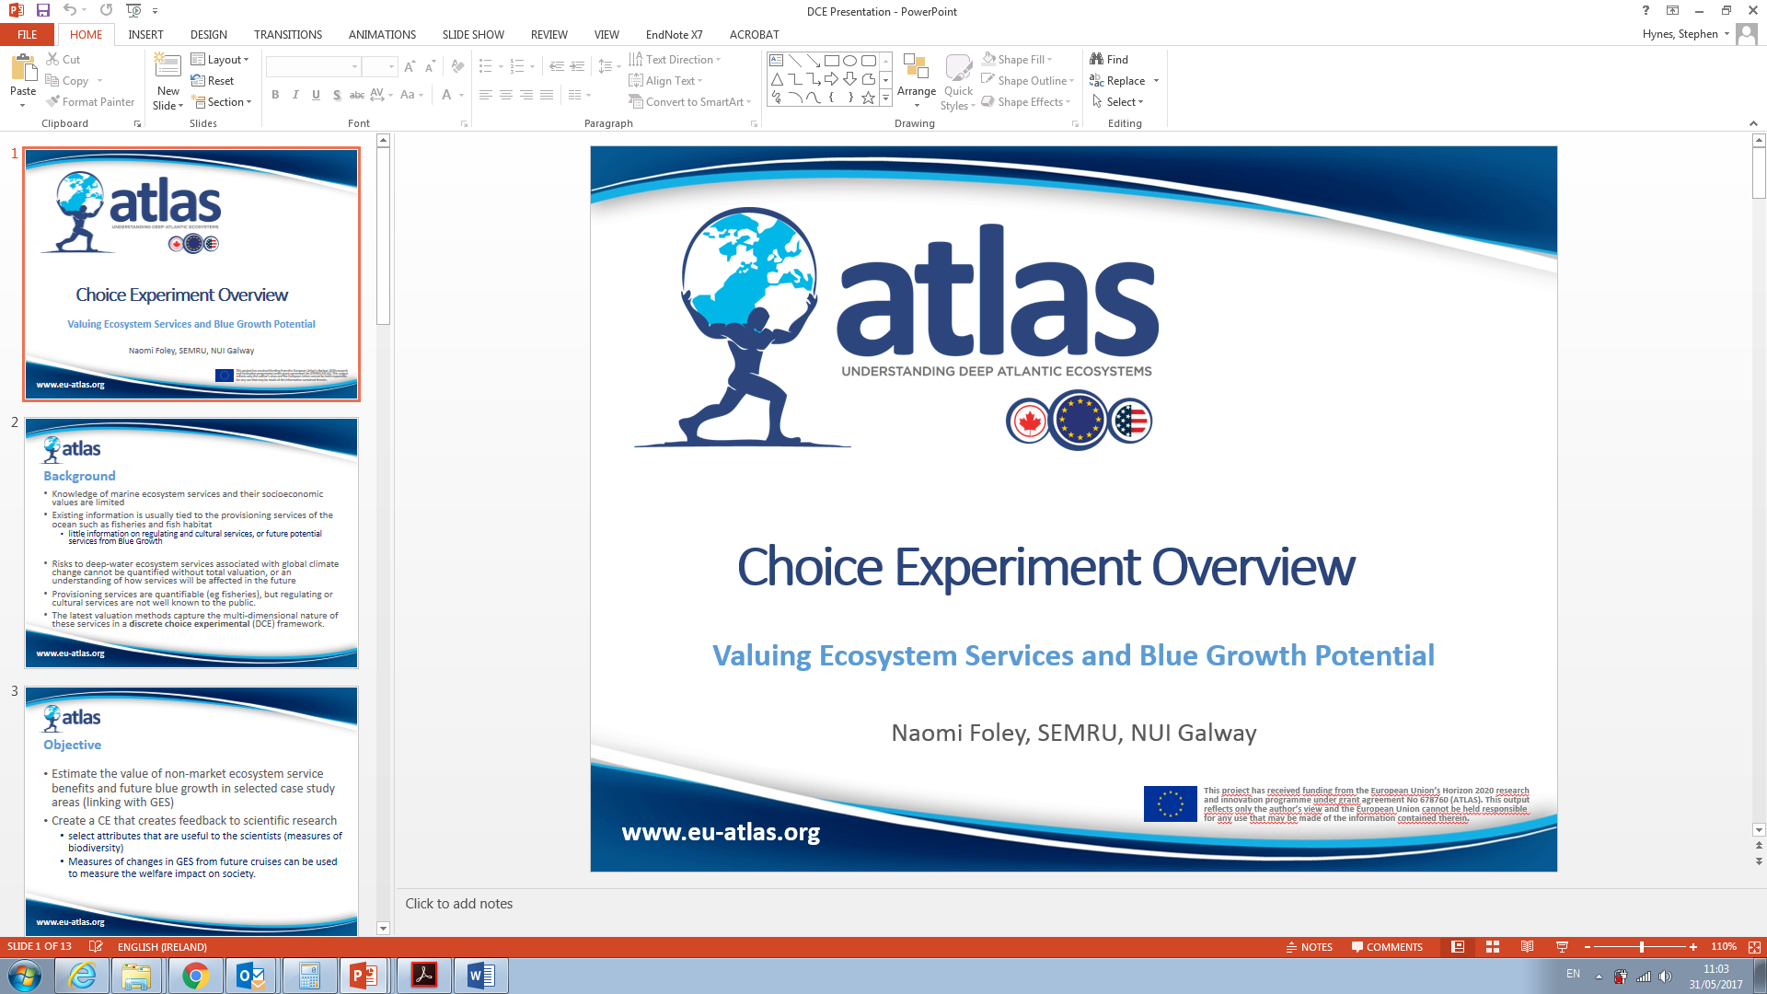
Valuing Marine Ecosystem Service Benefits

Slide 9
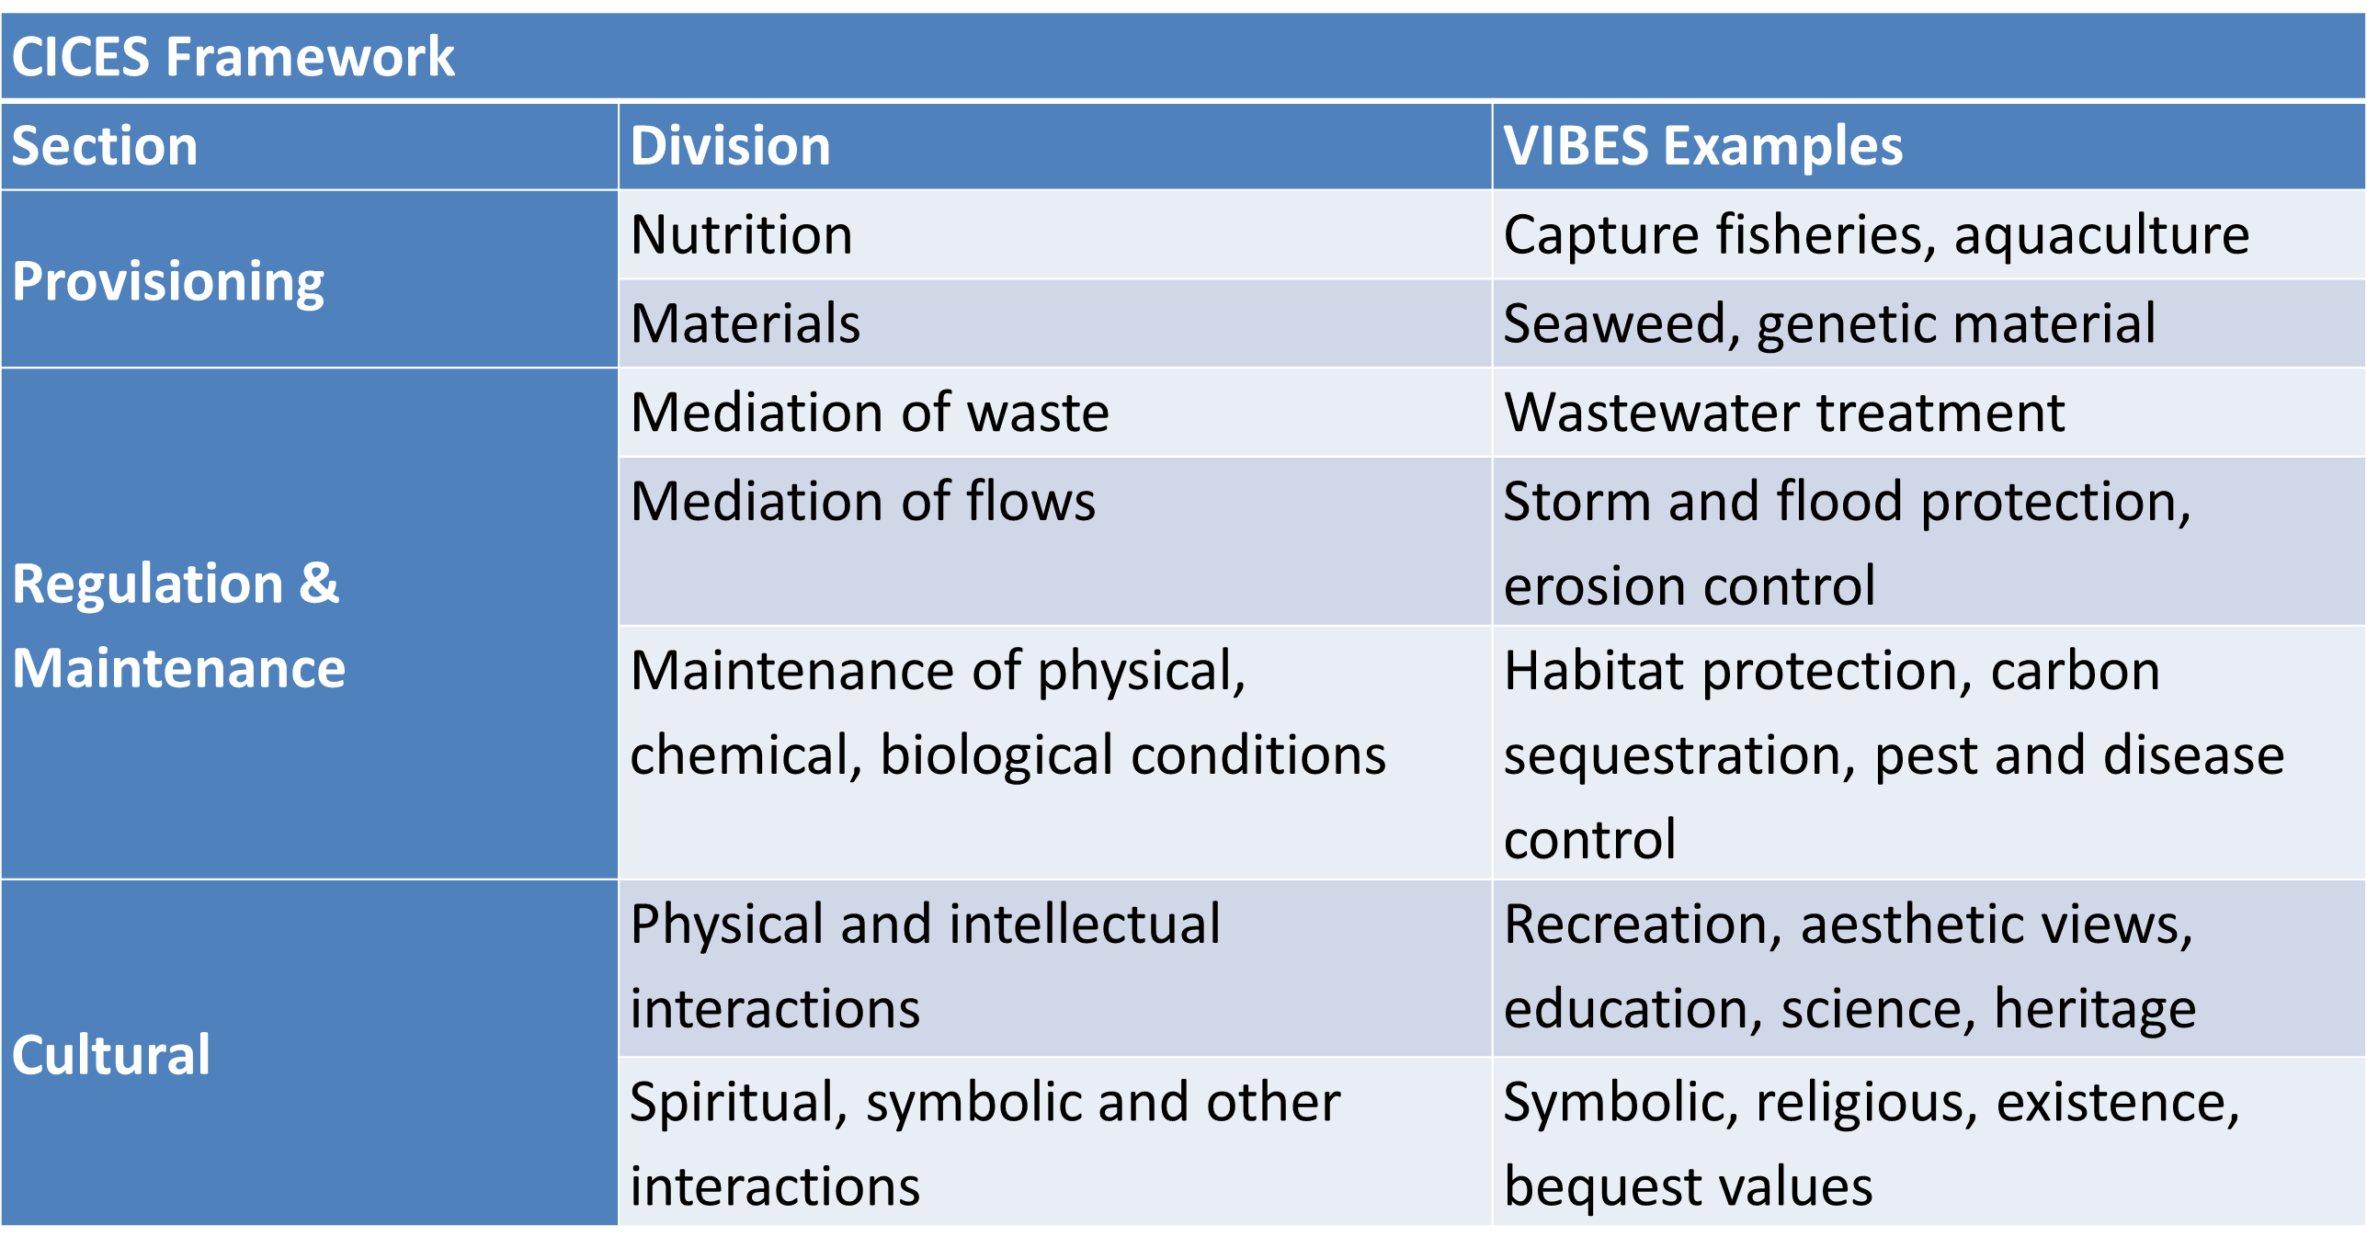
Common International Classification of Ecosystem Services (CICES) framework

Slide 10
Ireland’s Blue Economy
Data Sources
  STECF Data Dissemination
  ICES Catch statistics
  EPA
  CSO
  DAFT.ie
  NPWS
  Marine Institute
  ESRI and Own recreation surveys
  Price estimates from academic literature

Slide 11
Valuing Irish Blue Ecosystem Services
Ecosystem Service | CICES Classification | Quantity of ES
Off shore capture fisheries | Wild Animals | 449,848 tonnes
Inshore capture fisheries | Wild Animals | 17,102 tonnes
Aquaculture | Aquaculture | 35,627 tonnes
Plants and algae | from Aquaculture | 29,500 tonnes
Water for non-drinking purposes | Surface water non-drinking purposes | 1,019,692,399m³
Urban wastewater discharges | Mediation of waste | 14,465,519 kg organic waste
 |  | 6,207,986 kg nitrogen
 |  | 1,276,828 kg phosphorous
Habitat protection | Lifecycle and habitat | 773,333 ha of CME inclusive SACs
Storm protection | Moderation of flows | c. 350km protected by saltmarsh
Carbon sequestration | Climate regulation | c. 47,000,000 tCO2 sequestered

Slide 12
Valuing Irish Blue Ecosystem Services
Ecosystem Service | Value of ES per annum
Off shore capture fisheries | €472,542,000
Inshore capture fisheries | €42,113,000
Aquaculture | €148,769,000
Algae/ Seaweed harvesting | €3,914,000
Waste services | €316,767,000
Coastal defence | €11,500,000
Climate regulation | €818,700,000
Recreational services | €1,683,590,000
Scientific and educational services | €11,500,000
Aesthetic services | €68,000,000

