Slide 1
The task for IS Systems collecting NWCPO Data
Celine Kavanagh, IS Analyst Developer

Slide 2
Agenda
1
Introduction
2
What drives development in the NWCPO?
3
What we were building from
4
Beginner’s Guide to SQL concepts – nuts and bolts
5
Deliveries to the end users – Web portals & AR System

Slide 3
Drivers prompting the development work in the NWCPO
PRacticalities
Economic / Financial
Our previous third party development company were no longer in a position to support us
As we are a relatively new shared service we face constant updates and changes in what our stakeholders require from us
We need to extend to accept more information as our responsibilities grow
A desire to make the platform more extensible – futureproofing for example the introduction of centralised Facility Annual Returns and a desire to make the best use of this data.
Improve cost competiveness
Value for Money (VFM)
Efficient data management, crosschecking and reporting.
Embracing existing ICT advances to best advantage.

Slide 4
What we were building from
Solid back-end
EIMS
The core SQL database behind the NWCPO
Annual Return Data
- WCPs
- WFPs +
Add-on Surveys
Own Web Hosting Environ-ment
+ expertise
Existing Portal Infra-structure

Slide 5
The basics
EIMS
Firewall
Replicated Data Subset
AR Database
Local Authorities
Secure Offaly County Council Network
Permit Holders
Public
DMZ – Web hosting environment in Offaly County Council

Slide 6
Why not use Excel?!
lacks data integrity. Not a collaborative tool.
Is not very good for working with multiple datasets in combination.
is not very good for answering detailed questions with your data.
Does not scale.

Slide 7
Let the Data be the Data
Once the back-end dataset is sound, logical, reliable and relational you can build anything.
This takes time but reaps enormous benefits when it comes to data sharing and building applications to consume that data.

Slide 8
SQL Nuts and Bolts
Authentication
Tables The storage units for the data
Views
windows onto other databases that we can treat like local tables
Stored Procedures – the powerhouse – the tools for querying and returning the meaningful data to the web front-ends.

Slide 9
The SQL Back-end Web Front-end Model
Database Back-end
Enterprise Database
Web Based
Technology
Visual Studio 2012
Integrated
System
The databases are extensible – we can keep extending and scaling – Facilities? just another category
Excellent Reporting
Platform independent
High Availability
LA Standard
VM Ware
Reduced costs
Cohesive front-end
MS Server 2008
C# ASP.NET
Processing done on our side
Centralised

Slide 10
What was necessary
Consolidate the old Fitzpatricks and LA Facility data into solid and consistent formats – LOTS of data cleansing
Database Design and implementation
Front-end Development
Analysis of that consolidated data and data gathering from stake holders as to existing and medium term requirements

Slide 11
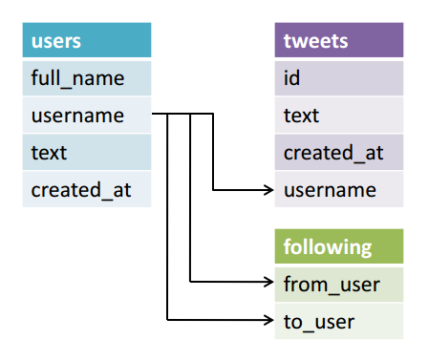
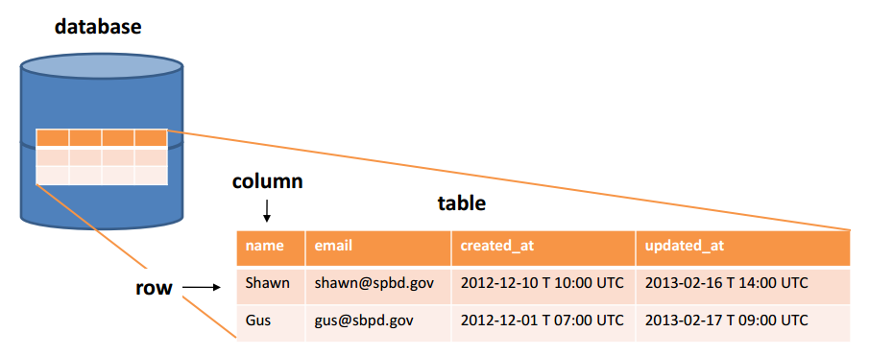
The SQL Advantage
Databases store information in relationship heavy tables – add more information by adding more tables and relationships These may be searched, retrieved and organized in countless ways

Slide 12
Extensibility
Id
Attributes
Adding new fields means collecting more granular data
Query
Joining new permits to previously held permit numbers
New category Id = new class of Returnees and ability to tailor questions to that class
New Tables = whole new sets of questions we can ask and link to previous data, for example ELV survey
Table

Slide 13
The Advantages of Centralising
One Master Copy
The ability to grow
Customised views
Faster, more efficient processing
No potential risk of groups working from separate copies of the data
Any question you need to ask in the future we can now add
Only see what you need to see
Our servers do the heavy lifting

Slide 14
ICT to the end user – Considerations
Infrastructure
* Management of the IIS and SQL servers
* Database design
* Backups *Disaster Recovery
* Maintenance and Amendments
Hosting
* DMZ server management
* Replication of Data
* Security and Firewall
* Authentication Services
Security
*currently consolidating 2 authentication systems and integrating with EDEN
* Maintenance and Updates
Development
* 3 ASP .NET Portals, soon a 4th for facilities.
* SQL Reports, document generation
* EIMS Maintenance
* Facility to analyse Annual Returns

Slide 15
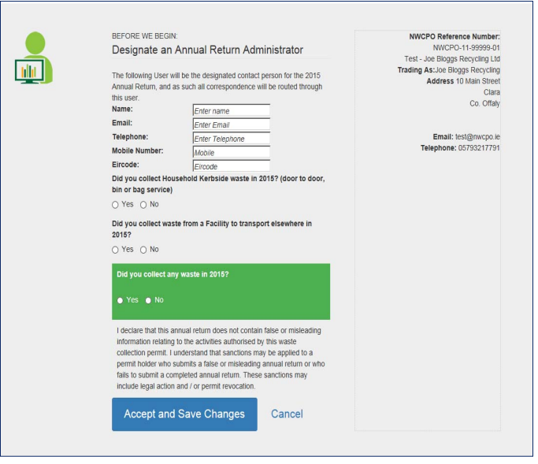
2015 Aims for the AR system
Permit Holder Return Responsibility
Same abilities as previous years
Faster, more stable hosting service
Intuitive, easier to use Interface
Include facilities for returns

Slide 16
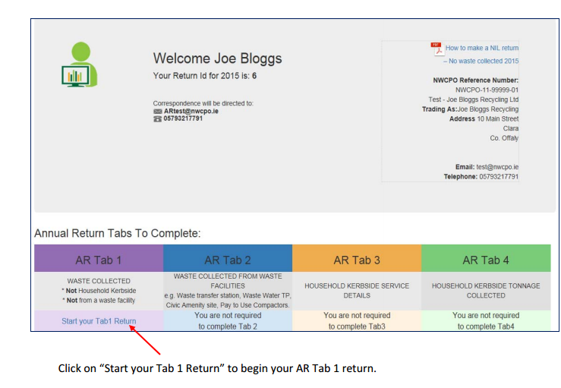
Design Considerations
Only show what’s necessary
Keep Interface clean as possible
Tight focus
Step by step streamlining

Slide 17
It’s the little things...

Slide 18
Automating Validation – a beginning

Slide 19
Increasing Self Validation
Highlight potential Issues
Cross checks – show WCP claimed returns to WFP/CoR Holders
Mandatory clarification making

Slide 20
One database, many views
WFP/CoR
WCP
LA Validation
Reports

