Slide 1
Biodiversity Indicators:
measuring progress on national and international commitments
Dr. Tomás Murray
www.biodiversityireland.ie
Facebook/Twitter @BioDataCentre

Slide 2
Talk Outline
National Biodiversity Data Centre
Policy context and timeline
Data flow and process
National Biodiversity Indicators
Next steps

Slide 3
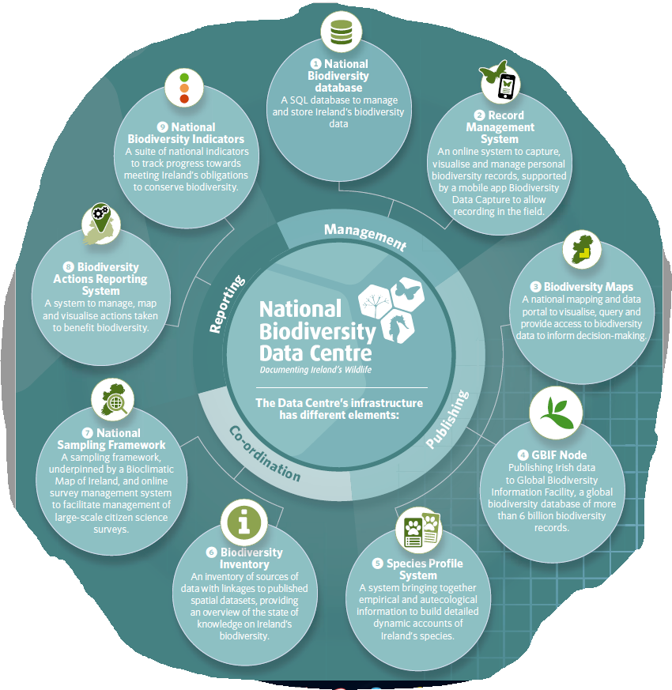
National Biodiversity Data Centre
Established by the Heritage Council in 2007 and funded by the Heritage Council and the Dept. Culture, Heritage and the Gaeltacht
Data Centre’s mission:
provide national co-ordination and biodiversity data standards
assist mainstreaming of biodiversity data and information into decision making, planning, conservation management and research
encourage greater engagement by society in documenting and appreciating biodiversity

Slide 4
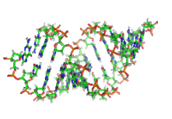
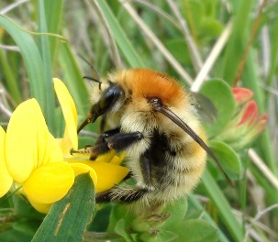
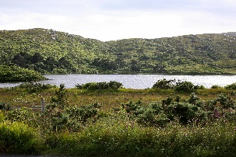
What is biodiversity?
Biodiversity = biological diversity = variety of life found on earth across a range of biological levels
Genetic diversity
variation within an individual, across individuals within a population and across populations within a species
Species diversity (31,448 species)
variation in the richness and abundance of species within a given area or community of species, across areas or communities
Ecosystem diversity (117 terrestrial and freshwater habitats, 23 seabed habitats)
Variation in the number of ecosystem types within a given area and across areas

Slide 5
What is a biodiversity indicator?
the current state, and change in state, of verifiable data that relate to biodiversity
Biodiversity indicator =
Types of biodiversity-relevant data =
direct measures e.g. no. of endangered species and habitats
indirect measures e.g. number of biodiversity-relevant policies implemented

Slide 6
What is a biodiversity indicator?
Strategic Goal A: Address the underlying causes of biodiversity loss by mainstreaming biodiversity across government and society
Strategic Goal B: Reduce the direct pressures on biodiversity and promote sustainable use
Strategic Goal C: To improve the status of biodiversity by safeguarding ecosystems, species and genetic diversity
Strategic Goal E: Enhance implementation through participatory planning, knowledge management and capacity building
Strategic Goal D: Enhance the benefits to all from biodiversity and ecosystem services
https://www.cbd.int/sp/targets/

Slide 7
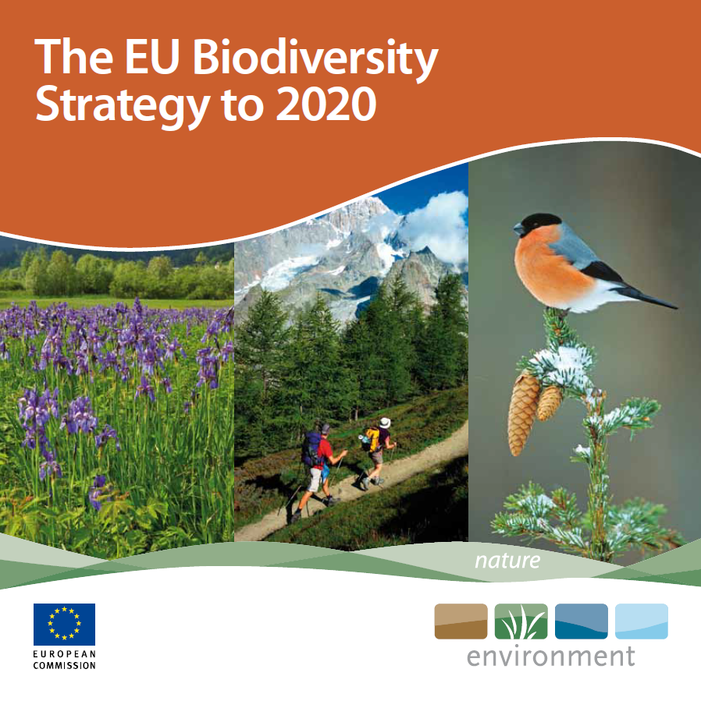
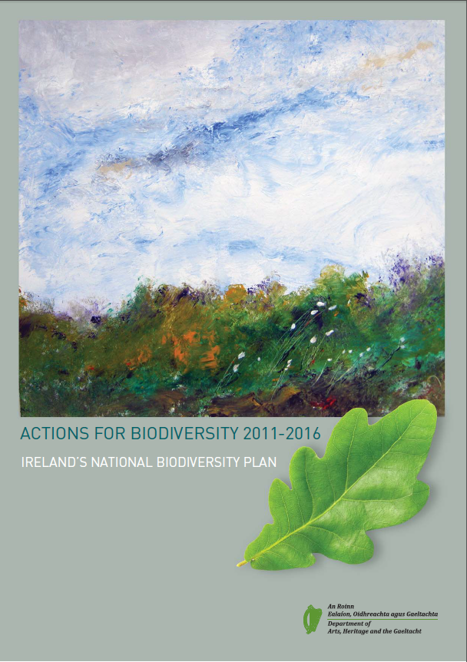
Policy context and timeline
Oct 2010 | Parties to the Convention on Biological Diversity (CBD) - Strategic Plan for Biodiversity 2011-2020 - Plan also contains a series of 20 targets, Aichi Biodiversity Targets - Countries then must update and align their own Strategic Plans
May 2011 | EU Commission adopts “EU Biodiversity Strategy to 2020” - 6 main targets, 20 actions
Nov 2011 | Ireland launches “Actions for Biodiversity 2011-2016” - 7 objectives, 18 targets, 103 actions

Slide 8
Policy context and timeline
Oct 2010 | Parties to the Convention on Biological Diversity (CBD) - Strategic Plan for Biodiversity 2011-2020 - Plan also contains a series of 20 targets, Aichi Biodiversity Targets - Countries then must update and align their own Strategic Plans
May 2011 | EU Commission adopts “EU Biodiversity Strategy to 2020” - 6 main targets, 20 actions
Nov 2011 | Ireland launches “Actions for Biodiversity 2011-2016” - 7 objectives, 18 targets, 103 actions
Nov 2012 | European Environmental Agency launches the Streamlining European Biodiversity Indicators (SEBI) - 26 EU-level indicators
Sep 2013 | National Parks and Wildlife Service commissioned Tentera to develop an indicator framework for Ireland - 8 focal areas, 33 headline indicators, 85 subindicators

Slide 9
Policy context and timeline
2013 | National Biodiversity Data Centre continues to develop framework Indicative list of 87 indicators released for consultation to Biodiversity Working Group, feedback received
2014 | National Biodiversity Data Centre development of website Continued collation, analysis and reporting of indicators 28 indicators prepared for consultation
2015 | Biodiversity Working Group Adopted framework for assessing trends and agree consultation process Fixed until end of the National Biodiversity Action Plan 2016, then revise 50 indicators completed and reviewed
 | National Biodiversity Data Centre/National Parks and Wildlife Service Consultation process on indicator content and interpretation concluded Launch of website in Q4 2015
2016 | National Biodiversity Data Centre/National Parks and Wildlife Service 23 indicators updated; three indicators completed and reviewed 34 remaining indicators identified as undeliverable
2017 | National Biodiversity Data Centre/National Parks and Wildlife Service Indicators revised and realigned for national and supranational reporting Internal review completed, reporting mechanism agreed, public report delivered

Slide 10
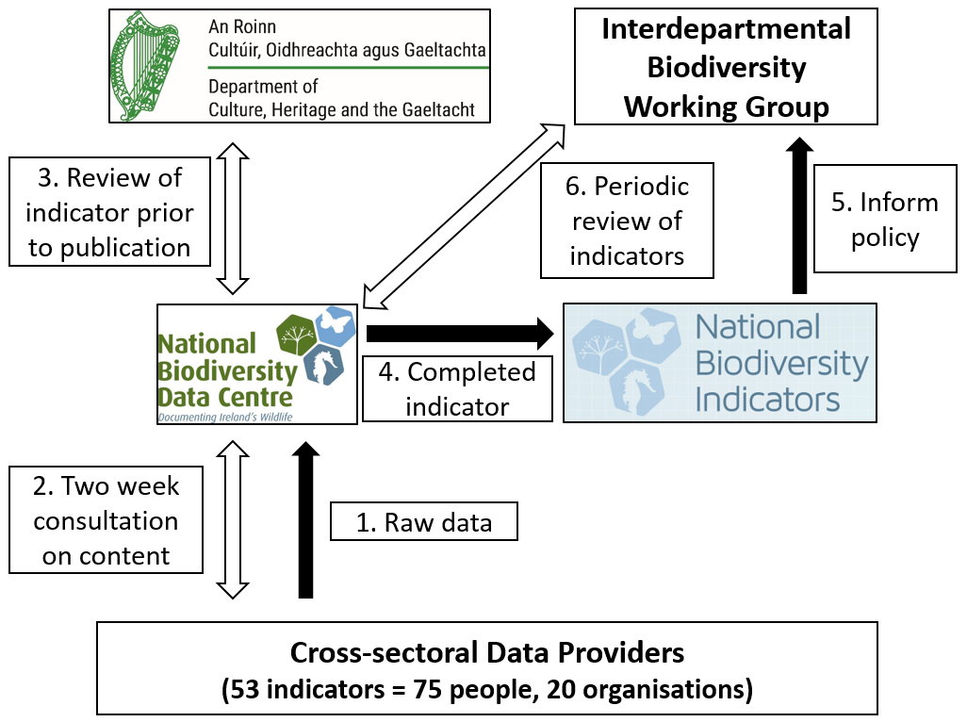
Data flow and process
Data flow
Content development and review

Slide 11
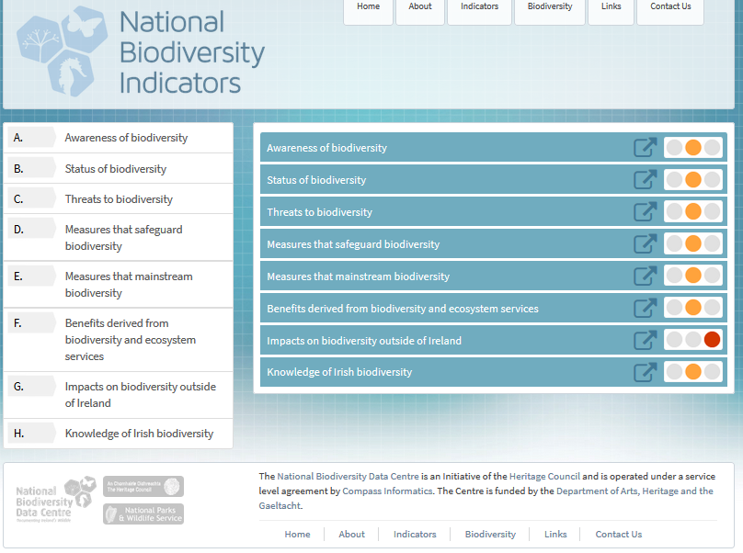
National Biodiversity Indicators
Interpretation of state and trends
Positive
Intermediate
Negative
Unknown
Current = Most recent reporting period
Short-term = 5 year trend
Long-term = 10 year

Slide 12
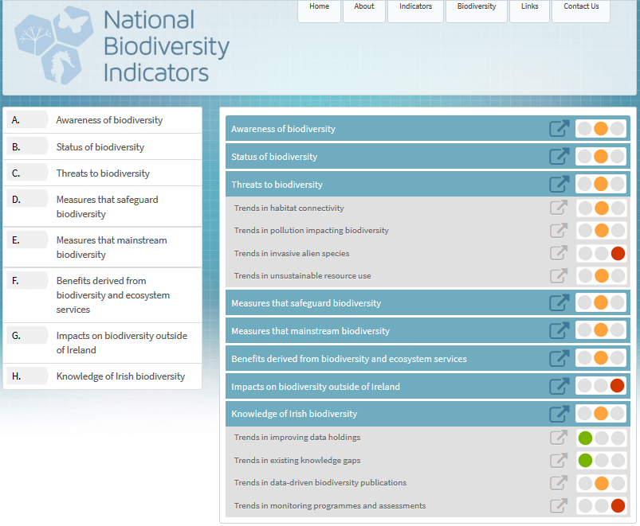
National Biodiversity Indicators
Interpretation of state and trends
Positive
Intermediate
Negative
Unknown
Current = Most recent reporting period
Short-term = 5 year trend
Long-term = 10 year

Slide 13
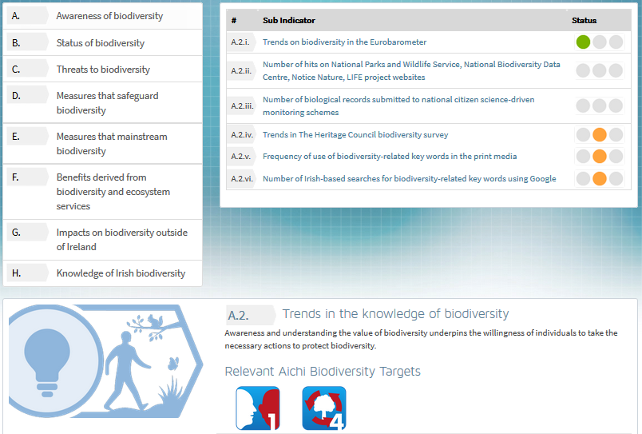
National Biodiversity Indicators
Interpretation of state and trends
Positive
Intermediate
Negative
Unknown
Current = Most recent reporting period
Short-term = 5 year trend
Long-term = 10 year

Slide 14
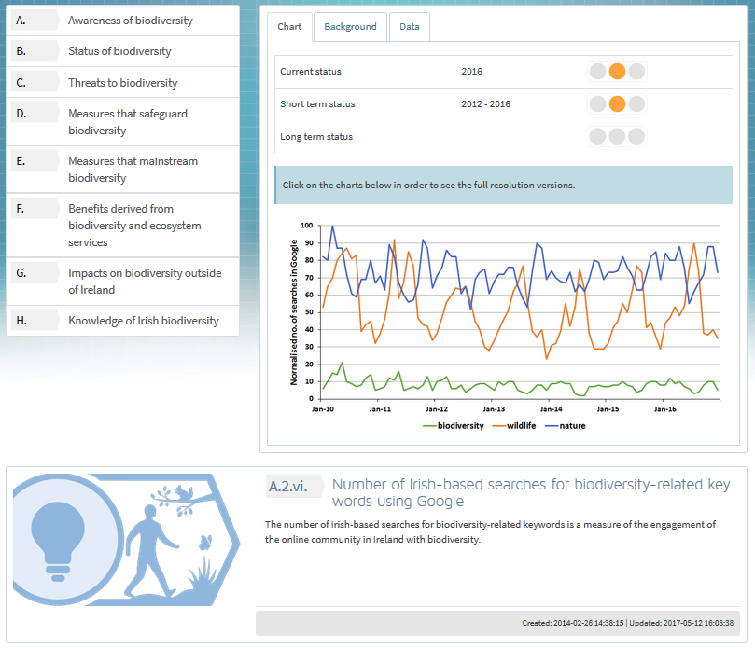
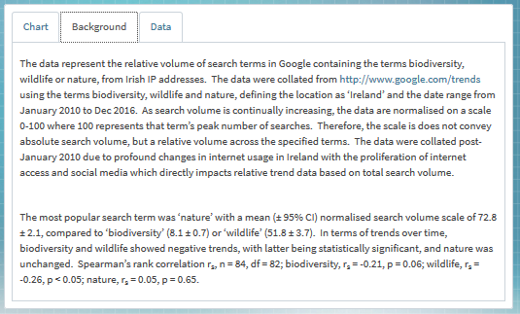
National Biodiversity Indicators

Slide 15
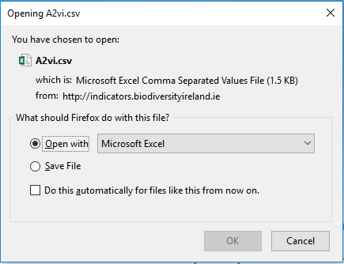
National Biodiversity Indicators

Slide 16
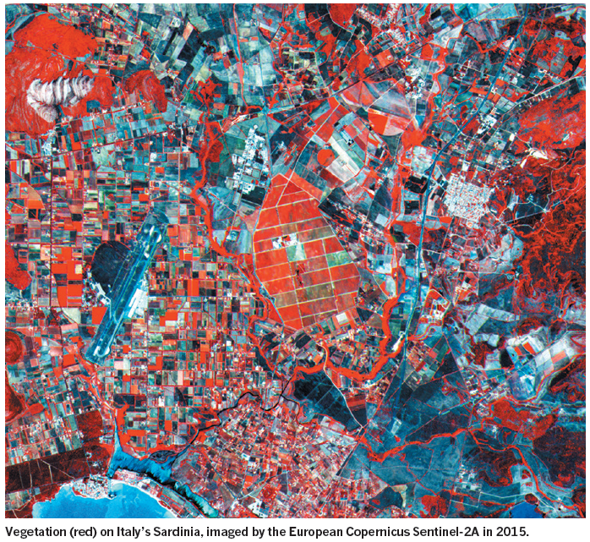
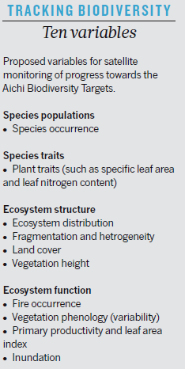
Next steps
Revision and realignment of indicators to national and supranational reporting obligations
Publication of an annual report on the biodiversity indicators for the general public
Establishment of a stakeholder working group
Integration of Marine Strategy Framework Directive – Good Environmental Status Indicators
Development of remote sensed biodiversity metrics (GEO BON)
Skidmore et al. (2015) Nature 523: 403-405

Slide 17
Thank you!
Any questions?
indicators.biodiversityireland.ie
tmurray@biodiversityireland.ie

