Slide 1
Use of Administrative Data for Census 2021
Máire Brolly
Notes:
NI vs RoI differences
How admin data used in NI censuses – increasing use
More detail on admin data use in 2011 – CUE
How we plan to develop and use in 2021 and beyond
Some adpe created in prep for 2021/proof of concept

Slide 2
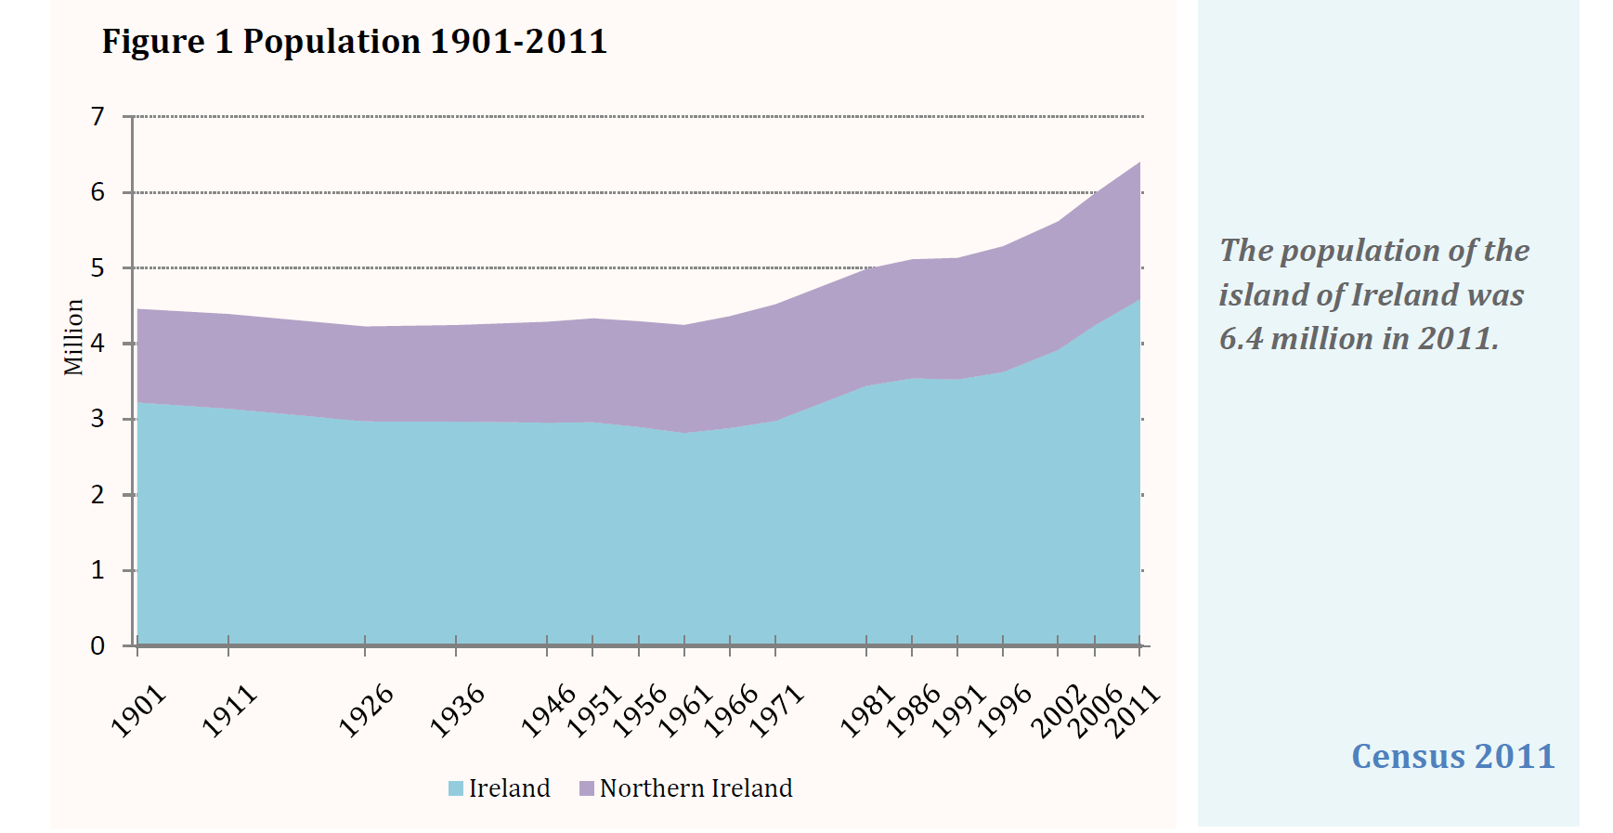
Notes:
Frequency
Every 5 years
Every 10 years
Population Base
de facto population
usually resident
Other
Adjust for Under-enumeration and non-response
Work with UK – efficiencies (60m) & Eurostat returns are UK-based
NI
Number of Households
1,654,208
703,275
Population
4,588,000
1,814,000

Slide 3
Up to & Including 1991
Hand deliver / collect
Persons present
No adjustment for under coverage
Similar to current RoI Census
Notes:
1991 30,000 to low

Slide 4
2001
UK-wide Methodology & Processing
Hand deliver / post back
Under coverage
‘One Number Census’
Census Coverage Survey (CCS)
Estimated under-enumeration
Imputed households and people
added 4.8% people
Notes:
80,000 people added

Slide 5
2011
Post out / post back
First attempt at online – 15%
Under coverage
Administrative data - Census Under-Enumeration (CUE)
CCS & household and person imputation

Slide 6
Northern Ireland 2011 Census
Census Count 1,653,000
Census Estimate 1,810,900
157,900 people added to Count (8.7%)
67,700 – Health Card Register (CUE)
90,200 – Coverage Survey
Notes:
Potentially could have added more but cautious approach

Slide 7
Plans for 2021
Predominantly Online
Development of 2011 methods for under coverage
Use more administrative data
Add in more records
Notes:
Target < 1% filled in by CCS

Slide 8
Other uses of admin data in 2021
Address register
Enumerator intelligence
Hard to Count measures
Supplement Census returns
Targeted Follow-up
Quality Assurance
Notes:
Address register
remove need for 100% address check
Enumerator intelligence
HTC
identify areas with high concentrations of households
different enumeration strategy
Targeted Follow-up

Slide 9
Administrative Sources & Coverage
Age | 0 |  |  |  |  | 5 |  |  |  |  | 10 |  |  |  |  | 15 |  |  |  |  | 20 |  |  |  |  | 25 |  |  |  |  | 30 |  |  |  |  | 35 |  |  |  |  | 40 |  |  |  |  | 45 |  |  |  |  | 50 |  |  |  |  | 55 |  |  |  |  | 60 |  |  |  |  | 65 |  |  |  |  | 70 |  |  |  |  | 75 |  |  |  |  | 80
Births
Child Benefit
School Census
Students at University
Health
Other Benefits
Electoral Register
Notes:
Person level data sources and coverage
Signs of Life / Activity
Legislation different (more difficult)
No unique identifier
Health Card
1,893,040
4.5%

Slide 10
Administrative Data Population Estimates
Proof of concept
Health Card Activity 24 months
Births used as estimate for 0 & 1 year olds
Adjust address of university students
- Move from home address to term-time address
No other modifications

Slide 12
Census count is 8.7% lower than Census Estimate (undercount)

Slide 13
ADPE 1.2% lower than Census Estimate

Slide 16
Useful links
Northern Ireland Census
http://www.nisra.gov.uk/census.html
2011 Methodology Overview
http://www.nisra.gov.uk/archive/census/2011/methodology/overview.pdf
Census 2011 - CUE
http://www.nisra.gov.uk/archive/census/2011/methodology/under-enumeration.pdf
Census 2011 - Ireland and Northern Ireland
http://www.cso.ie/en/media/csoie/releasespublications/documents/population/2011/Cen2011IrelandNorthernIreland.pdf
Census 2021 - Planning & ADPEs
http://www.nisra.gov.uk/census/2021/planning/reports-and-publications.html
Email: maire.brolly@dfpni.gov.uk

Slide 19
Active Patients
Person is alive and living in Northern Ireland in June 2011 AND had an interaction with the Health Service
a prescription or
dental treatment or
NHS Optician treatment or
changed their details on the register or
had an Accident & Emergency visit or
had an Admission or Discharge to Hospital
June 2009
June 2010
June 2011
24 months

