Slide 1
Insights into worker displacement, job flows and income inequality in Ireland using job churn data
Ms. Nóirín McCarthy
School of Economics, University College Cork

Slide 2
Job churn data & Research areas
The impact of displacement on the earnings of workers in Ireland
Employment earnings inequality in Ireland
Job flows in the Irish labour market

Slide 3
The impact of displacement on the earnings of workers in Ireland

Slide 4
The impact of displacement on the earnings of workers in Ireland
Dramatic changes in the Irish economy
Increase in the unemployment rate - 14% in 2011
Slow down in economic growth
Many workers became displaced from their employers
  Firm closure
  Mass Layoff
Issues
  Earnings losses of displaced workers.
  How firm-based and person-based characteristics are related to earnings losses of displaced workers.
  How does the industry a displaced worker finds re-employment in impact on their earnings?

Slide 5
The impact of displacement on the earnings of workers in Ireland

Slide 6
The impact of displacement on the earnings of workers in Ireland
Methodology – Propensity score matching
Displaced individuals matched with non-displaced individuals with similar propensity to be displaced.
A probit model is used;
  Nearest Neighbour matching,
  Without replacement,
  Caliper to ensure the closeness of the matches.
Common Support & Balancing tests performed.

Slide 7
The impact of displacement on the earnings of workers in Ireland - Some findings
The numbers displaced (matched), 2005-2010

Slide 8
The impact of displacement on the earnings of workers in Ireland - Some findings
The Probability of Employment
(a) Closure
(b) Mass Layoff

Slide 9
The impact of displacement on the earnings of workers in Ireland - Some findings
The Probability of Employment of displaced 26-35 year olds and displaced 56-64 year olds
(a) Closure
(b) Mass Layoff

Slide 10
The impact of displacement on the earnings of workers in Ireland - Some findings
The Earnings losses of displaced workers
(a) Closure
(b) Mass Layoff

Slide 11
The impact of displacement on the earnings of workers in Ireland - Some findings
The Earnings losses of displaced workers pre and post 2008
(a) Closure
(b) Mass Layoff

Slide 12
The impact of displacement on the earnings of workers in Ireland - Some findings
Displacement increased over the period in question.
It appears that those displaced due to mass-layoff are more adversely impacted.
Other areas under investigation
  The role of nationality and earnings losses.
  Those who switch versus stay in the same industry following displacement and earnings losses.

Slide 13
Employment earnings inequality in Ireland

Slide 14
Employment earnings inequality in Ireland
Why study income inequality?
Wilkinson and Pickett (2010) contend that countries with higher levels of income inequality are more likely to also suffer from a wide range of social problems including:
  poorer educational achievement
  lower life expectancy and other inferior health outcomes
  higher levels of violence and crime

Slide 15
Employment earnings inequality in Ireland
Job churn data
Sample of 1,406,901 individuals.
All individuals have a P35 return submitted for all years in the study.
Measuring earnings inequality: The Gini Coefficient.

Slide 16
Employment earnings inequality in Ireland – Some Findings
Median Pay (including by gender) for the period 2006 to 2010

Slide 17
Employment earnings inequality in Ireland – Some Findings
Male/Female Earnings Differential (2006 to 2010)

Slide 18
Employment earnings inequality in Ireland – Some Findings
Earnings Inequality (including by gender) from 2006 to 2010

Slide 19
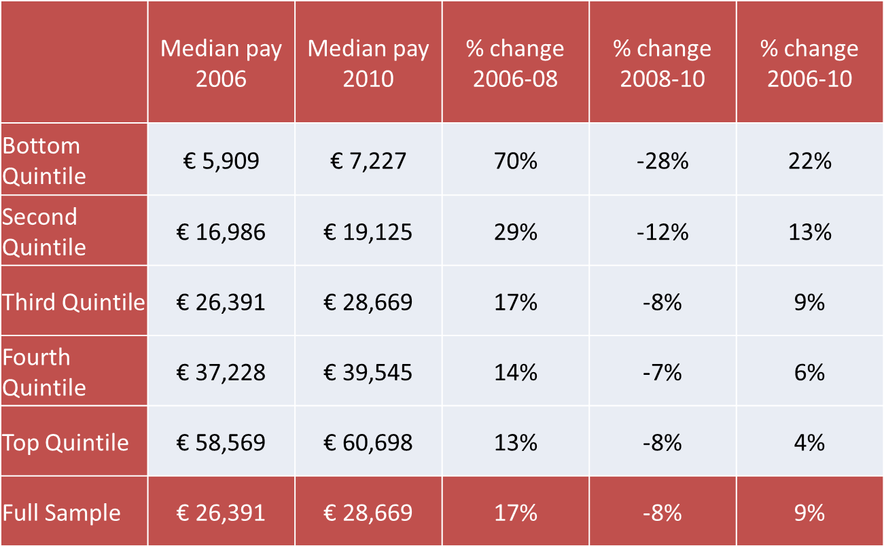
Employment earnings inequality in Ireland – Some Findings
Median Pay by Earnings Quintile

Slide 20
Implications
For those in employment throughout the period median, earnings increased to 2008 and fell (by a smaller amount) from 2008 to 2010.
The economic recession in Ireland has led to increased employment income inequality among individuals.
A gender pay gap exists in Ireland but has diminished over the study period.
Very few individuals see a dramatic change (move of more than one quintile) in their quintile position.

Slide 21
Job flows & the Irish labour market

Slide 22
Job flows & the Irish labour market
Other area of investigation
  The relationship between international trade and job creation and job destruction rates.
  How? Link to Census of Industrial Production data.
  Preliminary Findings
    Those who did engage in some exporting or importing activity had higher mean employment.
    The employment growth rate was negative over the period 2008-2010, it is less negative for exporters compared to non-exporters.

Slide 23
Acknowledgements
I would like to acknowledge the support of my PhD supervisor Prof. Peter Wright, Economics Department, University of Sheffield.
I would also like to acknowledge the support of PublicPolciy.ie who funded the study on “Employment earnings inequality in Ireland” as well as co-authors Ms. Marie O’Connor, Dr. Meadhbh Sherman and Dr. Declan Jordan, School of Economics, University College Cork.

Slide 24
Thank you for your attention
Ms Nóirín McCarthy, School of Economics, UCC
Email: noirin.mccarthy@ucc.ie

