Slide 1
How social media can influence statistics
By James eggers

Slide 2
About me / why I’m here
17 year old student from Dublin, Ireland.
I entered my Project “The Vibes of Ireland” into the BT Young Scientist and Technology Exhibition 2011, it won it’s category.
Read online at thevibesofrireland.com.
Over the summer I’ve been working at CLARITY: Centre for Sensor Web Technologies.

Slide 3
What is social media?
“Social Media are media for social interaction, using highly accessible and scalable publishing techniques.”
Creation and exchange of user-generated content.
Rapid spread of information.
Ability to reach a massive audience
Facebook – 700 Million Active Users.
Twitter – 100 Million Active Users.
LinkedIn – 100 Million Active Users.

Slide 4
The static web
1990’s
The static web
Websites were always the same, rarely changed.
Information was stagnant and outdated.
No real time information
No Social Networks
By 1991 traffic on the early Internet was 930 GB /month.

Slide 5
Dell in 1996

Slide 6
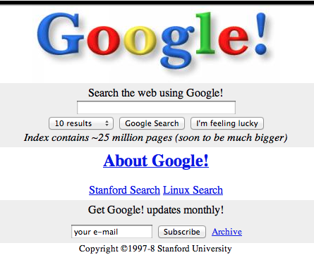
Google in 1998

Slide 7
The social web
2000+ we start to see the web becomes more real-time used more widely.
Facebook setup in 2004 which sets the stage for massive amounts of social information moving across the internet.
Imagine it like an Information super-highway.

Slide 8
The social web
APIs for accessing this information widely + easily available to everybody (almost).
Massive datasets full of information to be accessed and analysed.
Many avenues of analytics on this data yet to be explored + many ongoing creative experiments.

Slide 9
The social web
Facebook | Twitter | LinkedIn
2 Billion Likes + Comments per day | 100+ million Tweets per day | 120 Million People.

Slide 10
Why is twitter useful
Over 200 million people using Twitter.
Collectively these people create 200 million Tweets /day.
Each Tweet contains meta information (location, time, name of people mentioned in Tweet, info about user account etc).
Accessing 2-3% of these tweets is free.
Data from Twitter is widely used in research and statistical projects – it’s proven to work well.
Experiments such as predicting the stocks have proven very possible with twitter data.

Slide 11
The vibes of ireland
Calculating the average mood of counties in Ireland over a 4 month period. (September – December 2011)
Mood was derived from the ratio of “happy tweets” to “sad tweets”.
A tweet is a “happy” tweet if it the polarity¹ of the majority of words is positive.
A tweet is a “sad” tweet if the polarity¹ of the majority of words is negative.
With Real-time mood tracking I was able to correlate sudden changes in sentiment in a county to a news story.
E.g. Tyrone was unhappy for almost a week due to that woman’s death on her honeymoon.

Slide 12
The vibes of Ireland – How?
I built a data miner that is capable of downloading about 100,000 Tweets per day.
This miner was built using a language called PHP.
All 4 million tweets were grouped into the counties that they originated from.
I built an algorithm that differentiates between positive and negative tweets.

Slide 13
The vibes of Ireland – how?
Algorithm for Tagging Sentiment of Tweets
Used the Subjectivity Lexicon (courtesy of the University of Pittsburg)
Had 2000 words tagged as positive, negative or neutral.
Algorithm attempted to understand whole sentence, not just individual words.
E.g. “I am not happy” is a sad Tweet, “not” changes the meaning of the sentence. A bad algorithm would take that sentence as being a happy tweet.

Slide 14
The vibes of Ireland – How?
Algorithm for Tagging Sentiment of Tweets
Various identifiers can be used to teach the computer about a sentence.
E.g. if a word ends in “ing” it is most likely a verb.
E.g. if a word is preceded by a “a” is is likely a noun.
You could go on forever adding grammatical rules (see Machine Learning techniques).

Slide 15
The vibes of Ireland – Real-time
Real-time sentiment analysis was the icing on the cake for this project.
I had a map of Ireland with each county changing from shades of red to shades of green depending on the happiness/sadness of each county.
The average mood was also constantly being plotted on a graph so the past 6 hours of mood changes for each county could also be view too.

Slide 16
Results of experiment
People are happiest on a Friday evening, and least happy early on a Thursday morning.
There is a definite dip in the mood during the middle of the week.
On an average day, people are happiest at about 18:00 (6pm) and least happy early in the morning 04:00 – 08:00.

Slide 17
Results of experiment
I also found that the East Coast is generally in a worse mood than the West Coast.
When the Budget 2011 was being read, there was a dip in the overall mood.

Slide 18
Results of Experiment
Average Mood of all people in Ireland over an Average week:

Slide 19
Results of experiment
Definite dip in average mood in middle of week.
Highest mood is at about 7PM on a Friday Evening.
Lowest mood is at about 5AM on a Thursday morning.

Slide 20
Results of Experiment
Average mood of People in Ireland over an Average day:

Slide 21
Results of experiment
Highest mood is at about 7PM on a Friday Evening.
Lowest mood is at about 5AM on a Thursday morning.

Slide 22
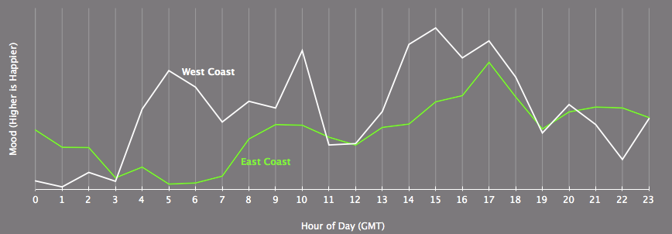
Results of Experiment
Average mood of People in East Ireland vs. West Ireland:

Slide 23
Results of experiment
People are nearly always happier on the West coast.
The east coast seems to consistently lag behind in terms of overall happiness.

Slide 24
Predicting the stock market with twitter
Research done by Johan Bollen, Huina Mao, and Xiao-Jun Zeng at Cornell University.
Measuring how calm People on Twitter are on a given day they can foretell the direction of the Dow Jons Ind Avg 3 days later with accuracy of 86.7%.

Slide 25
Predicting the stock market with twitter
“We’re using Twitter like a psychiatric patient,” Bollen said. “This allows us to measure the mood of the public over these six different mood states.”
Found that the ‘calm’ emotion matched up with the stock market movements.

Slide 26
How can this benefit statistics?
In my opinion, using data from Twitter and Facebook in statistics makes for some very interesting results.
What people say on handwritten forms and surveys is different to what they might say online. Twitter and Facebook could be used in conjunction with data from a handwritten survey to add an extra dimension to the results.

Slide 27
How can this benefit statistics?
If you’re looking to prove a point, try using Twitter to help.
Imagine a situation where you see that the number of robberies in Ireland has gone up in the past 2-3 years, you could use Twitter data to find that Irish people are indeed talking about robberies x% of the time.

Slide 28
In conclusion
Twitter is an invaluable resource.
Social Media can influence statistics heavily.
Relatively untapped gold mine of information in Facebook, Twitter, LinkedIn etc.
Hard Facts (surveys, census etc) can be married up with data from Twitter to make for more interesting and persuasive results.

Slide 29
Thanks!
Any Questions?
hello@thevibesofireland.com

