Slide 1
Person Activity Register - a statistical register of persons
Administrative Statistics Seminar
Dublin Castle
20th Feb 2014
John.Dunne@cso.ie, Berni.Dunne@cso.ie

Slide 2
Overview
Legal environment
Administrative Data Centre ADC @ CSO
National Data Infrastructure
3 pillars (Persons, Business, Property)
Overview of Person Activity Register
Population estimates from admin data
Some initial exploratory work

Slide 3
Legal environment
Data Protection
Freedom of Information
Official Statistics
Key : 3 Legislative pillars

Slide 4
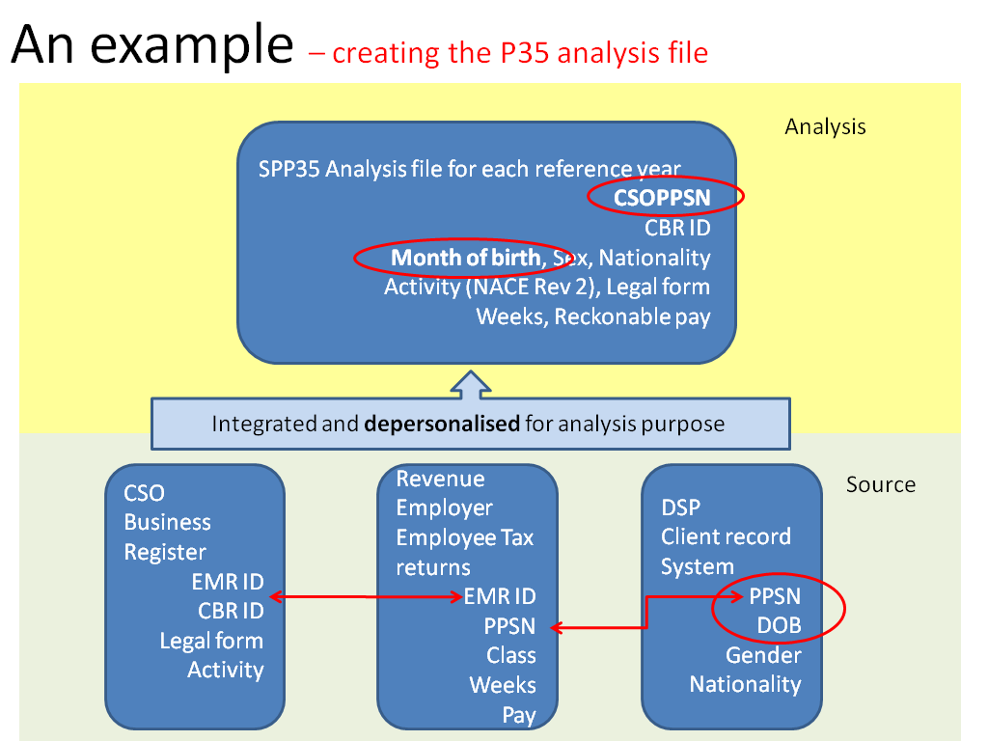
ADC @ CSO
An example of an Analysis tier data flow is the P35 (employee) dataset, which links person- and business-based registers as illustrated here:
PIK Protected Identifier Key

Slide 5
NDI - Joined up data
Enterprises/Firms
Persons
Buildings/Location
Key : Permanent official identification

Slide 6
Statistical view of NDI – Persons and Property
PropertyPerson
CSOProp_ID
CSOPPSN
Relationship
Sources
(Property)
- Census
- Geodirectory
- Property tax
- POSTCODE
- Electricity (MPRN)
- Gas (GPRN)
- Water charge
- Septic tank
- Rental properties
- Second properties
- Local Authority
Sources
(Cradle to Grave)
- Births
- Child benefit
- Post primary
- Higher Ed
- Further Ed
- Employee
- Self Employed
- Social Welfare
- Drivers
- Medical (to be)
- Pensions
- Deaths
PAR - Person Activity Register
(CSOPPSN)
2011 (4.3m)
Admin Active Population during year
Signs of life
Residential Property Register
(CSOProp_ID key)
COP2011_ID
GEODIR_ID
REVLPT_ID
MPRN
GPRN
WATERID
SEPTICID
POSTCODE
X,Y
PersonRelationship
CSOPPSN1
CSOPPSN2
Relationship

Slide 7
Purpose of PAR Person Activity Register
‘Cradle to Grave’
Purpose :
To track specific cohorts within the population
To act as a master key to administrative data in identifying feasibility of specific analyses
To investigate population structures over time
- Population estimates?

Slide 8
Population estimates using admin data?
For the year 2011,
taking a “signs of life” approach
the Person Activity Register identified activity from
4.35m persons
on Public Administration Systems.

Slide 9
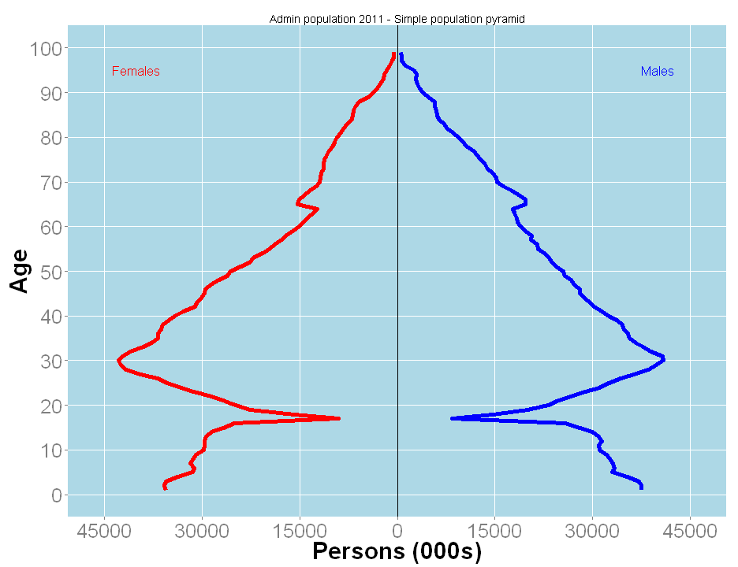
2011 Admin count by age and sex
Bumps at 65, qualify for pension?
Child benefit data (used 2012 instead of 2011)

Slide 10
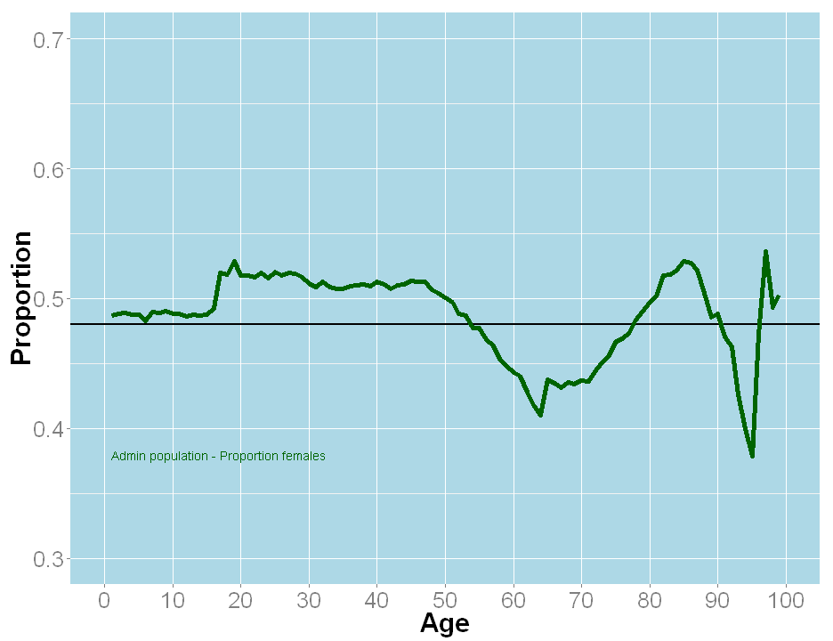
Look at proportion female
Jump probably linked to data availability?
0.48
Females aged 50 – 75?

Slide 11
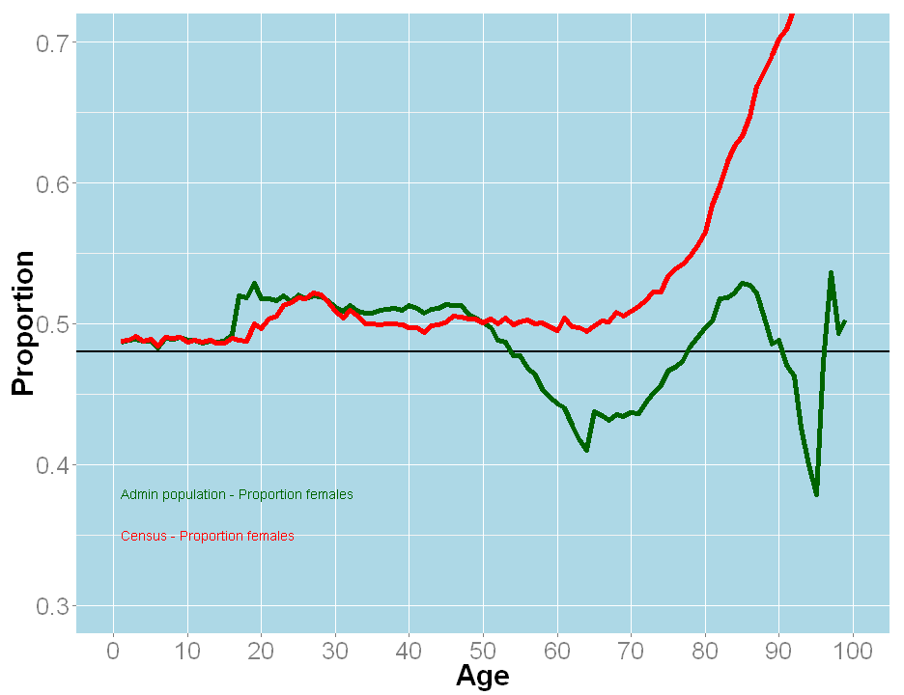
Look at proportion female - admin V census
Women live longer
0.48
Females aged 50 – 75?

Slide 12
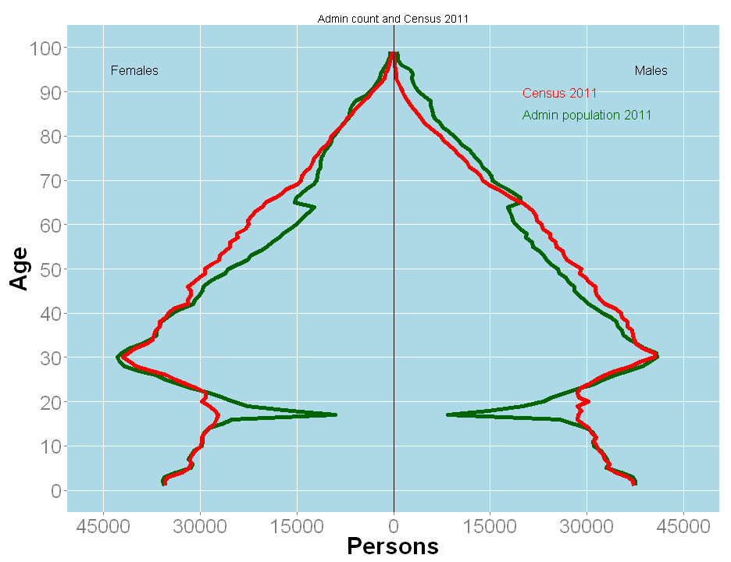
Admin Count V Census 2011
Would expect admin count curve to be outside by definition
Females aged 50 – 75?

Slide 13
Where to now?
Different measures
Dependency on admin data sources over time
A coverage survey ? (Can be costly)
Is there another way?

Slide 14
DSE Dual System Estimate or Capture Recapture
A second independent source such that
 | In 2nd Source | Out 2nd source
In PAR | A | B
Out PAR | C | D
Population estimate = A + B + C + D
where D = C * (B/A)
An example
 | In 2nd Source | Out 2nd source
In PAR | 900 | 4.5m
Out PAR | 100 | 0.5m
Population estimate = 5m + 1000
2 Questions
Is there such a source?
What are we estimating?

Slide 15
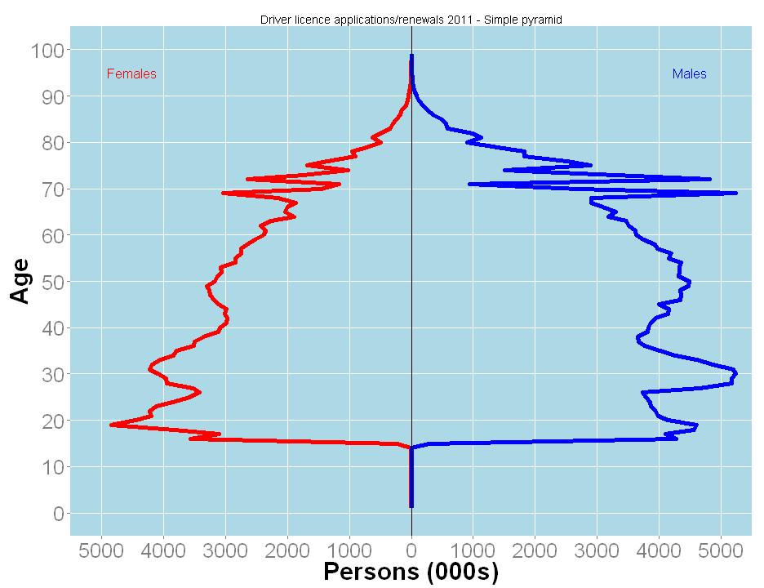
What about driver licence renewals?
Special consideration to
Ages 70 - 75 and under 20

Slide 16
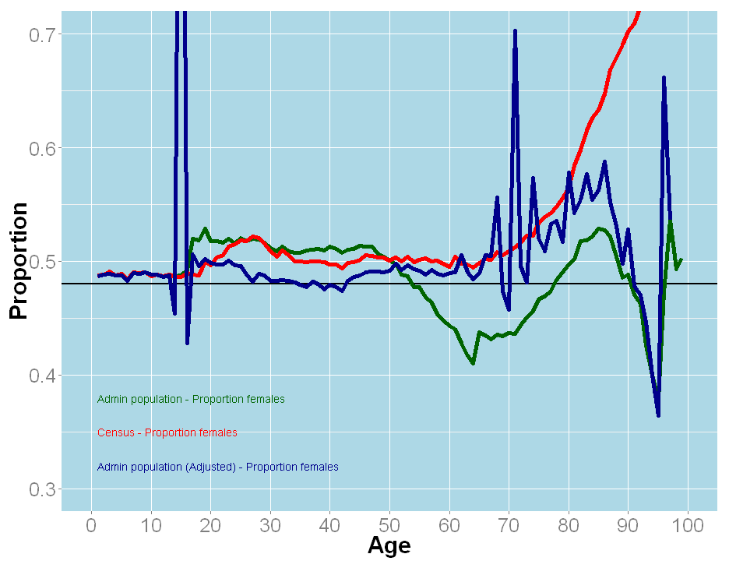
Correct for under coverage of females

Slide 17
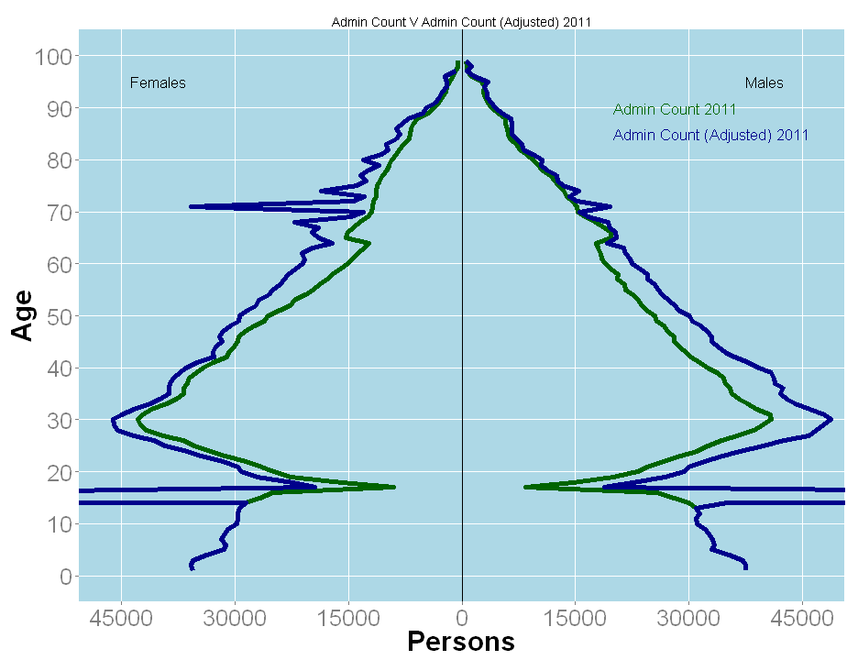
Looking at adjusted admin counts
Able to deal with transition to retirement?
Addressing female undercount?

Slide 18
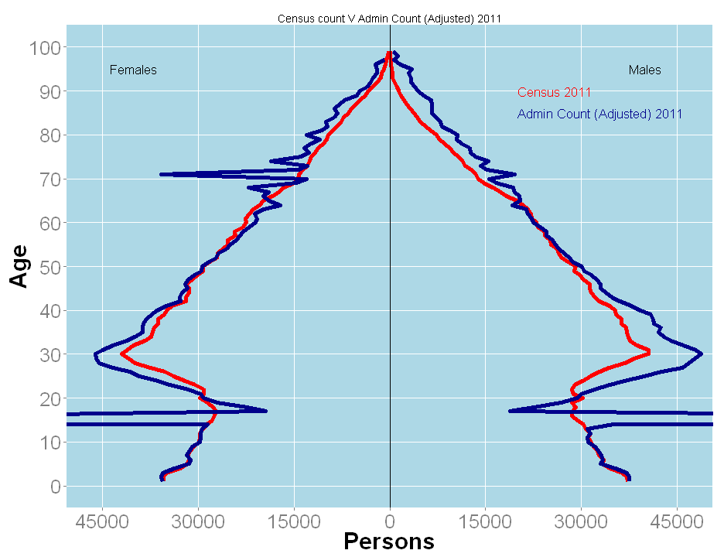
Census V Admin Count (Adjusted)
What are
we measuring?

Slide 19
Concluding remarks
Population estimates
Raises questions (what to measure?)
Verification of Independence assumption
Sensitivity of estimates to independence violations
Sustainability over time
Are there other independent sources?
Can we fit into current system of population estimates?

Slide 20
Concluding remarks - General
Opportunity for big leaps (Game changer)
Principles, Legislation, Policies
Responsible leadership
Develop the ecosystem to exploit NDI
Partnership approach

Slide 21
As the circle of light increases,
so does the circumference of darkness around it.

