Slide 1



Analytics Warehouse
P.J. Kelly

Slide 2
Data Warehouse vs. Data Lake*
 | Data Warehouse (BI) | Data Lake (Analytics)
Data | Structured | Structured, semi-structured, unstructured
Storage | Expensive | Low-cost, commodity hardware
Agility | Fixed | Agile, reconfigurable
Security | Mature | Maturing
Users | Business Professionals | Data Scientists, Analysts
*Tamara Dull, Director of Emerging Technologies, SAS Institute, blog August 28, 2015

Slide 3
Our Analytics approach.
Data Exploration
  Tools
  Metadata
Data Transformation
  Tools
  Compatibility
Data Modelling

Slide 4
Data Exploration – Previous
There are limitations to how much data we could store in our existing SAS environment given it sits on a single server.
Data context is solely determined from the library and dataset name.
Additional datasets require discovery and lead time to determine suitability, extract it from the source system and ship it across manually.

Slide 5
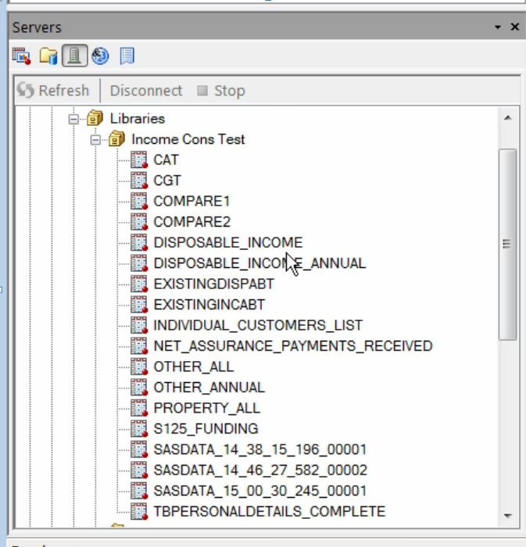
Data Exploration

Slide 6
Data Exploration
If the library names and table names are meaningless to you, Analysts new to the data have the same experience!

Slide 7
Data Exploration - Hadoop
Hadoop can scale to accommodate most or all of Revenues data sources. Including sources in formats not readily compatible with previous systems.
Once the data is in Hadoop it can be given context through the metadata features.
Analysts looking for particular insight can essentially “google” their data.

Slide 8
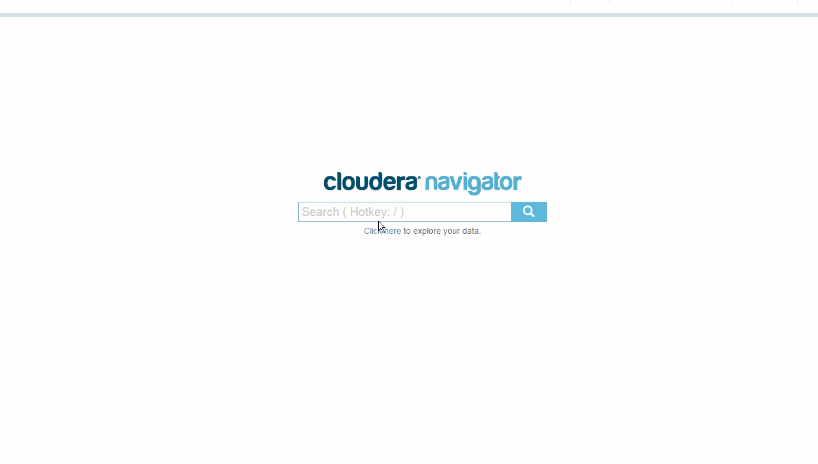
Data Exploration – Hadoop

Slide 9
Data Exploration – Hadoop
Search on tax head, source system or find data underlying specific dashboards.
If there’s a gap in the metadata, you can fill it.
We can tailor our metadata approach to analyst’s requirements.

Slide 10
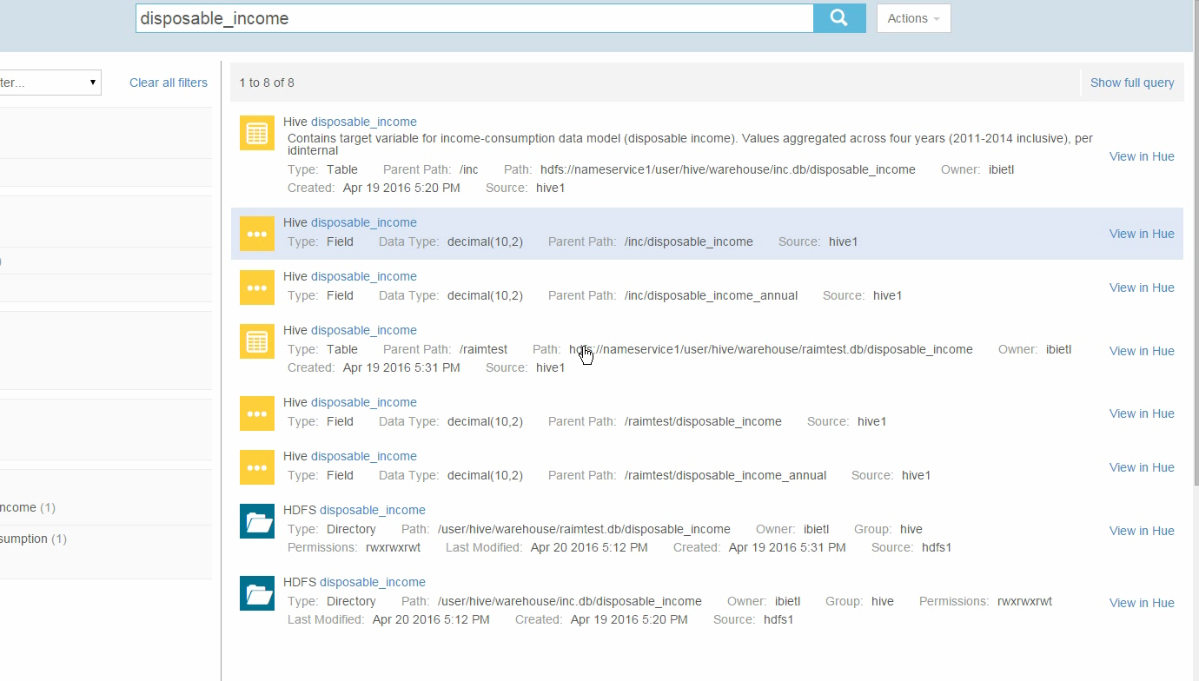
Data Exploration - Hadoop

Slide 11






Data Exp. – Workflow - Hadoop
Do you know if the data is already in Hadoop?
Do you know where?
Analysts
Analytics
Concept
ATS
Analysts
ATS
If navigator is populated your search ends there.
If not, at multiple stages in the process the insight captured can
be added to the metadata stores and shortens the search for any
future analysts.

Slide 12
Data Transformation
The data exists in a raw or unprocessed state.
The total data that’s needed is spread across multiple tables, source systems etc.
It needs to be joined, filtered and cleaned up.

Slide 13
Data Transformation - SAS E.Guide
Excellent for building ad-hoc processes to explore how best to transform data for a particular use.
Extensive existing experience within Revenue and a relatively low learning curve for data analysts.
Transformations have to be recreated from scratch to be “productionised”.
It’s an analyst tool.

Slide 14
Data Transformations - Hadoop
Suitable for ad-hoc queries and building production end to end Extraction, Transformation and Loading (ETL) processes.
Multiple toolsets and code types to choose from.
Any transformations are immediately accessible in E.Guide through an official SAS/Access Hadoop connector.
It’s an Analyst and Developer tool.

Slide 15
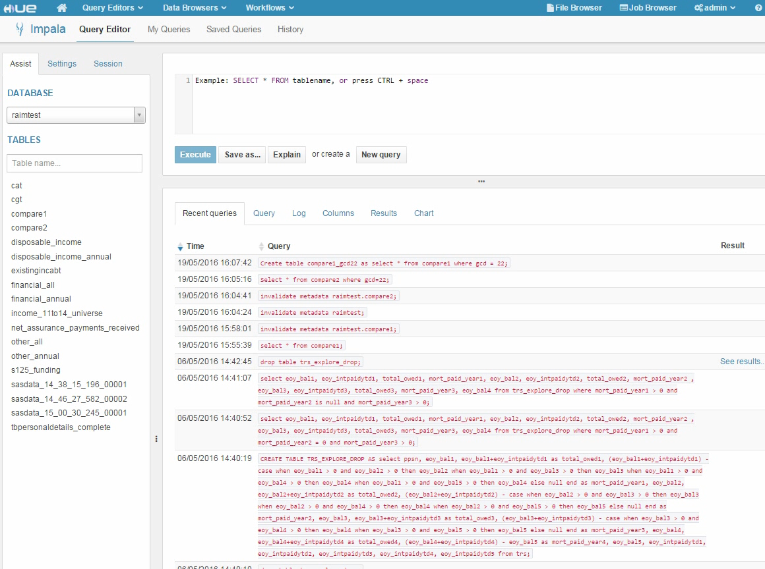
Data Transformation - Hadoop

Slide 16
Data Transformation - Hadoop
Hadoop isn’t a single toolset.
You can read and write to the same datasets using a number of different methods including SAS Enterprise Guide.
Two analysts can collaborate on the same data – one using native code in Hadoop , one using the drag and drop interface on SAS.

Slide 17
Data Transformation
A great deal of work is done processing raw data into states usable by reports and models.
This processing can obfuscate the origin and true meaning of data and make it difficult to reuse.
Only project documentation, speaking to the original developer or unravelling the live build process exist as options currently.

Slide 18
Data Lineage
Any development done within the Analytics Warehouse will have full Data Lineage Tracking
While complex it tracks every stage of transformation and maintains a full picture of where the data has come from.

Slide 19
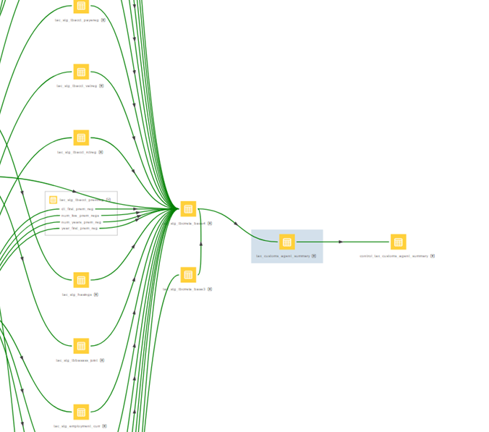
Data Lineage

Slide 20
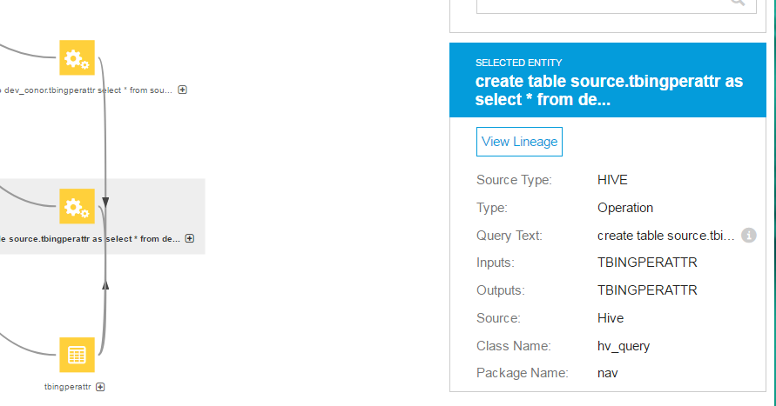
Data Lineage

Slide 21
ETL and Analytics
There can be no Analytics without ETL.
Presenting the data in a processed, model ready format, with rich metadata and the ability to track every dataset through every transformation frees the Analysts up for the highly skilled process of creating the end product.

Slide 22
ETL and Analytics
ETL engineers within ICT&L focus on building industrialised, metadata rich data assets with a long term focus.
Analysts focus on using these assets to their full potential with no technological restrictions.

Slide 23
Adv. Analytics - Toolsets
Hadoop is constantly evolving with the field.
  A multitude of open source tools currently released or being developed can be seamlessly added with zero compatibility issues.
  All of these tools can read from and write to the same datasets. Allowing collaboration between different analysts using different toolsets.

Slide 24
Thank you

