Slide 1
SUSI Eircodes, APIs and Onwards…
Paul Spring, ICT Manager

Slide 2
What is SUSI?
Student Universal Support Ireland
Government initiative
Student Support Act of 2011
Replaces 66 grant awarding authorities
Began processing in 2012

Slide 3
The Objectives…
Achieve consistency
Increase automation
Timely processing / payments
Minimise overall cost of administration
Ensure integrity of Student Support Act 2011

Slide 4
The Story so far…
2012: 70,000 applications - 40,000 awards
2013: 90,000 applications - 60,000 awards
2014: 103,000 applications - 74,000 awards
2015: 108,000 applications - 83,000 awards
2016: 106,000 applications - 87,000 awards

Slide 5
Some Context…
46% of all students in receipt of grant support
Donegal (67%) – Dublin (35%)
€370m
€200m Tuition Fees and Student Contribution
€170m Student Maintenance Grants
60,000 students received Maintenance Grants

Slide 6
Key Criteria…
Nationality
Residency
Course and Institution
Progression in Education
Income

Slide 7
APIs for Income?
From all sources for previous year:
Employment, Self-Employment, Farming, Rental Income, Pensions, Savings, Investments, Maintenance Agreements, Lump Sum Payments, Disposal of Assets, Gifts, Inheritance and Social Welfare Payments.
But disregarding:
Child Benefit, Family Income Supplement, Disability Allowance, One Parent Family Payments, Guardian’s Payment, Foster Care, Carer’s Allowance, Student Assistance Fund…

Slide 8
DSP API…
45,520 SUSI applications had some element of Social Welfare income for 2012 season
50,556 Social Welfare Statements requested
Request – Post – Scan – Merge – Reassess
DSP API introduced for 2014 season
0 requests for Social Welfare Statements

Slide 9
But… where does Eircode fit into all of this?

Slide 10
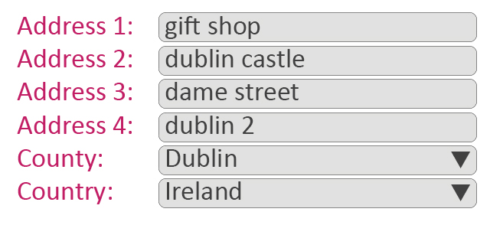
ECAD Eircode Address Database

Slide 11
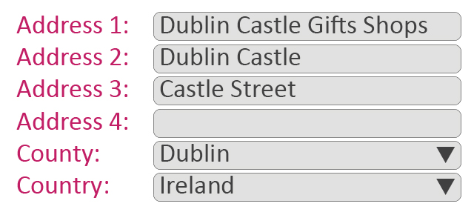
ECAD Eircode Address Database

Slide 12
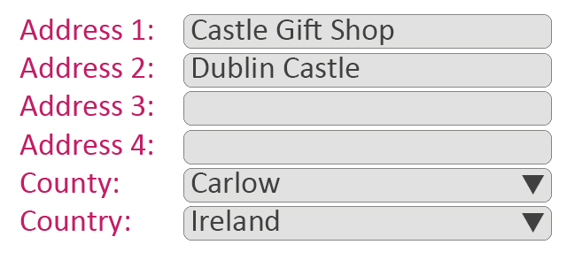
ECAD Eircode Address Database

Slide 13
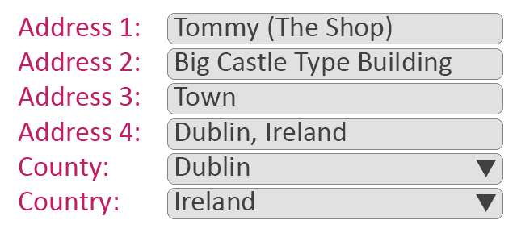
ECAD Eircode Address Database

Slide 14
How can Eircode mitigate against this?
ECAD holds consistently formatted addresses
Spelling and grammatical errors eliminated
Authoritative source of data
Single version of the ‘truth’
But Eircode presented another opportunity

Slide 15
Could Eircodes be used to solve a problem?
Adjacent or Non-Adjacent rate of grant
45km from Normal Residence to College

Slide 16
That generated these headlines?

Slide 17
SUSI is not using Eircodes to determine grants
Using Eircodes to determine locations…
ECAD stores geo-coordinates
Google Maps understands geo-coordinates
‘…criteria for measuring a route
must be accessible, particularly
to the applicant…’

Slide 18
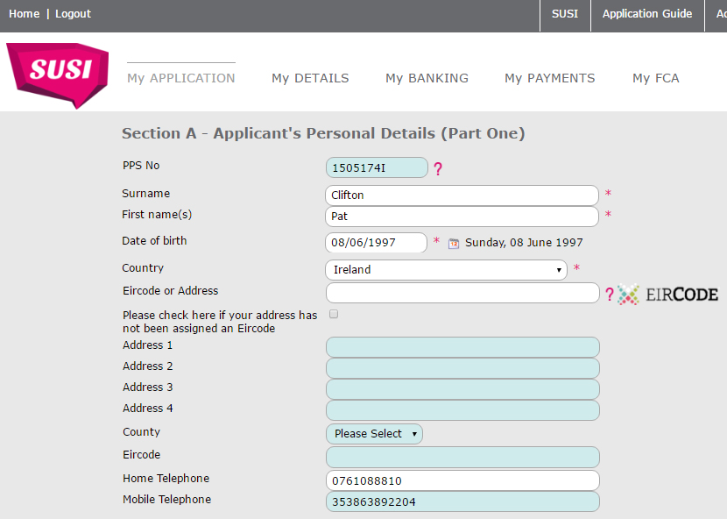
SUSI Captures Eircode as Part of the Address

Slide 19
SUSI Captures Eircode as Part of the Address

Slide 20
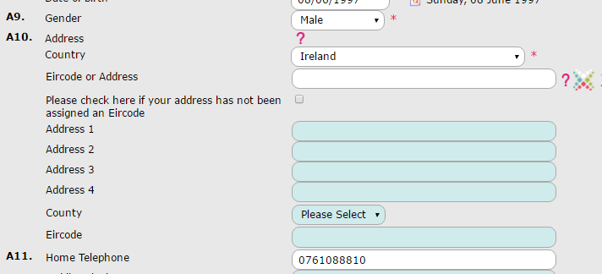
Not Mandatory but Encouraged

Slide 21
Very Strongly Encouraged
“If you have tried to use the Eircode Finder and
still cannot obtain the Eircode for your address, you can still apply for a student grant
although the processing of your
student grant application
may be delayed while we
confirm your home address.”

Slide 22
The Technical Bit…
if country = IRELAND
engage AutoAddress API
get data from ECAD
send geo-coordinates to Google API
save route and distance
print MAP (to SCREEN)

Slide 23
How much did it Cost?
Implementation / Development €6,000
ECAD Licence (125,000 lookups) €14,000
Google Premium API Licence €7,600
€27,600

Slide 24
What were the Benefits?
Accuracy (Addresses / Locations)
Removal of data entry errors
Consistency in application of Grant Scheme
Increased Automation
Time (2,666 hours)
Nice data!

Slide 25
Some Lessons?
SUSI did not make Eircode mandatory
But encouraged people to provide Eircode
Engaged with Data Protection Commissioner
Uptake has been 92%

Slide 26
End. Thank You.
Paul Spring – Student Universal Support Ireland
susi.ie

