Slide 1


Slide 2
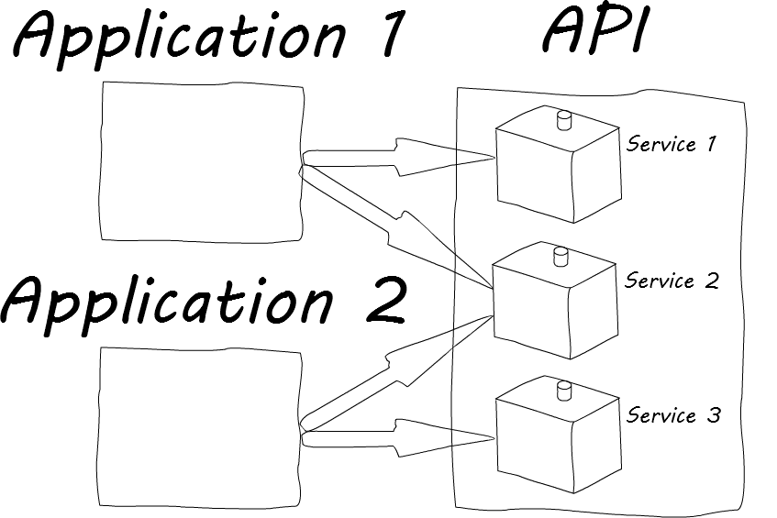
An API (Application Programming Interface) is a contract (standards, protocols) between one piece of software and another. APIs allow developers to (re)use external data and functionality as building blocks.
API Characteristics:
Loose Coupling
Autonomy
Statelessness
Granularity
Discoverability
Examples: Google Maps API. Flickr API, YouTube API, Amazon Product Advertising API

Slide 3
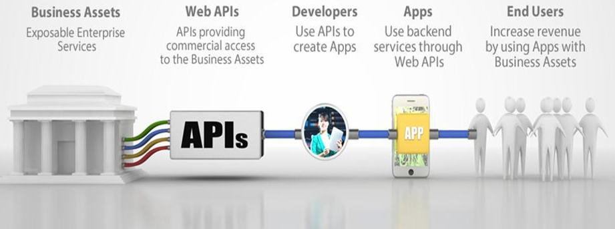
APIs create ecosystems

Slide 4
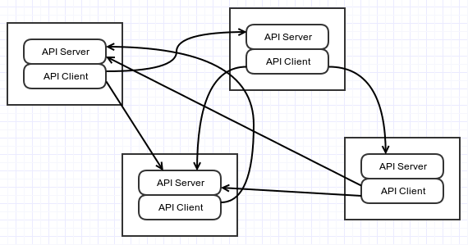
Applications can be clients and servers

Slide 5
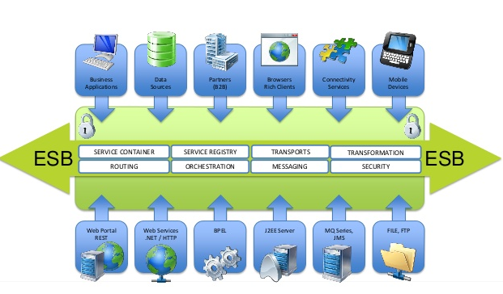
But….things can get complex

Slide 6












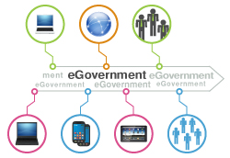
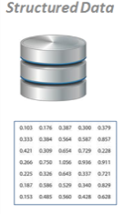

DECISIONS
Insight
With
Micro Data
No Micro Data
REPORTING
Methodology + Aggregate Data
Data Analysts
Dept. questions
Information
ANALYSIS
RECORD LINKING
Integrated Data
Shareable
Admin Data
Confidential
Data
Dept 1 warehouse
CSO Warehouse
DATA SILOS
E-Services
E-Footprint
Raw Data
Structured Data
Administrative Data
Big Data
Secondary
Data
…
Primary Data
Dept 1
Dept n
Electronically Observed Data
Dept 2
Business / Entity
DATA IDENTIFIERS
Data Model
Location
Person

Slide 7
DECISIONS
Insight
MORE / BETTER
Anonymous
Open Data
Anonymous
Research Data
INSIGHT REPORTS
Methodology + Aggregate Data
Data Analysts
Dept. questions
Information
MORE / EASIER
ANALYSIS
LESS
Integrated Data
Shareable
Admin Data
Confidential
Data
RECORD LINKING
Dept 1 warehouse
X
DATA SILOS
Raw Data
Admin Data
Departmental
Administrative
Data
Federated
Logical
NDI
DATA NODES
…
Dept 1
Dept 2
Dept n
Data Model
Business / Entity
Location
Person

Slide 8
National Data Infrastructure (NDI) Actions
Business / Entity
Location
Person
Collect Identifiers where permissible
  Collect once, use often
Identify Pathfinder projects
Leverage CSO expertise

