Slide 1
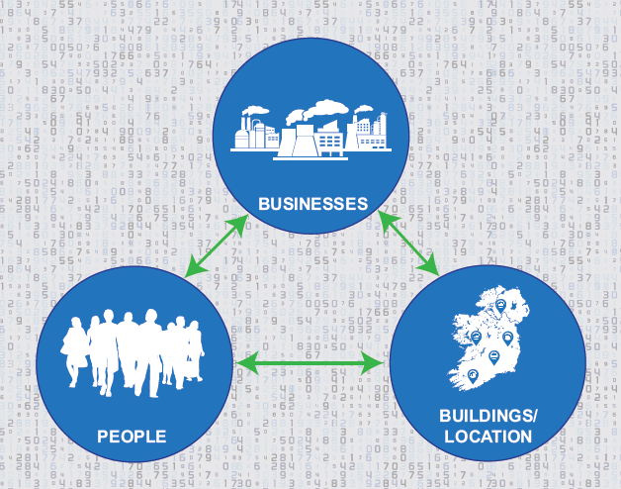
The Value of APIs
in the National Data Infrastructure
Agenda
14.00 - 16.00 Workshop start/end time
16.00 - 16.30 Meet speakers Tea/coffee
Welcome and introduction Andrew O’Sullivan, Chief Information Officer, Central Statistics Office
Eircodes, APIs and Onwards - Paul Spring, Student Universal Support Ireland
MyGovID in the Department of Social Protection (DSP) - Identity and Access Management- Sean Gaffney, DSP
Benefacts.ie - the database of Irish nonprofits - John Lyons, Benefacts
Towards a common API for Earth Observation - Bruno Voisin, Irish Centre for High-End Computing (ICHEC)
30 minutes meet the speakers and tea/coffee

